Slide 1
A data-reachability model for elucidating privacy and security risks related to the use of online social networks
S. Creese, M. Goldsmith, J. Nurse, and E. Phillips. In 2012 IEEE 11th International Conference on Trust, Security and Privacy in Computing and Communications (TrustCom), 2012, pp. 1124-1131.
DOI: 10.1109/TrustCom.2012.22
Presented by Sam Kavanagh
Notes:
1. Title
Bib info
2. Summary
Introduce OSNs, ask a question?
Digital footprint
3. Summary
There are lots of tools which claim to facilitate the extraction of specific classes of personal data (either directly or through correlation)
Example attacks
The purpose of this paper was to understand the risks of all of these tools and techniques becoming available to a malicious entity.
If one has certain information about an entity in the OSN domain, what other information can they derive and with what ease and accuracy
4. Summary
Through the amalgamation and synthesis of current research and general knowledge they developed a Data-Reachability Model
*Picture of model*
Derivation process until no more = transitive closure. Inverse gives you the minimal datasets required to get x.
Explain the coding system.
They view this work as a key method (which a user-friendly interface can easily be developed) in which they might make cyber risk more tangible to users of OSNs by showing them an attack-centric view
7. Appreciative
They have created a flexible, extensible model for effectively expressing the risks associated with the unchecked publishing of data in the OSN domain.
Allows you to easily see which factors are most enabling.
Enables you to see what risks are associated with what you’re sharing.
8. Appreciative
They have developed a prototype tool which can derive a given data point from a starting points that has not hitherto been considered.
They have developed a tool which can represent the matrix as a weighted/coloured graph which they hope to turn into a user friendly interface.
The value is in the approach not the values…
5. Critical
…Nonetheless, if this is the case then they have hardly done anything new, most definitely not something which could be posited as the missing piece of the puzzle. In fact:
Much of the work of the matrix was taken from others….. (elaborate)
6. Critical
So what value is there really in it? The only novelty really is that they’ve developed a nice way of presenting existing information. But then again, perhaps that’s all that’s needed to inspire action…
9. Question
For people who don’t need a pretty UI to understand it, has this made a big enough impact on you to result in change? Do you believe it’s really sufficient to be posited as potentially the missing piece in the puzzle.

Slide 2
Motivation
A couple of quick questions:
How many of you have an account on some form of Online Social Network (OSN)?
How many of you have changed the default privacy settings?
Digital footprints and unchecked data
‘A key piece in the puzzle of making these risks tangible to Internet users’

Slide 3
Summary
There are many existing tools which claim to facilitate the extraction of specific classes of personal data (data points)
What’s the risk associated with all of these tools becoming available to a malicious entity?
If one has certain information about an entity, what else can they derive?
  With what ease?
  With what accuracy?
Notes:
3. Summary
There are lots of tools which claim to facilitate the extraction of specific classes of personal data (either directly or through correlation)
Example attacks
The purpose of this paper was to understand the risks of all of these tools and techniques becoming available to a malicious entity.
If one has certain information about an entity in the OSN domain, what other information can they derive and with what ease and accuracy

Slide 4
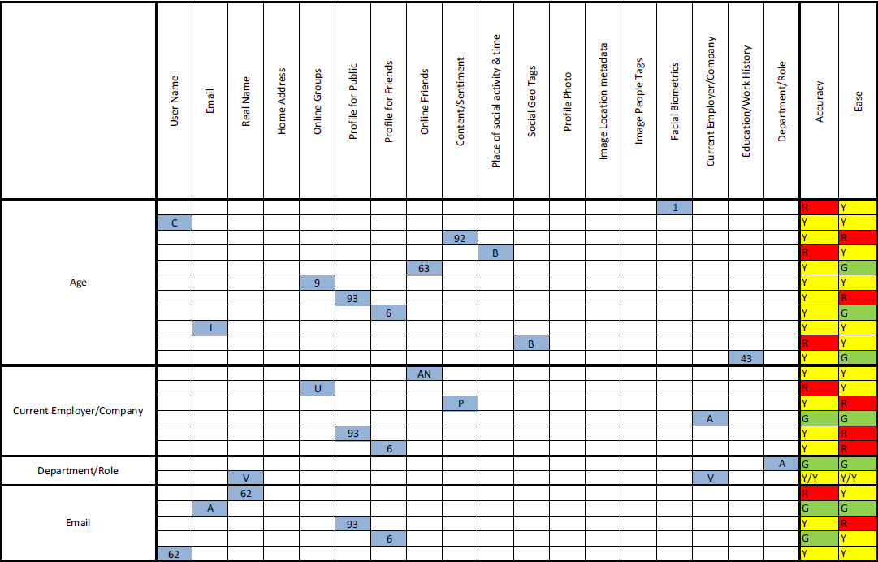
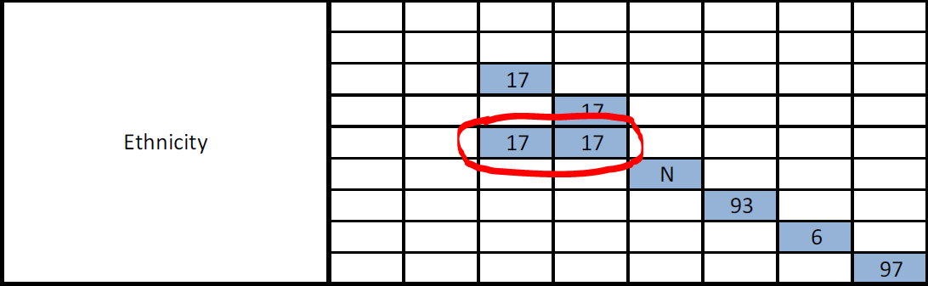
Data-Reachability Matrix
Notes:
4. Summary
Through the amalgamation and synthesis of current research and general knowledge they developed a Data-Reachability Model
*Picture of model*
Derivation process until no more = transitive closure. Inverse gives you the minimal datasets required to get x.
Explain the coding system.
They view this work as a key method (which a user-friendly interface can easily be developed) in which they might make cyber risk more tangible to users of OSNs by showing them an attack-centric view
The term for finding one data point given others is inference
The numbers represent papers for which the authors have found evidence of the inference, whereas letters are those they have posited based on general knowledge.
The authors claim these numbers and letters are part of a much bigger catalogue too large to include in the paper.

Slide 5
Appreciation
Data-Reachability Model is easily extensible
Effectively expresses the risks associated with the unchecked publishing of data in the OSN domain
Demonstrates most enabling factors
Notes:
7. Appreciative
They have created a flexible, extensible model for effectively expressing the risks associated with the unchecked publishing of data in the OSN domain.
Allows you to easily see which factors are most enabling.
Enables you to see what risks are associated with what you’re sharing.
(Transitive closure and inverse gives you starting points)

Slide 6
Appreciation Cont.
Based on this model they have developed two (prototype) tools:
  Derivation of combinations hitherto unconsidered
  Conversion of matrix to weighted and coloured graph
Notes:
8. Appreciative
They have developed a prototype tool which can derive a given data point from a starting points that has not hitherto been considered.
They have developed a tool which can represent the matrix as a weighted/coloured graph which they hope to turn into a user friendly interface.
The value is in the approach not the values…

Slide 7
Criticism
‘A key piece in the puzzle of making these risks tangible to Internet users’
How? Novelty?
  ‘The value is in the approach, not the values…’
  What have the authors really contributed to academia and/or practical applications?
    Matrix content garnered primarily from existing knowledge
    Unverified
      Ease
      Accuracy
      Derivation
Notes:
5. Critical
…Nonetheless, if this is the case then they have hardly done anything new, most definitely not something which could be posited as the missing piece of the puzzle. In fact:
Much of the work of the matrix was taken from others….. (elaborate)
At the same time it’s limited by what they found in their searches
They didn’t verify anything, including the ease and accuracy.
Flow on effects

Slide 8
Criticism Cont.
A tidy way of assimilating and organizing existing information.
  Sufficient?
Web Interface?
Notes:
6. Critical
So what value is there really in it? The only novelty really is that they’ve developed a nice way of presenting existing information. But then again, perhaps that’s all that’s needed to inspire action…
The author thinks so, and so he’s creating a web interface!

Slide 9
Question
As people who can understand this information without a fancy web interface: Is this sufficient to actually result in any action on your part?
Why?
Why not?
Notes:
9. Question
For people who don’t need a pretty UI to understand it, has this made a big enough impact on you to result in change? Do you believe it’s really sufficient to be posited as potentially the missing piece in the puzzle.

