Slide 1
A Data-Reachability Model for Elucidating Privacy and Security Risks Related to the Use of Online Social Networks
S. Creese, M. Goldsmith, J. Nurse, E. Phillips
11th IEEE International Conference on Trust, Security and Privacy in Computing and Communications (TrustCom), 2012,pp. 1124-1131. DOI: 10.1109/TrustCom. 2012.22
Presented By - Siddhesh Chandoskar

Slide 2
Summary
Information which is shared with online social media and networking sites is exposed to third parties.
There are many tools and methods which help in the extraction of online data.
Data Reachability Model is used to infer data from the information which is currently shared online.
Matrix is used to check, with how much ease and accuracy the data can be accessed.

Slide 3
Online Social Networks
Online Social Networks is a source of wide range of personal data.
User name, Date of Birth, Address, Phone Numbers, Relationship Status, views and interests, Profile photos, etc are some of the basic details shared by most of the users.
Different types of information is revealed by a single person on different networking sites.

Slide 4
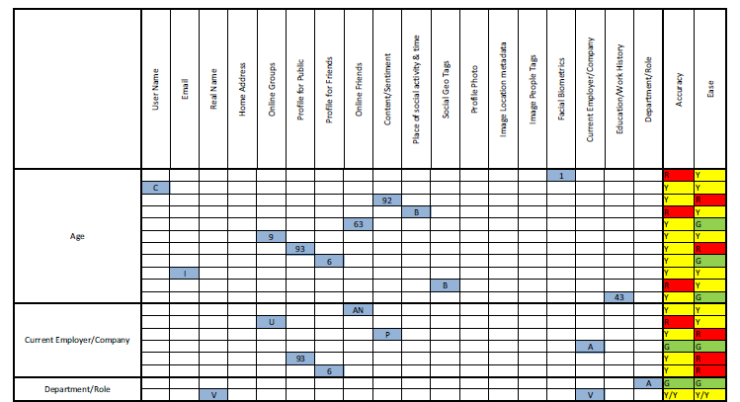
Data-Reachability Matrix

Slide 5
Use of Matrix
It is used to link data exposed on social media and other sensitive data in online and offline world.
Target information is the data which is to be derived from the data points which is already shared online.
Data points are nothing but a group of details which are used to reach the target information.

Slide 6
Matrix Explanation
Target information obtained from combination of data points.
Eg- User’s friends info can be used to derive age and gender.
Accuracy specifies about the degree of accuracy to which target information can be derived from the data point.
Ease specifies about the degree of ease to which we can use data point to reach target information.

Slide 7
Appreciation
Spreading awareness to think before revealing data on the social networks.
For eg- Profile cloning and identity thefts can be carried out by an attacker, who has data like photo, name and friend associations, age and gender. This cloned profile can be used to make friendship.

Slide 8
Appreciation Cont.
Data Reachability Model can be extended.
The value of the model is in the approach, not in the values.
Different users can use the matrix to represent their own data.

Slide 9
Criticism
Data Reachability matrix is vague and explanation is incomplete.
Numbers represent inferences for which published evidence could be found.
Letters represent inferences based on general knowledge of field and brainstorming.

Slide 10
Question?
What measures can we adapt to keep ourselves away from the threats of online social networks and to protect our privacy?

Slide 11
Thank You!

