Slide 1
Alice in Warningland: A Large-Scale Field Study of Browser Security Warning Effectiveness Devdatta Akhawe, Adrienne Porter Felt Usenix Security Symposium, Washington DC, 2013
Presented by: Rong Wang

Slide 2
Summary
Provided statistics of Google Chrome and Firefox user's behaviour when encounting numerous type of security warnings including Malware, Phishing and SSL warning.
Only studied bypassable warning of these two browsers.
Clickthrough rate represents the proportion of users in their data set that upon seen a warning, dismissed the message and proceeded with his or her original task.

Slide 3
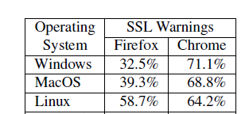
Summary
Clickthrough rates vs. User OS

Slide 4
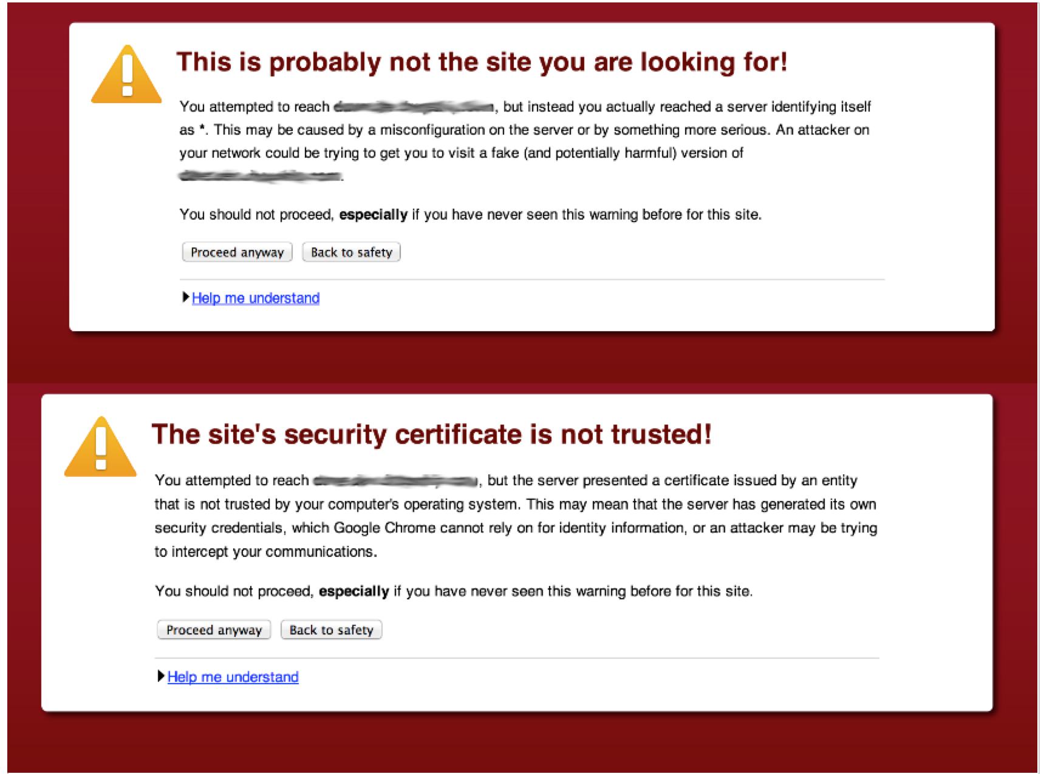
Google Chrome's ssl warning message

Slide 5
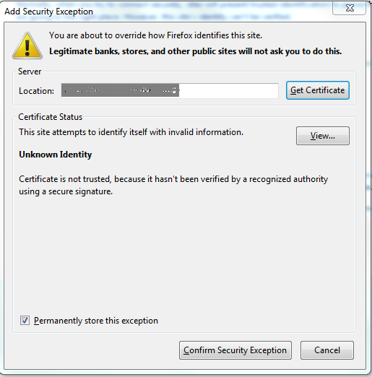
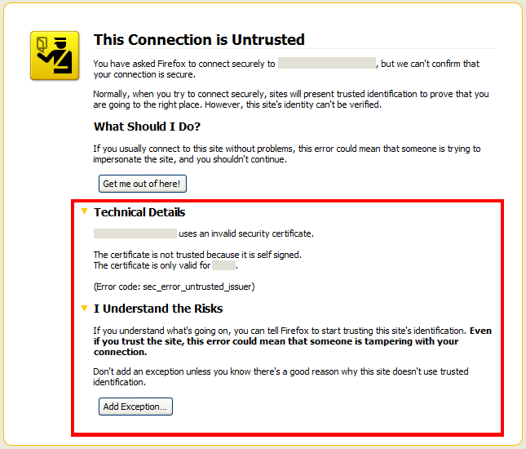
Frirefox's ssl warning message

Slide 6
Summary
User behaviour varies across different types of warnings as well as user OS and browser.
Browser security warnings can be effective in practice on the contrary to ordinary beliefs that users are oblivious and ignorant to security warnings most of the time.
“Warning design and user experience do have a tremendous impact on user behavior.”

Slide 7
Appreciation
Used Telemetry to collect pseudonymous data.
New methodology.
“First in-depth, large-scale field study”, around 25 millions warning impressions.
“Unobtrusively measure user behavior during normal browsing activities” hence provide a certain level of realism.
Provided different opionions to previous related studies.
Previous studies were mainly conducted in laboratory enviroments.
Based on feedbacks from the participants of these studies, the researchers admitted that these laboratory enviroments do have an impact on how the participants responded to the test therefore biased the clickthrough rates they have obtained.

Slide 8
Criticism
The paper tried to make recommendations for warning designers and researchers, but some of the points it made were self-contradicting.
“More Information” could reduce Firefox’s clickthrough rates even further.
Some statistical results could be potentially biased and/or may lead to misunderstanding.
Not a random sample.
“Technically skilled users ingore warnings more often”.

Slide 9
Criticism
Some statistical results could be potentially biased and/or may lead to misunderstanding.
Not a random sample.
“Technically skilled users ingore warnings more often”.

Slide 10
Criticism
Some statistical results could be potentially biased and/or may lead to misunderstanding.
Not a random sample.
“Technically skilled users ingore warnings more often”.
Firefox data is from the beta channel and Google Chrome data is from the stable channel.
Sample size of Firefox data set contains about 10000 impressions and Google Chrome data set contains more than 16000000 impressions.

Slide 11
Question
Assume the table above is representitive of the total user population behavior of the the two browsers to some degree, that is, Google Chrome users are more likely to clickthrough SSL warning than Firefox users by a significant amount. What could be the most crucial reason? And how can we improve the overall user experience?

Slide 12
The End. Thank you!

