Slide 1
An Evaluation of Extended
Validation and Picture-in-Picture
Phishing Attacks
Presented by: Pratik Gupta - pgup014
Reference:: C. Jackson, D. Simon, D. Tan, and A. Barth, “An evaluation
of extended validation and picture-in-picture phishing attacks," in
Financial Cryptography and Data Security, ser. Lecture Notes in
Computer Science, S. Dietrich and R. Dhamija, Eds. Springer Berlin Heidelberg, 2007, vol. 4886, pp. 281-293.

Slide 2
Quick Summary
Usability study of phishing attacks & browser anti-phishing defenses – extended validation certificate.
27 Users in 3 groups classified 12 web sites as fraudulent or legitimate using browser indicators.
Picture-in-picture attacks as effective as the homograph attack.
Extended validation did not help users identify either attack.
Reading help file makes real & fake websites seem legitimate when no phishing warning appears.

Slide 3
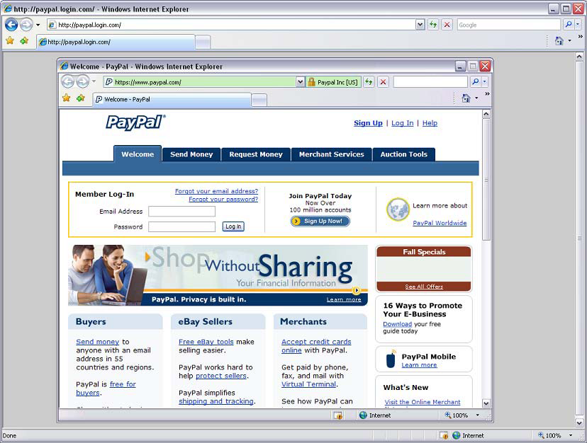
Threats - Phishing Attacks
What are Phishing Attacks?
  Email + Victim + Deceptive website login = Stolen info
Picture-in-Picture attack
Homograph attack
  www.bankofthewest.com
  vs.
  www.bankofthevvest.com

Slide 4
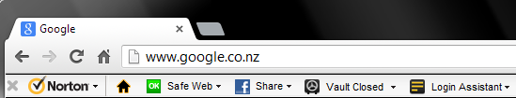
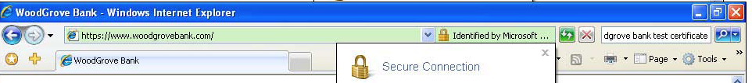
Defenses – Phishing Warnings
Commercially available Security toolbars
HTTPS encryption (HTTP + SSL/TLS encryption)
Normal certificates – only indicates owner controls a domain name.
Extended validation certificates – also attest to the identity of a legitimate business

Slide 5
User Study
Familiarized users with 2 real websites. Classify random sequence of 12 websites as real or fake.
Divided 27 users into 3 groups:
  Trained - about Extended Validation certificates & read IE 7 help file about address bar
  Untrained – just shown Extended Validation certificates but no training
  Controlled – Not shown extended validation certificates
Measured effect of:
  extended validation certificates only at legitimate sites and
  Reading a help file about security features in IE 7.

Slide 6
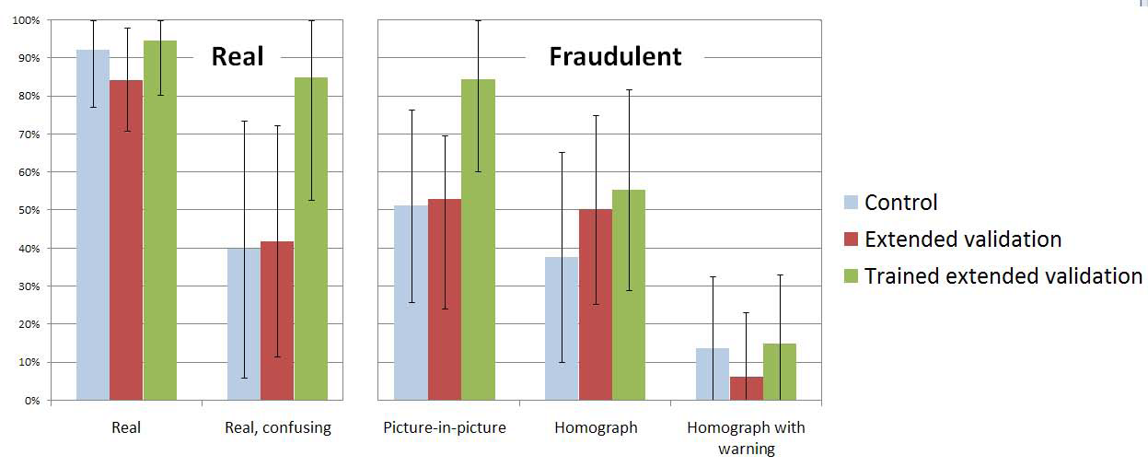
User Study Results

Slide 7
Results Discussion
Untrained extended validation group performed similarly to the control group on all tasks
Across all groups: picture-in-picture attacks were as effective as the homograph attack.
Extended validation did not help users identify either attack
When NO phishing warnings appear - trained participants more likely to classify both real AND fake web sites as legitimate.

Slide 8
Critique
They say “extended validation could becomemore effective over time as it is adopted by more financial web sites and public awareness grows.“
Although at the time of study (September 2006) they did not observe that it had a significant effect on user behaviour.
No point stated on HOW extended validation could be a potential.
Instead stated wide spread use of extended validation is vulnerable to imitate its trust indicator.

Slide 9
Appreciation
Authors mentioned “participants were invited to participate in a study involving “usability of online banking,” but were not told ahead of time that the study involved security.”
Many real attacks exploit psychology as much as technology.
I believe results were not affected by such factors:
  Paranoia from participants.
  External learning about online security.

Slide 10

Question
Is it advancement of a security mechanism OR
Users perception of a security mechanism over time that proves that given security mechanism is effective?
Thanks!

