Slide 1
An Evaluation of Extended
Validation and
Picture-in-Picture
Phishing Attacks
BY: Mehul Raniga
Reference: C. Jackson, D. Simon, D. Tan, and A. Barth, “An evaluation
of extended validation and picture-in-picture phishing attacks," in
Financial Cryptography and Data Security, ser. Lecture Notes in
Computer Science, S. Dietrich and R. Dhamija, Eds. Springer Berlin Heidelberg, 2007, vol. 4886, pp. 281-293.

Slide 2
A Quick Insight
Paper about phishing attacks based on usability study
Users required to classify websites as fraudulent/legitimate using security tools
Users divided into 3 groups to study effect of Extended Validation Certificates
Phishing techniques - Picture-in-picture attack & Homograph attack included in study

Slide 3
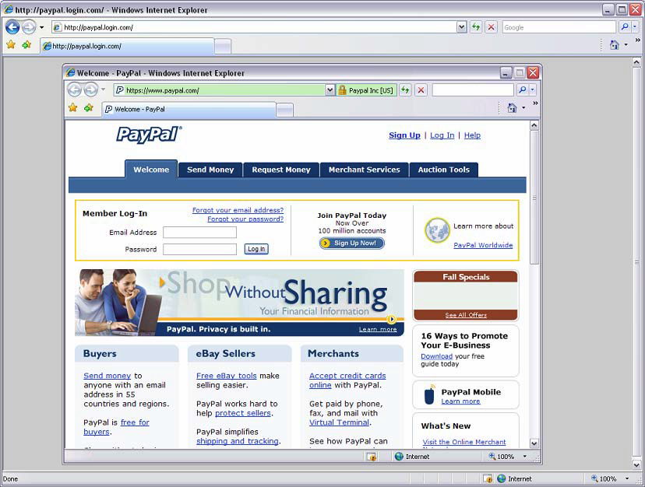
The Threats
What is a Phishing attack?
Some Techniques of Phishing attack:
Picture-in-picture attack
[1]
Homograph attack
www.westpac.com
compared to
www.vvestpac.com

Slide 4

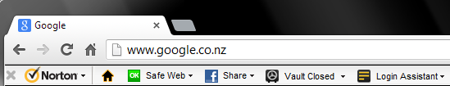
The Defences
Phishing Filters
The use of Extended Validation Certificates
Security toolbars
The use of HTTPS encryption (HTTP + SSL/TLS encryption)

Slide 5
The Usability Test
Participants familiarised themselves with websites they were tested on
Participants were then divided into 3 groups:
  The Trained group – Users had learnt about Extended Validation Certificates and other security features found in browsers such as the phishing filter.
  The Untrained group – Users were just shown Extended Validation Certificates but received no training on its meaning.
  The Controlled group – Users weren’t even shown Extended Validation Certificates and their tasks were modified as to not include the Extended Validation indicators
Participants were required to classify a sequence of websites as legitimate or fraudulent. The websites were divided into the following categories:
  The Real website.
  The Real website, but designed to induce confusion.

Slide 6
The Usability Test (continued...)
  c. Site with Homograph attack.
  d. Homograph site that triggers a warning.
  e. Site with a Picture-in-picture attack.
  f. A Picture-in-picture attack with mismatched browser colour scheme.
  g. A site with an IP address instead of domain name blocked by phishing filter.

Slide 7
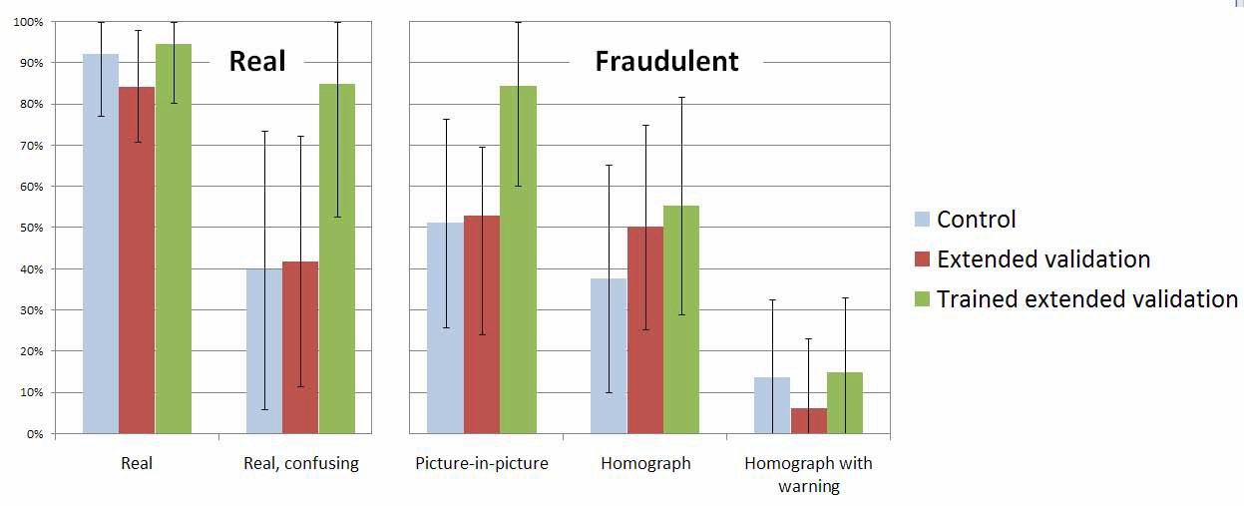
Study Results

Slide 8
Results Discussion
Users in the trained group were the most likely to classify both real and fraudulent sites as legitimate!!! (more in criticism)
The untrained extended validation group performed similar to the control group across all tasks.
The Picture-in-picture attacks and Homograph attack proved to be quite effective.
Post-tests revealed that a very small number of users actually used the extended validation to classify websites (need to raise more awareness)
The Browser’s inbuilt phishing warning significantly helped users.

Slide 9
Criticism
The trained extended validation group assumed the browser’s filter would indicate a fraudulent website 100% of the time.
This dramatically changed the results and as a result flawed the study.
If more information was provided about the filter then the results could have been much lower.
This study could have yielded a different result. Eg:
  Because the users were educated about the Extended Validation and other related security features they were able to protect themselves from attacks and thus this proves that raising awareness about security is very crucial
  (This is my interpretation of an altered outcome)
Authors just reported this flaw as an observation
  “The participants who were asked to read the Internet Explorer help file were more likely to classify both real and fake sites as legitimate”

Slide 10
Appreciation
Authors must have realised the cause of the flaw in their study and try to pass the message across
The various security mechanisms do not guarantee safety or they are not accurate 100% of the time
Authors do this on several counts throughout the report:
  “The lock icon in browsers, which indicates the presence of SSL/TLS encryption, does not ensure the site is trustworthy”
  “Extended validation, which turns the address bar green in Internet Explorer 7, also does not guarantee that the site is safe to do business with or that it complies with applicable laws”
  “Another approach to the password theft problem is a password manager...................these solutions can be vulnerable to picture-in-picture user interface spoofing”

Slide 11
Question
If security mechanisms are not accurate 100% of the time, could we rely on them?

