Slide 1
Unique in the crowd:
The privacy bounds of human mobility
Y.-A. de Montjoye, C. A. Hidalgo, M. Verleysen, and V. D. Blondel, Scientific reports, vol. 3, 2013.
Presented by:
Lim Tze Ching Josephine
(jlim102)

Slide 2
Introduction
Mobility data – contains approximate location of individuals
Highly sensitive information - usually anonymized to protect individual privacy
But if an individual’s patterns are unique enough, outside information can be used to link the data back to him

Slide 3
Research problem
Analyzed a simply anonymized dataset
  15 months of human mobility data for 1.5 million individuals
  Each time user makes a call, closest antenna and time of call recorded
4 spatio-temporal points found to be sufficient to uniquely identify 95% of individuals.

Slide 4
Results
Authors derived a formula for expressing the uniqueness of human mobility
Found that uniqueness decays as the 1/10th power of spatio-temporal resolution
Hence even coarse data sets provide minimal anonymity

Slide 5
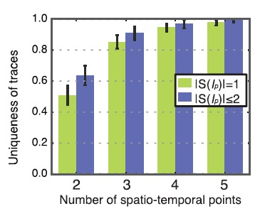
Results
I_{p}
  a set of spatio-temporal points
S(I_{p})
  subset of traces that match I_{p}
S(I_{p}) = 1
  unique trace
Green bars
  the fraction of completely unique traces

Slide 6
Focus of article
The article draws attention to a concept often taken for granted:
To what extent can we rely on ‘anonymity’?
Simply anonymized mobility datasets are widely available to third parties
  Apple allows sharing of the spatio-temporal location of their users with “partners and licenses”.
  The geo-location of ~50% of all iOS and Android traffic is available to ad networks.

Slide 7
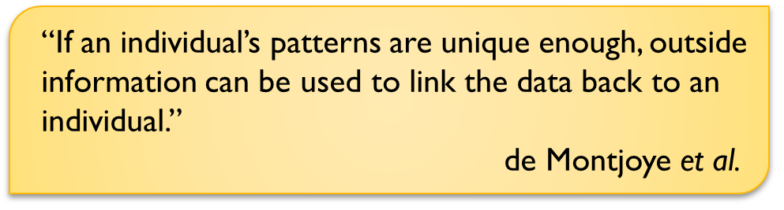
Focus of article
People think it’s acceptable just because they are ‘anonymized’
Is it really okay?

Slide 8
Appreciation
The concerns raised by this article can be used as the basis for:
  Emphasizing the need for user education regarding privacy risks of revealing geo-location
    Apps that request permission to check location
  Potential reconsideration of current laws regarding user privacy and sharing of mobility data

Slide 9
Criticism
Data collected in 2006-2007, but this article was published in 2013
6-7 year difference!
Trends in mobile phone usage have evolved rapidly over past 6 years
  Increased mobile phone subscriptions
  The advent of smartphones and mobile broadband
  Apps that transmit location data

Slide 10
Mobile phone subscriptions per 100 people, by income group
(2001 – 2011)
(Source: World Bank report 2012)
Mobile app downloads and mobile broadband access
(2007 – 2011)
(Source: World Bank report 2012)

Slide 11
Criticism
How well does their uniqueness formula generalize to a much noisier and denser data set?
We might need to test the authors’ formula on a more recent data set, to prove that it is still applicable today

Slide 12
Question
Are current privacy/protection laws sufficient in the light of these findings?

Slide 13
Thank you!

