Slide 1
Personas: Moving Beyond Role-Based Requirements Engineering
Granville Miller and Laurie William
http://agile.csc.ncsu.edu/SEMaterials/Personas.pdf
Microsoft Corp and North Carolina State University(2006)
Presented by: Faheem Mushreef

Slide 2
Objectives:
Determining the significance of Personas
Understanding Role-Based Engineering
Analyzing the effects of Personas at Microsoft and its outcome

Slide 3
Introduction:
Persona is an archetype of a fictional user representing a specific group of typical users
Personas have a hypothetical name, occupation and other specific personal data.
They present themselves as a ‘proxy’ within the development team

Slide 4
Defining values for Personas
Each requirement in the development team is assigned a value for each persona:
-1: This suggests that the persona is confused, annoyed or harmed by the environment
0:The persona does not care about the requirement
1:The feature provides some value to persona
2:The persona loves the feature.

Slide 5
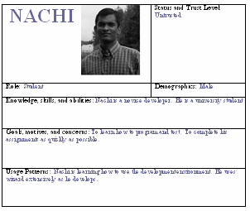
Using scenarios with personas
Scenarios are narrations that put a persona in action where customers may use a product.

Slide 6
Personas at Microsoft
Development teams at microsoft have been using Personas since mid 1990s.
There were 3 personas representing the developer role
When missing steps were discovered during development, personas helped Program Managers(PM) find the needed functionality.
MSF(Agile+Formal) use both scenario as well as persona in development process.

Slide 7
Appreciative Comment:
This paper:
Gave a new approach to Requirement engineering from scenario-based techniques
Gave the details of IT giant like Microsoft having implemented it in mid 90s
More recently IBM has also started using Personas

Slide 8
Critical Comment:
This paper should have had:
Given more appropriate distinction between Use-cases and Persona since both of them sound SAME!!

Slide 9
Thought provokoing question
Although the authors explain about Personas,
In a world of real-time Cloud computing and mobile technology, do we really need something like Personas hung on our office Walls ? ?

Slide 10
Questions ?

