Slide 1
Misplaced Confidences: Privacy and the Control Paradox
L. Brandimarte, A. Acquisti, and G. Loewenstein
Social Psychological and Personality Science Vol. 4, 2013
By Harrison Kim

Slide 2
Summary
Privacy is generally considered as the control over personal information flows.
People often respond to safety measures in ways that counteract them.
Giving users more perceived control can make them reveal more information.

Slide 3
Summary
Three survey-based studies to investigate the relationship between control and disclosure.
  Study 1: Decreased control over release
  Study 2: Increased accessibility of information
  Study 3: Increased control over access
More perceived control appeared to make people less aware of other risks.

Slide 4
Study 1
Participants asked to answer 40 questions varying in intrusiveness.
Two conditions:
  Certain publication - answers would be published on profile
  Uncertain publication - only half of participants would have their answers published

Slide 5
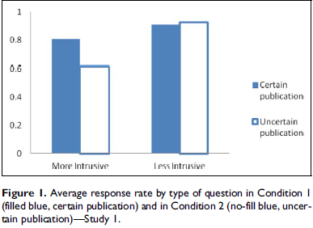
Study 1
Less participants willing to answer intrusive questions with uncertain publication despite lower risk.

Slide 6
Study 2
Extension of study 1.
Same certain and uncertain publication conditions.
Changed level of accessibility of provided information:
  Readable by students only.
  Readable by students and faculty members.

Slide 7
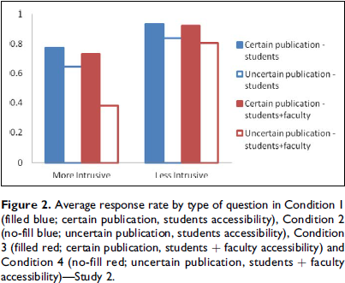
Study 2
Reassurances about control over privacy appeared to decrease participants’ attention to other issues.

Slide 8
Study 3
10 yes/no questions with sensitive information (drugs, lying, stealing).
Test impact of increasing control:
  Can choose not to answer a question.
  Check box for permission to publish all answers.
  Check boxes for permission to publish age, gender or country of birth.
  Check box for permission to publish single answers.

Slide 9
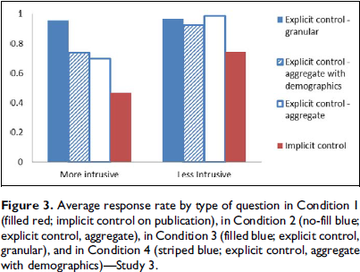
Study 3
Participants more likely to disclose sensitive information if given explicit control over publication.

Slide 10
Appreciation
A wide variety of studies to examine effects of a range of variables.
  Perceived control
  Associated risks
  Accessibility
  Sensitivity of information
Supported by statistical analysis of results.
Identifies a weakness in current popular privacy protection methods.

Slide 11
Criticism
Only one demographic tested.
In their background, they acknowledged a limited attention effect, but drew attention to the control manipulations in their studies.

Slide 12
Question
How could malicious users abuse this control paradox to gather information?
Given recent revelations about the NSA, were legislators and government bodies acting in the interests of the users when they pushed to provide more control for enhanced privacy protection or were they abusing the control paradox?

