Slide 1
Misplaced Confidences: Privacy and the Control Paradox
L. Brandimarte, A. Acquisti, and G. Loewenstein,"Misplaced Confidences: Privacy and the control paradox," Social Psychological and Personality Science, vol. 4, no. 3, pp. 340-347, 2013.
- Arthur Lewis (alew525)

Slide 2
Table of Contents
Summary
  Introduction
  User study specifics
  Study results
Appreciation
Critique
Question

Slide 3
Introduction
Privacy is a major concern today
People feel secure if they perceive “control” over the release of information
This makes them fail to recognize risks which they can’t control
A “control paradox” is thus observed

Slide 4
User Study Specifics
University Students were asked to participate
Sample size was 132 students for study 1 and 2, 134 students for study 3
Students had to answer personal information to help create profiles for a social networking website for the first 2 studies
The third study was a survey about ethical behaviors
Nature of questions were intrusive or less intrusive
Results supported their hypothesis
Notes:
Who, where, when and why??
Voluntary??
Sample size
Nature of questions
Intrusiveness factor

Slide 5
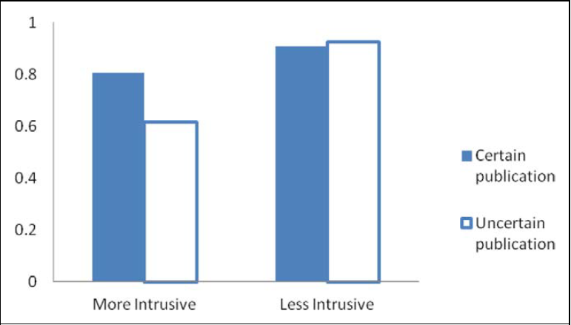
Study 1
Tested manipulation of control over the willingness to release personal information
2 conditions:
  certain publication (more control) i.e. information will certainly be published
  uncertain publication (less control) i.e. only 50% of the participants will have their information randomly published

Slide 6
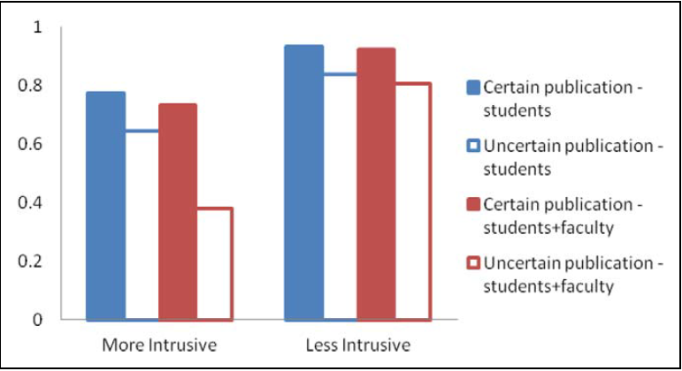
Study 2
Extended the first study
The direct accessibility of information was taken into account
Personal information could be read either by students only or by both students and faculty

Slide 7
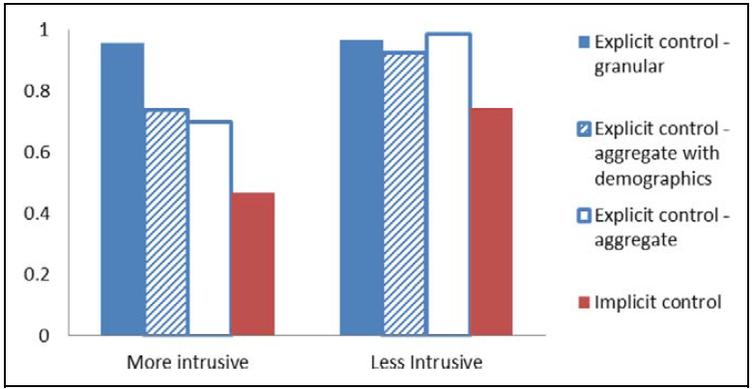
Study 3
Purpose was to infer whether the effect of control applies to disclosure of information that can personally identify the revealer
Participants were told that their answers will be published by researchers on some research bulletin
Consisted of yes/no questions about ethical behaviors with 4 layers of granularity

Slide 8
Appreciation
Presented a psychological view point to the issue of privacy concerns
Control isn’t sufficient to address privacy concerns

Slide 9
Critique
Study sample comprised of university students
Participation was not voluntary
The participants should have been given some minimal indication about the risks involved in disclosing information
More information should have been given about what “intrusiveness” was all about

Slide 10

Question
If users disclose information more readily if they perceive a great deal of “control” over its release, then do policy makers have to change their stance about giving users more control to uphold their privacy?

Slide 11
Thank You!!!

