Slide 1
Basics of Public Key Cryptography, Cryptoprotocols, and Steganography
19 August 2013
Clark Thomborson
University of Auckland

Slide 2
Analysing a Security Requirement
Alice wants to send a message to Bob. Moreover, Alice wants to send the message securely: Alice wants to make sure Eve cannot read the message.”
  [Adapted from Schneier, Applied Cryptography, 2nd edition, 1996]
Exercise 1. Draw a picture of this scenario.
Exercise 2. Discuss Alice’s security requirements, using the terminology developed to date in CompSci 725.
Exercise 3. In this scenario, Alice is the sender, Bob is the receiver, and Eve is the eavesdropper. Name another actor with an important role in communication security.
  Answers at http://en.wikipedia.org/wiki/Alice_and_Bob.

Slide 3
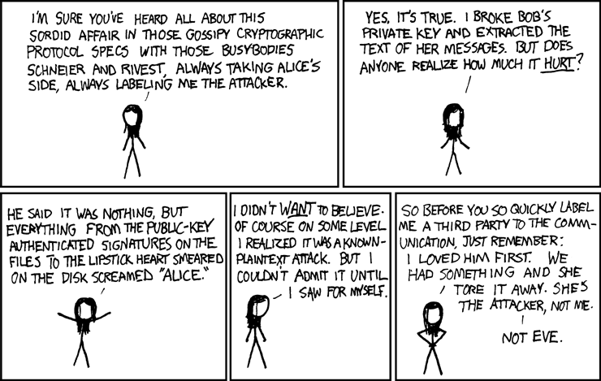
Alice and Bob
http://xkcd.com/177/ (Creative Commons 2.5 licence)

Slide 4
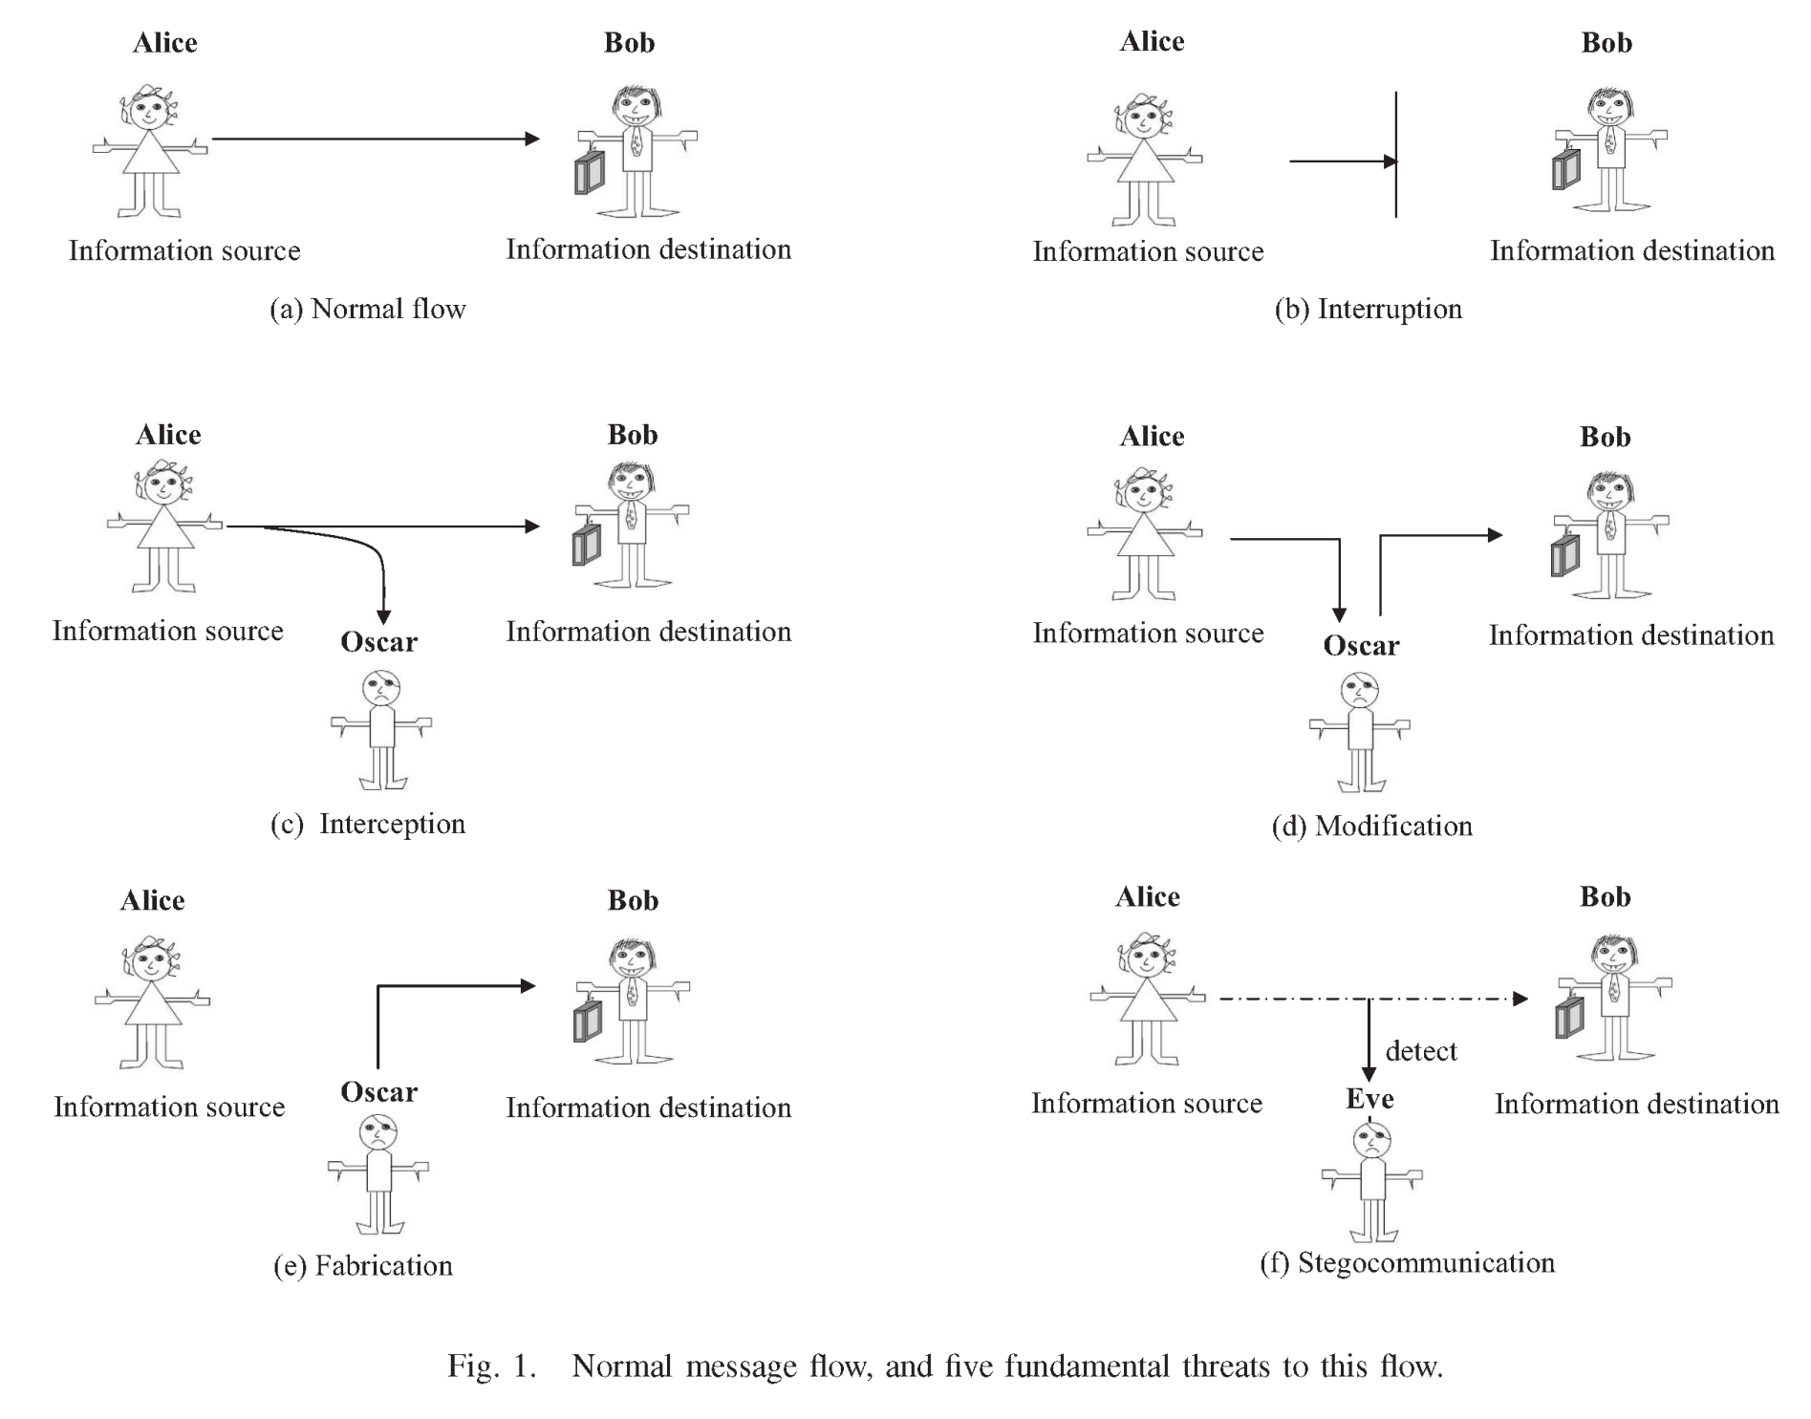

Slide 5
An Attack Taxonomy for Communication Systems
Interception (attacker reads the message)
Interruption (attacker prevents delivery)
Modification (attacker changes the message)
Fabrication (attacker injects a message)
  Impersonation (attacker pretends to be a legitimate sender or receiver, e.g. this is either a fabrication or an interruption)
Stegocommunication (attackers make surreptitious use of a communication system: Eve wears the “white hat”)
Repudiation (attacker falsely asserts they did not send or receive a message: defender must prove there was no fabrication or impersonation)

Slide 6
Symmetric and Public-Key Encryption
If the decryption key d can be computed from the encryption key e, then the algorithm is called symmetric.
  Example: E(p) = (p + e) mod 256 is a symmetric (and very weak) encryption of a char p, because D(x) = (x + d) mod 256 is a decryptor when d = 256 - e.
If the decryption key cannot be feasibly computed from the encryption key, then the algorithm is called asymmetric or public-key.

Slide 7
Message Integrity
Encryption assures confidentiality
  Assume: the attacker can’t discover the key or “crack” the cypher.
Integrity can also be assured by message codes.
Sending a plaintext message, plus its Message Authentication Code (MAC), will ensure message integrity to anyone who knows the (shared) secret key.
  The CBC-MAC is the last ciphertext block from a CBC-mode block cipher.
  Changing any message bit will change the MAC – this defends against modification.
  Unless you know the secret key, you can’t compute a MAC from the plaintext – this defends against fabrication.
Keyed hashes (HMACs) are another popular type of MAC.
  SHA-1 and MD5 are used in SSL
  To learn more, read Stamp’s Information Security, 2nd Edition, Wiley, 2011, at pp. 136-7.

Slide 8
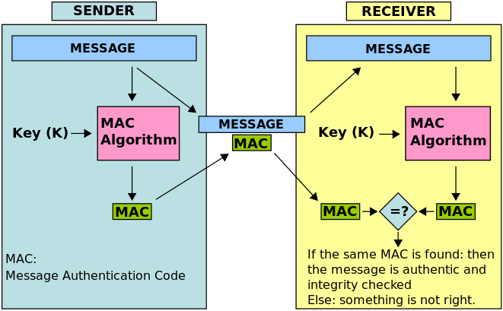
MAC
http://en.wikipedia.org/wiki/Message_authentication_code

Slide 9
Public Key Cryptography
Encryption E: Plaintext × EncryptionKey → Cyphertext
Decryption D: Cyphertext × DecryptionKey → Plaintext
The sender must know the encryption key.
The receiver can decrypt, if they know the decryption key.
In public-key cryptography, we use key-pairs (s, p), where our secret key s cannot be computed efficiently (as far as anyone knows) from our public key p and our encrypted messages.
  The algorithms (E, D) are standardized.
  We let everyone know our public key p.
  We don’t let anyone else know our corresponding secret key s.
  Anybody can send us encrypted messages using E(*, p).
  Convenient notation: {P}_{Clark} is plaintext P that has been encrypted by a secret key named “Clark”. [Stamp, pp. 89-91]

Slide 10
Authentication in PK Cryptography
We can use a secret key s to encrypt a message which everyone can decrypt using our corresponding public key p.
  E(P, s) is a “signed message”. Simpler notation: [P]_{Clark}
  Only people who know the secret key named “Clark” can create this signature.
  Anyone who knows the public key for “Clark” can validate this signature.
  This defends against impersonation and repudiation attacks.
If you use a key-pair (s, p) for encryption, then you can’t use it safely for signing!
  Do you understand why?

Slide 11
Key Management & Distribution
We should use many different public/private key pairs:
  For our email,
  For our bank account (our partner knows this private key too),
  For our workgroup (shared with other members), …
A “public key infrastructure” (PKI) will help us create, publicise, and discover public keys (p₁, p₂, …).
A “certificate authority” (CA) is a registry for public keys – this is an important part of a PKI..
  The CA uses one of its signing keys to sign a “certificate” of the form [name, p]_{CA}.
  Anyone who knows the CA’s corresponding public key can verify that p was registered by someone who convinced the CA that they are identified by name.
  Note: we also need some way to discover CAs and their keys… our web browsers help with this…

Slide 12
Some Security Issues with CAs
The name in a certificate might not be a unique identifier for a person or an organisation – there are many people named “John Doe”.
A CA might register a key to an impersonator.
The end-user might not inspect the certificate to confirm that
  name is a (reasonably) unique identifier for the person or organisation they are trying to communicate with.

Slide 13
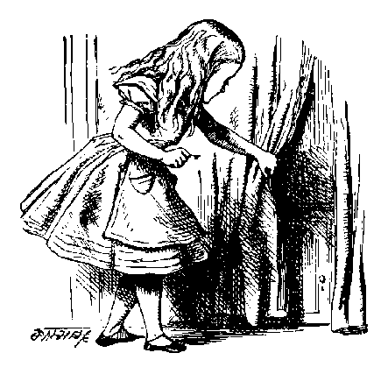
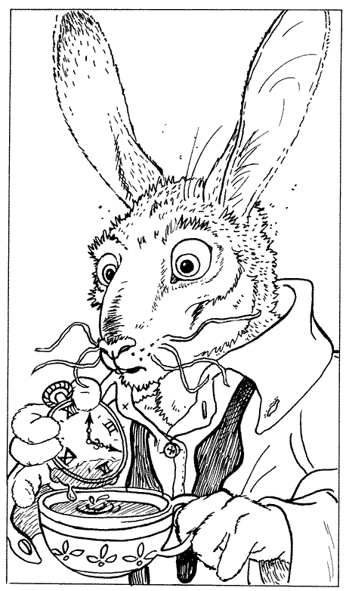
A Simple Cryptographic Protocol
R_{A}
[B, “Bob”]_{CA}
{SK}_{B}, {P}_{SK}
Alice
Bob
Alice sends a service request R_{A} to Bob.
Bob replies with his digital certificate.
  Bob’s certificate contains Bob’s public key B and Bob’s name.
  This certificate was signed by a Certificate Authority, using a public key CA which Alice already knows.
Alice creates a symmetric key SK. This is a “session key”.
  Alice sends SK to Bob, encrypted with public key B.
  Alice and Bob will use SK to encrypt their plaintext messages.

Slide 14

Protocol Analysis
R_{A}
R_{A}
[T, “Trudy”]_{CA}
[B, “Bob”]_{CA}
{SK}_{T}, {P}_{SK}
{SK}_{B}, {P}_{SK}
Trudy: acting as Alice to Bob,
and as Bob to Alice
Alice
Bob
How can Alice detect that Trudy is “in the middle”?
What does your web-browser do, when it receives a digital certificate that says “Trudy” instead of “Bob”?
Trudy’s certificate might be [T, “Bob”]_{CA’}
  If you follow a URL to “https://www.bankofamerica.org”, your browser might form an SSL connection with a Nigerian website which spoofs the website of a legitimate bank!
Have you ever inspected an SSL certificate?

Slide 15
Attacks on Cryptographic Protocols
A ciphertext may be broken by…
  Discovering the “restricted” algorithm (if the algorithm doesn’t require a key).
  Discovering the key by non-cryptographic means (bribery, theft, ‘just asking’).
  Discovering the key by “brute-force search” (through all possible keys).
  Discovering the key by cryptanalysis based on other information, such as known pairs of (plaintext, ciphertext).
The weakest point in the system may not be its cryptography!
  See Ferguson & Schneier, Practical Cryptography, 2003.
  For example: you should consider what identification was required, when a CA accepted a key, before you accept any public key from that CA as a “proof of identity”.

Slide 16
Limitations and Usage of PKI
If a Certificate Authority is offline, or if you can’t be bothered to wait for a response, you will use the public keys stored in your local computer.
  Warning: a public key may be revoked at any time, e.g. if someone reports their key was stolen.
Key Continuity Management is an alternative to CAs.
  The first time someone presents a key, you decide whether or not to accept it.
  When someone presents a key that you have accepted previously, it’s ok to accept it again if you haven’t had any bad experiences with that key,
  If someone presents a changed key, you should think carefully before accepting!
  This idea was introduced in SSH, in 1996. It was named, and identified as a general design principle, by Peter Gutmann (http://www.cs.auckland.ac.nz/~pgut001/).
  Reference: Simson Garfinkel, in http://www.simson.net/thesis/pki3.pdf

Slide 17
Identification and Authentication
You can authenticate your identity to a local machine by
  what you have (e.g. a smart card),
  what you know (e.g. a password),
  what you “are” (e.g. your thumbprint or handwriting)
After you have authenticated yourself locally, then you can use cryptographic protocols to…
  … authenticate your outgoing messages (if others know your public key);
  … verify the integrity of your incoming messages (if you know your correspondents’ public keys);
  … send confidential messages to other people (if you know their public keys).
  Warning: you (and others) must trust the operations of your local machine! We’ll return to this subject…

Slide 18
Watermarking, Tamper-Proofing and Obfuscation – Tools for Software Protection
Christian Collberg & Clark Thomborson
IEEE Transactions on Software Engineering 28:8, 735-746, August 2002

Slide 19
Watermarking and Fingerprinting
Watermark: an additional message, embedded into a cover message.
Messages may be images, audio, video, text, executables, …
Visible or invisible (steganographic) embeddings
Robust (difficult to remove) or fragile (guaranteed to be removed) if cover is distorted.
Watermarking (only one extra message per cover) or fingerprinting (different versions of the cover carry different messages).

Slide 20
Our Desiderata for (Robust, Invisible) SW Watermarks
Watermarks should be stealthy -- difficult for an adversary to locate.
Watermarks should be resilient to attack -- resisting attempts at removal even if they are located.
Watermarks should have a high data-rate -- so that we can store a meaningful message without significantly increasing the size of the object.

Slide 21
Attacks on Watermarks
Subtractive attacks: remove the watermark (WM) without damaging the cover.
Additive attacks: add a new WM without revealing “which WM was added first”.
Distortive attacks: modify the WM without damaging the cover.
Collusive attacks: examine two fingerprinted objects, or a watermarked object and its unwatermarked cover; find the differences; construct a new object without a recognisable mark.

Slide 22
Defenses for Robust Software Watermarks
Obfuscation: we can modify the software, so that a reverse engineer will have great difficulty figuring out how to reproduce the cover without also reproducing the WM.
Tamperproofing: we can add integrity-checking code that (almost always) renders it unusable if the object is modified.

Slide 23
Classification of Software Watermarks
Static code watermarks are stored in the section of the executable that contains instructions.
Static data watermarks are stored in other sections of the executable.
Dynamic data watermarks are stored in a program’s execution state. Such watermarks are resilient to distortive (obfuscation) attacks.

Slide 24
Dynamic Watermarks
Easter Eggs are revealed to any end-user who types a special input sequence.
Execution Trace Watermarks are carried (steganographically) in the instruction execution sequence of a program, when it is given a special input.
Data Structure Watermarks are built (steganographically) by a program, when it is given a special input sequence (possibly null).

Slide 25
Easter Eggs
The watermark is visible -- if you know where to look!
Not resilient, once the secret is out.
See www.eeggs.com

Slide 26
Software Obfuscation
Many authors, websites and even a few commercial products offer “automatic obfuscation” as a defense against reverse engineering.
Existing products generally operate at the lexical level of software, for example by removing or scrambling the names of identifiers.
We were the first (in 1997) to use “opaque predicates” to obfuscate the control structure of software.

Slide 27
Opaque Predicates
{A; B } ⇒
A
A
A
T
p^{T}
F
T
P?
F
T
P^{T}
F
B
B
B’
B
B^{bug}
“always true”
“indeterminate”
“tamperproof”
(“always false” is not shown)

Slide 28
Conclusion
Software obfuscation can make it more difficult for pirates to defeat standard tamperproofing mechanisms, or to engage in other forms of reverse engineering.
Software watermarking can embed “ownership marks” in software, making it difficult for anyone to be sure that they have “removed all the marks”.
Software steganography is immature:
  More R&D is required before robust obfuscating and watermarking tools will be easy to use.

