Slide 1
Review of “Towards Taming Privilege-Escalation Attacks on Android”
Sven Bugiel, Lucas Davi, Alexandra Dmitrienko, Thomas Fischer,
Ahmad-Reza Sadeghi, Bhargava Shastry
In Proceedings of the 19th Annual Network & Distributed System Security Symposium (February 2012)

Slide 2
Summary
The authors of this paper has presented the design and implementation of a security framework that protects against both confused deputy attack and collusion attack
Also included results for performance evaluation

Slide 3
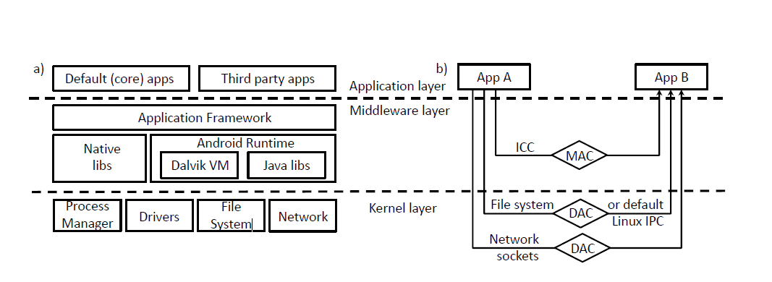
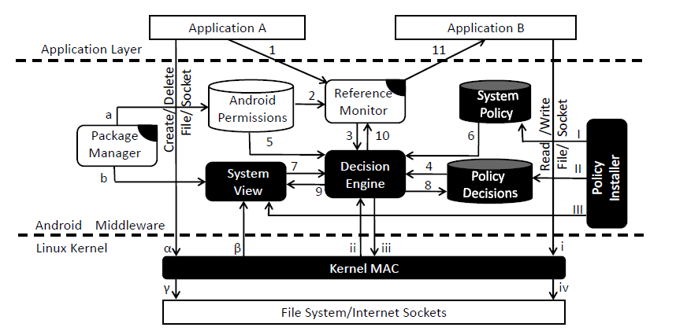
Android architecture & Security framework architecture

Slide 4
Appreciation
The first security framework that addresses both confused deputy attack and collusion attack
System-centric solution that generally captures all application level privilege attacks: not dependent of applications, not just targeting attack subclasses
Scalable performance over-head (adversary models: weak, basic, advanced and strong)

Slide 5
Criticism
Heuristic evaluation: hard to simulate worst case scenario, sample size of 50 still sounds small given the amount of categories (27)
Adversary model VS performance??
Separated test of “ICC based communication apps” and “File system and socket based communication” (I.E PDF plug-in for dolphin browser) (all tests were carried out where there’s only two nodes & single path, a mixed case would have more that two nodes and potentially multiple paths)

Slide 6
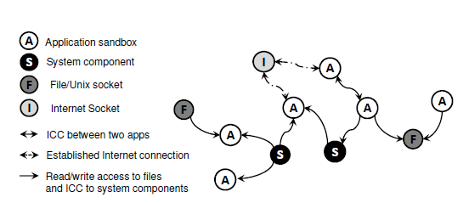
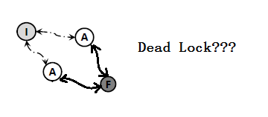
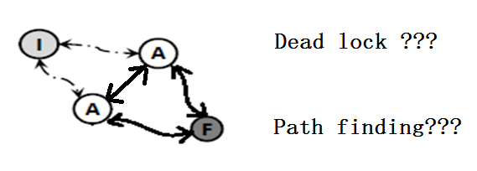
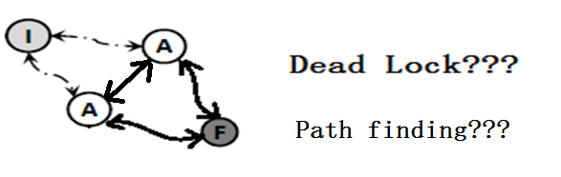
Sample scenario

Slide 7
Question
Given that this security framework was built on a rather obsolete version of Android (2.2.1), do you think it will still satisfy the need on devices with newer Android versions ? (Android 4 had new features such as Android Beam, Screen Shots and On-device Encryption!)

