Slide 1
Basics of Cryptography and Steganography
(Handout 5)
July 2012
Clark Thomborson
University of Auckland

Slide 2
My Attack Taxonomy for Communication Systems with Access Control and Identification
Interception (attacker reads the message);
Interruption (attacker prevents message delivery);
Modification (attacker changes a message);
Impersonation (attacker pretends to be an authorised receiver);
Fabrication (attacker pretends to be an authorised sender);
Repudiation (attacker falsely asserts that they did not send or receive a message).
Subversion (two or more attackers communicate on a stegochannel).

Slide 3
Analysing a Security Requirement
“Suppose a sender [Alice]
wants to send a message to a receiver [Bob].
  Moreover,
  [Alice] wants to send the message securely:
  [Alice] wants to make sure an
  eavesdropper [Eve] cannot read the message.”
(Schneier, Applied Cryptography, 2nd edition, 1996)
Exercise 1. Draw a picture of this scenario.
Exercise 2. Discuss Alice’s security requirements, using the terminology developed in CompSci 725.

Slide 4
Terminology of Cryptography
Alice
Decryption
plaintext
ciphertext
plaintext
key
key
Encryption
Bob
Cryptology: the art (science) of communication with secret codes. Includes
  Cryptography: the making of secret codes.
  Cryptanalysis: “breaking” codes, so that the plaintext of a message is revealed.
Exercise 3: Let Eve be a cryptographer with access to the ciphertext. For each of the attacks in my taxonomy, who are the threat agents?

Slide 5
A Simple Encryption Scheme
Rot(k,s) : “rotate” each character in string s by k:
for( i=0; i<len(s); i++ )
s[i] = ( s[i] + k ) mod 26;
return(s);
Exercise 4: write the corresponding decryption routine.
Exercise 5: how many keys must you try, before you can “break” a ciphertext Rot(k,s)?
This is a (very weak) “secret-key” encryption scheme, where the secret key is k.
When k=3, this is “Caesar’s cipher” [Stamp, p. 22]

Slide 6
Symmetric and Public-Key Encryption
If the decryption key kd can be computed from the encryption key ke, then the algorithm is called “symmetric”.
Question: is Rot(ke,s) a symmetric cipher?
If the decryption key kd cannot be computed (in a reasonable amount of time) from the encryption key ke, then the algorithm is called “asymmetric” or “public-key”.

Slide 7
One-Time Pads
If our secret key K is as long as our plaintext message P, when both are written as binary bitstrings, then we can easily compute the bitwise exclusive-or K⊕P.
This encoding is “provably secure”, if we never re-use the key.
  Provably secure = The most efficient way to compute P, given K⊕P, is to try all possible keys K. [Stamp, pp. 27-29]
  It is often impractical to establish long secret keys.
Note: non-cryptographic security goals may be compromised if an attacker knows that an encrypted message has been sent!
  Traffic analysis: if a burst of messages is sent from the Pentagon… [http://www.wired.com/dangerroom/2007/05/urban_legend_le/]
  Steganography is the art of sending imperceptible messages.

Slide 8
Stream Ciphers
We can encrypt an arbitrarily long bitstring P if we know how to generate an arbitrarily-long “keystring” S from our secret key K.
The encryption is the bitwise exclusive-or S⊕P.
Decryption is the same function as encryption, because S ⊕ ( S ⊕ P ) = P.
RC4 is a stream cipher used in SSL. [Stamp, p. 52]

Slide 9
Block Ciphers
We can encrypt an arbitrarily long bitstring P by breaking it up into blocks P₀, P₁, P₂, …, of some convenient size (e.g. 256 bits), then encrypting each block separately.
You must vary the encryption at least slightly for each block, otherwise the attacker can easily discover i, j : P_{i} = P_{j}.
A common method for varying the block encryptions is “cipher block chaining” (CBC).
  Each plaintext block is XOR-ed with the ciphertext from the previous block, before being encrypted. [Stamp, pp. 57, 72-73]
Common block ciphers: DES, 3DES, AES.

Slide 10
Message Integrity
So far, we have considered only interception attacks.
The Message Authentication Code (MAC) is the last ciphertext block from a CBC-mode block cipher.
  Changing any message bit will change the MAC.
  Unless you know the secret key, you can’t compute a MAC from the plaintext.
Sending a plaintext message, plus its MAC, will ensure message integrity to anyone who knows the (shared) secret key.
This defends against modification and fabrication!
Note: changing a bit in an encrypted message will make it unreadable, but there’s no general-purpose algorithm to determine “readability”.
Keyed hashes (HMACs) are another approach.
  SHA-1 and MD5 are used in SSL
  [Stamp, pp. 136-7]

Slide 11
Public Key Cryptography
Encryption E: Plaintext × EncryptionKey → Cyphertext
Decryption D: Cyphertext × DecryptionKey → Plaintext
The receiver can decrypt if they know the decryption key k_{d} :
    ∀ P: D( E( P, k_{e} ), k_{d} ) = P.
In public-key cryptography, we use key-pairs (s, p), where our secret key s cannot be computed efficiently (as far as anyone knows) from our public key p and our encrypted messages.
  The algorithms (E, D) are standardized.
  We let everyone know our public key p.
  We don’t let anyone else know our corresponding secret key s.
  Anybody can send us encrypted messages using E(*, p).
  Simpler notation: {P}_{Clark} is plaintext P that has been encrypted by a secret key named “Clark”. [Stamp, p. 107]

Slide 12
Authentication in PK Cryptography
We can use our secret key s to encrypt a message which everyone can decrypt using our public key p.
  E(P, s) is a “signed message”. Simpler notation: [P]_{Clark}
  Only people who know the secret key named “Clark” can create this signature.
  Anyone who knows the public key for “Clark” can validate this signature.
  This defends against impersonation and repudiation attacks!
We may have many public/private key pairs:
  For our email,
  For our bank account (our partner knows this private key too),
  For our workgroup (shared with other members), …
A “public key infrastructure” (PKI) will help us discover other people’s public keys (p₁, p₂, …), if we know the names of these keys and where they were registered.
  A registry database is called a “certificate authority” (CA).
  Warning: someone might register a key under your name!

Slide 13
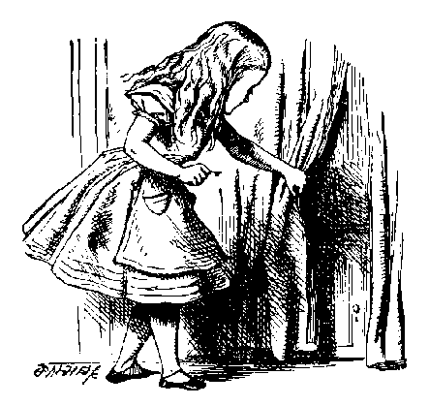
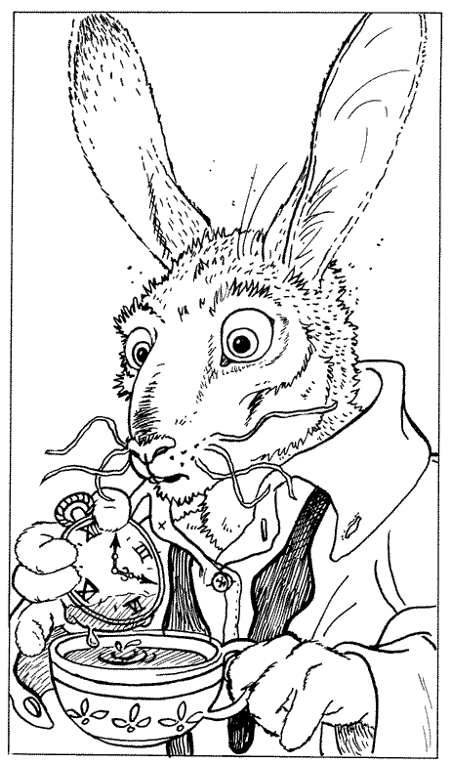
A Simple Cryptographic Protocol
R_{A}
[B, “Bob”]_{CA}
{SK}_{B}, {P}_{SK}
Alice
Bob
Alice sends a service request R_{A} to Bob.
Bob replies with his digital certificate.
  Bob’s certificate contains Bob’s public key B and Bob’s name.
  This certificate was signed by a Certificate Authority, using a public key CA which Alice already knows.
Alice creates a symmetric key SK. This is a “session key”.
  Alice sends SK to Bob, encrypted with public key B.
  Alice and Bob will use SK to encrypt their plaintext messages.

Slide 14
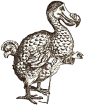
Protocol Analysis
R_{A}
R_{A}
[T, “Trudy”]_{CA}
[B, “Bob”]_{CA}
{SK}_{T}, {P}_{SK}
{SK}_{B}, {P}_{SK}
Trudy: acting as Alice to Bob,
and as Bob to Alice
Alice
Bob
How can Alice detect that Trudy is “in the middle”?
What does your web-browser do, when it receives a digital certificate that says “Trudy” instead of “Bob”?
Trudy’s certificate might be [T, “Bob”]_{CA’}
  If you follow a URL to “https://www.bankofamerica.org”, your browser might form an SSL connection with a Nigerian website which spoofs the website of a legitimate bank!
Have you ever inspected an SSL certificate?

Slide 15
Attacks on Cryptographic Protocols
A ciphertext may be broken by…
  Discovering the “restricted” algorithm (if the algorithm doesn’t require a key).
  Discovering the key by non-cryptographic means (bribery, theft, ‘just asking’).
  Discovering the key by “brute-force search” (through all possible keys).
  Discovering the key by cryptanalysis based on other information, such as known pairs of (plaintext, ciphertext).
The weakest point in the system may not be its cryptography!
  See Ferguson & Schneier, Practical Cryptography, 2003.
  For example: you should consider what identification was required, when a CA accepted a key, before you accept any public key from that CA as a “proof of identity”.

Slide 16
Limitations and Usage of PKI
If a Certificate Authority is offline, or if you can’t be bothered to wait for a response, you will use the public keys stored in your local computer.
  Warning: a public key may be revoked at any time, e.g. if someone reports their key was stolen.
Key Continuity Management is an alternative to PKI.
  The first time someone presents a key, you decide whether or not to accept it.
  When someone presents a key that you have previously accepted, it’s probably ok.
  If someone presents a changed key, you should think carefully before accepting!
  This idea was introduced in SSH, in 1996. It was named, and identified as a general design principle, by Peter Gutmann (http://www.cs.auckland.ac.nz/~pgut001/).
  Reference: Simson Garfinkel, in http://www.simson.net/thesis/pki3.pdf

Slide 17
Identification and Authentication
You can authenticate your identity to a local machine by
  what you have (e.g. a smart card),
  what you know (e.g. a password),
  what you “are” (e.g. your thumbprint or handwriting)
After you have authenticated yourself locally, then you can use cryptographic protocols to…
  … authenticate your outgoing messages (if others know your public key);
  … verify the integrity of your incoming messages (if you know your correspondents’ public keys);
  … send confidential messages to other people (if you know their public keys).
  Warning: you (and others) must trust the operations of your local machine! We’ll return to this subject…

Slide 18
Watermarking, Tamper-Proofing and Obfuscation – Tools for Software Protection
Christian Collberg & Clark Thomborson
IEEE Transactions on Software Engineering 28:8, 735-746, August 2002
Note: This article is not on the 725 reading list.
Author’s copy available at http://www.cs.auckland.ac.nz/~cthombor/Pubs/Old/WatermarkingTPandObf.pdf

Slide 19
Watermarking and Fingerprinting
Watermark: an additional message, embedded into a cover message.
Messages may be images, audio, video, text, executables, …
Visible or invisible (steganographic) embeddings
Robust (difficult to remove) or fragile (guaranteed to be removed) if cover is distorted.
Watermarking (only one extra message per cover) or fingerprinting (different versions of the cover carry different messages).

Slide 20
Our Desiderata for (Robust, Invisible) SW Watermarks
Watermarks should be stealthy -- difficult for an adversary to locate.
Watermarks should be resilient to attack -- resisting attempts at removal even if they are located.
Watermarks should have a high data-rate -- so that we can store a meaningful message without significantly increasing the size of the object.

Slide 21
Attacks on Watermarks
Subtractive attacks: remove the watermark (WM) without damaging the cover.
Additive attacks: add a new WM without revealing “which WM was added first”.
Distortive attacks: modify the WM without damaging the cover.
Collusive attacks: examine two fingerprinted objects, or a watermarked object and its unwatermarked cover; find the differences; construct a new object without a recognisable mark.

Slide 22
Defenses for Robust Software Watermarks
Obfuscation: we can modify the software, so that a reverse engineer will have great difficulty figuring out how to reproduce the cover without also reproducing the WM.
Tamperproofing: we can add integrity-checking code that (almost always) renders it unusable if the object is modified.

Slide 23
Classification of Software Watermarks
Static code watermarks are stored in the section of the executable that contains instructions.
Static data watermarks are stored in other sections of the executable.
Dynamic data watermarks are stored in a program’s execution state. Such watermarks are resilient to distortive (obfuscation) attacks.

Slide 24
Dynamic Watermarks
Easter Eggs are revealed to any end-user who types a special input sequence.
Execution Trace Watermarks are carried (steganographically) in the instruction execution sequence of a program, when it is given a special input.
Data Structure Watermarks are built (steganographically) by a program, when it is given a special input sequence (possibly null).

Slide 25
Easter Eggs
The watermark is visible -- if you know where to look!
Not resilient, once the secret is out.
See www.eeggs.com

Slide 26
Software Obfuscation
Many authors, websites and even a few commercial products offer “automatic obfuscation” as a defense against reverse engineering.
Existing products generally operate at the lexical level of software, for example by removing or scrambling the names of identifiers.
We were the first (in 1997) to use “opaque predicates” to obfuscate the control structure of software.

Slide 27
Opaque Predicates
{A; B } ⇒
A
A
A
T
p^{T}
F
T
P?
F
T
P^{T}
F
B
B
B’
B
B^{bug}
“always true”
“indeterminate”
“tamperproof”
(“always false” is not shown)

Slide 28
Conclusion
Software obfuscation can make it more difficult for pirates to defeat standard tamperproofing mechanisms, or to engage in other forms of reverse engineering.
Software watermarking can embed “ownership marks” in software, making it difficult for anyone to be sure that they have “removed all the marks”.
Software steganography is immature:
  More R&D is required before robust obfuscating and watermarking tools will be easy to use.

