Slide 1
The Emperor's New Security Indicators
S. Schechter, R. Dhamija, A. Ozment, I. Fischer
“The Emperor’s New Security Indicators”
in IEEE Symposium on Security and Privacy (S&P 2007), pp. 51-65, 2007
Sachini Yapa

Slide 2
Summary
Aim
  Evaluate site authentication
    Man-in-the-middle, Phishing, Other
  Investigate participant behaviour
    Role playing vs real data
Results
  53% of all participants didn’t notice any security threats
  Role playing participants behave less securely compared to users using personal accounts
Notes:
The authors ran an experiment where they removed security indicators from a browser
There were 3 sets of experiments, with indicators getting increasingly obvious
Wanted to see how many users would notice these indicators
Through the experiments, MiM, phishing and other site forgery attacks were simulated
Another aim of the paper was to look into how experiments like this should be conducted. When such experiments are conducted, users are asked to play a role, bc you want to protect their privacy. Wanted to look into whether role-playing affects their security behaviour. Also, do users behave differently when they know that you are testing security?

Slide 3
Appreciative comment
Empirical study on role-playing VS real data
Role playing
  53% of users never noticed security threat
Using personal accounts
  36% of users never noticed security threat
Notes:
If you guessed that users are less secure when playing a role, you’re right. But now there’s evidence that this is the case.
Do users behave more securely when they use their own accounts? Yes. But how often can experiments be run where participants are willing to give their own accounts.
And what about when users KNOW you’re testing their security behaviour? Obviously in these situations they’ll be looking out for security threats or indicators.
This paper claims it is the first to look into these three sets of users. It is nonetheless a big step toward understanding users beh in security experiments. It’s all a trade-off which type of experiment you want but now researchers can make more educated decisions due to this work.

Slide 4
Critical comment 1
What is the population being represented?
Advertised experiment around Harvard campus
  Students & staff
  91% of participants were University students
“Role playing has a significant negative effect on the security vigilance of study participants”
Notes:
Flyers distributed to get people into experiment.
Tertiary level
Demographic different to joe bloggs on street.

Slide 5
Critical comment 2
Ethical to reveal that a proxy can prevent HTTPS activation?
The good people can understand
The bad people can extend to cause harm
Pfleeger
  The right to know
    Everyone has a right to know this information
  The right to privacy
    Bad people can exploit the innocent’s privacy through this information
Notes:
What would Pfleeger say?
The good people (you and me) would learn about security and know where there are boundaries and where the bad people can compromise our security
This information being available isn’t always only available to us. The bad people can learn about where they can compromise us, they can take these ideas and build on them to create even more dangerous attacks
So, do security researchers not share anything they learn or do they make all these possible threats available to everyone?

Slide 6
Critical comment 2…
Ethical to reveal that a proxy can prevent HTTPS activation?
Confucian ethics
  Yi (right conduct): “how can I accommodate you?”
  De (power of moral example): leaders must show good character
  Wen (the arts of peace): scholars should practice peace not war
Consequential ethics
  Authors may have revealed because they decided it was best to be informed
(Source: Thomborson, C. “Software Law” Lecture, August 1, 2007)
Notes:
Ren (human-heartedness): “measure the feelings of others by your own”
Li (propriety): nothing in excess
These 2 can’t really be used.

Slide 7
Discussion question
Is it ethical to reveal that a proxy can prevent HTTPS activation?
Universal, Rule-based | Pfleeger | Confucian | Individual, Consequential

Slide 8
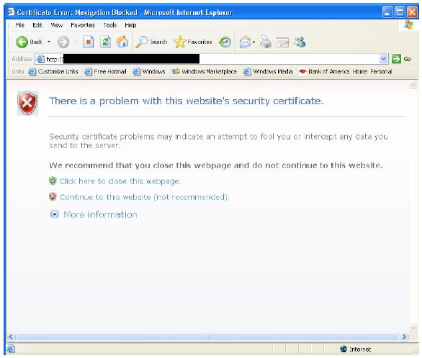
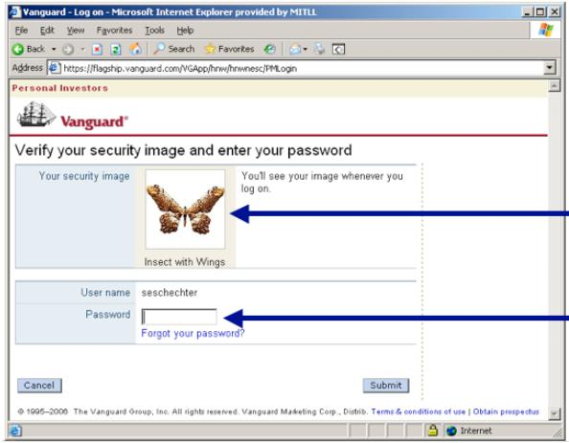
Back up slide
The experiment

