Slide 1
Evaluation Methods and Human Research Ethics Jim Warren COMPSCI 702 / SOFTENG 705

Slide 2
What is usability?
Usability is the measure of the quality of a user’s experience when interacting with a product or system (www.usability.gov 2006)
Usability is a quality attribute that assesses how easy user interfaces are to use (Nielsen 2003)

Slide 3
Usability Factors
Fit for use (or functionality) – Can the system support the tasks that the user wants to perform
Ease of learning - How fast can a user who has never seen the user interface before learn it sufficiently well to accomplish basic tasks?
Efficiency of use - Once an experienced user has learned to use the system, how fast can he or she accomplish tasks?
Memorability - If a user has used the system before, can he or she remember enough to use it effectively the next time or does the user have to start over again learning everything?
Error frequency and severity - How often do users make errors while using the system, how serious are these errors, and how do users recover from these errors?
Subjective satisfaction - How much does the user like using the system?

Slide 4
Setting usability goals
Not necessarily a 1-dimensional measure; may have multiple threshold requirements
Average = 2 /hour
Over 50% less than 1 /hour
Less than 5% over 5 /hour
Can have varying levels of success
E.g. minimum: not worse than the old way!
User errors per hour using the system
Unacceptable
Minimum
Target
Exceeds
5
4
3
2
1
0
Current value
Planned value
Optimal

Slide 5
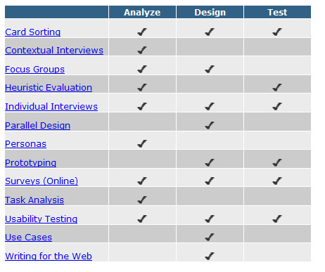
Types of Usability Evaluations
Heuristic evaluations
Performance measurements
Usability studies
http://www.usability.gov/methods/

Slide 6
Heuristic evaluations
Expert evaluation
An expert looks at a system using common sense and/ or guidelines (e.g. Nielsen’s Heuristics)
Expert - reviewer
First law of usability:
Heuristic evaluation has only 50% hit-rate
Predicted
problems
False problems
Actual
problems
Missed problems

Slide 7
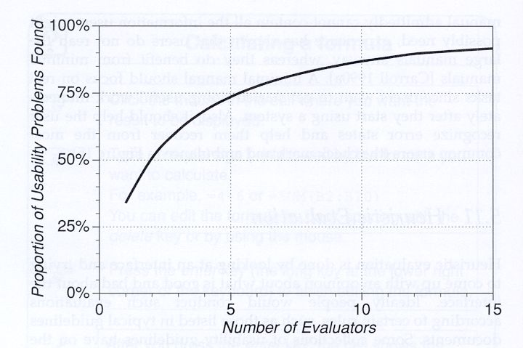
Evaluation – Heuristic Evaluation
Heuristic evaluations are performed by usability experts using a predetermined set of criteria designed to measure the usability of a proposed design.
The evaluator follows a scenario through the design and tests each step against the heuristic criteria.
The evaluator makes recommendations to the design team either through a written document or during a team meeting.

Slide 8
Nielsen’s Heuristics
Visibility of System Status
Match between System and the Real World
User Control and Freedom
Consistency and Standards
Error Prevention
Recognition Rather Than Recall
Flexibility and Efficiency of Use
Aesthetic and Minimalist Design
Help Users to Recognise, Diagnose, and Recover from Errors
Help and Documentation

Slide 9
Nielsen’s heuristic #2
Does the vocabulary match the user’s expectations and knowledge?
Are you calling the objects on the screen by terms that the user understands (and finds natural)?
E.g. ‘student #’ or ‘user id’ or ‘UPI’
Does the workflow match the task?
Will the user have all the required information at the time I am asking?
Are they copying from a paper source that lays out the material differently than my data input screen?
Am I making them stop in the middle of a task they’d rather not interrupt?

Slide 10
Nielsen heuristic #6
If I can put the item on a dropdown list, then I should
Why make them type it in and maybe choose an option that’s not available?
Show the user something
Maybe you’ll get lucky and it’ll be just what they want!
E.g. I hate a search that makes me specify whether I want those options available starting with ‘A’ or ‘B’ etc. (or even worse, just a blank)
You can give me shortcuts to those, but have an alphabetic list visible (maybe have most frequent, or last selected options at very top!)
Basically, use menus and lists instead of relying on blanks

Slide 11
Performance Measurements
I.e., an analytical performance measurement that can be extracted directly from the interface as compared to an empirical performance measurement observed in a usability study
Fitts’ Law is the classic performance measure for time to complete the task of pointing at an object
Hick–Hyman Law time taken to make a decision (e.g., that is the object I want!)
There are other more comprehensive models we won’t cover here
KLM – keystroke-level model
GOMS – goals, operators, methods and selection rules

Slide 12
Fitts’ Law
Fitts’ Law is the classic performance measure.
Time to target depends on target width (W) and distance to move pointer (D) (see tutorial exercise)
It is a very valuable measure for designing
Control size and location
Its also fun to play with!
2
1
3

Slide 13
Hick–Hyman Law
The time it takes for a person to make a decision as a result of the possible choices
Particularly important for menus
Although log2 only holds if menu is sorted in a logical order (e.g. alphabetical) – otherwise search time is linear!
Other factors
Recognition time: for icon or word
Consistency is good: spatial memory is very powerful –
Knowing it’s at the left/right side, top/bottom

Slide 14
Usability Testing
Testing it with representative users
users will try to complete typical tasks while observers watch, listen and take notes.
Goal is to identify any usability problems
collect quantitative data on participants' performance (e.g., time on task, error rates)
determine participant's satisfaction with the product.
http://www.90percentofeverything.com/2009/07/24/more-dilbert-on-user-experience/

Slide 15
Usability studies
Specific tasks
Observed
Recorded
Measured
Think-aloud
I try this
because ...
User doesn’t
notice ...
Facilitator
Listens
Asks as needed
Logkeeper
Listens
Records problems
User
Performs tasks
Thinks aloud

Slide 16
When to Test
You should test early and test often. Usability testing lets the design and development teams identify problems before they get coded (i.e., "set in concrete”). The earlier those problems are found and fixed, the less expensive the fixes are.
Test as much as possible with paper prototypes
Main flow (fit to user’s notion of natural workflow)
Interface metaphor (the ‘big picture’ of the look and feel)
Key screens where most of the work will get done

Slide 17
Role of the usability test
In design
Early, often, informal, preferably with paper prototype to get the right product concept
As the design progresses
Working prototypes, more formal
Feedback to design team and broader project management on areas and priorities for change
In product selection
Will this product work for your organisation (or your client)?
Where is it at variance from ideal? Can the vendor address these issues and/or the client cope with them??

Slide 18
How to test
Know what your goal is (actually this is true for all usability evaluation methods – heuristic, performance measure-based [e.g. Fitts’ Law] or participant based)
Focus on whatever you believe are the key aspects, e.g.
Navigation
Specific task
Perfecting a specific (novel or critical) control
Set the task accordingly
Recruit participants
Observe
Record (e.g. with specialised tool: Morae)
Co-located, or Remote

Slide 19
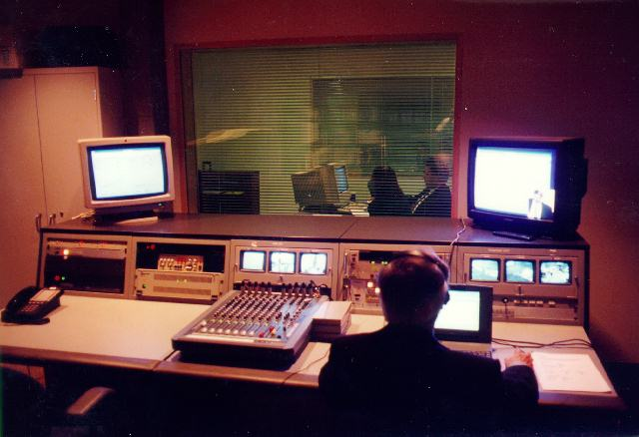
Old-fashioned deluxe usability lab
Still, can be handy to get thorough documenta-tion of a test!

Slide 20
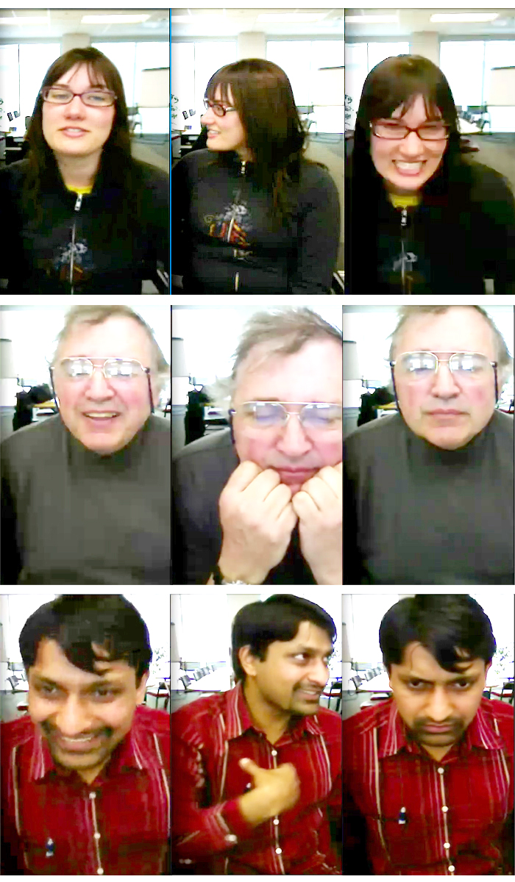
Remote usability testing
Nowadays you can do a usability test with all or part of the evaluation team in another country!
Log audio and video of user
And log synchronized video of action on screen

Slide 21
What You Learn
About completing routine tasks successfully
How long it takes to do that
Where people run into trouble
What sort of errors they make
How satisfied participants are with your interface
Helps to identify changes required to improve user performance
Alas, finding a problem doesn’t automatically hand you the answer, but at least gives you a focus for re-design / iterative refinement
Measures the performance to see if it meets your usability objectives

Slide 22
Making Use of What You Learn
Someone designed what you are testing
They may be defensive / offended that their design isn’t already perfect.
Usability testing is not just a milestone to be checked off on the project schedule. The team must consider the findings, set priorities, and change the prototype or site based on what happened in the usability test.
Find the Best Solution
Most projects, including designing or revising computer interaction, have to deal with constraints of time, budget, and resources. Balancing all those is one of the major challenges of most projects.

Slide 23
Usability testing results
Tabulate what you find (again, also true for other usability evaluation – e.g. scores on heuristics)
Individual and mean scores of performance measure, error/problem counts, and questionnaire responses
On a larger scale you may use statistics such as 95% confidence intervals and ANOVA versus ‘control’ (comparison) type of interface
Include video
Otherwise the designers might not believe your ‘spin’
Reach conclusions
Summarise the data into major (and minor) issues

Slide 24
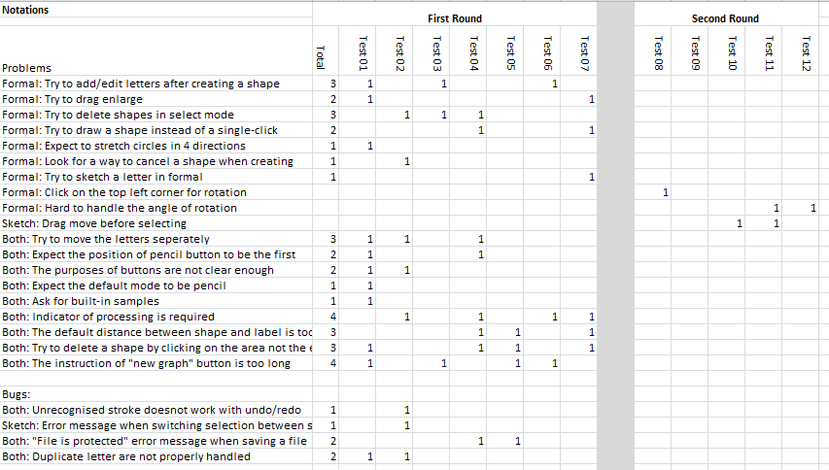
Iterative evaluation
Big problems mask little ones (sample from Beryl’s work)

Slide 25
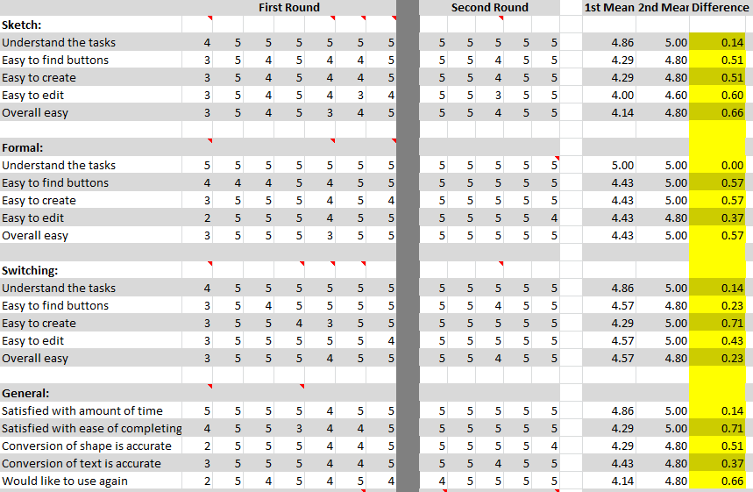
Improved User Satisfaction!

Slide 26
Example of a Morae screen (real GP, actor as patient, cardiovascular risk assessment task)

Slide 27
A recent informal expert review finding

Slide 28
Test Planning
A good plan is absolutely essential for a good test and defendable results
The higher the stakes, the better the plan needs to be
In early iteration for design it might be quite informal
Remember: test early and often
As we move from design to prototype to pre-market product the formality picks up
Can also do formal testing as part of product selection, too
It’s much more common to be selecting a product to get a job done than to be perfecting a product for market
Even a software shop might purchase a leave booking system

Slide 29
Selecting ‘users’
Who are the users for a usability test?
People you can get!
Have a recruitment plan
Dissemination, incentive
Runs into research ethics – do they know what they’re in for? Can they say no?
Are they representative of your intended user base?
YOU, for instance, are probably almost perfectly wrong for it (IDE interfaces aside) in terms of skills and intrinsic understanding of the product and its design (you know too much!)
Heuristic evaluation and performance measurement are (valuable!) ways to side-step the issue of user selection
Replace user with an expert, or a model

Slide 30
Task Selection
Utterly central to what you will learn in the usability test
There just isn’t time / resources to do usability testing on everything
Select the tasks that are ‘make-or-break’ for the application
You’re looking for the risk
What’s novel? What will differentiate this product?
If you’re in a ‘safe’ zone where you’re emulating well-established interaction patterns, then you’ll learn less
Then again, still can be important to check that you got it right!

Slide 31
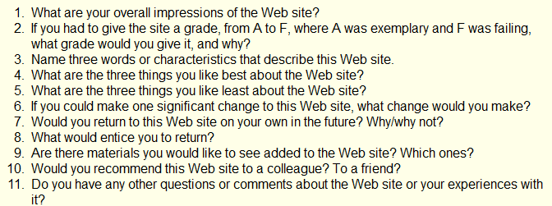
Questionnaire
The easiest way to gather satisfaction data is a questionnaire
There are several ‘standard’ questionnaires
http://www.usabilitynet.org/trump/documents/Suschapt.doc
http://www.w3.org/WAI/EO/Drafts/UCD/questions.html#posttest

Slide 32
Questionnaire – open and closed
Open questions (as per previous slide) give you rich qualitative data
Best for finding the seeds of resolutions to problems
Closed questions allow you to quantify
Would you recommend this website to a friend? [Circle one] YES NO
Yes/No is OK, but better to use Likert scale
This website is easy to use: Strongly Agree Agree Disagree Strongly Disagree
Converts to scores (1-4, 1-7, etc.), can report mean and other statistics and graphs
There’s a whole world to writing questionnaires; starter: http://www.terry.uga.edu/~rgrover/chapter_5.pdf

Slide 33
Write a Script
Back to the test plan…
Script the usability study EXACTLY
Greeting
Ethics
Task instructions
Questionnaire

Slide 34
Pilot Test
Try the whole thing out on one or two people (or more if it’s a really important and large usability study)
After first person fix obvious problems
If very few corrections needed in test plan then you can go straight to testing
But it is much better to do a second pilot than discover major problems half way through

Slide 35
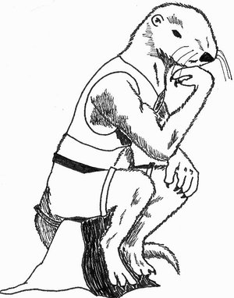
Once you’ve tested: Think!
The big picture
What have you found?
What is worth fixing?
Is there a business case?
How could the problems be alleviated?

Slide 36
Report
Document
Detailed report of everything you have found
Three formats here
http://www.usability.gov/templates/index.html
Remember numbers are very convincing, compare:
Several people had trouble finding the shopping basket
3 out of 7 people abandoned the task because they couldn’t find the shopping basket. For the other 4 the average time to find the shopping basket was 3.59seconds (longest 8.0 seconds)
Video
Imagine clipping together the 7 people looking for the shopping basket icon … with puzzled looks on their faces!

Slide 37
Ethics
If you are doing a study with living (human or animal) participants in a university you will probably need ethics approval
Can be quite a lot of paperwork, and takes a while to get an answer (which is usually to revise and re-submit!)
You will need such approval for a study to be part of your dissertation or thesis
Many journals require such approval to publish
Quite a few companies have similar requirements

Slide 38
Research ethics basics
Informed consent
Participant knows what they are ‘in for’
Task, time, why you’re doing it (even though you may be allowed to ‘deceive’ them about some aspect of the task)
Confidentiality of their data
Compensation (if any)
Participant is clear that they are not compelled to participate
This is a bit of a trick in lecturers experimenting on their students! (or doctors on patients, or bosses on their employees)
They need to know that they can refuse, or withdraw (even retrospectively!) without jeopardising the key service (healthcare, education, employment)
Anonymous questionnaires, esp. in public, are probably the easiest from an ethics perspective

Slide 39
Ethics application
Explains protocol and goals: essentially like a test plan
And so it’s helpful to complete one because it acts as a check on your plan
Particular focus on issues such as who has access to the data and the risk (and benefits, if any) to participants
Research organisations (University, District Health Board) have standing committees to review applications
Have representatives from a range of perspectives: clinical, legal, statistical (and Maori in NZ)

Slide 40
Where did this research ethics process come from?
Useful in understanding the specific requirements on informed consent and confidentiality of research data
Seem a bit overly burdensome for user experience evaluations
Example studies that initiated current review processes
Nazi war crimes, HeLa, Tuskegee
Today there’s new sensitivity with the linkage of data sets in the Web era
Probably more to fear from the commercial enterprises than researchers, but good that at least the research data uses are [relatively] clear and constrained

Slide 41
Nazi experiments on prisoners
At the Nuremberg “doctors’ trial”
Brought 23 German doctors to trial immediately after World War II
Prosecutors found 15 defendants guilty of war crimes and crimes against humanity; seven were hung
Experiments included exposure to high-altitude pressures and freezing, simulated battle wounds and attempts at bone, muscle and joint transplantation

Slide 42
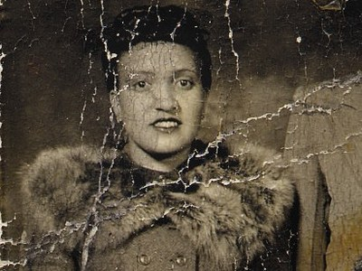
HeLa
Henrietta Lacks died of aggressive cervical cancer in 1951
Some of her cancer cells were taken without consent as part of routine treatment and used by a researcher interested in setting up immortal cell lines for research
With minimal interest in confidentiality he named the line ‘HeLa’
Her cells have since been used in at least 60,000 research papers and 11,000 patents
The HeLa cells may mass around 20 tons
Her family wasn’t aware of any of this until recent times and wasn’t in on any of the profits
http://www.wisegeek.com/what-is-the-controversy-surrounding-hela-cells.htm (book, The Immortal Life of Henrietta Lacks)

Slide 43
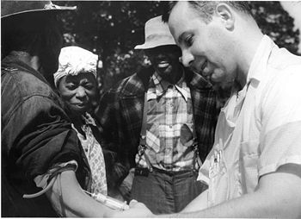
Tuskegee
The Tuskegee syphilis experiment
Conducted between 1932 and 1972 by the U.S. Public Health Service to study the natural progression of untreated syphilis
Enrolled a total of 600 impoverished sharecroppers from Alabama
399 who had previously contracted syphilis before the study began, and 201 without the disease
The men were given free medical care, meals, and free burial insurance
They were never told they had syphilis, nor were they ever treated for it
Were told they were being treated for "bad blood", a local term for various illnesses that include syphilis, anaemia, and fatigue

Slide 44
For us today
Relatively uniform principles of human research ethics
Hopefully your experiments will go a little easier on the subjects!
But appreciate that there will be continued vigilance especially for the protection of any groups seen as vulnerable
Including less educated individuals, minorities, children, prisoners, soldiers or people with disabilities
The culture of experimentation is vigorously alive!
Just accept that consultation with stakeholders, protocol review and consent are part of the process

Slide 45
Summary
Evaluate usability early and often in development and [preferably staged] roll-out
Also evaluate alternatives before making a decision to purchase/adopt a system
In more formal settings, you need a complete and detailed testing plan
Heuristic evaluation is a handy intermediate level between just asking a couple people for feedback and doing a full-blown usability study

