Slide 1
Computing Education
Andrew Luxton-Reilly

Slide 2
What is it all about?
Computer Science Education
  Learning concepts important to CS
  Improving programming ability
  Some overlap with HCI (IDEs, visualization)
Computers in Education
  Software related to learning
  Interface and user experience plays major role

Slide 3
Programming for children
What do children want to program?
  Games
  Drawing and creativity
  Games
  Internet applications
  Games
Expectations about how it works
  Give commands to objects (declarative)
  Commands continue over time (parallelism)

Slide 4
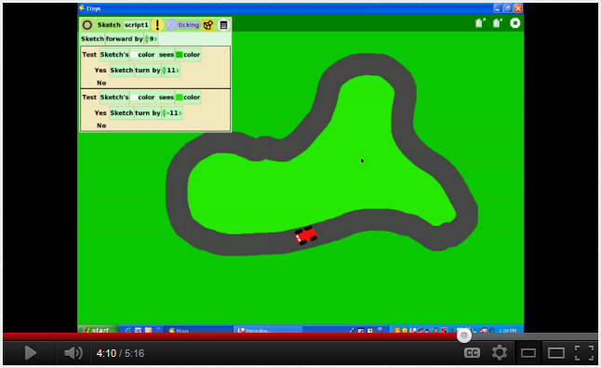
Programming for children
Squeak

Slide 5
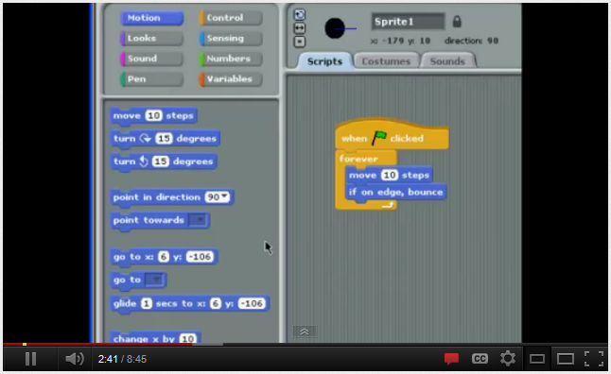
Programming for children
Scratch / BYOB / Snap!

Slide 6
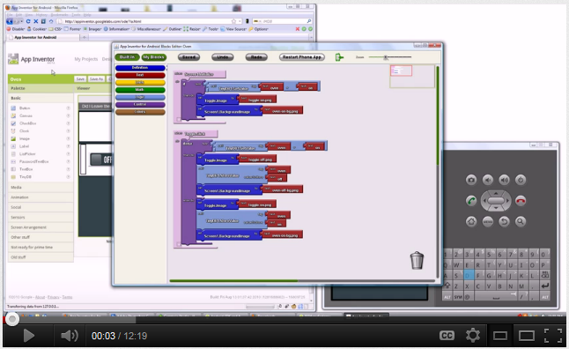
Programming for children
Google App Inventor
http://www.youtube.com/watch?v=Iq9KkAbhxQg&NR=1&feature=endscreen

Slide 7
Scaffolding for programming
Structured assistance for learning to program
  Visualizations
  Intelligent tutoring systems
  Tool support

Slide 8
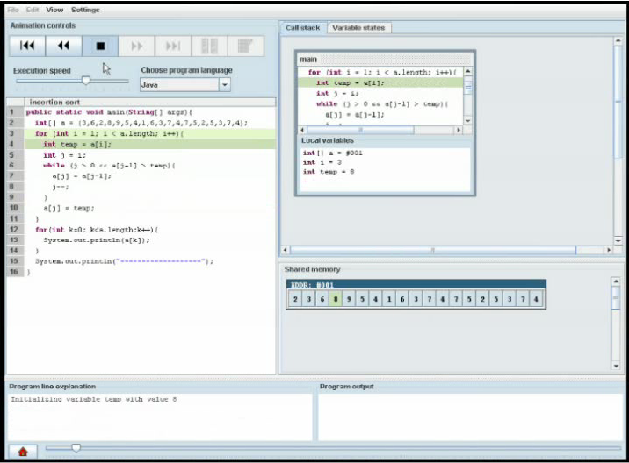
Novice programming environments
ViLLE
Erkki Kaila, Teemu Rajala, Mikko-Jussi Laakso, and Tapio Salakoski. 2010. Effects of course-long use of a program visualization tool. In Proceedings of the Twelfth Australasian Conference on Computing Education - Volume 103 (ACE '10), Tony Clear and John Hamer (Eds.), Vol. 103. Australian Computer Society, Inc., Darlinghurst, Australia, Australia, 97-106.

Slide 9
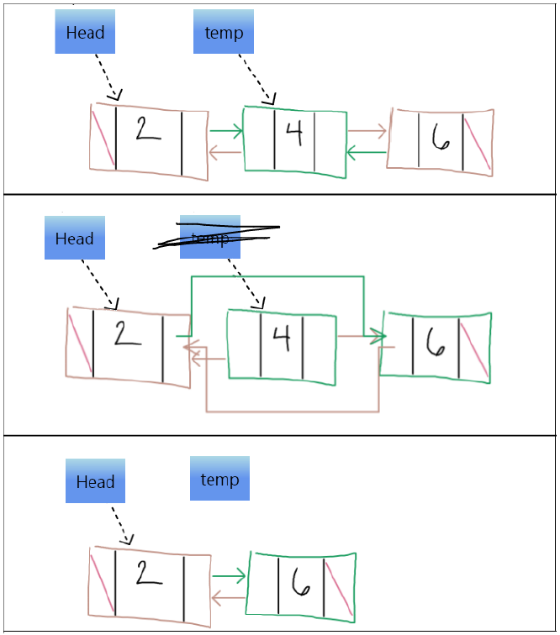
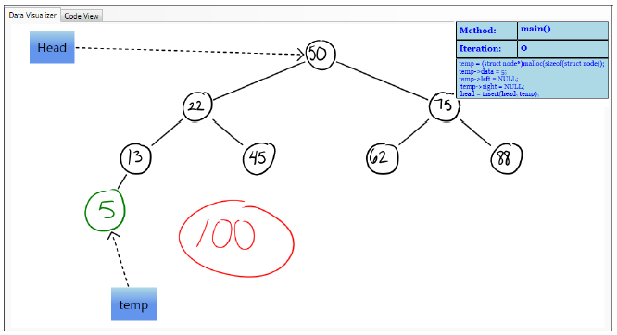
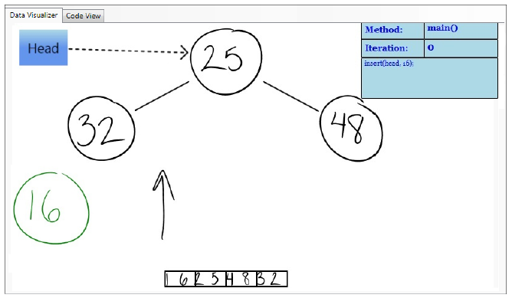
Novice programming environments
CSTutor
Sarah Buchanan, Brandon Ochs, and Joseph J. LaViola Jr.. 2012. CSTutor: a pen-based tutor for data structure visualization. In Proceedings of the 43rd ACM technical symposium on Computer Science Education (SIGCSE '12). ACM, New York, NY, USA, 565-570. DOI=10.1145/2157136.2157297 http://doi.acm.org/10.1145/2157136.2157297

Slide 10
Educational games
Assignments involving games
  Andrew Luxton-Reilly and Paul Denny. 2009. A simple framework for interactive games in CS1. In Proceedings of the 40th ACM technical symposium on Computer science education (SIGCSE '09). ACM, New York, NY, USA, 216-220. DOI=10.1145/1508865.1508947 http://doi.acm.org/10.1145/1508865.1508947
Developing games that are educational
Gamification of systems involving learning

Slide 11
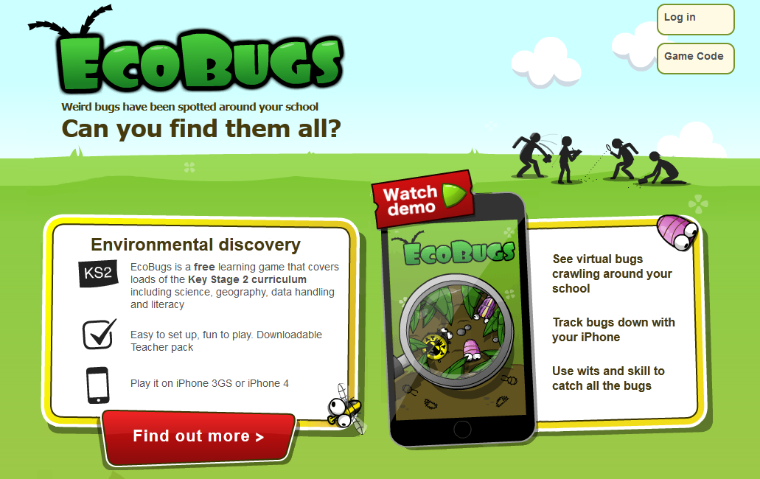
Educational Games
EcoBugs

Slide 12
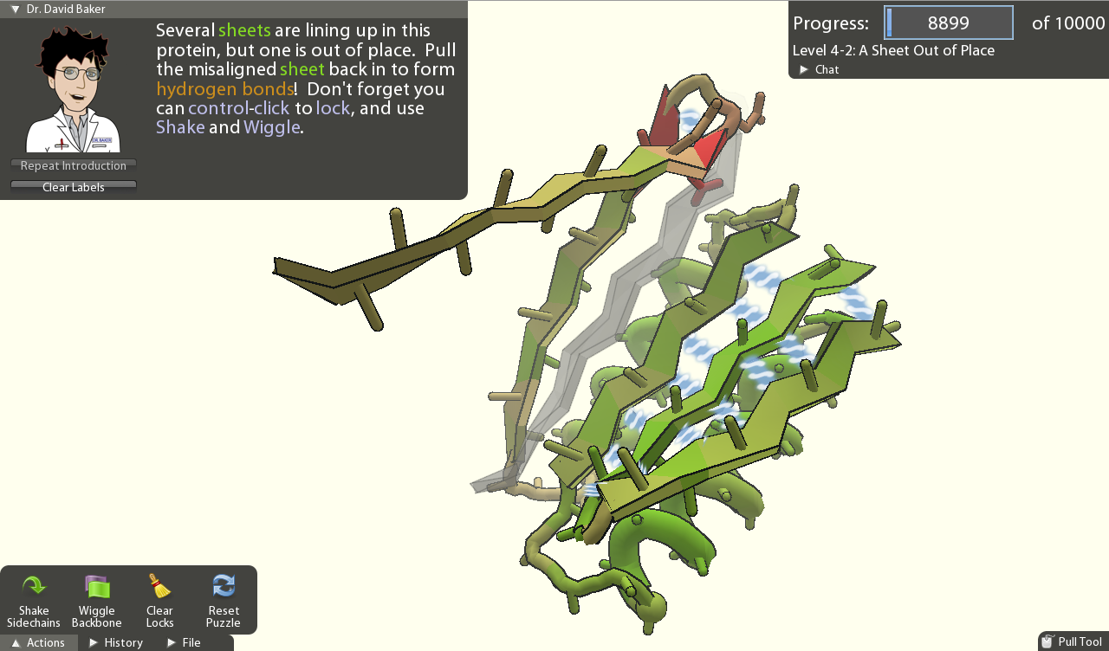
Serious games
FoldIt
The challenge of designing scientific discovery games. Seth Cooper, Adrien Treuille, Janos Barbero, Andrew Leaver-Fay, Kathleen Tuite, Firas Khatib, Alex Cho Snyder, Michael Beenen, David Salesin, David Baker, Zoran Popović and Foldit players. In Foundations of Digital Games, 2010.

Slide 13
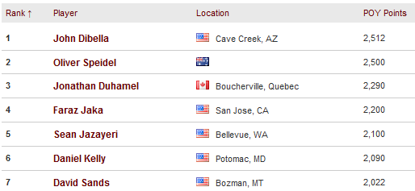
Gamification
Points, Badges, Leaderboards, Incentives
  Tracking, feedback, goal setting
  Competition, self-assessment
  Rewards, extrinsic motivation

Slide 14
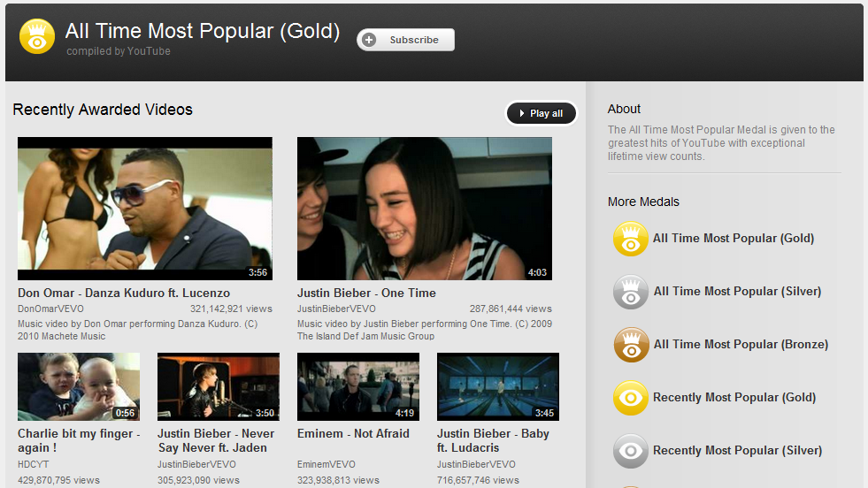
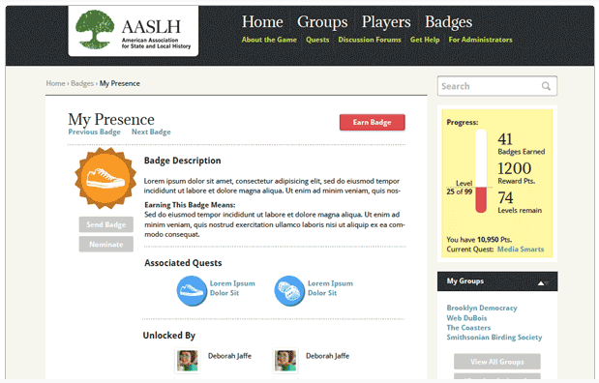
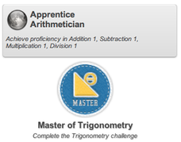
Badges, achievements
Five social psychological functions
  Goal setting
  Instruction
  Reputation
  Status/affirmation
  Group identification
Antin, J.; Churchill, E.F. Badges in Social Media: A Social Psychological Perspective. CHI 2011, ACM, Vancouver, BC (2011)

Slide 15
Mobile learning
Studies of the limitations/uses of such devices in educational settings
  CS Outreach / motivational
Educational apps designed for mobiles
  Games
  Visualizations
  Interactive
http://www.igi-global.com/journal/international-journal-mobile-blended-learning/1115

Slide 16
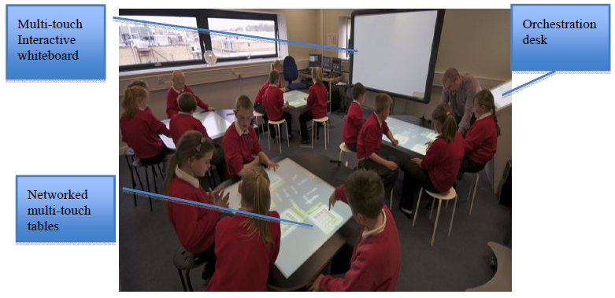
Multi-touch Surfaces
Amanda Harris, Jochen Rick, Victoria Bonnett, Nicola Yuill, Rowanne Fleck, Paul Marshall, and Yvonne Rogers. 2009. Around the table: are multiple-touch surfaces better than single-touch for children's collaborative interactions?. In Proceedings of the 9th international conference on Computer supported collaborative learning - Volume 1 (CSCL'09), Claire O'Malley, Daniel Suthers, Peter Reimann, and Angelique Dimitracopoulou (Eds.), Vol. 1. International Society of the Learning Sciences 335-344.
Andrew Hatch, Steve Higgins, Andrew Joyce-Gibbons, Emma Mercier (2011) NumberNet: Using Multi-Touch Technology to Support Within and Between-Group Mathematics Learning. In Proceedings of CSCL 11.

Slide 17
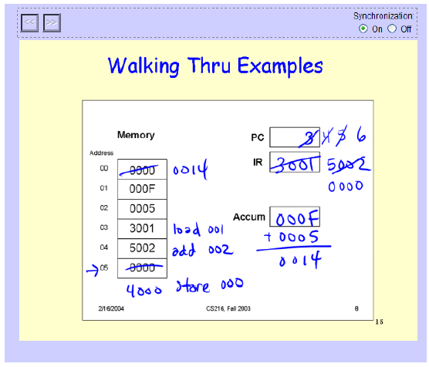
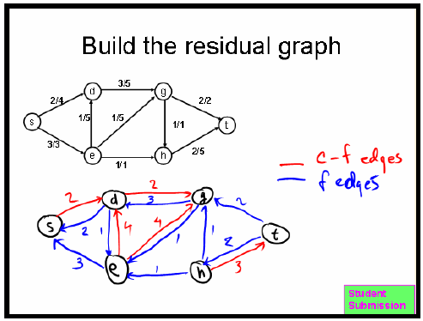
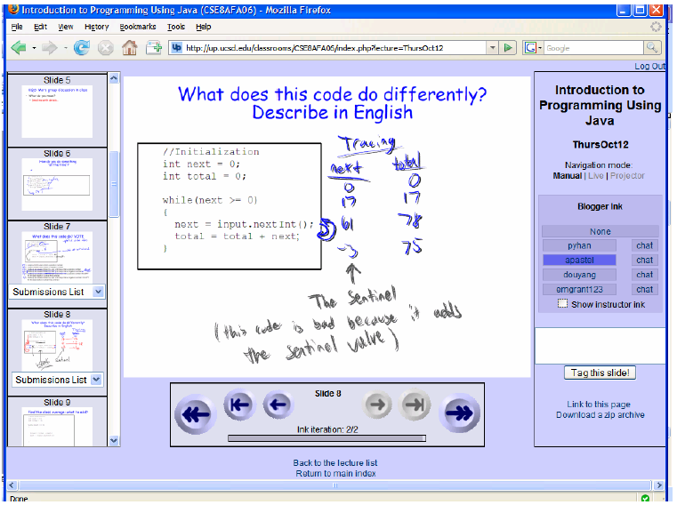
Collaborative learning
Classroom Presenter / Ubiquitous Presenter

Slide 18
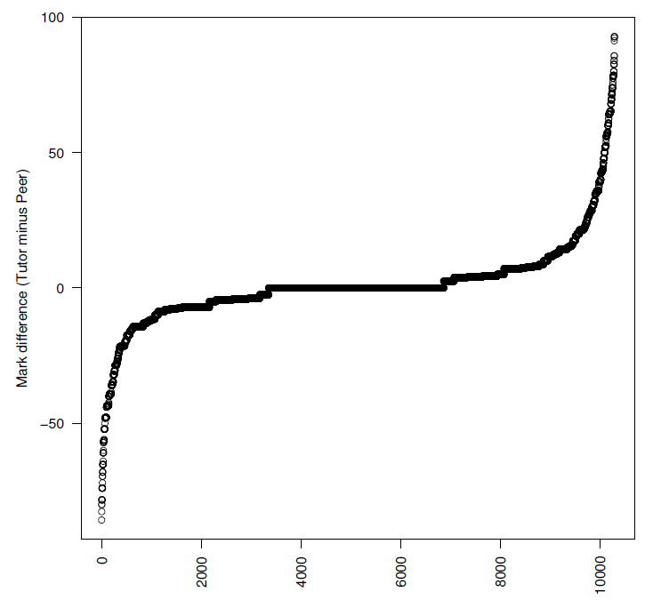
Peer Review
Aropa
  10,000+ reviews
  89% similar
  (difference < 20%)
John Hamer, Helen C. Purchase, Paul Denny, and Andrew Luxton-Reilly. 2009. Quality of peer assessment in CS1. In Proceedings of the fifth international workshop on Computing education research workshop (ICER '09). ACM, New York, NY, USA, 27-36. DOI=10.1145/1584322.1584327 http://doi.acm.org/10.1145/1584322.1584327

Slide 19
Question-generation
Asking students to write exam-style questions (and corresponding solutions) as a learning activity
Similar, although not identical technique to self-questioning behaviour used to improve reading comprehension
Online tools – PeerWise, StudySieve, CodeWrite

Slide 20

PeerWise

Slide 21
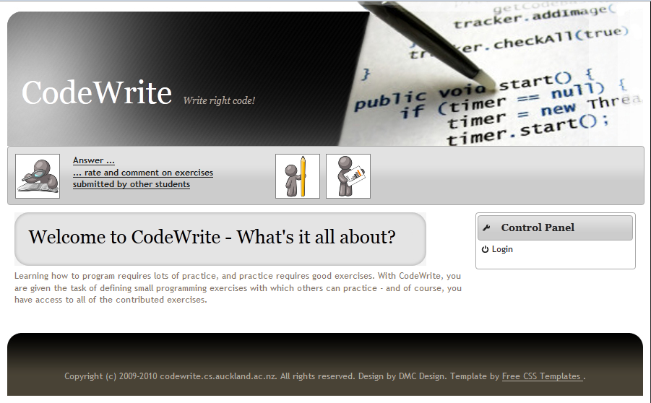
CodeWrite

Slide 22
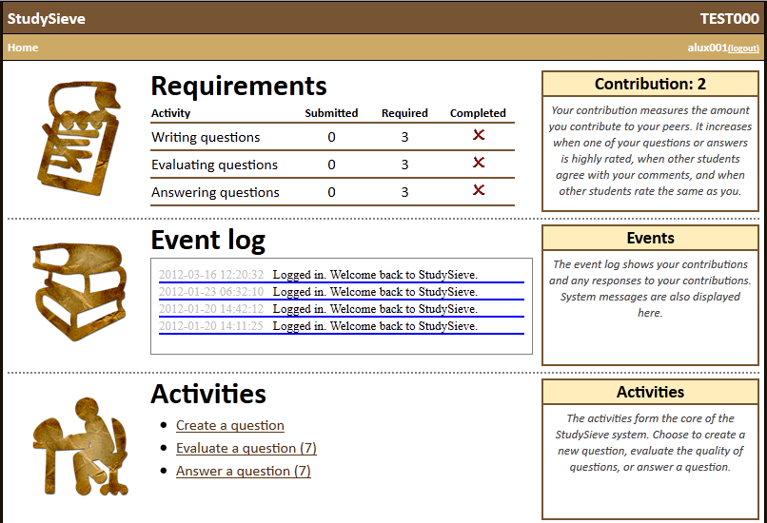
StudySieve

Slide 23
Evaluation of question-generation
Three aspects to evaluate:
  How do students respond to, and use, StudySieve?
  What is the nature of the questions developed?
  What is the relationship between activity and learning?
Andrew Luxton-Reilly, Paul Denny, Beryl Plimmer, and Daniel Bertinshaw. 2011. Supporting student-generated free-response questions. In Proceedings of the 16th annual joint conference on Innovation and technology in computer science education (ITiCSE '11). ACM, New York, NY, USA, 153-157. DOI=10.1145/1999747.1999792 http://doi.acm.org/10.1145/1999747.1999792
Andrew Luxton-Reilly, Daniel Bertinshaw, Paul Denny, Beryl Plimmer, and Robert Sheehan. 2012. The impact of question generation activities on performance. In Proceedings of the 43rd ACM technical symposium on Computer Science Education (SIGCSE '12). ACM, New York, NY, USA, 391-396. DOI=10.1145/2157136.2157250 http://doi.acm.org/10.1145/2157136.2157250
Andrew Luxton-Reilly, Paul Denny, Beryl Plimmer, and Robert Sheehan. 2012. Activities, affordances and attitude — how
student-generated questions assist learning. In Proceedings of the 17th annual joint conference on Innovation and technology in computer science education (ITiCSE '12). ACM, New York, NY, USA – Accepted for publication

Slide 24
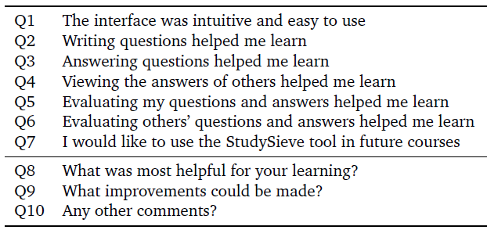
How do students respond?
Use a questionnaire
  Likert-scale (quantitative)
  Open-ended (qualitative)

Slide 25
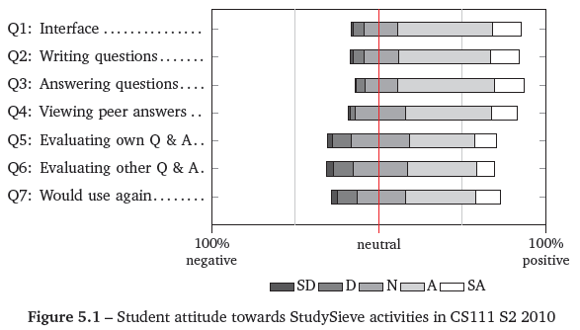
Student responses - Quantitative
Positive for all questions, all courses, all semesters

Slide 26
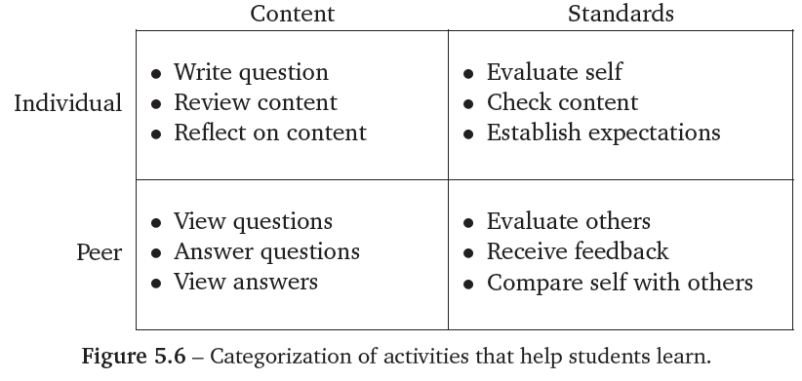
Student responses - Qualitative
Analysis based (loosely) on grounded theory

Slide 27
Example quotes
“Writing and answering questions helped test my knowledge and think about what kind of questions might be asked in a test/exam”
“The fact that we had to create our own questions and provide the answers. Need to do some revision first in order to complete them”
“Having to think more deeply about the info in order to create questions (interact with the study material)”
“Seeing other students answers helped me construct my own image of what is expected by comparing myself”

Slide 28
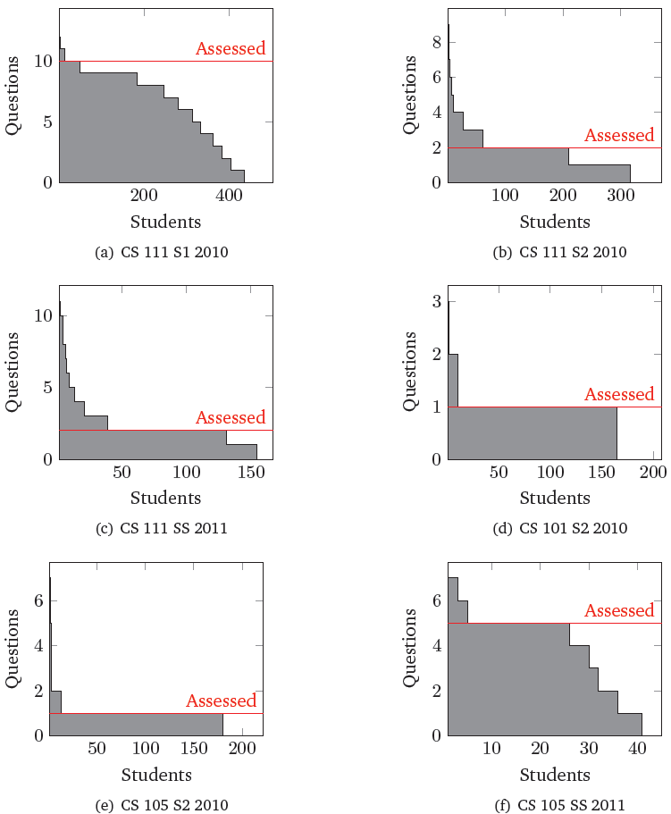
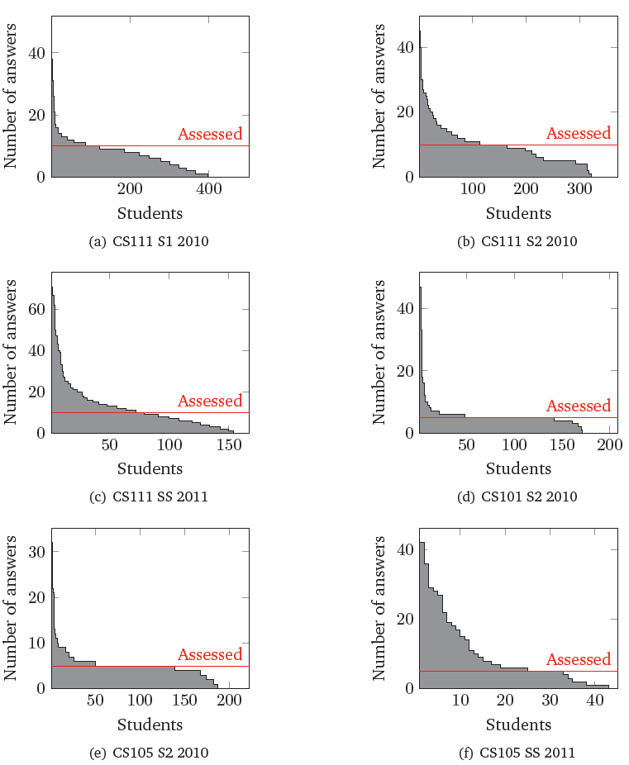
How do students use the tool?

Slide 29
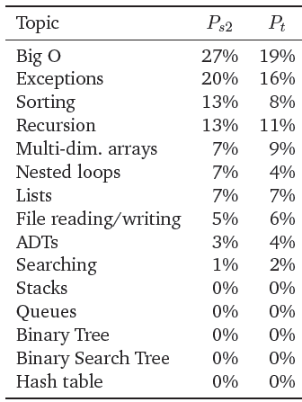
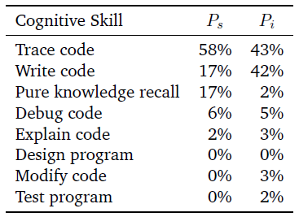
What is the nature of the questions?
Evaluate by topic and cognitive level
  Look at each question
  Categorize using a taxonomy

Slide 30
Activity – performance relationship
Hypothesis: If students write a lot of questions, answer a lot of questions and write a lot of feedback then they will learn more than students who don’t.
Test hypothesis: Measure relationship between activity and performance on final exam.

Slide 31
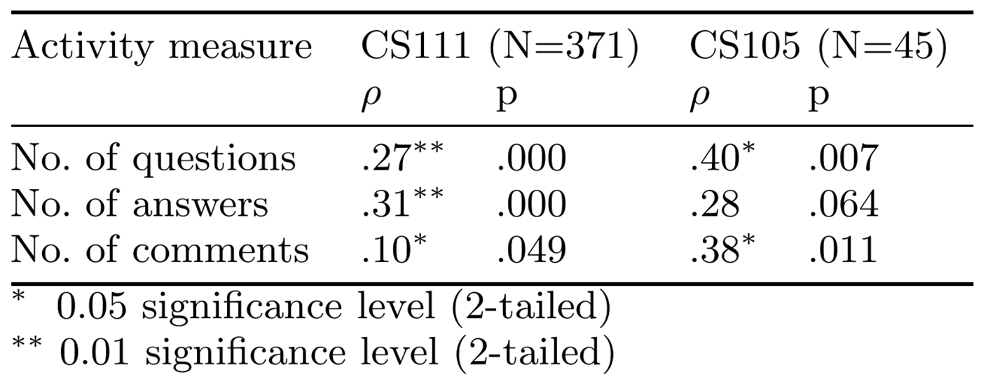
Activity improves performance
Consistent with studies of similar tools – QPPA, Concerto, QSIA, ExamNet, PeerWise

Slide 32
… or does it?
What about prior ability?
Is there any relationship between activity and exam performance when we control for prior ability?
No measure of prior ability for CS111, but incoming GPA can be used for most CS105 students.

Slide 33
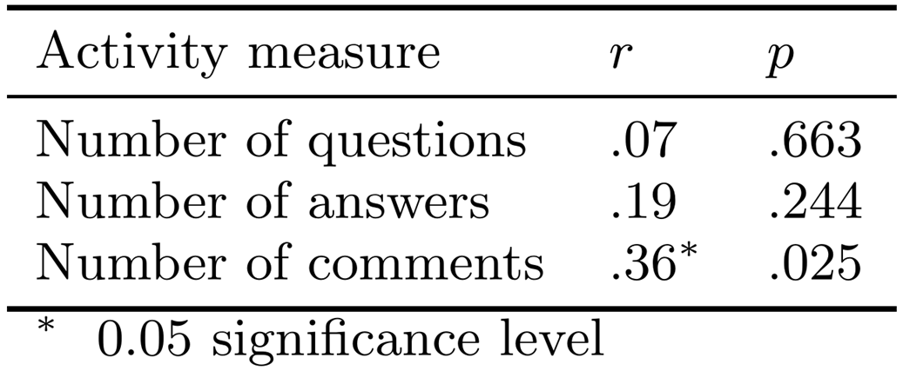
Yes, it still improves performance!
Perform a partial correlation between activity and performance, controlling for GPA
Consistent with findings from studies of QSIA, ExamNet and PeerWise.

Slide 34
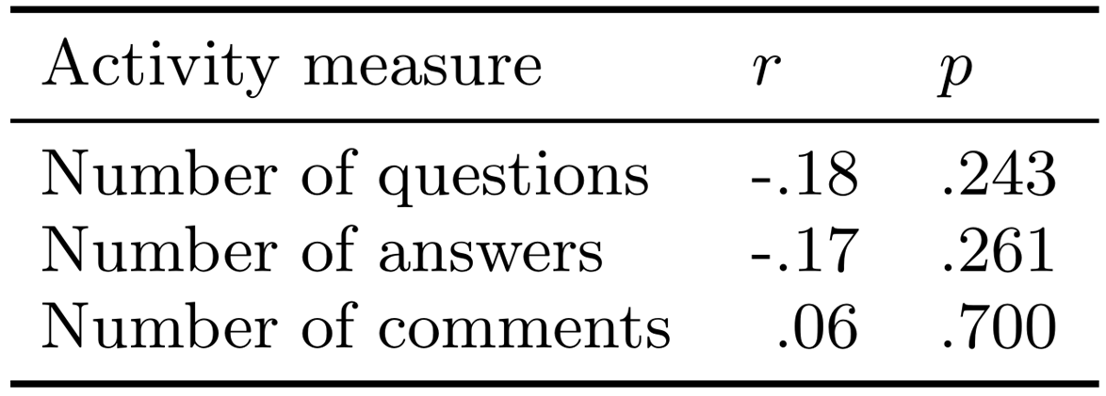
… or does it? Really?
GPA doesn’t account for engagement within a specific course
Use a measure of ability within a course
Perform a partial correlation between activity and performance, controlling for Assignments

Slide 35
Educational Psychology
Question-generation literature
  Some studies show improvements following question-generation, but some don’t
Focus on related topics only
  Students who generate questions perform better on related exam questions

Slide 36
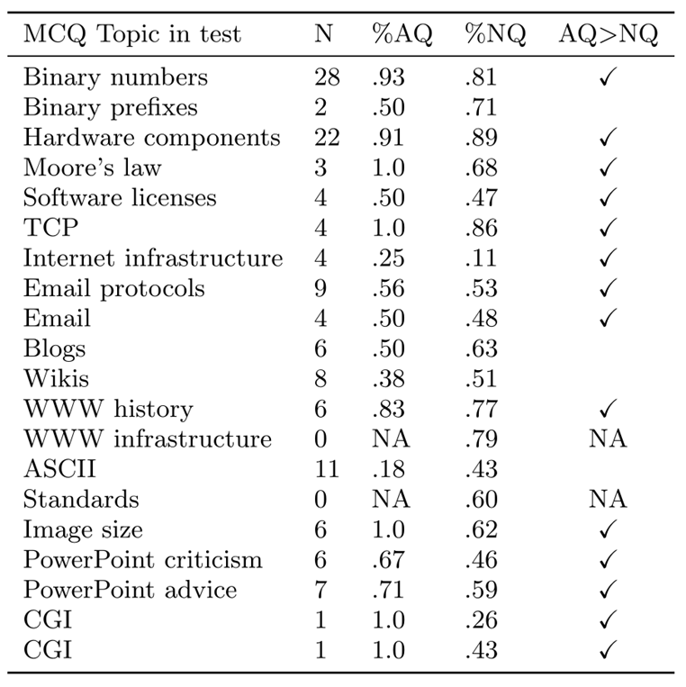
CS111
In 14 of 18 questions, authors beat non-authors

Slide 37
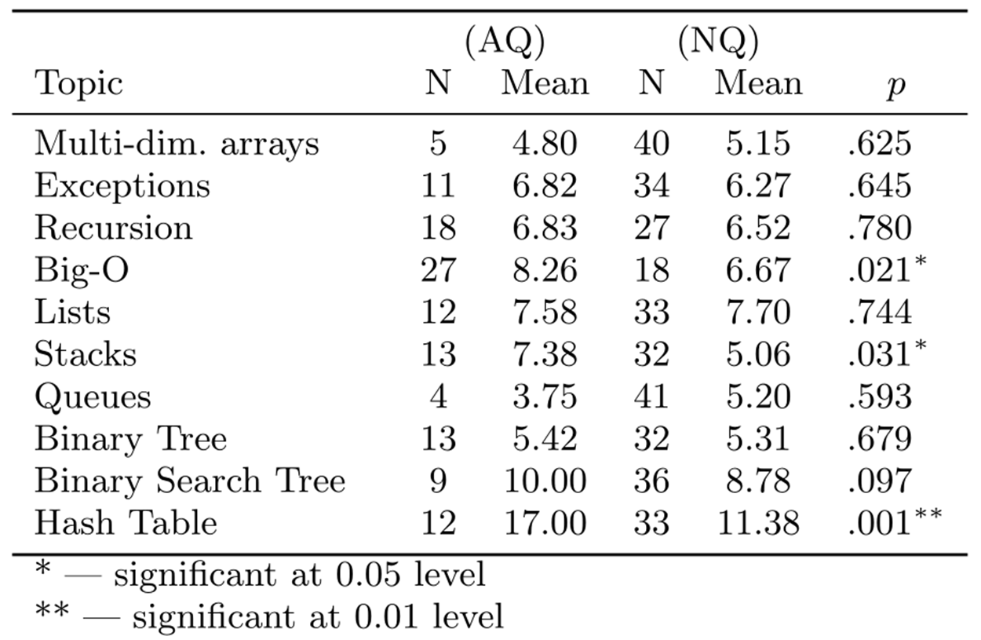
CS105

Slide 38
… but are you sure it helps?
Maybe students just write questions about topics they know?
CS105 had weekly assignments, followed by StudySieve activity, so compare AQ with NQ assignment marks before they author questions.
Mann-Whitney U test shows no difference between groups on Assignment questions involving Big-O or Stacks.

Slide 39
Conclusions
Asking students to write exam-style questions with corresponding sample solutions does help them learn more than not writing them
  ... but only the topic of the question
  ... and only sometimes

Slide 40
Studying Computing Education
COMPSCI 707 - Special Topic in Computing Education
  Second Semester 2012
  Computer Science Education
  Computers in Education
Lecturers
  Andrew Luxton-Reilly
  Robert Sheehan
  Paul Denny (?)

