Slide 1
The Effects of Requirements and Developer Practices on App Security
Written by Weir, Hermann & Fahl (2020)
Presentation by Callum Bradding

Slide 2
Motivation
Software security and privacy have become major problems for us as a society
Software developers play a key part in creating services and applications that can protect the user
There are a lot of inexpensive security assurance techniques available for software developers
Therefore, it is proposed that maybe developers do not use these techniques enough within their project

Slide 3
Problem
To investigate how big a problem this may be in practice. Weir, Hermann & Fahl developed four research questions.
1. To what extent, and how, does a perceived need for security and privacy lead to security-enhancing activities and interactions in the development team?
2. To what extent do the need for security, the involvement of specialist roles, and the use of assurance techniques in a development team lead to fewer security defects?
3. What proportion of Android developers have access to security experts?
4. To what extent do Android developers actually use assurance techniques?

Slide 4
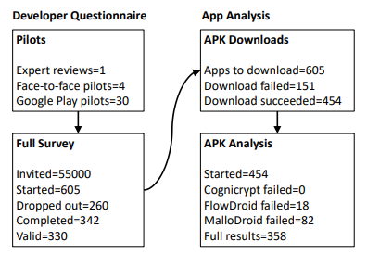
Phase 1: Questionnaire
To answer this, they conducted an online survey with Google Play Android developers
Only developers that had the 100+ downloads & updates requirement in Google Play were surveyed
They asked about personal questions such as team & developer environments & practices, the number of apps they worked on and demographic information
They were also asked what secure development practices they used & whether they had access to security professionals

Slide 5
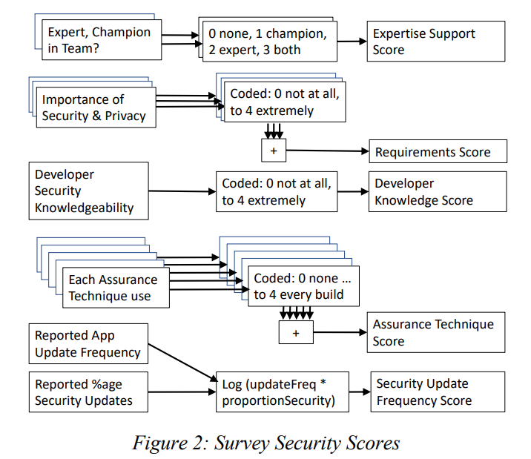
Phase 1 Cont.
To produce a measurable result for RQ1, a survey score was created based on the questionnaire
The higher the score, the better the security of the application
The Expertise Support Score, Requirements Score, Developer Knowledge, and Assurance Technique Score are all encoded as integers
Security Update Frequency is the product of two questions to give one result

Slide 6
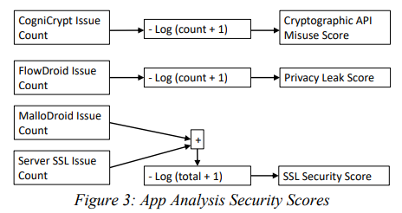
Phase 2: Application Analysis
For the second phase of the project, they downloaded and analysed apps corresponding to survey responses
They used a selection of vulnerability scanners to analyse these apps
They covered three key areas: SSL Security, Cryptographic API Misuse, and Privacy Leaks
To investigate & measure RQ2, they defined scores to represent the outcome “fewer security defects”

Slide 7
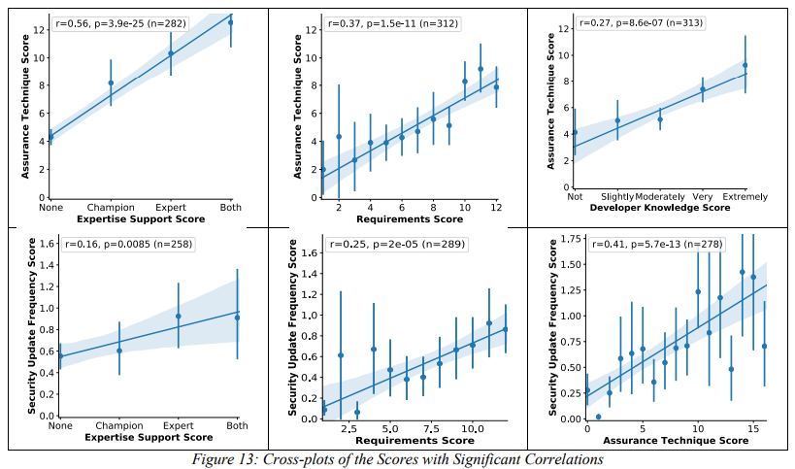
Results
RQ1: To what extent, and how, does a perceived need for security and privacy lead to security-enhancing activities and interactions in the development team?
These graphs show that the use of assurance techniques & security updates increase based on the importance of security for the application
This is because using assurance techniques costs time & financially
Updating apps also costs and contains more security updates for apps where security is more important
Notes:
It shows us “security-enchanging activities and interactions in the development team” plotted against four independent “need and mechanisms for security and privacy scores”
Security Update Frequency & Developer Knowledge is not plotted because it is deemed insignificant

Slide 8
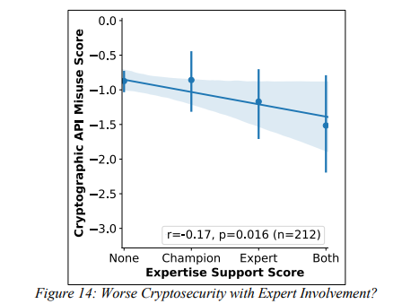
Results
RQ2: To what extent do the need for security, the involvement of specialist roles, and the use of assurance techniques in a development team lead to fewer security defects?
Most of the results show that the use of assurance techniques was not associated with better security
However, this result suggests that the involvements of security experts is associated with worse Cryptographic API misuse outcomes, albeit not by much
This is probably because security experts use cryptography in applications more frequently

Slide 9
Results
RQ3: What proportion of Android developers have access to security experts?
Between 14% and 22% of developers work with security experts
In order to protect applications from more vulnerabilities, more security experts should be hired to work with developers

Slide 10
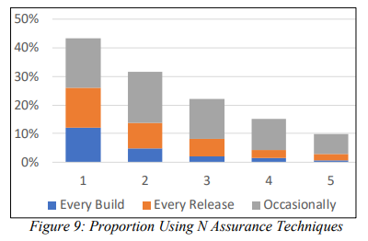
Results
RQ4: To what extent do Android developers have actually use assurance techniques?
Using the 95% confidence intervals from Figure 9 we can derive the upper & lower bounds
Only between 22% and 30% regularly use assurance techniques
The most common techniques among those who used at least two regularly were Automatic Static Analysis & Config Review.
Followed by Automatic Static Analysis & Code Review

Slide 11
Something to Consider
They chose a random sample of 55,000 developers from 312,369 developer accounts
A link was sent to their email address containing the survey
Therefore obviously being developers and security conscious about unsolicited emails, they state that they received 330 valid surveys
Maybe developers who are more security conscious, tend not to respond to reply to unsolicited emails?
They were only able to analyse applications that were free on the Google Play store
This may introduce a bias, as apps that cost more money might have more backing & therefore more security experts behind it

Slide 12
Thanks For Listening!
Please feel free to ask questions

