Slide 1
"What Apps Did You Use?": Understanding the Long-term Evolution of Mobile App Usage
Presented by: Qiaochu Song

Slide 2
Introduction
Q: How mobile apps usage evolves over the long-term period?
Study on both level:
Macro-level : app category
Micro-level : individual apps
Data collection:
1,465 long-term users
12,457,867 records starting from January 2012 to December 2017

Slide 3
The long-term usage evolution of app-categories and apps shows different processes.

Slide 4
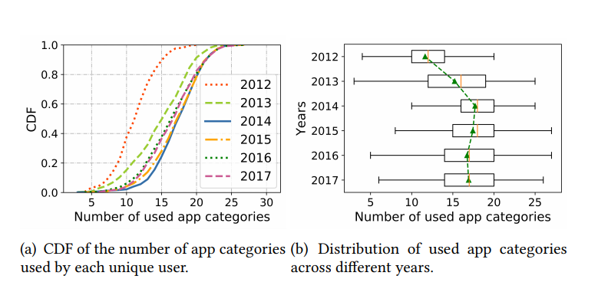
Number of App Categories
Stage one (2012-2014): the number of app categories increased significantly

Slide 5
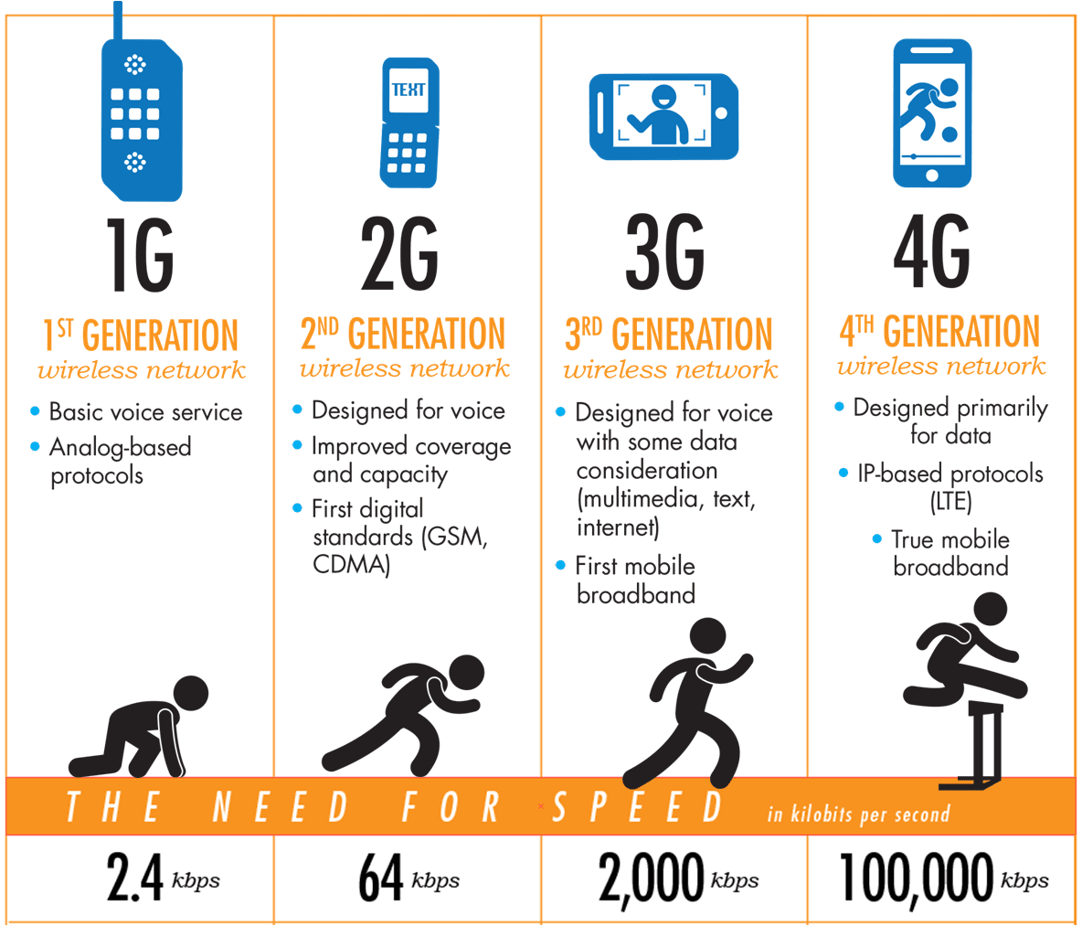
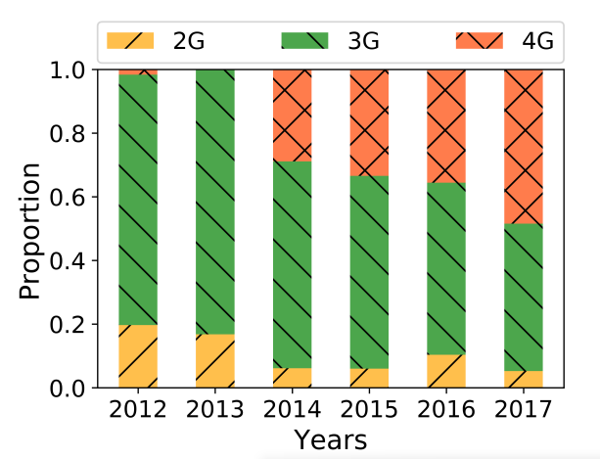
Number of App Categories
Stage one (2012-2014): the number of app categories increased significantly
Reason:
The development of the mobile network.
By 2014, around 30% of users were using the 4G network and the proportion keep growing steadily.
The mobile network not limit the usage of latency-sensitive and data consuming applications anymore.

Slide 6
Number of App Categories
Stage two (2014-2017): the number of app categories remained stable over time

Slide 7
Number of Used Apps
Stage one (2012-2014): users increased the number of apps used on their smartphone, consistent with the macro-level
Stage two (2014-2017): the number of apps used by each user decreased year by year, which significantly different to macro-level.

Slide 8
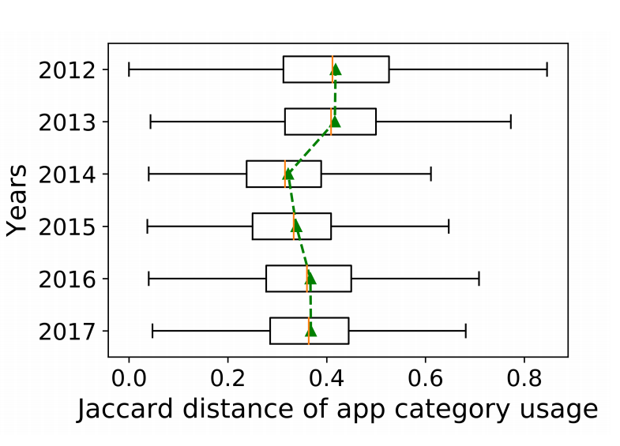
Diversity of App-category Usage
The average value shows a downtrend, suggests that the diversity for app-category usage declined, and users' requirements for smartphone functions tend to be consistent.
Reason:
the development of technologies cause more app categorise to become popular, users use similar app categorise.
The ecosystem pushes mobile users to use similar app categories.

Slide 9
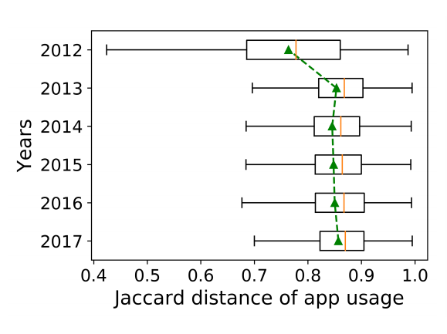
Diversity of App Usage
The average distance increased. The trend is opposite to the app category at the macro-level.
At the micro-level, mobile users have different preferences and use more various apps.

Slide 10
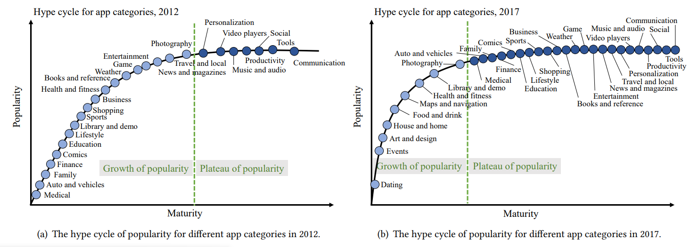
Popularity of App Categories
Growth of popularity: the popularity of the app category increases.
Plateau of popularity: the popularity of the app category tends to be stable.

Slide 11
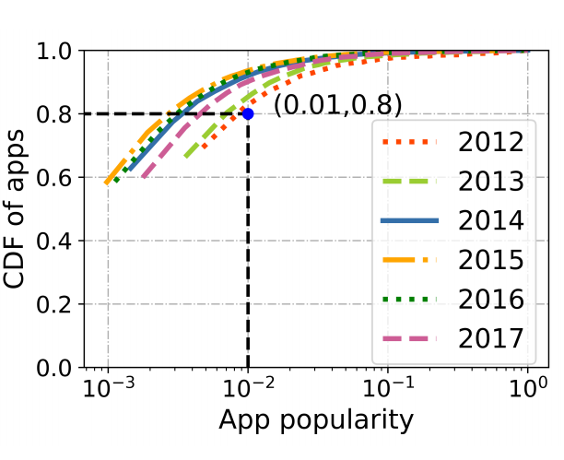
Popularity of App Usage
From 2012-2017, shows a typical pareto effect for app usage.
(Over 80% of apps have less than 0.01 popularity in 2012, while this number increased to 90% by 2017.)
The app market is still governed by a small number of dominating apps.

Slide 12
Correlations of App Categories
Increases from the year 2012 to 2014.
Tended to be stable from 2014 to 2017.
Suggested a robust app ecosystem had formed.

Slide 13
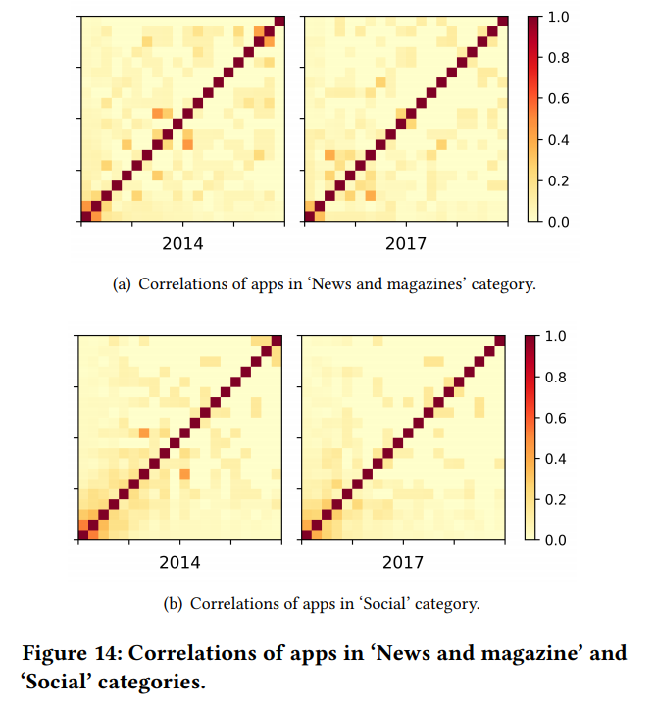
Correlations of App Usage
Compared with app categories, the correlations of apps in the same category is much lower, and most are below0.2.
Reason:
The intra-category competition leads to the occurrence of an elimination stage and a decrease in the correlations of apps.

Slide 14
Provide Insight
Release of new technologies trigger increase of between app categories and apps.
Stakeholders can hold opportunity to extend market shares.
Opposing trends in usage diversity between app categories and apps
App market intermediaries should focus on the consistent requirements across mobile users instead of customized services.
The fierce intra-category competition between apps causes an elimination stage of app usage
Developers should focus on small groups of users and meeting their personalized needs.
App developers must improve the competitiveness of their apps, especially during the elimination stage
Discover

Slide 15
Thank you!

