Slide 1
“What Apps Did You Use?”
Understanding the Long-term Evolution of Mobile App Usage
Author: Tong Li, Mingyang Zhang, Hancheng Cao, Yong Li, Sasu Tarkoma, Pan Hui
Presented by: Yifeng Ma (Eden)

Slide 2
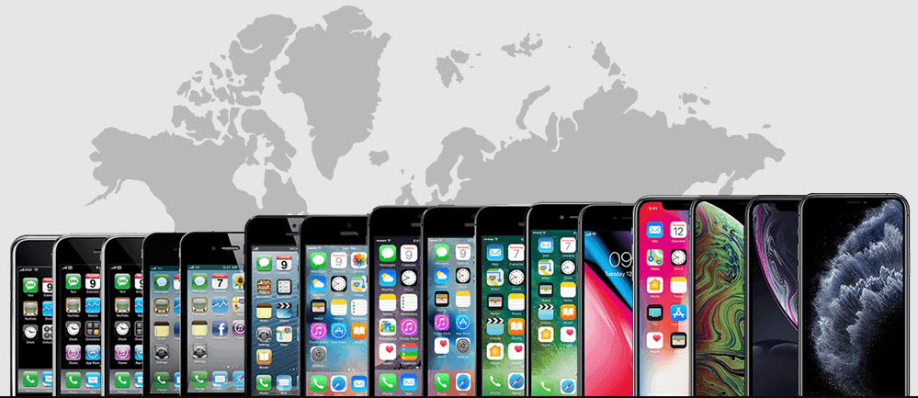
Motivation
Existing research mainly focuses on short-term application analysis.
It is difficult for application developers to find market rules in a short-term of research to make their applications develop better
Notes:
Existing research mainly focuses on short-term application analysis.
Over time, the software and hardware of smartphones are developing rapidly.
Almost all brands release at least one smartphones every year, and new technologies are produced every year.
short-term research is no longer suitable for appliation analysis today.
It is difficult for application developers to find market rules in a short term of research to make their applications develop better.

Slide 3
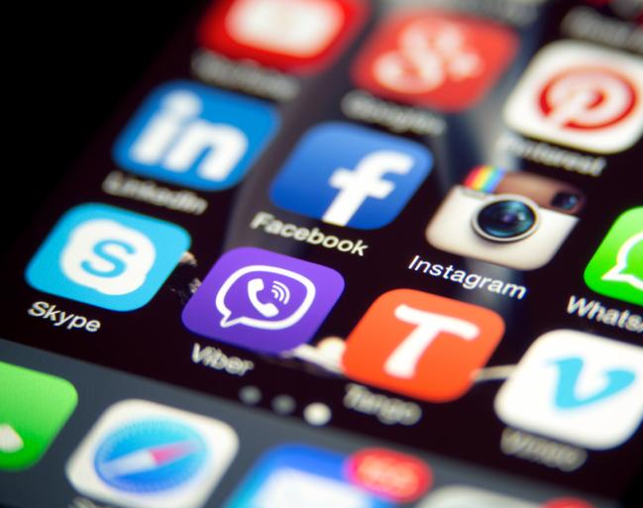
Question
What is the law of the long-term evolution of smartphone applications?

Slide 4
Number of the application category
The first stage: the growth stage (2012-2014)
The category of applications used by users have risen sharply between 2012 and 2014
Notes:
There are two stages in the development of application category, growth stage and plateau stage,
For growth period,
From 2012 to 2014, the number of application categories used by users increased significantly.
Average number of application categories used increased 41%
App categories used by 80% of users increased 42%

Slide 5
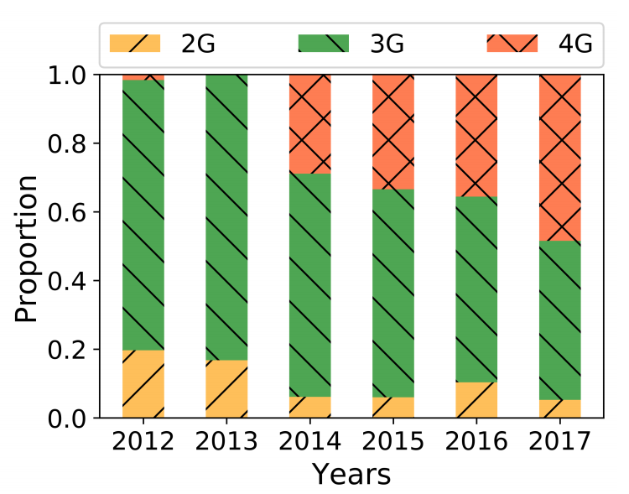
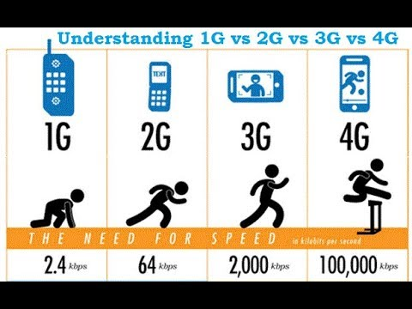
Number of the application category
Possible reason:
Internet speeds become faster, and some delay-sensitive applications are no longer restricted.
Notes:
The one of the possible reason for this increase is that many countries such as the United States and the United Kingdomhave begun to deploy and use 4G networks at 2014.
Compared with 3G, 4G network is almost 50 times faster than of 3G.
Due to Internet speeds become faster, and some delay-sensitive applications are no longer restricted.
such as online games, online videos and maps have begun to develop rapidly.

Slide 6
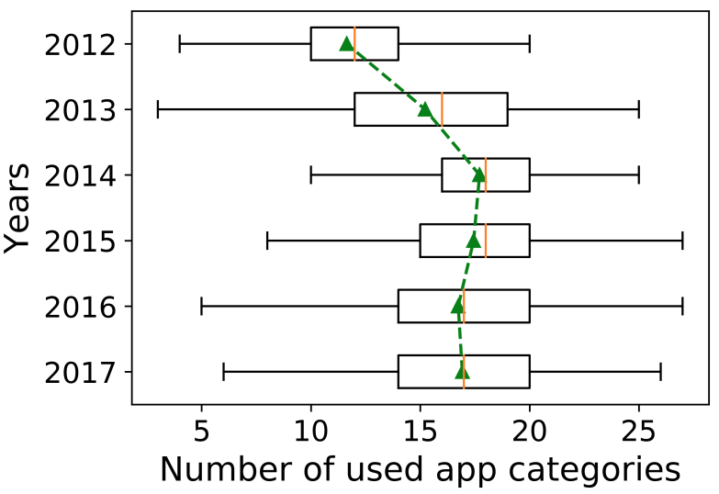
Number of the application category
The second stage: the plateau stage (2014-2017)
From 2014 to 2017,
the application categories used by users remained stable.
Notes:
Between 2014 and 2017, the number of types of applications used by users did not change much.
The possible reason is that during this period, the smartphone did not have any major improvement.
At the same time, it also means the popularity of the application category shows almost no signs of decline.
This may be due to user habits, the generation of communities and ecosystems.
When there are not too many new categories of applications, most people will keep using the original applications according to their habits.

Slide 7
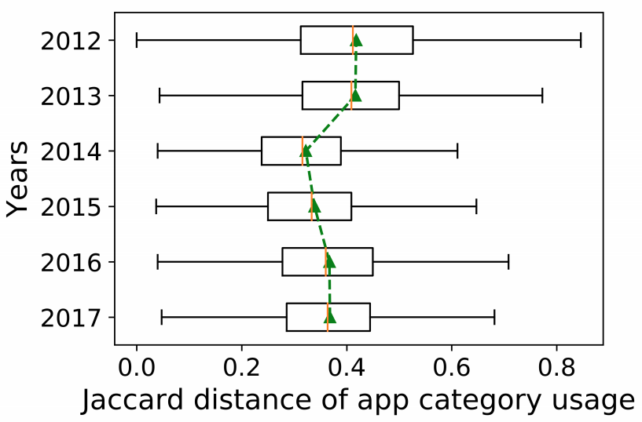
Application category usage difference
Possible reason:
Some categories of applications have become popular such as online games.
The formation of an application ecosystem.
Jaccard: The difference in the use of the two user application categories. The smaller the Jaccard, the smaller the difference in usage
Notes:
due to development of mobile network and smartphone hardware has led to the development of online games.
When online games appear on smartphones, the feature that mobile games can be played with friends anytime, anywhere attracts a large number of people to try.
After the application ecosystem is build, users tend to use similar applications.
For example, one day A sent a video to B, saying that the video is very interesting, and you can watch it.
When B opens the video, the interface shows that if you want to watch the video, you must first download the app.
This is very common in our daily lives. Most people also download apps in order to watch that video. This has led we usually use same applications.

Slide 8


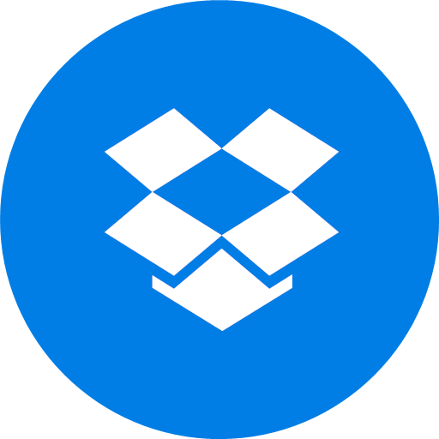
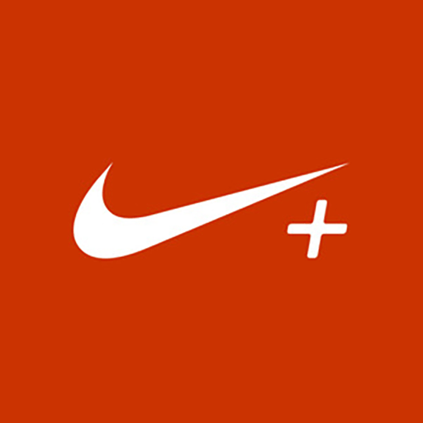
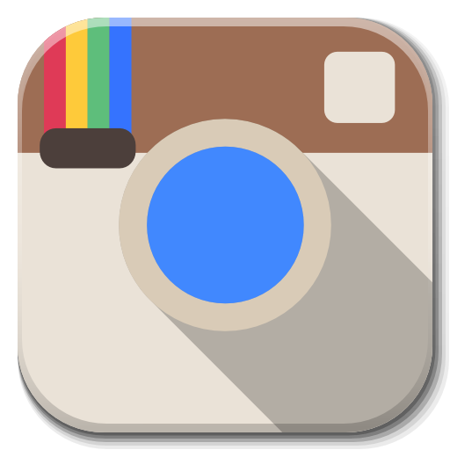



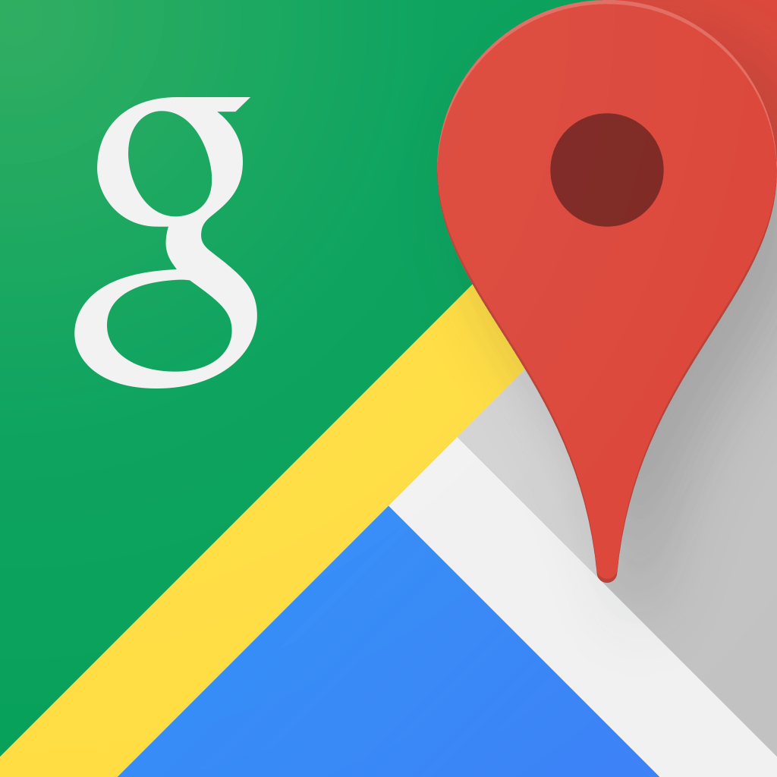
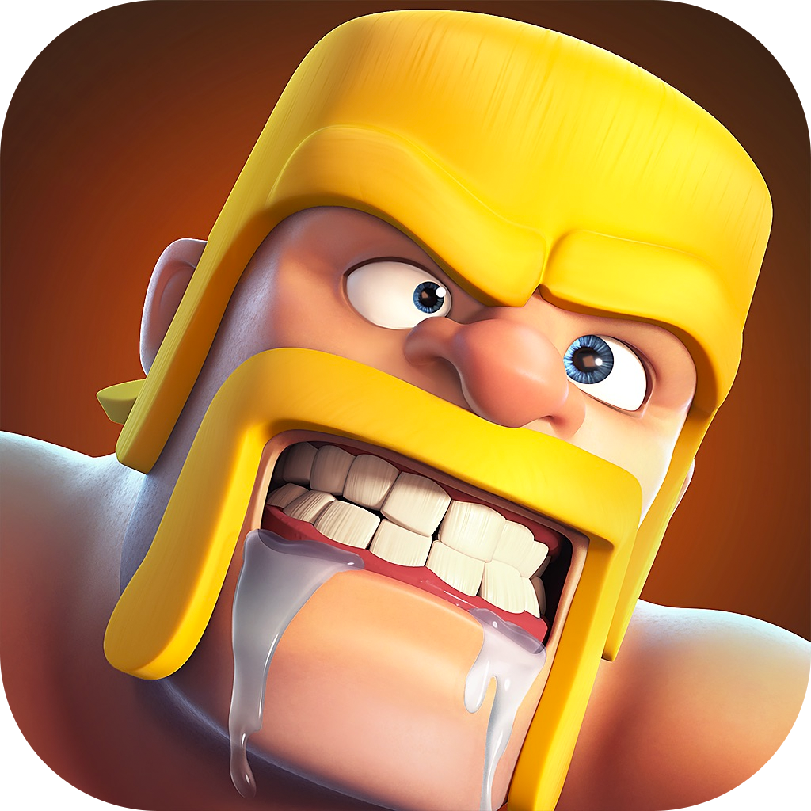



Application category usage difference
Most popular game/apps in 2012:
Most popular game/apps in 2014:
Most popular game/apps in 2017:
Notes:
We can see that in 2012, only Instagram using internet frequency.
As a well-known online game, Hearthstone became one of the most popular app in 2014.
It just verified that the rapid increase in application categories in 2014 was due to the growth of the network
Netflix’s first mobile app was released in 2014.
As we said before, we have 4g network at this year.
Imagine watch 4K video on 3G network.

Slide 9
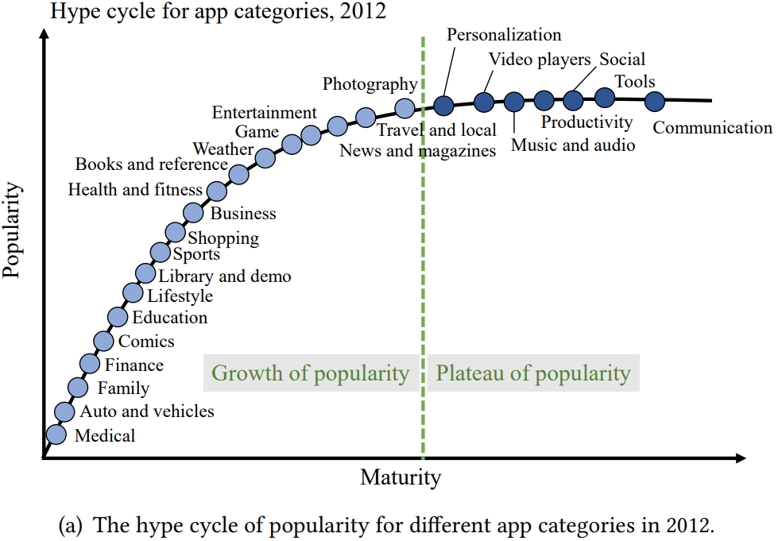
Popularity of application categories
In 2012, most of the popular smartphone application categories belonged to the functional category.
Notes:
In 2012, most of the popular smartphone application categories belonged to the functional category.
Such as communication, music, tools, video players.

Slide 10
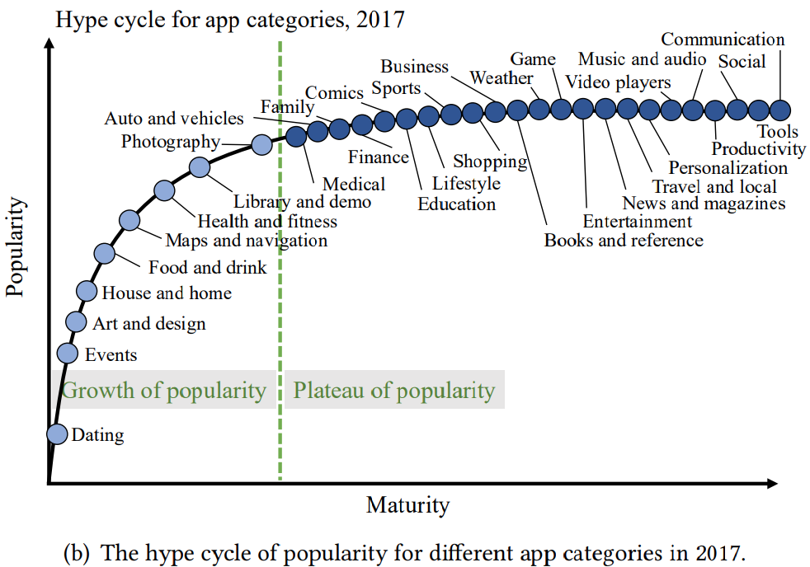
Popularity of application categories
The types of popular apps in 2017 tend to be life assistants like entertainment, photography, news.
Notes:
The types of popular apps in 2017 tend to be life assistants like entertainment, photography, news.
The possible reason for this change is
With the emergence of smartphones with larger screens, better cameras and CPUs.
watch the news

Slide 11
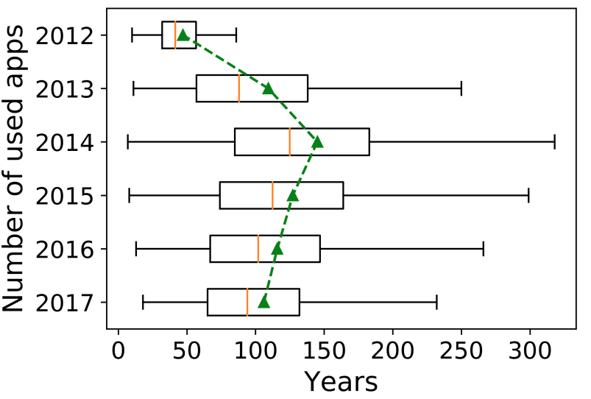
The number of applications used by the user.
Between 2012 and 2014, the number of applications used by users rose sharply.
Possible reason:
A large number of new application categories attract users to try different software.
Notes:
Between 2012 and 2014, the number of applications used by users rose sharply.
Possible reason:
A large number of new application categories attract users to try different software.

Slide 12
The number of applications used by the user.
After 2014, the number of application used decreased.
Notes:
After 2014, the number of applications gories used have stabilized, and users will choose several high-quality applications and discard other applications of the same type.
Fierce competition within the category has led to the elimination stage, and most users will gather in a small number of popular applications. The Pareto effect appears.

Slide 13
Conclusion
Application categories have two stages: the growth stage and the plateau stage. The application has an additional elimination stage.
Whenever a new technology appears, it will trigger an increase in application categories and application usage.
For applications, covering more categories, focusing on the consistent needs of mobile users, and improving application quality can allow applications in the long run.
Notes:
Application categories and long-term use of applications have two stages: the growth period and the plateau period. The application has an additional elimination period.
Whenever a new technology appears, it will trigger an increase in application categories and application usage.
For applications, covering more categories, focusing on the consistent needs of mobile users, and improving application quality can allow applications to maintain high competitiveness in the long run.

Slide 14
Thank you
Any Question?

