Slide 1
Understanding Worldwide Private Information Collection on Android
Yun Shen, Pierre-Antoine Vervier, and Gianluca Stringhini
Present By Linda Liang

Slide 2
Motivation
Raise the issue regarding to data regulation
Encourage regulation on how user information is used and shared and how accountability of private information collection (PIC) can be truly guaranteed

Slide 3
Problem
An increased knowledge of the dangers associated with third-party collection of confidential user data
Platforms tend to collect information that supposed to remain private
User data collection could be use for business purposes or nefarious reasons

Slide 4
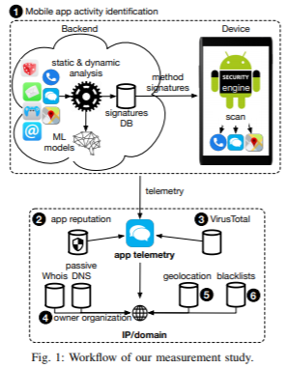
Workflow and approach

Slide 5
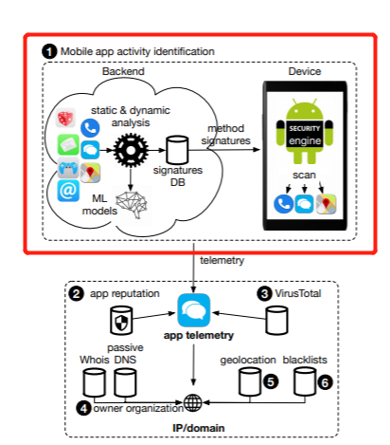
Mobile app activity identification
2.3 million devices
200 countries and regions

Slide 6
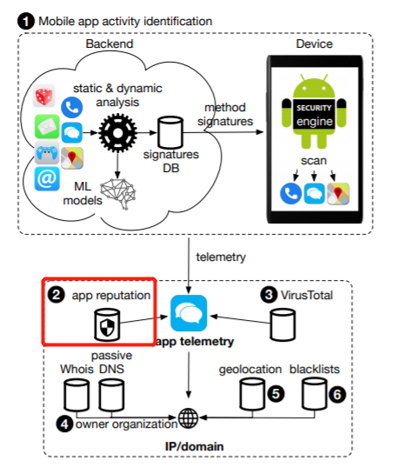
App reputation data
Augmented activity data with mobile reputation data
To Identify potential harmful application (PHA)

Slide 7
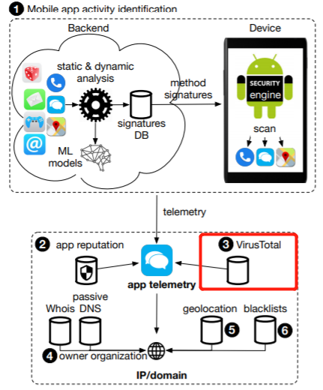
Virus Total
6.5M unique app hashes collected from mobile app activity data is querying on virus total report to identify PHA.

Slide 8
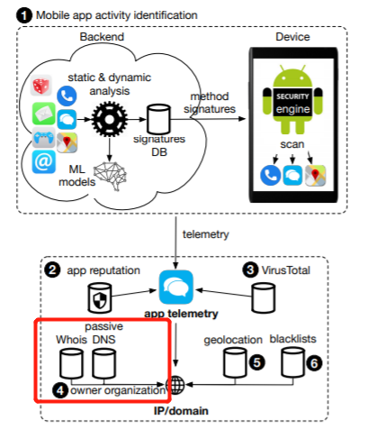
Domain and IP Whois and passive DNS
extract domain ownership information
Group multiple domain names

Slide 9
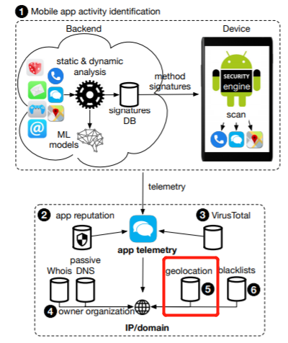
Geolocation
identify the country where apps send data

Slide 10
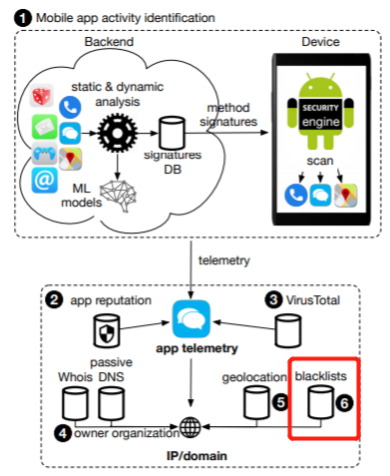
Blacklists
identify domains associated with malicious activity
Activities include:
  Sending spam emails
  Hosting malware
  Phishing
  Fraud websites

Slide 11
General data collection
73.8% of all devices in the dataset have at least one app collecting at least 5 unique categories of private information
These information are sent to at least 5 unique PIC domains

Slide 12
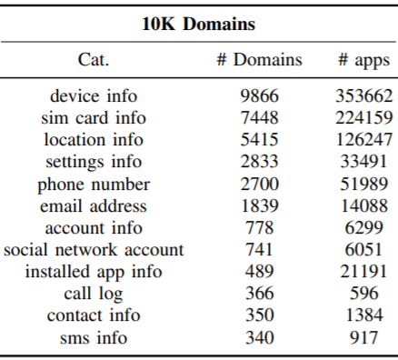
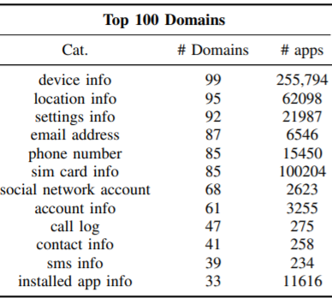
Top 10K domains vs top 100 domains PIC

Slide 13
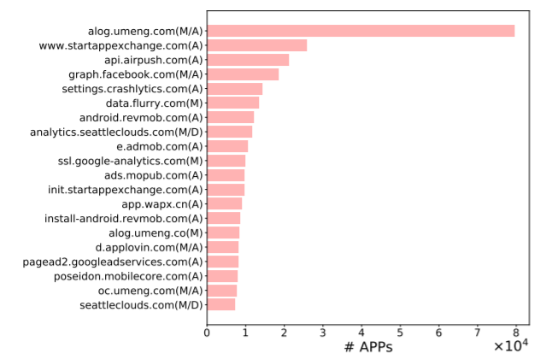
App presence
Impacts user data collections
Numbers of private information collection (PIC) domains that are contacted by 10K or more apps

Slide 14
Geolocation of PIC domains
Existence of regional apps varies by PIC domain
Business targeting specific regional market
Collect different types of personal data

Slide 15
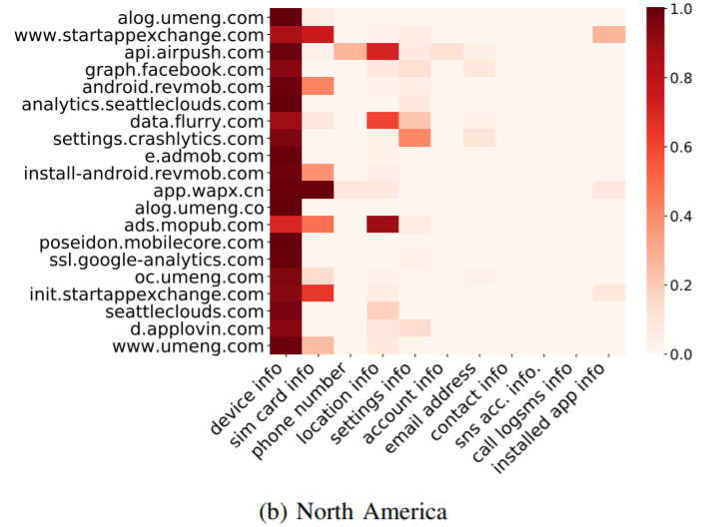
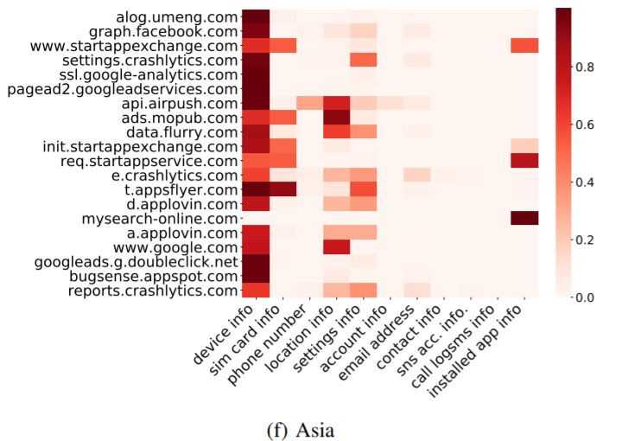
Geolocation of PIC domains

Slide 16
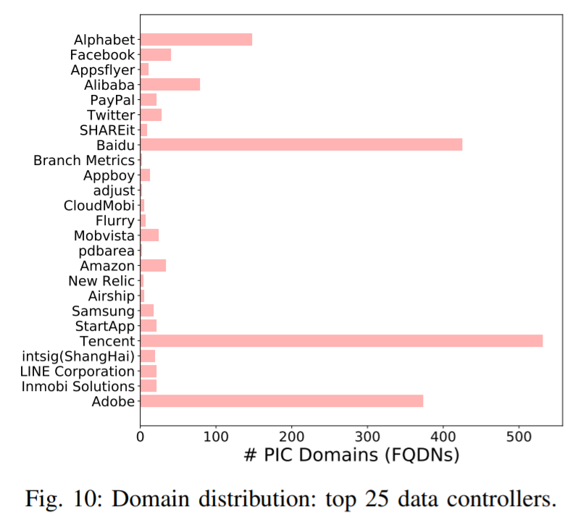
Data processor and controllers
16 out of top 25 data processors and controllers have less than 21 PIC domain
Top 3 data processors and controllers are Baidu, Tencent and Adobe
PIC domain own by an organization may host in different countries

Slide 17
PHA private information collection
put users, user data and device at risks
Collect tracking information
Collect data in aggressive manner
But only small portion of PHA communicate with malicious hosts and domain

Slide 18
“transferred to recipients in countries located outside the European Economic Area (including in Singapore where the Site is hosted) which do not provide a similar or adequate level of protection to that provided by countries in the European Economic Area ”

Slide 19
Solution for PIC
General Data protection Regulation(GDPR) entered into effect in 2018
Data transfer requires data subject to be informed
However, this solution proposed does not have significant impact on PIC

Slide 20
Thank you!

