Slide 1
See No Evil: Phishing for Permissions with False Transparency
Güliz Seray Tuncay*†, Jingyu Qian†, Carl A. Gunter†
*Google, †University of Illinois at Urbana-Champaign

Slide 2
Contextual information in Android
Lack of user permission context, user do not know when and how the permission is used.
Install-time Permissions < Android 6.0

Slide 3
Contextual information in Android
More context in user permissions, pop up a dialog while asking for permissions.
Runtime Permissions $≥$ Android 6.0

Slide 4
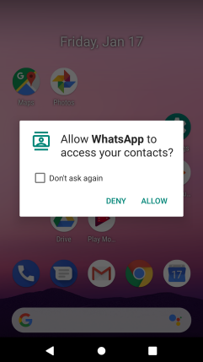
Quick Survey
Q:Suppose now that you received a permission request from an app installed on your phone while you were not actively using any app. Will you grant the permission?

Slide 5
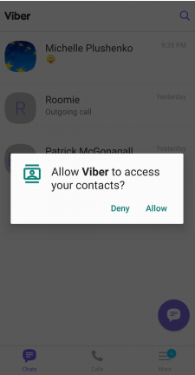
Quick Survey
Q: Suppose that you have installed Viber, when you launch it for the first time, it requires access to your contacts to allow you to contact your friends. Will you grant it the permission?

Slide 6
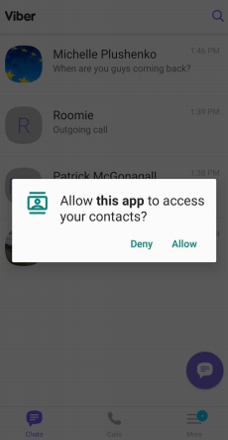
Quick Survey
Q: Suppose you texted a couple of friends on Viber, then you switched to some other applications. Eventually, you switched back to Viber to continue texting your friends and now you are prompted for the contacts permission as shown in the following screenshot. Will you grant the permission?

Slide 7
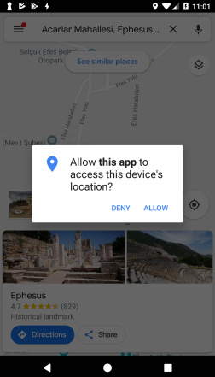
Quick Survey
Q: Suppose you are traveling the world and you found yourself wanting to go to the magical ancient Greek city of Ephesus. You open Google Maps to navigate to these ruins. You are prompted with a permission dialog as in the following picture. Who is requesting this permission?

Slide 8
False Transparency
Viber is a free, simple, fast and most secure messaging and calling app.

Slide 9
False Transparency
Asking for user permission

Slide 10
False Transparency
Seems good?

Slide 11
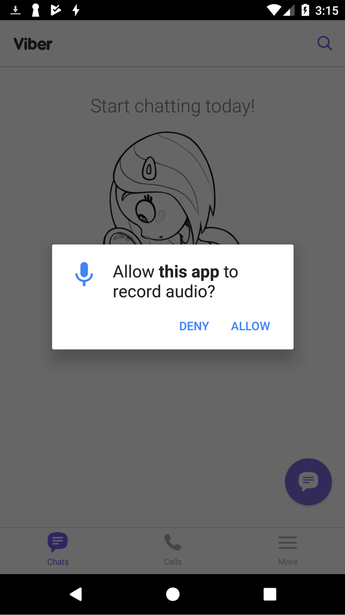
False Transparency
Lest review the process.
Anyone noticed some difference?
What is this app?

Slide 12
False Transparency
On Android, a task is a collection of activities that collaboratively perform a specific job. Android arranges activities forming a task into a stack, in the reverse order of their initiation.
Viber is the top application

Slide 13
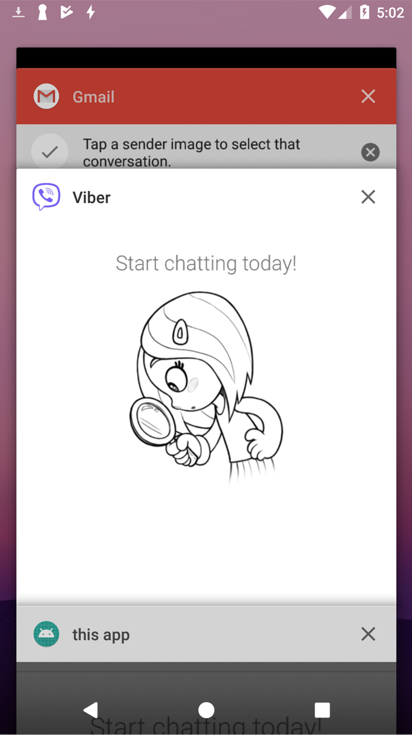
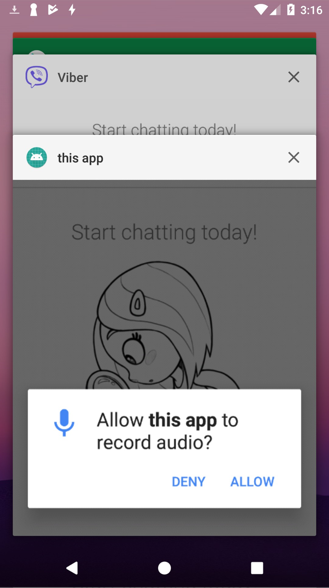
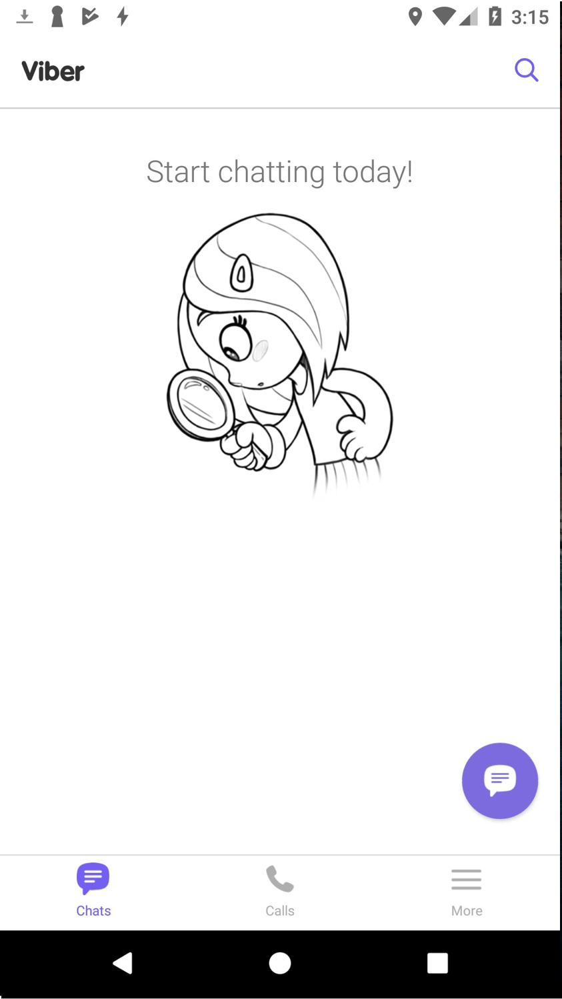
False Transparency
False transparency attacks on runtime permissions
This app is the top application

Slide 14
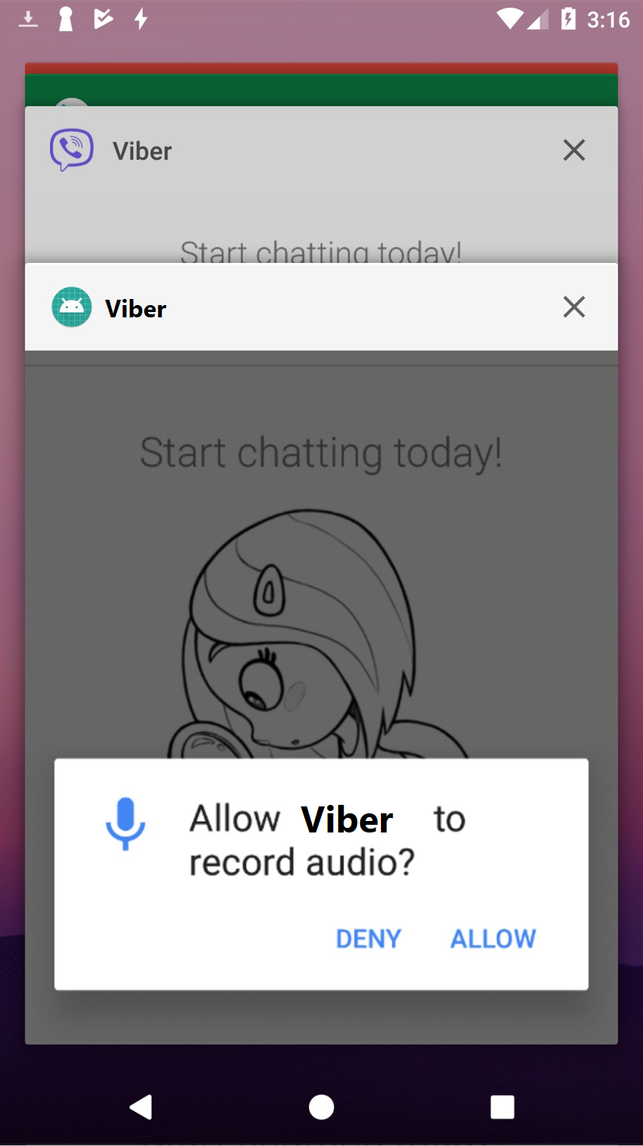
False Transparency
False transparency attacks on runtime permissions
APP name may even be same!
Affects Android 6-11

Slide 15
User Test
They recruited 20 subjects to participate in our in-lab study on a voluntary basis.
Their participant pool consists of undergraduate and graduate students who major in computer science or other engineering fields
Three popular Android apps as victims: 1) Google Maps, 2) Shazam and 3) Facebook Messenger

Slide 16
User Test
They have three separate attack apps installed on the device, each targeting only one of the victim apps. The attack apps that target Google Maps and Shazam utilize the same app name as their victims (i.e., Maps and Shazam respectively). The attack app that targets Messenger uses “this app” as its app name also test for the feasibility of our multi-targeted attack case.

Slide 17
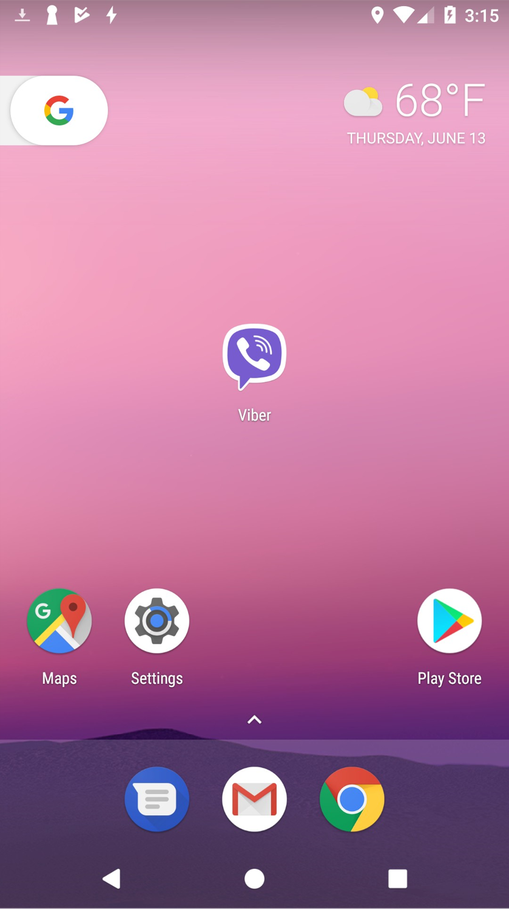
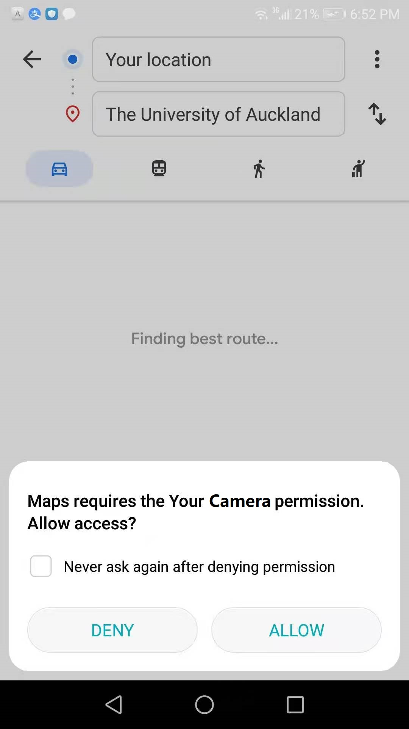
Attack Steps
1) Lurk in the background.
Prior to Android 8 using Service or IntentService classes After Android 8 JobScheduler
2) Choose your victim carefully.
3) Choose your permission carefully.
query the PackageManager to obtain the requested permissions of this app
4) Cloak and dagger.
invisible activity from the background service via the startActivity() API then requests the chosen permission requestPermissions() API.
5) Leave no trace behind.
call the moveTaskToBack() API in order to move to the back of the activity stack

Slide 18
Result
None of their participants were able to notice the attacks, despite the natural tendency for tec savviness and security-consciousness among them.

Slide 19
Defenses and Countermeasures
Suggestions:
1) New app store policies
For example, Google Play (GP) can implement name checks to ensure the uniqueness of app names across all the apps served on GP.
2) Enforcing app name integrity in the Android framework
This enforcement can be performed during installation to filter out apps with suspicious app names on a first-come-first-serve basis.
3) Additional app identifiers in the permission dialog.
4) Mandatory app transition effects.
mandatory transition effects can be added between foreground app switches.
5) Prohibition of transparent activities.

Slide 20
Thank you

