Slide 1
The Abuser Inside Apps:
Finding the Culprit Committing Mobile Ad Fraud
Joongyum Kim, Jung-hwan Park, and Sooel Son
Presented by: Tim Koo
May 5, 2021

Slide 2

Mobile Ad Fraud
Operation that generates unwanted ad traffic
The mobile ad market has been expanding explosively
- $187 billion in 2020 (30.5% of the global ad market)
As a result, mobile ad fraud has become a major problem to security
Total loss due to mobile ad fraud expected to be 9%-20%
Two types
- Click fraud
- Impression fraud

Slide 3



Click Fraud & Impression Fraud
Click fraud
- The attacker sends multiple click URL requests
- Deceives users into clicking ad impressions
Impression fraud
- Hide ads underneath other visible elements
- Invisible ads

Slide 4

Ad Fraud Detectors
MAdFraud
- Detects URL requests and their responses without interacting with app
- If URL requests found, the app is fraudulent
MAdLife
- Compares pre-click and post-click log data and screenshots
- If equivalent, the app is fraudulent
Limitations
- No user interactions – what about fraud which requires user interaction?
- Only looks at external behaviours – pinpoint which module conducts fraud?
- Requires emulators to test – not an actual mobile device environment

Slide 5
Can We Solve These Limitations…?

Slide 6
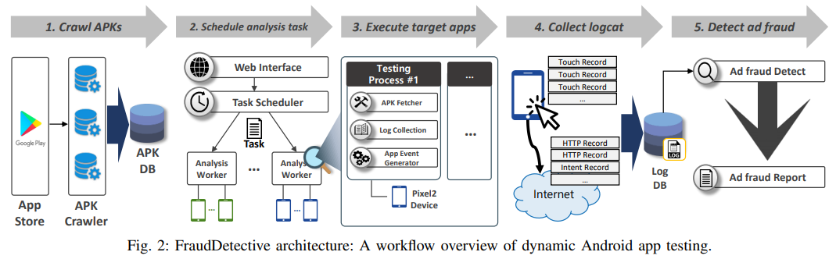
FraudDetective

Slide 7
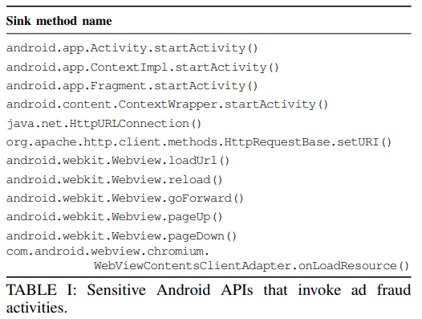
Executing Apps & Collecting Logcat
FraudDetective executes apps with a revised Android Open Source Project (AOSP) framework
Finds ad fraud candidate (FC)
- Sensitive Android APIs
- Argument patterns eg) ad SDKs
- Invocations of cross-app Intents
The revised AOSP gives us an FC in Logcat logs

Slide 8
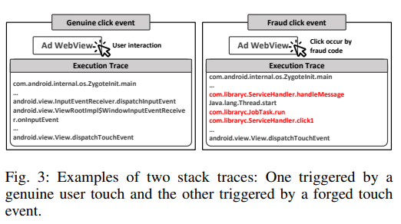
Full Stack Trace (FST)
With the revised AOSP framework leaving FC, we compute FST
FST shows the methods used to reach the FC from a program entry point
Finds if there is a user-defined code
by checking dispatchTouchEvent
Solves the limitations!

Slide 9



Types of Ad Fraud Activities
FraudDetective identifies three types of ad fraud activities
Type-1
- Click URL request sent by a mimicked user click
- Checks if there is a non-Android internal class in dispatchTouchEvent invocation
Type-2
- Click URL request sent with no user interactions
- FST finds click URL requests
Type-3
- Invocation of other apps by a cross-app Intent
- FST detects cross-app Intents
Type-3 Example

Slide 10
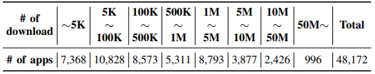
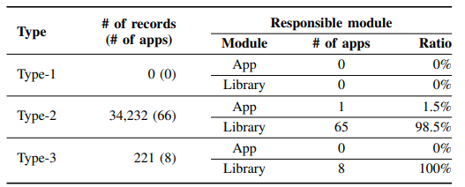

FraudDetective in Action!
Crawled 48,172 apps from Google Play Store
FraudDetective reported 34,453 records of fraud activities from 74 apps

Slide 11
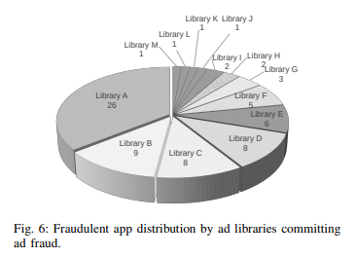
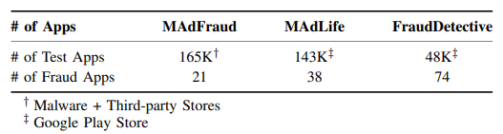
FraudDetective vs Other Detectors
MAdFraud was not able to find 36 out of 74 apps because it does not interact with apps
FraudDetective could detect all 30 apps MAdLife found (eight apps were not available or deprecated)
FraudDetective could pinpoint which module triggered ad fraud

Slide 12
Thank you!

