Slide 1
Finding the Culprit Committing Mobile Ad Fraud
Paper by Kim, Park, and Son
Presented by Justin Kim

Slide 2
Problem
In 2020, the US mobile ad market revenue was 187B USD
How much of that was generated through fraudulent advertising?

Slide 3
Background Knowledge
Ad service providers
CPM, CPI, CPC
Mobile fraud definition
Generate fake, unwanted ad traffic, leading to fraudulent revenues
Click fraud VS Impression fraud
Click fraud generates fake clicks
Impression fraud has ads in invisible elements

Slide 4
Motivation
MAdLife, MAdFraud
Cannot manifest casual relationships between user interaction and fraudulent activities
Cannot pinpoint exact Android module which committed fraud
Does not interact with target apps
Both run on emulators
Attempt to address these shortcomings with FraudDetective

Slide 5
FraudDetective
Crawl APKs from Google Play store, adding them to database
Task scheduler module creates tasks and schedules to available analysis worker
Analysis worker carries out dynamic testing, using Logcat to store information
Ad fraud detector verifies full stack trace for each task, reporting fraudulent activity

Slide 6
FraudDetective - Answer to Everything?
Cannot manifest casual relationships between user interaction and fraudulent activities
FD is able to identify whether each trace originates from actual user interactions
Cannot pinpoint exact Android module which committed fraud
FD looks at the full stack trace of activities
Does not interact with target apps
FD separates user interaction from fraud detection policies
Both run on emulators
FD uses Android devices (Pixel 2) with modified Android Open Source Project

Slide 7
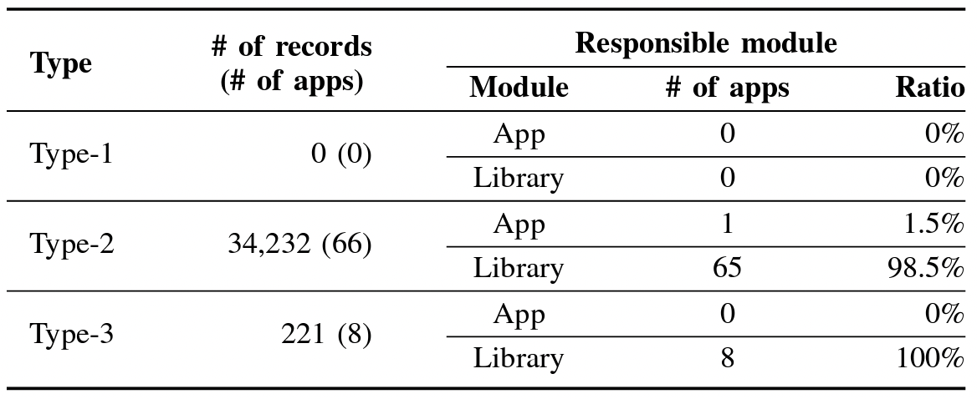
FraudDetective - Findings
Tested 48172 apps
34453 frauds found
Type 1 - Forged user click
Type 2 - No user interaction
Type 3 - Other app invoked without interaction
98.6% of ad fraud is done by ad libraries

Slide 8
FraudDetective - Findings
Out of 74 apps:
19 removed
49 updated
No false negatives when compared to previous works

Slide 9
Closing Thoughts
Google’s restrictions towards ad fraud
Possibilities of other fraudulent methods

Slide 10
Thank You

