Slide 1


COMPSCI 702
Post-Challenge Phase
By Derrick Chen, Linda Liang, Qiaochu Song, Yifeng Ma
May
2021
01

Slide 2

Introduction
Context
Problem
Solution
  In the Development Phase, we developed a simple timer Android application using Java.
  The application achieved simple statistical functions that users can easily record each learning session and store in the history.
  In the challenge phase, we identify the specific data and control flow obfuscation used in the code.
  We use series of existing research to help us better understand the code obfuscation, and found two tools to apply to our obfuscation work
  After we carried out manual obfuscation and we try to obfuscate the program further with our auto obfuscation strategy.
  We obfuscate in four main categories:
    layout obfuscation
    design obfuscation
    data obfuscation
    control obfuscation
  what kind of automated obfuscation tool should we use for our code, and how to use it reasonably.
  Changed the code format, removed spaces and line breaks, compressed everything together.
  Renamed the variables and files.
  Use Mess and ProGuard to perform the design obfuscation, and data obfuscation to make essential data unreadable or incomplete.
  We used single-language third-party name libraries to make it hard to distinguish the critical information and variables after renaming the variables, this approach is novel, it also has a good effect on improving security.

Slide 3
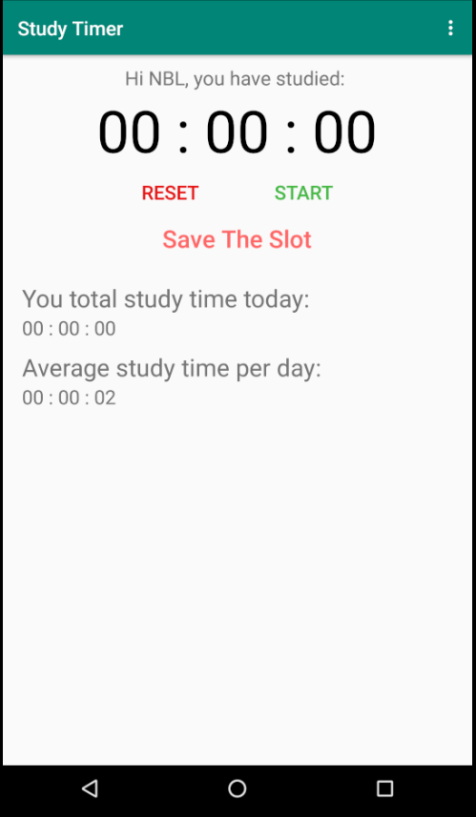
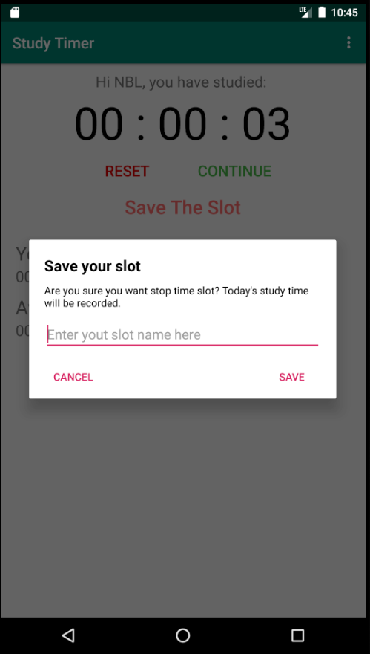
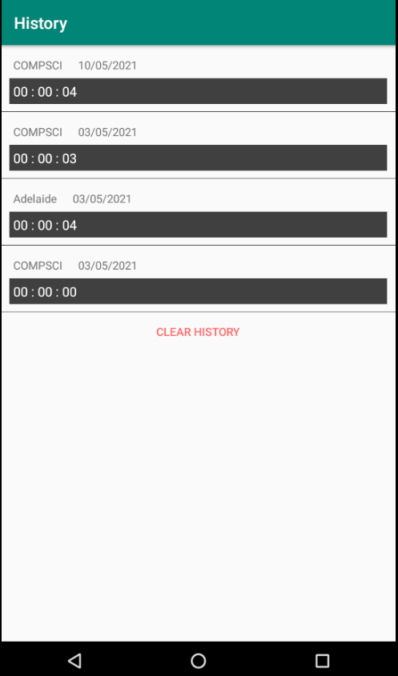
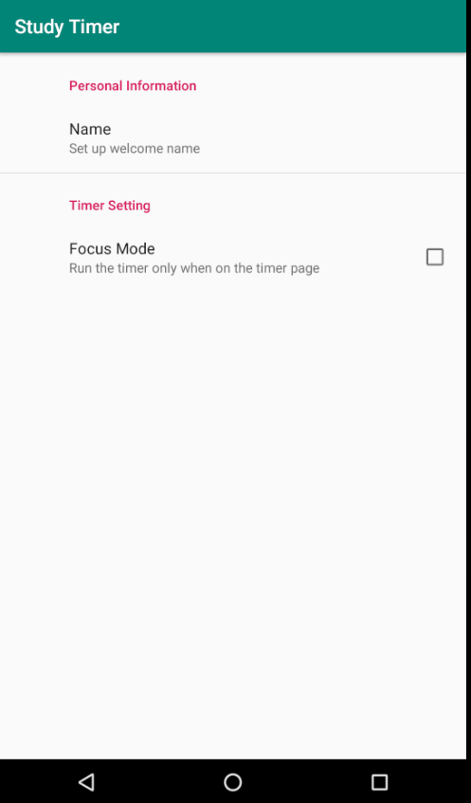
Introduction
Notes:
We conducted a series of related work, found the existing research to help us better understand the code obfuscation, and found two tools to apply to our obfuscation work

Slide 4

Related Work
Technique that consider to be control obfuscate
  Inserting Dead or Irrelevant Code
  Extend Loop condition
  Add Redundant Operands
  Reorder Statements and Expressions
  Reorder Loop
Technique that consider to be Data obfuscation
  Merging Scalar Variables
  Class Transformations
  Change Encoding
  Split Variables
  Data ordering

Slide 5
Related Work
Technique that consider to be Layout obfuscation
  Renaming for class, methods and variables
Technique that consider to be Preventive transformations
  Bytecode Encryption
  String Encryption

Slide 6
Related Work
Class splitting
  The class splitting, class coalescing and type hiding methods are proposed by Sosonkin et al.
  Class splitting is where an original class is split into two classes and methods of the original may exist in one of both of the split classes.
  The type hiding method uses an interface that is used in variables, fields and methods declaration and casting operations.
Identifier Mangling
  The number of obfuscation techniques is defined by Schulz to protect software and algorithms. Dalvik bytecode and x86 architecture are the two main research.
  Identifier mangling, string obfuscation, dynamic code loading and Jumpbytes are considered to be a technique that is under x86.
  Dynamic code loading requires an unpacking stub that executes when starting the application.
  Dynamic code loading and junk byte are the limitations that we have because it is a compiler level of obfuscation, it is not considered in our proposed idea but this technique can be used in future research.

Slide 7
Related Work
Data Aggregation
  The article introduced by Faruki et. al. proposed different techniques for data obfuscation.
  Data aggregation, data storage and encoding and data ordering is the main approach.
  Having a large number of expressions gives an explicit view of our variables, therefore applying this to only a few numbers of index variable and obfuscate with other techniques enable our program to be more difficult to understand and read.

Slide 8
Related Work
Tools that we use
Proguard
  Proguard is a tool that consists of a shrinker, optimizer, obfuscator and pre-verification feature.
  Detecting and removing unused class, fields, methods and attributes.
  It generates automatic obfuscation through renames the classes, fields and method with meaningless names.
Mess
  Mess is the Gradle plugin for obfuscation.
  It obfuscates code including activity, service, receiver, provider and custom view.
  This tool reduces the code readability after reverse engineering.
  It runs after Proguard, and mess hooks it just to read the obfuscation mapping reference.

Slide 9
Proposed Obfuscation
Idea
Layout Obfuscation
Our goal is to change the formatting of the source code to make it hard to read. Rename some variable names and filenames to make them indistinguishable and unreadable.
Design Obfuscation
Our goal is to disrupt the original design of the code so that it is difficult for the attacker to understand the structure and functionality of the entire code.
For better security, we first manually obfuscated our program and then make custom rules for existing automation obfuscate tools such as Proguard to automate obfuscation.
Data Obfuscation
Our goal is to make the important data and name unreadable or incomplete to make it harder for an attacker to attack.
Control Obfuscation
Our goal is decomposing basic blocks to make it difficult for an attacker to follow the control flow.

Slide 10
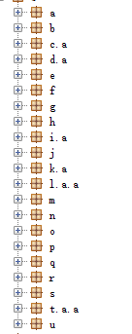
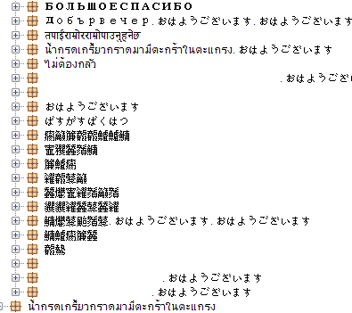
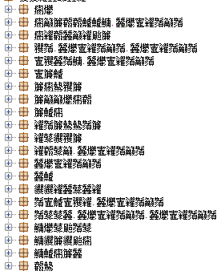
Layout Obfuscation
Renaming Files

Slide 11
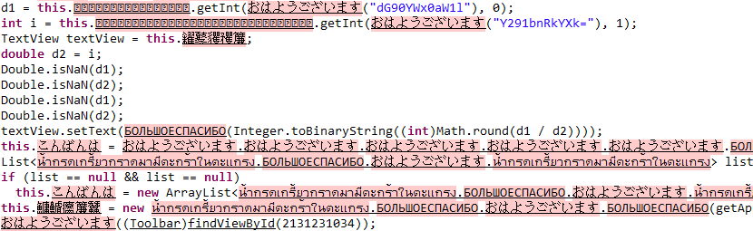
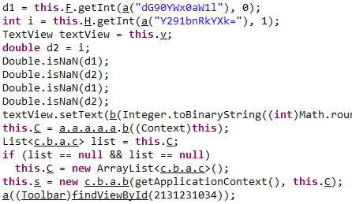
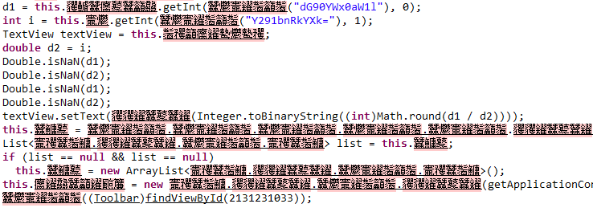
Layout Obfuscation
Renaming Variables and class

Slide 12
Layout Obfuscation
Change Formatting

Slide 13
Design Obfuscation
Merge Class
Reorder class

Slide 14
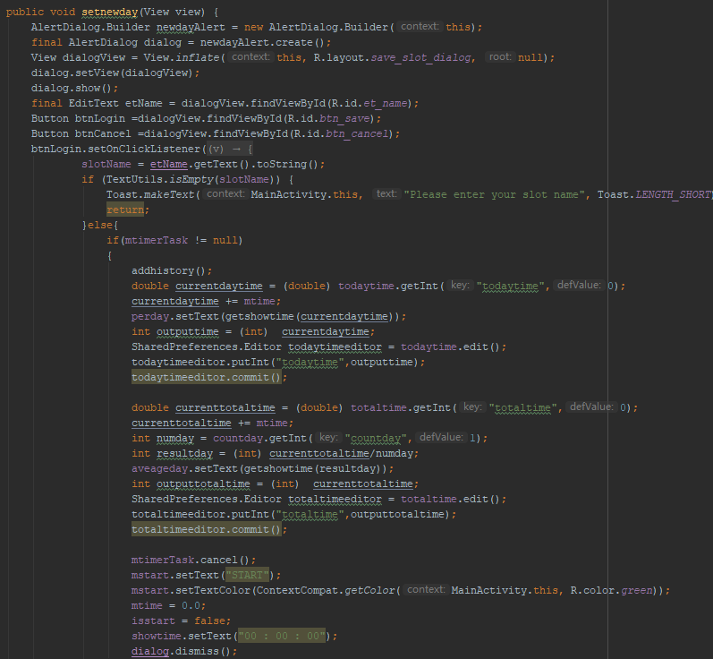

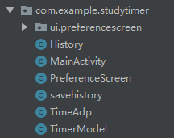
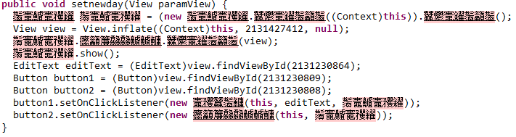
Design Obfuscation
Split Class
Hidden Class

Slide 15

Design Obfuscation
You may ask why the function name is plaintext without obfuscation

Slide 16
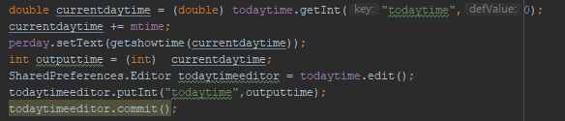
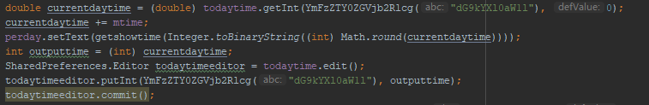
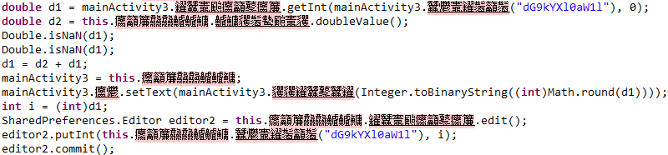
Data Obfuscation
Encrypt Data

Slide 17
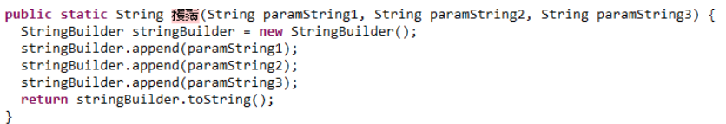
Data Obfuscation
Variable Splitting

Slide 18
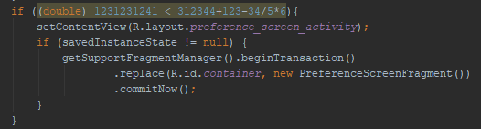
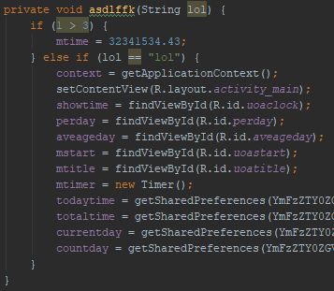
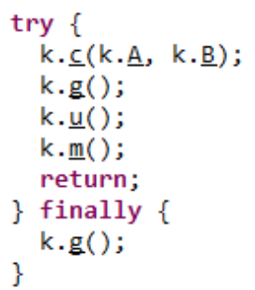
Control Obfuscation
Add Opaque Predicates.

Slide 19
Evaluation
Performance
  On average there are around 20ms to 40ms differences between Gradle build and installation time.
  The obfuscated application generally has a longer execution time because renaming variable or obfuscated information requires time.
  Some obfuscation techniques only have little impact on performance, it may even reduce the file size.
  Classes split, merge or reordering could potentially impact the execution order of the program, however as shown in the time comparison, it is minimal.
Size
  Obscurement can greatly reduce the size of the application if the DEX file indexes a large number of classes, methods, and fields.
  Our original application consists of 2.4MB, this is higher than the obfuscated application.
  There is a significant reduction in file size reduction.

Slide 20
Discussion
Limitations
  Some system variables are not obfuscated(Especially in MainActivity)
-- attackers could understand the structure of the entire program through some system variables.
Possible extensions
  Improvement in design obfuscation
1. Hide all the classes in the source code and store them in different places.
2. More completely class splitting.
  Obfuscate the system variables
Debugging and Updates
  For obfuscated app updates
Use the app version information for version control. If a version update is required, we will increase the version code and release a new version.
  For obfuscated app debug
We test the obfuscated apk file in the Android virtual machine and the actual smartphone separately.
If bugs occur, we will find the mapping relationship before and after the obfuscation through the mapping file generated with the apk file to debug.

Slide 21
Reverse Engineering
Several different code obfuscation techniques could be found in the source code of different groups’ applications, including splitting up the control flow from the source code, changing the source and binary form of a programme, covering the class after segmentation, and so on.
Reverse Engineering Process and Tools
Dex2Jar
JD-GUI
JEB2
JADX
Notes:
Layout
Design
Data
Control
the apk file contains a .dex file, which contains binary Dalvik bytecode. This is the format that the platform actually understands. However, it's not easy to read or modify binary code, so there are tools out there to convert to and from a human readable representation.
The most common human readable format is known as Smali. This is essentially the same as the dissembler you mentioned.

Slide 22
Thank you for your time!
Please feel free to send us any questions you may have.

