Slide 1
Networking and the Internet
Lecture 4 – COMPSCI111/111G SS 2016

Slide 2
Today’s lecture
History of the Internet
How the Internet works
Network protocols

Slide 3
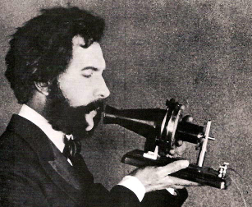
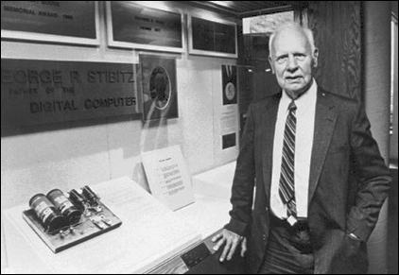
The telephone
1876: first successful bi-directional transmission of clear speech by Alexander Bell and Thomas Watson
1940: first successful transmission of digital data through over telegraph wires by George Stibitz

Slide 4
WWII and the Cold War
Computer technology played an important role in code-breaking during WW2
Cold War between US and USSR led to a technology and arms race
1958: Advanced Research Projects Agency (ARPA) established
April 1969: construction of ARPANET begins, a packet-switching network

Slide 5
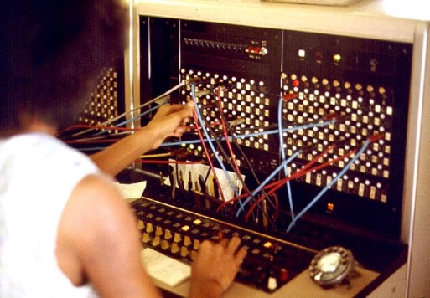
Circuit-switching network
Nodes are connected physically via a central node
Used by the telephone network
Originally, switchboard operators had to manually connect phone calls, today this is done electronically
B
A

Slide 6
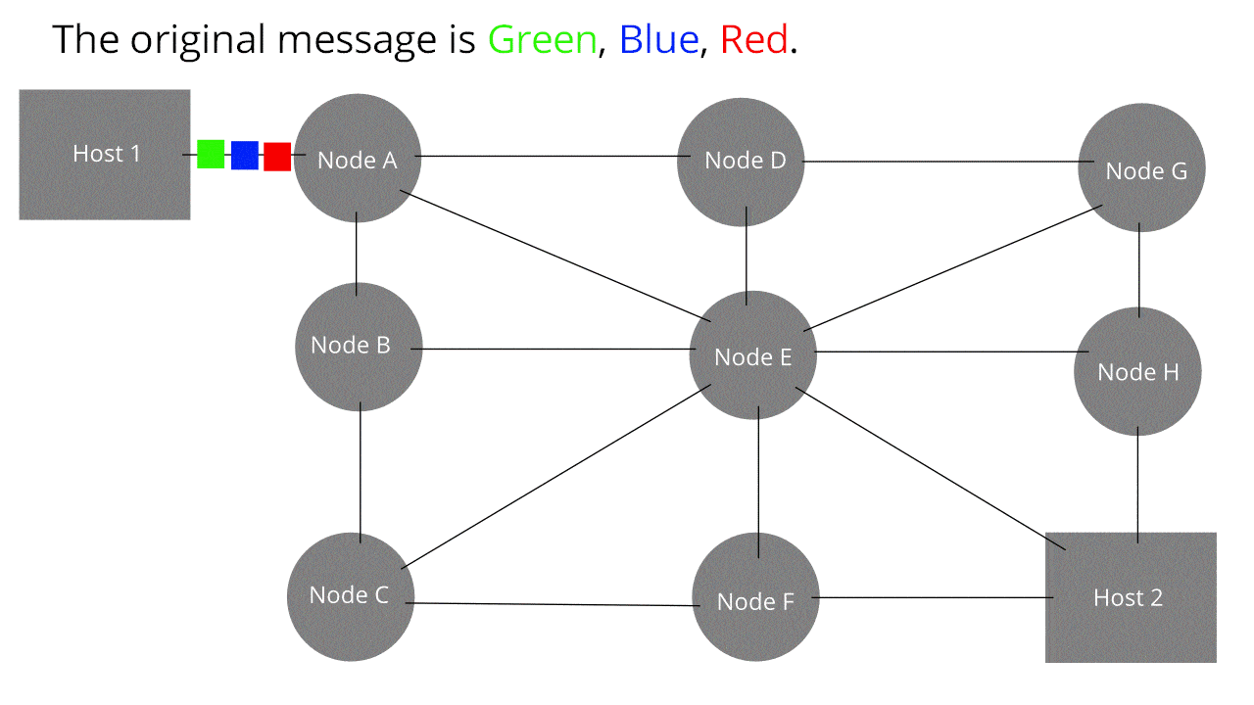
Packet-switching network
Data is broken into packets, which are then sent on the best route in the network
Each node on the route sends the packet onto its next destination, avoiding congested or broken nodes

Slide 7
ARPANET
October 1969: ARPANET is completed with four nodes
1973: Norway connects to ARPANET via satellite, followed by London via a terrestrial link

Slide 8
ARPANET

Slide 9
ARPANET
1983: TCP/IP implemented in ARPANET
1990: ARPANET is formally decommissioned

Slide 10
ARPANET to the Internet
Networks similar to ARPANET sprang up around the USA and in other countries
1984: domain name system (DNS) implemented
1985: NSFNET was established
1989: Waikato University connects to NSFNET
1991: World Wide Web (WWW) created at CERN (European Organization for Nuclear Research) by Tim Berners-Lee
1995: NSFNET is retired

Slide 11
WWW vs Internet
World Wide Web (WWW) refers to the applications (eg. web pages, email, Skype, Youtube etc) that run on hardware
The Internet refers to the hardware on which the WWW runs

Slide 12
Internet growth

Slide 13
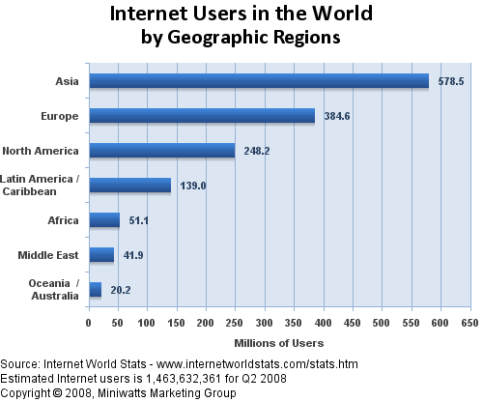
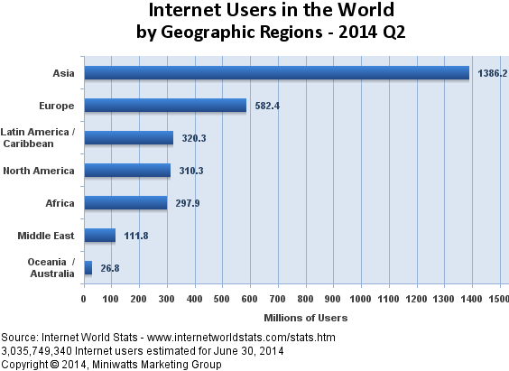
Internet usage

Slide 14
Types of networks
Local Area Network (LAN)
Operates within 1 km radius
Client-server or peer-to-peer configuration
Can connect multiple LANs to form an intranet
Wide Area Network (WAN)
Distances over 1km
The Internet
Network of networks that use the TCP/IP protocol

Slide 15
How the Internet works
The Internet
Networking hardware
Protocols
IP addresses and Domain names
Client and server software

Slide 16
Networking hardware
Connection
Wired, eg. Ethernet
Wireless, eg. Wi-Fi, cellular
Network card
Can be built into the motherboard or an expansion card
Some network cards support wired and wireless connections
Switch
Used to connect multiple devices to the same network
Router
Directs traffic around the network and connects networks together

Slide 17
Networking hardware
Modem (modulator/demodulator)
Responsible for transmitting data on the medium and receiving data from the medium
For example, a modem:
Modulates data from computer/router onto a phone line
Demodulates signals from a phone line and sends to the computer/router
There are different kinds of modems
Dial-up modems up to 56 kbit/s
Broadband (DSL; digital subscriber line) modems between 256 kbit/s to 20 mbit/s

Slide 18
Protocol
Protocol: a standardised method of communication
Very important in a network in order for the sender and receiver to communicate properly
Protocols include rules for:
Opening and maintaining a connection
Sending and receiving data
Ending the connection

Slide 19
Protocols
Common Internet protocols:
TCP/IP: transports data reliably
UDP: transports data faster but less reliably
FTP: used for transferring files
HTTP: used for client/server communication, mostly web pages.
POP3, IMAP, SMTP: used for email
Many protocols used in networking are defined in their RFC (Request for Comments)
RFC 791: IP
RFC 2616: HTTP

Slide 20
Protocols – TCP/IP, UDP
IP - Internet Protocol:
A unique identifier for computers on the network
Defines routing information
v4: 32-bit addresses (eg. 192.168.1.1), ran out of addresses
v6: 128-bit addresses (eg. 2001:0db8:0a0b:12f0:0000:0000:0000:0001)
TCP - Transmission Control Protocol:
Divides the message into packets (typically about 1 KB)
Checks that all packets arrive (error detection)
Ensures packets are not sent faster than they can be received (flow control)
Combines packets to recreate the data
UDP – User Datagram Protocol:
Lacks error detection and flow control, better suited to real-time data

Slide 21
Protocols - HTTP
HyperText Transfer Protocol
Used by web browsers to request objects (eg. webpages, images, sounds etc) from the server

Slide 22
Protocols – Email
These protocols are used by email clients (eg. Outlook, Apple Mail) to send and receive email
POP3 – Post Office Protocol v3:
Emails downloaded from server to email client
Emails are then deleted from server
IMAP – Internet Message Access Protocol:
Downloads messages to email client and keeps them on the server
SMTP - Simple Mail Transfer Protocol:
Used to send emails from an email client via the email server

Slide 23
IP addresses and domain names
Domain name system (DNS) is used to convert between IP addresses and human-readable text (domain name)
A domain name against an IP address
DNS servers perform the translation between IP address and URL
Name
DNS server
IP Address
cs.auckland.ac.nz
130.216.158.22

Slide 24
Client and server software
Client software:
Web browsers
Email clients:
Server software:

Slide 25
Connecting to the Internet
An Internet Service Provider (ISP) provides you with an IP address and a connection to the Internet
Modem
ISP Server
Modem
Other Servers, Internet
Modem

Slide 26
Connecting to the Internet
At home, you plug your modem into your phone jack
Your modem sends and receives information from the Internet over your phone line
Computer
Router
Modem
Phone Jack

Slide 27
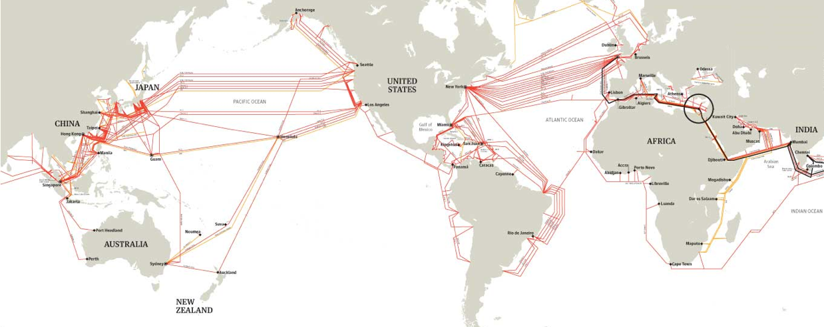
The Internet’s backbone
High-capacity fibre cables, on land and under the sea
Owned by a few carriers who rent out capacity
See www.submarinecablemap.com

Slide 28
Summary
The Internet is packet-switching network consisting of multiple networks joined together
A number of protocols and technologies underpin the Internet
As more people use the Internet, authorities tasked with maintaining it need to ensure the Internet can handle the increased demand (eg. IPv4 to IPv6)

