Slide 1
Python 3 – Turtle graphics
Lecture 24 – COMPSCI111/111G SS 2016

Slide 2
Today’s lecture
Recap
The Turtle graphics package
Brief history
Basic commands
Drawing shapes on screen

Slide 3
Logo and Turtle graphics
In 1967, Seymour Papert and Wally Feurzeig created an interpretive programming language called Logo.
Papert added commands to Logo so that he could control a turtle robot, which drew shaped on paper, from his computer
Turtle graphics is now part of Python
Using the Turtle involves instructing the turtle to move on the screen and draw lines to create the desired shape

Slide 4
The Turtle package
Some functions are part of Python’s core libraries, in other words they are ‘built-in’
print()
input()
float()
Other functions need to be imported into your Python program
The turtle module needs to be imported at the start of any Python program that uses it: import turtle

Slide 5
Basic Turtle commands
There are four basic turtle commands
turtle.forward(x)
Moves turtle forward in direction it is facing by x steps
turtle.back(x)
Moves turtle backward from its facing direction by x steps
turtle.left(x)
Turns the turtle x degrees counterclockwise
turtle.right(x)
Turns the turtle x degrees clockwise

Slide 6
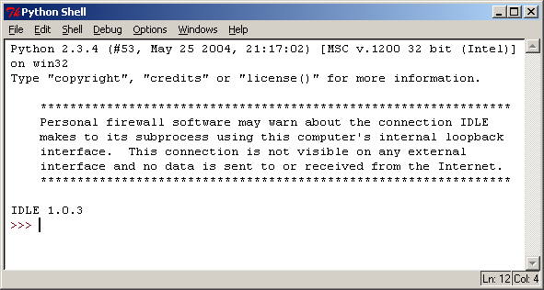
Turtle example
Using the Python interpreter in IDLE to demonstrate how to use Turtle graphics
First, import the turtle package
>>> import turtle
>>>

Slide 7
Turtle example
We are going to draw a right-angled triangle
>>> import turtle
>>>
>>> turtle.forward(200)
>>>

Slide 8
Turtle example
Note how the turtle is now facing upward after being turned 90 degrees left
>>> import turtle
>>>
>>> turtle.forward(200)
>>> turtle.left(90)
>>>

Slide 9
Turtle example
>>> import turtle
>>>
>>> turtle.forward(200)
>>> turtle.left(90)
>>> turtle.forward(200)
>>>

Slide 10
Turtle example
>>> import turtle
>>>
>>> turtle.forward(200)
>>> turtle.left(90)
>>> turtle.forward(200)
>>> turtle.left(135)
>>>

Slide 11
Turtle example
Working out the length of the longest side using the Pythagoras’ formula
>>> import turtle
>>>
>>> turtle.forward(200)
>>> turtle.left(90)
>>> turtle.forward(200)
>>> turtle.left(135)
>>> c = ((200**2)+(200**2))**0.5 #around 283 steps

Slide 12
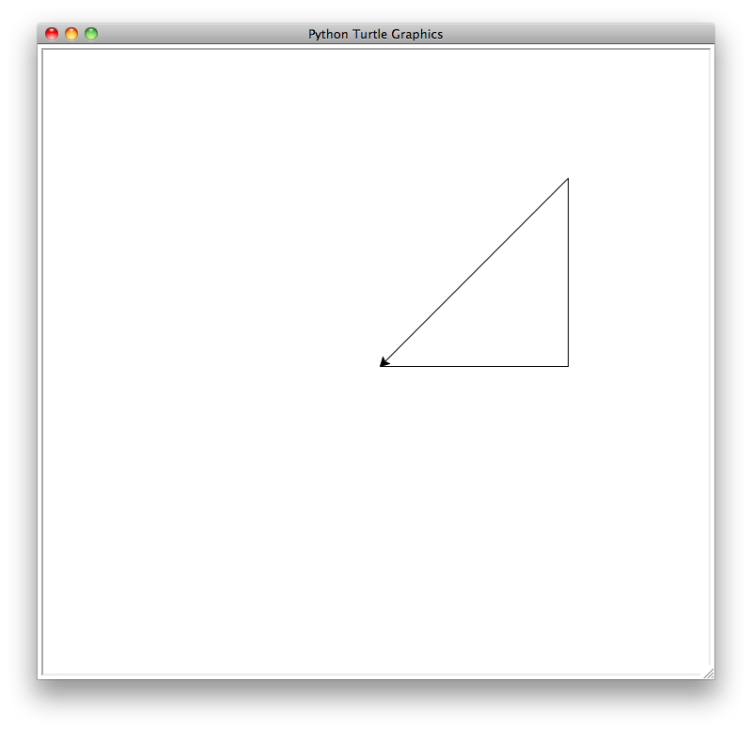
Turtle example
The finished image
>>> import turtle
>>>
>>> turtle.forward(200)
>>> turtle.left(90)
>>> turtle.forward(200)
>>> turtle.left(135)
>>> c = ((200**2)+(200**2))**0.5)
>>> turtle.forward(c)

Slide 13
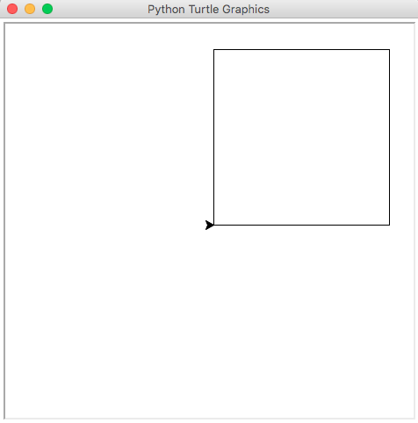
Turtle example
We can use loops when drawing shapes using Turtle graphics
Write a program that will draw a square using a loop
import turtle
count = 0
while count < 4:
turtle.forward(200)
turtle.left(90)
count = count + 1

Slide 14
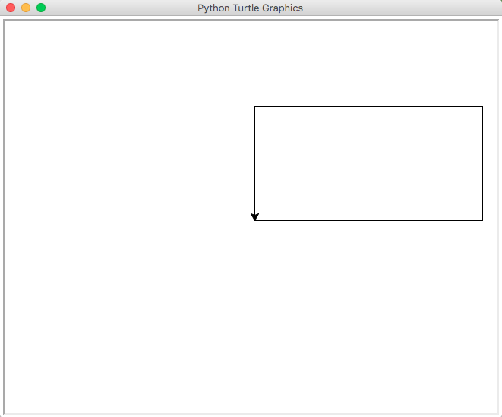
Exercise
Write a Python program that draws a rectangle. The long sides must be 300 steps long and the short sides must be 150 steps long
import turtle
turtle.forward(300)
turtle.left(90)
turtle.forward(150)
turtle.left(90)
turtle.forward(300)
turtle.left(90)
turtle.forward(150)

Slide 15
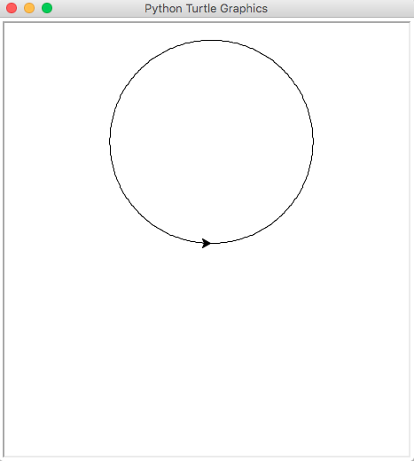
Turtle example
Write a program that will draw a circle
import turtle
count = 0
while(count < 360):
turtle.forward(2)
turtle.left(1)
count = count + 1
print("Finished!")

Slide 16
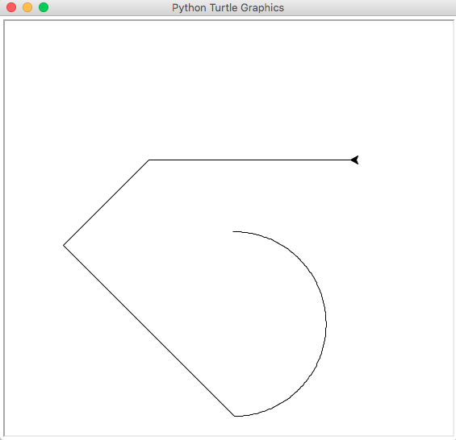
Exercise
Draw the shape that is produced by the following Python program:
import turtle
count = 0
while(count < 180):
turtle.forward(2)
turtle.right(1)
count = count + 1
turtle.right(45)
turtle.forward(300)
turtle.left(90)
turtle.back(150)
turtle.right(45)
turtle.back(250)

Slide 17
Exercise
import turtle
big_line = 100
little_line = 50
angle = 90
turtle.left(angle)
turtle.forward(big_line)
count = 0
while count < 4:
turtle.right(angle//2)
if count != 3:
turtle.forward(little_line)
else:
turtle.forward(big_line)
count = count + 1
turtle.right(90)
turtle.forward(130)

Slide 18
Summary
The Turtle package must be imported into every Python program that uses it
The Turtle has four basic commands; forward, back, left and right

