Slide 1
Python – Input, output and variables
Lecture 22 – COMPSCI111/111G SS 2016

Slide 2
Today’s lecture
What is Python?
Displaying text on screen using print()
Variables
Numbers and basic arithmetic
Getting input from keyboard using input()

Slide 3
What is a programming language?
A formal language that specifies how to perform a computational task
Many programming languages exist:
Visual Basic
C and C++
C#
Java
Python
Python was created in 1989 by Guido Van Rossum in The Netherlands

Slide 4
Statements
A program consists of a series of commands called statements
They are generally executed (ie. run) in the order they appear
The statements must be written correctly otherwise you will get a syntax error
Python programs are saved in files with the ‘.py’ extension

Slide 5
Translating code
The statements in our programs are translated into simpler instructions that the CPU can execute
Two ways of doing this:
Compiler: translates the entire program file at once
Interpreter: repeatedly translates one line and runs it
Python is an interpretative programming language
There are also compilers available for Python

Slide 6
IDLE Integrated Development Environment (IDE)
An IDE is used by programmers to:
Write code
Check for errors
Translate code and run the program
We use the IDLE IDE; a popular IDE for Python
IDLE has a shell for the Python interpreter
You can also create a new file that can be compiled when you’ve finished writing a program

Slide 7
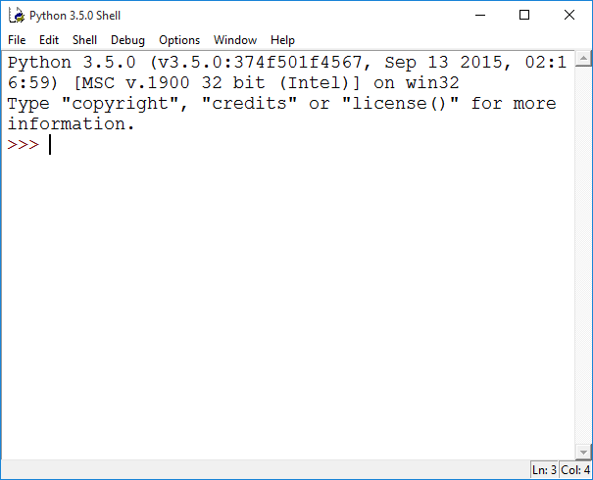
IDLE IDE
The interpreter allows you to type statements, translate them and see them run instantly
Very helpful for experimentation and learning

Slide 8
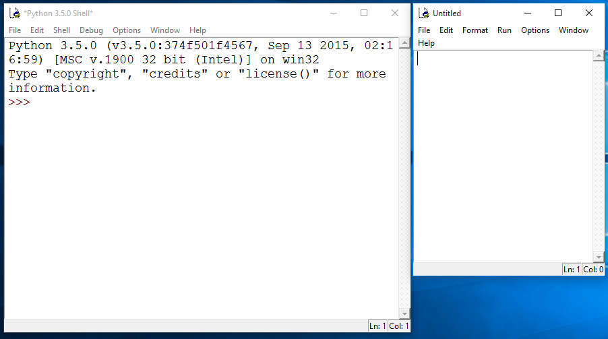
IDLE IDE
Create a new program by clicking on File → New File
Type your statements in the file, then click on Run → Run Module…

Slide 9
“Hello world”
Traditional first program is displaying “Hello World” on screen
To display text on screen you use the print() function

Slide 10
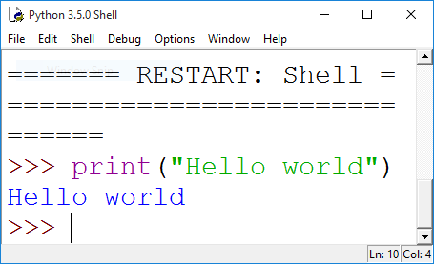
“Hello world”
Using the Python interpreter:

Slide 11
Comments
When writing a program, it is helpful to leave comments in the code
You can write a comment in Python by typing a ‘#’ in front of the line
The compiler will ignore all text after the ‘#’

Slide 12
Data types
Strings:
Sequence of characters
Plain text (ASCII or Unicode)
Enclosed in quote marks
Eg: "Hello", "Goodbye"
Integers:
Whole numbers (ie. without a decimal point)
Eg. -100, 0, 45
Floating point numbers:
Numbers with a decimal point
Eg. 5.2, -1.002, 0.0

Slide 13
Variables
A ‘container’ in the computer’s memory in which you can store data
A variable’s value can change when the program runs
Python variables are loosely-typed; they can hold any data type

Slide 14
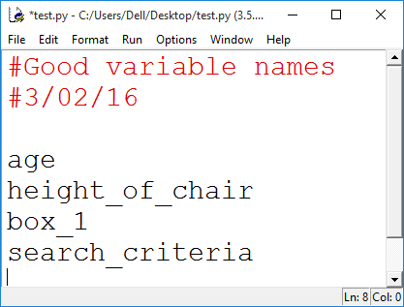
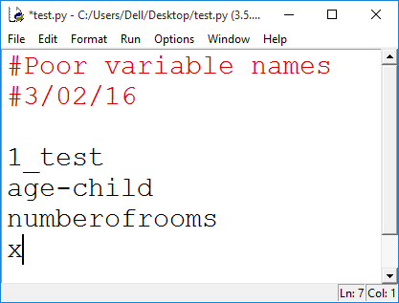
Variables
Rules to follow when naming your variables:
Names should reflect what is stored in the variable
Can begin with a letter or underscore (eg. ‘_’)
Variable names can include numbers
Generally, all words are lowercase and words are separated using an underscore

Slide 15
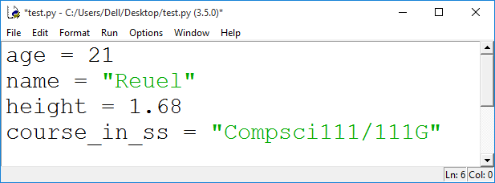
Variables
Assigning a value to a variable:

Slide 16
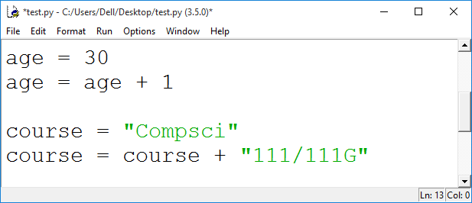
Variables
Changing the value in a variable:

Slide 17
Arithmetic operations
Operation | Symbol | Example
Exponent | ** | 2 ** 3 = 8
Multiply | * | 2 * 2 = 4
Divide | / | 10 / 3 = 3.333
Divide (integer) | // | 10 / 3 = 3
Remainder | % | 10 % 3 = 1
Add | + | 8 + 9 = 17
Subtract | - | 9 - 7 = 2

Slide 18
Print() function
Used to display information on the screen
Code | Output

Slide 19
Print() function
Concatenation: this involves joining two or more strings together
Repetition: lets you print a string multiple times

Slide 20
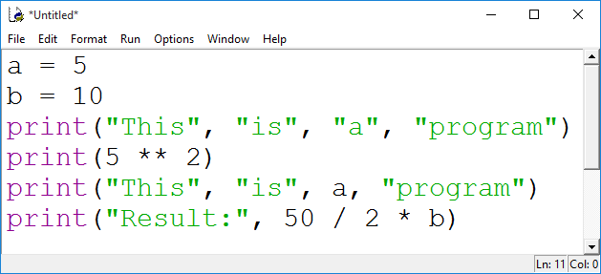
Exercise
What is the output for the following print() statements:

Slide 21
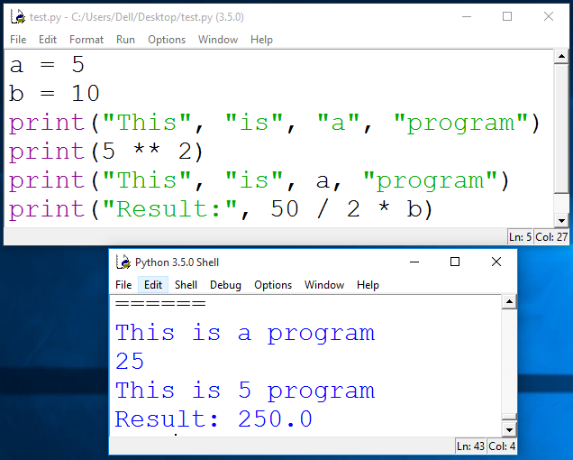
Exercises

Slide 22
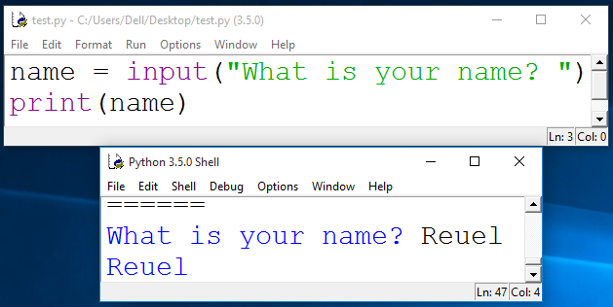
Getting input
Primary source of input for our programs will be the keyboard
The input() function:
Prints a prompt for the user to read
Captures the user’s keystrokes
When the user presses ‘Enter’, stores the string in a variable

Slide 23
Getting input
You convert the string value returned by input() to an integer or floating point value
You need to do this when you want the actual numerical value the user is entering
age = int(input(“Enter your age: “))
height = float(input(“Enter your height: “))
height = height + 1.5

Slide 24
Exercise
Write a Python program that converts feet to metres. The conversion formula is:
1 foot = 0.3048 meters
Your program’s output should look like this:
Enter feet: 34
34 feet is equal to 10.3632 metres
You will need to use:
Variables
Arithmetic operator
input() and print()

Slide 25
Exercise
feet = int(input(“Enter feet: “))
feet_to_metres = 0.3048
metres = feet * feet_to_metres
print(feet, “feet is equal to”, metres, “metres.”)

Slide 26
Summary
Python programs consist of statements that are translated by an interpreter or compiler into instructions that the CPU can execute
We’ve discussed the Python programming language and its features:
print()
Data types: string, int, float
Arithmetic operators
Variables and variable naming convention
input() and int(), float()

