Slide 1
Spreadsheets 2 - Functions and Charts
Lecture 21 – COMPSCI111/111G SS 2016

Slide 2
Today’s lecture
IF function recap
VLOOKUP and HLOOKUP
Sorting data
Inserting chart

Slide 3
IF function
Inserts a value in a cell based on the outcome of a logical test (ie. true/false)
Syntax: =IF(logical_test, value_if_true, value_if_false)
Logical tests:
Comparison operators: =, <, >, >=, <=
Logical functions:
AND(a, b)
OR(a, b)
NOT(a)

Slide 4
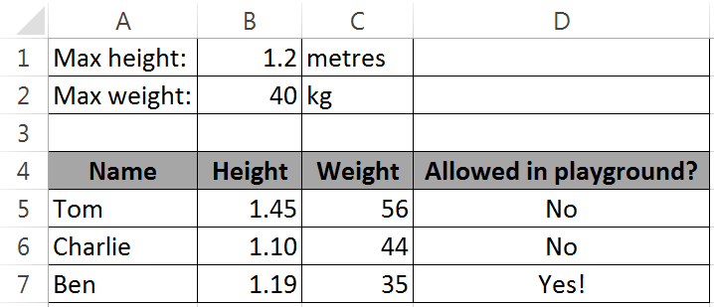
IF function
Use an IF function in cell D5 to check whether a child is under the maximum height and weight. If they are, write “Yes!”, otherwise write “No”. Ensure that your formula can be filled down.

Slide 5
IF function
Syntax: =IF(logical_test, value_if_true, value_if_false)
=IF(AND(B5<B1, C5<B2), value_if_true, value_if_false)

Slide 6
IF function
Syntax: =IF(logical_test, value_if_true, value_if_false)
=IF(AND(B5<B1, C5<B2), “Yes!”, “No”)

Slide 7
IF function
Syntax: =IF(logical_test, value_if_true, value_if_false)
=IF(AND(B5<$B$1, C5<$B$2), “Yes!”, “No”)

Slide 8
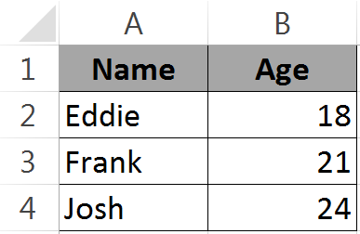
Lookup functions
Sometimes we will need to look up values in a table in our spreadsheet
For example, matching a student’s ID number with their name
Two kinds of look up functions
VLOOKUP: used with vertical tables
HLOOKUP: used with horizontal tables

Slide 9
VLOOKUP
Syntax: VLOOKUP(value, table, column, range)
Value: the cell that you are looking up
Table: a range of cells containing the table, usually written as absolute references
Column: the column of the table that contains the values we want to retrieve
Range: this is a Boolean value; true if the lookup value falls within a range, false if an exact match is required

Slide 10
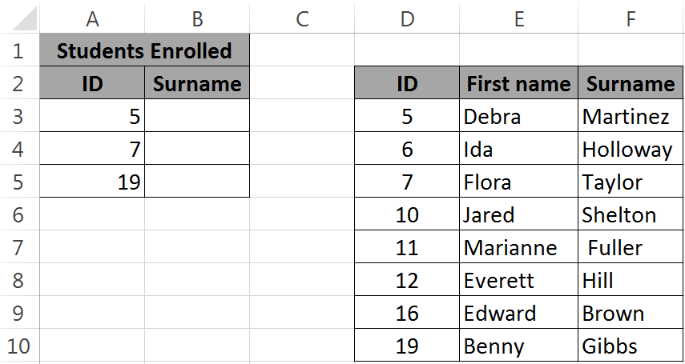
Example
Use VLOOKUP to insert the students’ surnames in the blank cells, given their ID number

Slide 11
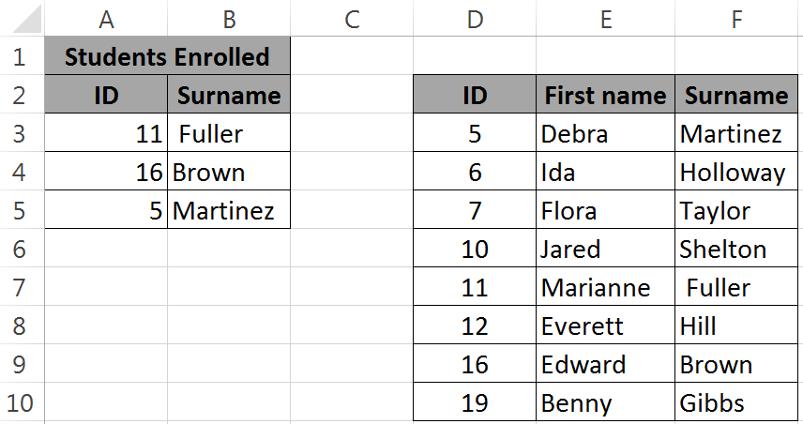
VLOOKUP Example
=VLOOKUP(A3, $D$3:$F$10, 3, false)
=VLOOKUP(value, table, column, range)

Slide 12
HLOOKUP
Same syntax as VLOOKUP, except it is used to look up values in horizontal tables
Write a formula for C6 that finds the cost of tickets on a day in A6:A8 and multiplies the cost with the number of tickets

Slide 13
HLOOKUP
Same syntax as VLOOKUP, except it is used to look up values in horizontal tables
=HLOOKUP(A6,$B$1:$H$2,2,FALSE)*B6
=HLOOKUP(value, table, row, range)

Slide 14
Exercise
Write a formula in E3 that uses the table in cells A1 to B5 to find the person’s grade and place it in the cell. Your formula must be able to be filled to the right

Slide 15
Exercise
=VLOOKUP(E2, $A$2:$B$5, 2, TRUE)

Slide 16
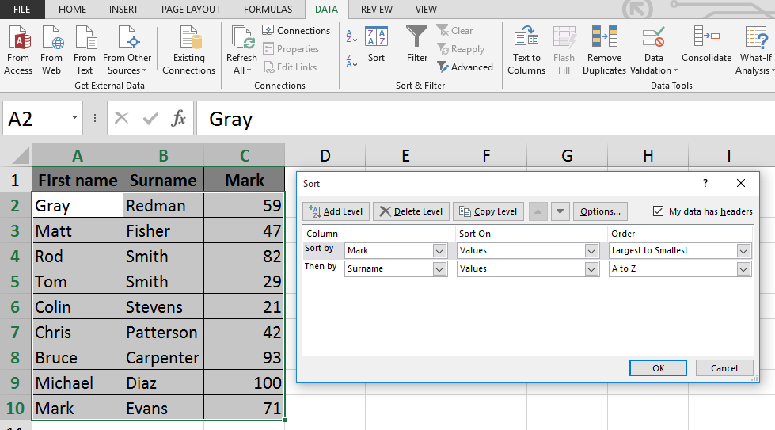
Sorting data
Excel can sort data using columns; Data → Sort

Slide 17
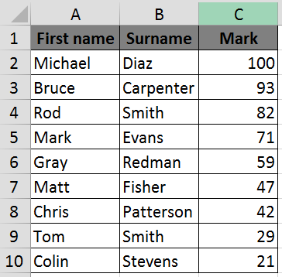
Sorting data
When we click ‘OK’ the data is sorted

Slide 18
Inserting a chart
Once you have sorted data, you can create a Chart to insert in your spreadsheet
We’ll use the data from the previous slide
Decide on what is the best chart to use to present your data
We also need to decide on the dependent and independent variable
Independent goes on the x-axis
Dependent goes on the y-axis

Slide 19
Inserting a chart
Clicking on the 2D Column chart icon gives me a preview of my chart

Slide 20
Inserting a chart

Slide 21
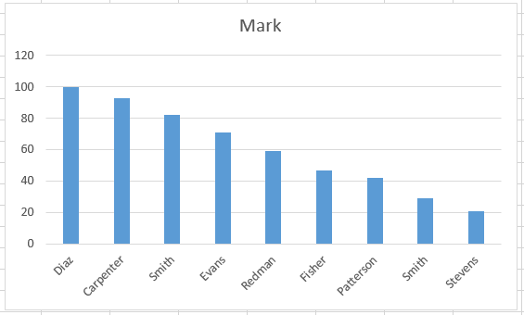
Inserting a chart
The chart that Excel generated had a few things missing

Slide 22
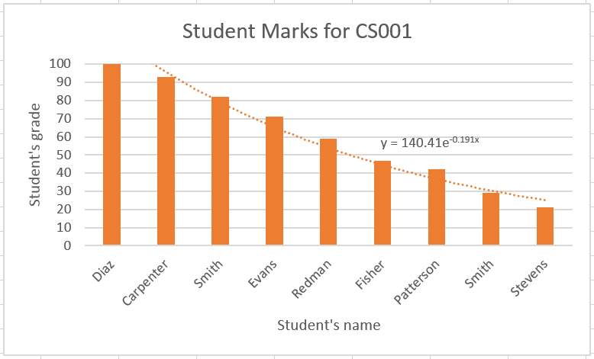
Inserting a chart
Added axis title, adjusted scale, added trendline and equation

Slide 23
Summary
Looked at three functions:
IF
VLOOKUP
HLOOKUP
Discussed more Excel features:
Sorting data
Inserting and modifying charts

