Slide 1
Spreadsheets 1 – References and Formulas
Lecture 20 – COMPSCI111/111G SS 2016

Slide 2
Today’s lecture
ORDER BY question from last class
History of spreadsheet applications
How a spreadsheet works
Absolute vs relative references
Functions:
Basic functions (SUM, MIN, MAX, AVG)
IF function
Logical tests and operators

Slide 3
Multiple ORDER BY fields
ORDER BY [field] ASC/DESC, [field] ASC/DESC
SELECT [First Names], Surname, Age FROM Students ORDER BY Surname ASC, [First Names] ASC;

Slide 4
VisiCalc
The first spreadsheet program was called VisiCalc, short for Visible Calculator
Developed by Dan Bricklin and Bob Frankston, released in 1979
VisiCalc was the first ‘killer app’ on the PC

Slide 5
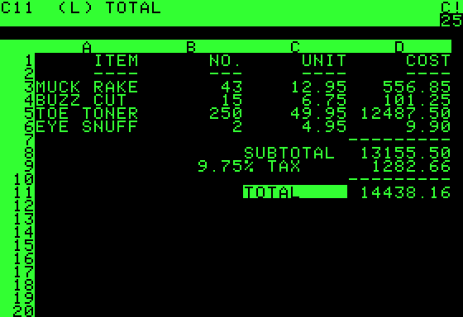
VisiCalc
VisiCalc had a number of features that are commonly found in spreadsheet programs today:
Organising calculations in rows and columns
Automatic updating of calculations
Copying formulas

Slide 6
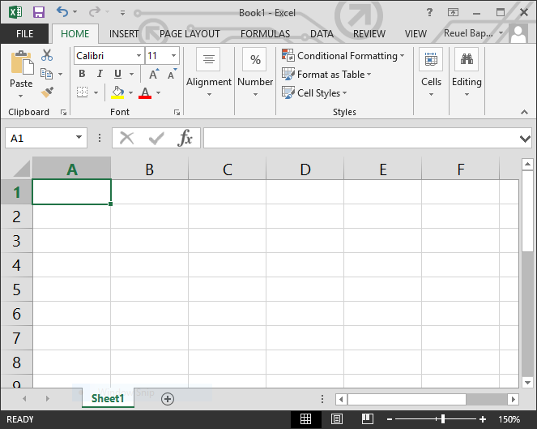
Microsoft Excel
Commonly used spreadsheet program, part of Microsoft Office
Formula bar
Current cell
(A1)
Column
Row

Slide 7
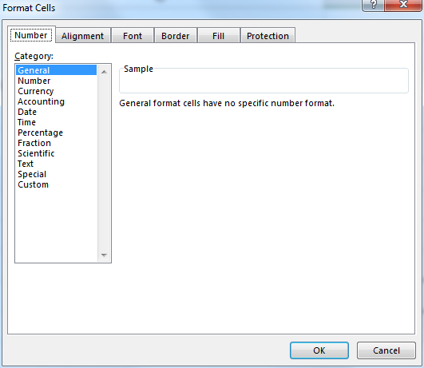
Appearance of cells
You can change the appearance of cells:
Alter size
Add borders
Add shading
Alter font
Formatting (eg. currency, decimal points, date values)

Slide 8
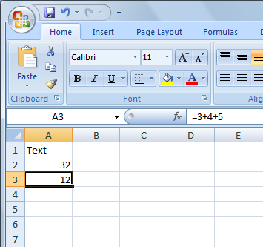
Entering data
Enter data into:
The cell
The Formula Bar (after selecting a cell)
You can enter:
Text
Numbers
Images
Formulas; must begin with ‘=’
When you enter a value, any formulas which use the current cell are recalculated

Slide 9
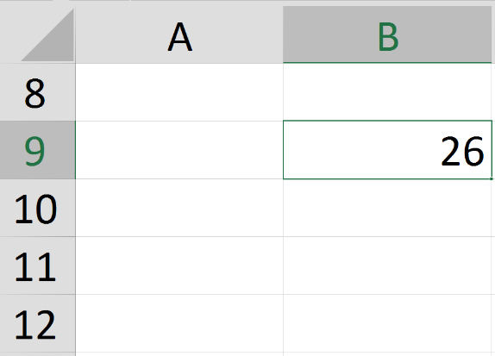
Filling cells
Allows you to automatically copy a value or formula from one cell in any direction
Steps:
Select a cell
Click and drag the small box in the bottom right hand corner in any direction
Release mouse when you’ve selected the cells to fill

Slide 10
Cell references
In some formulas, you’ll need to refer to other cells. There are two kinds of cell references.
Relative references (eg. C3)
The cell reference moves along with the formula
Absolute reference (eg. $C$3)
The ‘$’ locks the column and/or row in the reference, meaning it stays the same if the formula moves

Slide 11
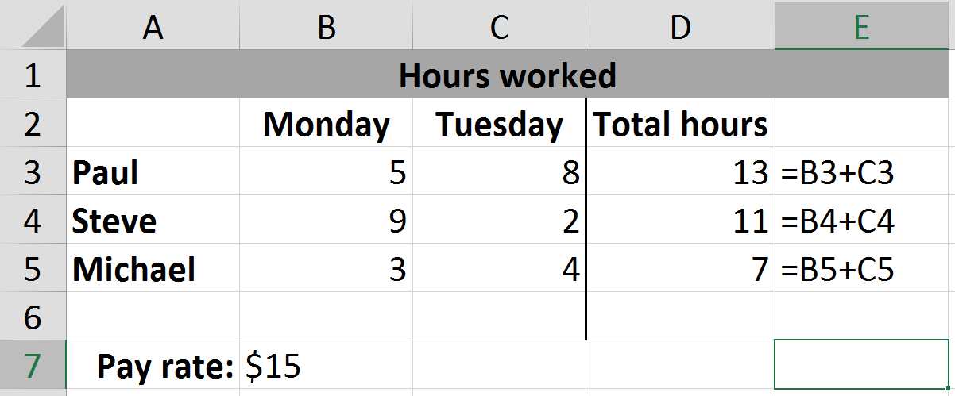
Relative references
When the formula moves down by one row, the cell references move down by one row

Slide 12
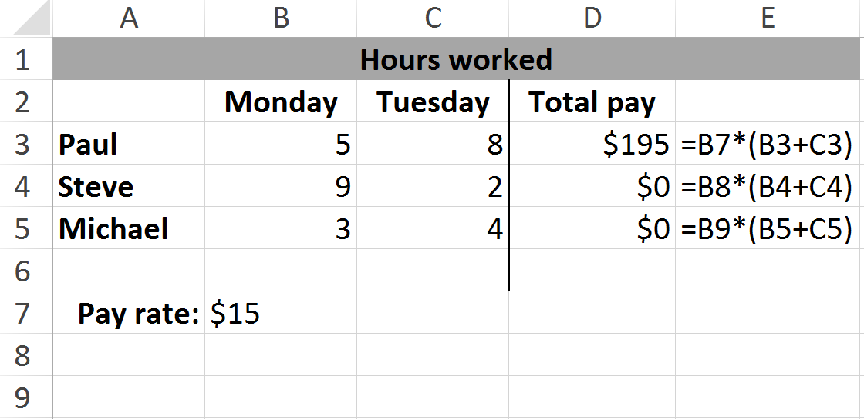
Absolute references
Since the reference to ‘Pay Rate’ is not fixed, we get incorrect results

Slide 13
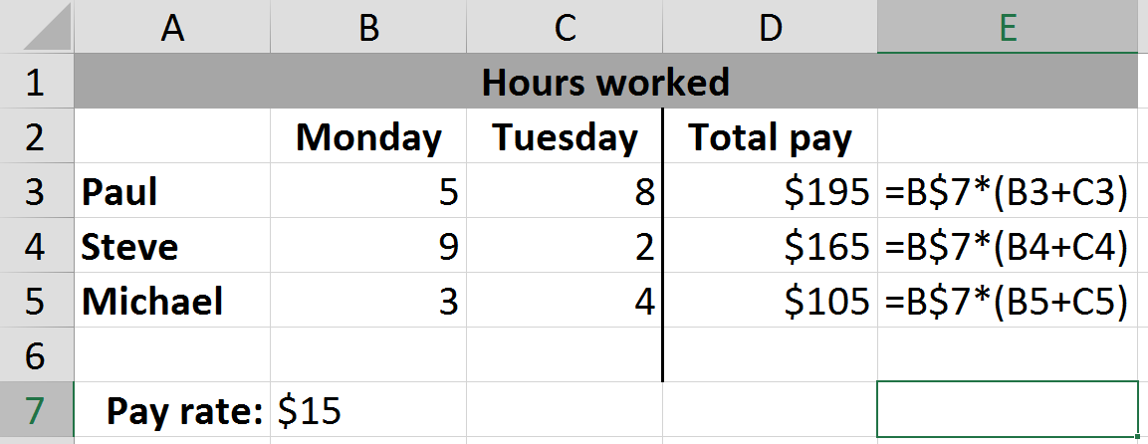
Absolute references
Using ‘$’ to lock the row in place fixes the problem
We can also lock the column with ‘$’ but it doesn’t make a difference in this case

Slide 14
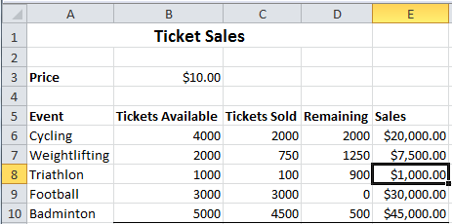
Example
What formula would you use in cell E8 to calculate the money made from ticket sales? Your formula must be able to be filled up and down

Slide 15
Example
=C8*$B$3

Slide 16
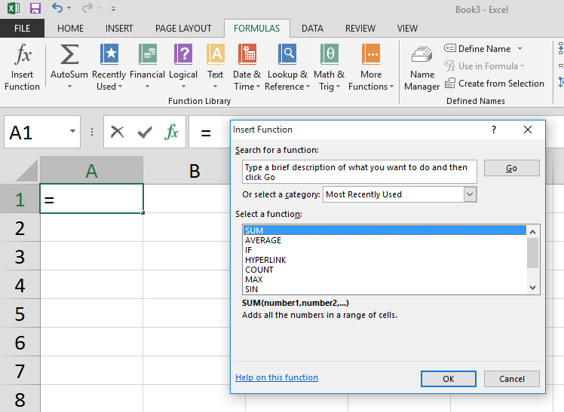
Functions
Allow you process data in your spreadsheet
Formulas → Insert Function lets you search for functions and learn about their syntax

Slide 17
Basic Functions
SUM, MAX, MIN, AVERAGE
Similar syntax: [function name](values)
SUM(range), eg. SUM(B3:B10)
SUM(cell, cell …), eg. SUM(B3, B4, B5)
SUM(number, number …), eg. SUM(5, 7, 8)
Functions can be included in formulas =B6 + SUM(A1:A100)

Slide 18
IF function
Inserts a value in a cell based on the outcome of a logical test (ie. true/false)
Syntax: =IF(logical_test, value_if_true, value_if_false)

Slide 19
Logical tests
A condition which evaluates to TRUE or FALSE
Comparison operators:
= eg. =10 = 15 is false
> and < eg. =5 > 10 is false
>= and <= eg. =5 >= 5 is true

Slide 20
Logical tests
Boolean functions:
AND(a, b); both a and b must be true eg. =AND(3 = 4, 2 = 2) is false
OR(a, b); either a or b can be true eg. =OR(3 = 4, 2 = 2) is true
NOT(a); inverts the outcome of a eg. =NOT(2 = 3) is true

Slide 21
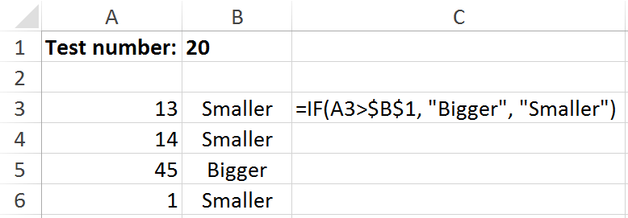
IF function
Syntax: =IF(logical_test, value_if_true, value_if_false)
IF statement places ‘Bigger’ in column B if number in column A is bigger than number in B1, and ‘Smaller’ if number in column A is smaller than number in B1

Slide 22
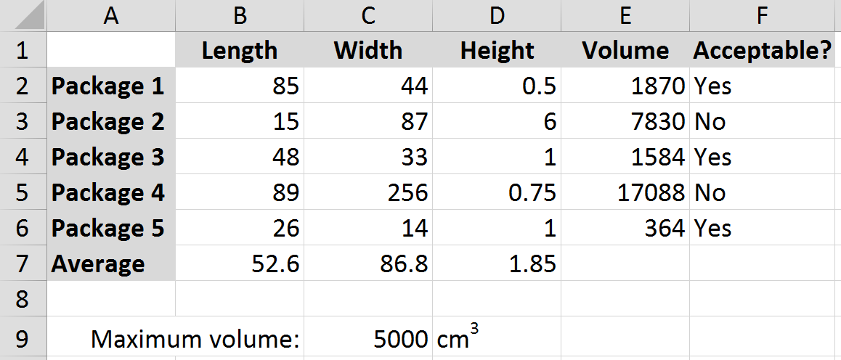
Exercise
Write formulas that can be filled down:
E2: formula to calculate the package’s volume
volume = length * width * height
F2: if the package is less than 5000cm³, then write “Yes” in cell, otherwise write “No”
Formula for B7 that can be filled right, which finds the average package length, width, height

Slide 23
Exercise
Formula in E2: =B2*C2*D2
Formula in F2: =IF(E2<$C$9, “Yes”, “No”)
Formula in B7: =AVERAGE(B2:B6)

Slide 24
Summary
VisiCalc was the first spreadsheet program and ‘killer app’
Microsoft Excel is centred on a spreadsheet made up of columns and rows
Cell references can be relative and absolute
Formulas allow us to compute values in cells. Functions allow us to process data and see an output
Functions: SUM, MAX, MIN, AVERAGE, IF

