Slide 1
Bits, bytes and digital information
Lecture 2 – COMPSCI111/111G SS 2016

Slide 2
Today’s lecture
Understand the difference between analogue and digital information
Convert between decimal numbers and binary numbers

Slide 3
Analogue vs digital information
Information in the real world is continuous
Continuous signal
Information stored by a computer is digital
Represented by discrete numbers
Weight shown
Real Weight
Weight shown
Real Weight

Slide 4
Encoding information
Real world information is stored by a computer using numbers
Visual information
11111111111111111111111
01111111111111111111111
00001111111111111111111
00000011111111111111111
00000000011111111111111
44444000001111111111111
75444000000011111111111
55554401000000111111111
33367544000000011111111
22283554444000000111111
99928357544000000011111
99999233657504000001111
99999983666554400000011
99999928338674400000001
Image
Pixels
Give each pixel colour a number.
Let the computer draw the numbers as coloured pixels (eg. black = 0).

Slide 5
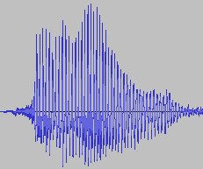
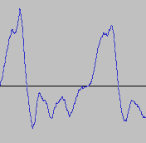
Encoding information
Sound information
Sound
Waveform
Samples
Give each sample a number (height of green box).
Let the computer move the loudspeaker membrane according to the samples.

Slide 6
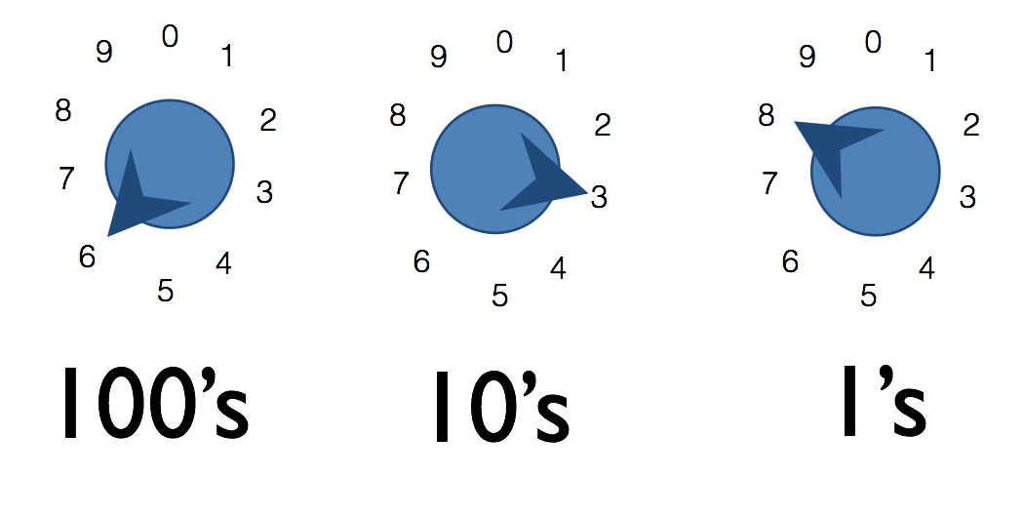
Decimal numbers
The decimal number system is a base 10 system
You can think about it as a dial with 10 positions:
600 + 30 + 8 = 638

Slide 7
Decimal numbers
The number of dials corresponds to the numbers that can be generated
So:
Possible numbers = 10^{n}
Range = 0 to 10^{n}-1
For example, if we have four dials…
Therefore:
10⁴ = 10,000 possible numbers
Note 10 = base 10 and 4 = number of dials
Range = 0 to 9999 (ie. 0 to 10⁴-1)

Slide 8
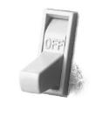
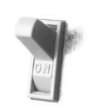
Binary numbers
A number whose value is either 0 or 1
Too complex to create 10 states in electronic circuitry. Much easier if we have two states like a switch, ON and OFF
This is how binary numbers work; 0 usually means OFF and 1 usually means ON
0
1

Slide 9
Binary numbers
Each binary number is called a bit (binary digit)
Using strings of bits, we can represent any whole number
Using one switch (ie. one bit) we can generate up to two numbers (ie. 0 and 1)

Slide 10
Binary numbers
Using two switches (ie. two bits) we can generate up to four numbers
Binary
Decimal
00
0
01
1
10
2
11
3

Slide 11
Binary numbers
So:
Possible numbers = 2^{n}
Range = 0 to 2^{n}-1
For example, if we have four switches…
Therefore:
2⁴ = 16 possible numbers
Note 2 = base 2 and 4 = number of switches
Range = 0 to 2⁴-1:
0000₂ to 1111₂
0₁₀ to 15₁₀

Slide 12
Converting binary to decimal
With decimal numbers, each dial’s position has a value:
1 * 10³ + 5 * 10² + 2 * 10¹ + 1 * 10⁰
1000 + 500 + 20 + 1
= 1521₁₀
Similarly with binary numbers, each switch’s position has a value. Convert 1101₂ to decimal:
1 * 2³ + 1 * 2² + 0 * 2¹ + 1 * 2⁰
1 * 8 + 1 * 4 + 0 * 2 + 1 * 1
= 13₁₀

Slide 13
Converting binary to decimal
Convert 10011₂ to decimal
Convert 35₁₀ to binary

Slide 14
Prefixes
A group of 8 bits is a byte
A group of 4 bits is a nibble
Bytes are the common unit of measurement for memory capacity
There are two sets of prefixes:
Decimal
Binary

Slide 15
Decimal prefixes
10^{n} | Prefix | Symbol | Decimal
1 | none |  | 1
10³ | kilo | K | 1000
10⁶ | mega | M | 1,000,000
10⁹ | giga | G | 1,000,000,000
10¹² | tera | T | 1,000,000,000,000
10¹⁵ | peta | P | 1,000,000,000,000,000
10¹⁸ | exa | E | 1,000,000,000,000,000,000
10²¹ | zetta | Z | 1,000,000,000,000,000,000,000
10²⁴ | yotta | Y | 1,000,000,000,000,000,000,000,000

Slide 16
Binary prefixes
2^{n} | Prefix | Symbol | Decimal
2⁰ | none |  | 1
2¹⁰ | kibi | Ki | 1024
2²⁰ | mebi | Mi | 1,048,576
2³⁰ | gibi | Gi | 1,073,741,824
2⁴⁰ | tebi | Ti | 1,099,511,627,776
2⁵⁰ | pebi | Pi | 1,125,899,906,842,624
2⁶⁰ | exbi | Ei | 1,152,921,504,606,846,976
2⁷⁰ | zebi | Zi | 1,180,591,620,717,411,303,424
2⁸⁰ | yobi | Yi | 1,208,925,819,614,629,174,706,176

Slide 17
Prefixes in Computer Science
Both decimal and binary prefixes are used in Computer Science
Decimal prefixes are preferred because they are easier to calculate, however binary prefixes are more accurate
Binary prefix | Decimal prefix | Value (bytes)
8 bits | 1 byte | same
1 KiB | 1 KB | 1024 ≠ 1000
1 MiB | 1 MB | 1,048,576 ≠ 1,000,000

Slide 18
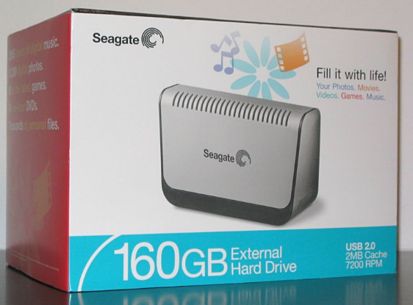
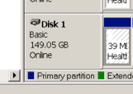
Example – hard disk sizes
A 160GB hard disk is equivalent to 149.01GiB
160GB = 160 * 10⁹
149.01GiB = (160 * 10⁹) / 2³⁰

Slide 19
Examples
Which has more bytes, 1KB or 1KiB?
How many bytes are in 128MB?
What is the decimal prefix for 10¹² bytes?

Slide 20
Summary
Computers use the binary number system
We can convert numbers between decimal and binary
Decimal prefixes and binary prefixes are used for counting large numbers of bytes

