Slide 1
Databases 2 – Retrieving information
Lecture 19 – COMPSCI111/111G SS 2016

Slide 2
Today’s lecture
Recap of yesterday’s lecture
Using Queries to retrieve information from database
Using Reports to retrieve information from a database

Slide 3
Recap
Databases can use the relational model, where relationships exist between entities
Relationships require tables, primary key and foreign key. Referential integrity is an important concept
Looked at how to create tables, insert fields and data and create a relationship

Slide 4
Aspects of a database
Before we can create our database, we need to decide how to:
Organize data in our database
Models, tables, relationships
Enter data in our database
Datasheet view
Retrieve data from our database
Present the retrieved data to the user

Slide 5
Retrieving data - queries
Queries allow you to retrieve certain records from your database
Two kinds of queries in Access:
Query by example (QBE):
Visual way of designing queries
Access converts your QBE queries into SQL
SQL (Structured Query Language):
Uses commands to retrieve data from databases
Developed by IBM in the late 1970’s
Access creates a table containing the results of the query

Slide 6
QBE queries

Slide 7
QBE queries
QBE grid
Choosing fields
Adding criteria to the field

Slide 8
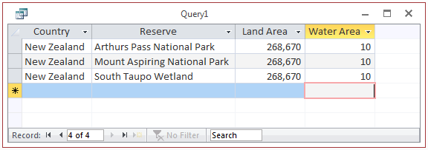
QBE queries
‘Run’ button
Query results

Slide 9
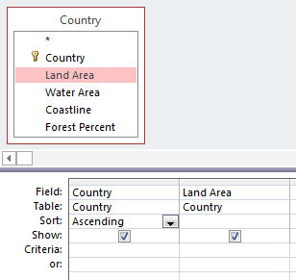
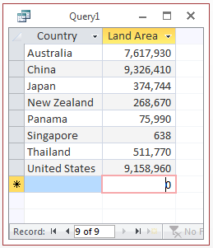
QBE queries - sorting
Results from QBE queries can be sorted in ascending and descending order

Slide 10
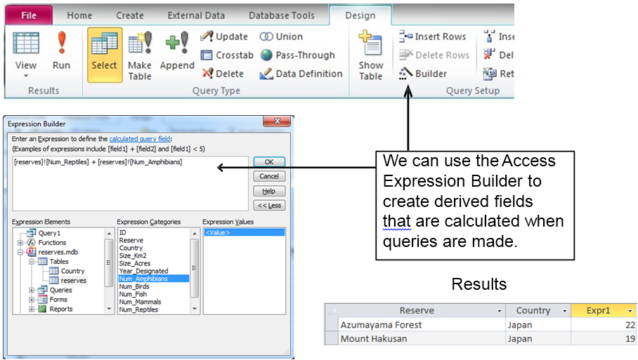
QBE queries - expressions
Fields can be combined together to create an expression with the Expression Builder
[reserves]![Num_Reptiles]+
[reserves]![Num_Amphibians]

Slide 11
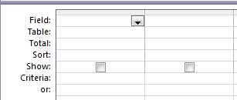
QBE queries
A Totals QBE query allows us to group data using functions such as Min, Max, Avg, Sum etc.
‘Totals’ button

Slide 12
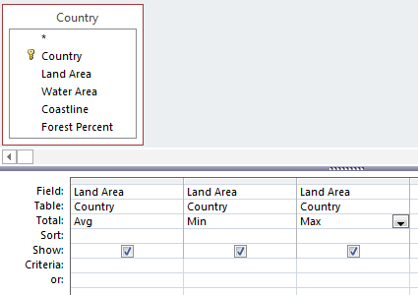
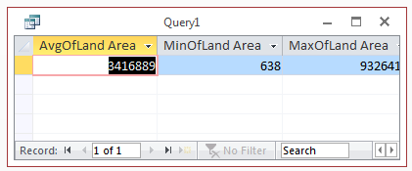
QBE queries

Slide 13
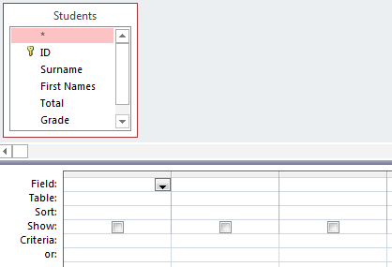
QBE Exercise
Complete this QBE grid so that it will return the first names, surname and grade (in that order) of all students who have received an A+. Sort the results by surname in alphabetical order

Slide 14
QBE Exercise

Slide 15
SQL introduction
Structured Query Language (SQL) was developed by IBM in the 1970s and is commonly used today
It uses text commands to perform operations on databases, such as inserting and removing records and running queries

Slide 16
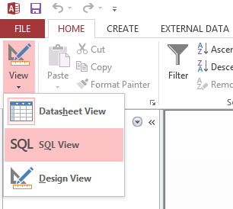
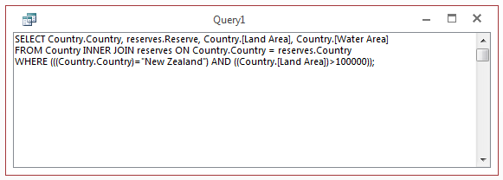
QBE queries

Slide 17
SQL queries
Four clauses that can be part of a simple SQL query:
SELECT
FROM
WHERE
ORDER BY
Construct a SQL query that will return the first names, surname, and grade (in that order) of all students who have received an A+. Sort the results by surname in alphabetical order

Slide 18
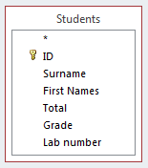
SQL queries - SELECT
Selects fields from the tables that we want to display in our results table
Syntax: SELECT [comma separated list]
SELECT [First Names], Surname, Grade
Note the square brackets around ‘First Names’ needed because of the space

Slide 19
SQL queries - FROM
Specifies the table which holds the field(s) listed in the SELECT clause
Syntax FROM [comma separated list]
SELECT [First Names], Surname, Grade FROM Students

Slide 20
SQL queries - WHERE
Optional; used to provide criteria that limit the records displayed in the results table
Syntax WHERE [criteria], [criteria], …
There are a range of criteria we can use:
Comparisons (=, >, <, <=, >=, <>)
e.g., WHERE [Land Area] < 50000
BETWEEN … AND …
e.g., WHERE Price BETWEEN 10 AND 20
LIKE (some pattern)
e.g., WHERE [City] LIKE ‘San *'
AND, NOT, OR (combined with any of above)
e.g., WHERE Country = ‘New Zealand' AND City = ‘Auckland'
IS NULL, IS NOT NULL
e.g., WHERE [Postal Code] IS NOT NULL

Slide 21
SQL queries - WHERE
SELECT [First Names], Surname, Grade FROM Students WHERE Grade = ‘A+’

Slide 22
SQL queries – ORDER BY
Optional; allows us to sort our data in ascending or descending order
Syntax: ORDER BY [name of field] [ASC/DESC]
SELECT [First Names], Surname, Grade FROM Students WHERE Grade = ‘A+’ ORDER BY Surname ASC

Slide 23
SQL queries
You need to ensure that you put a semi-colon on the last clause of your SQL query:
SELECT [First Names], Surname, Grade FROM Students WHERE Grade = ‘A+’ ORDER BY Surname ASC;

Slide 24
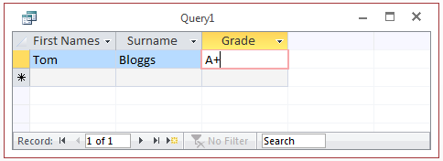
SQL queries
We run a SQL query in the same way that we run a QBE query
‘Run’ button

Slide 25
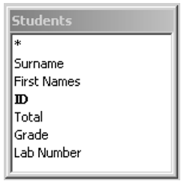
SQL exercise
Write an SQL command that will only display the first name, surname and grade of students whose Total mark was greater than 70. Order the results table by ID number in ascending order

Slide 26
SQL exercise
SELECT [First Names], Surname, Grade FROM Students WHERE Total > 70 ORDER BY ID ASC;

Slide 27
Aspects of a database
Before we can create our database, we need to decide how to:
Organize data in our database
Models, tables, relationships
Enter data in our database
Datasheet view
Retrieve data from our database
QBE and SQL queries
Present the retrieved data to the user

Slide 28
Reports
Reports allow you to present the contents of a table, query etc. in a nicely formatted table
There are two ways of creating Reports:
Report Tool (show entire table, some formatting control)
Report Wizard (table/field selection, grouping, sorting)

Slide 29
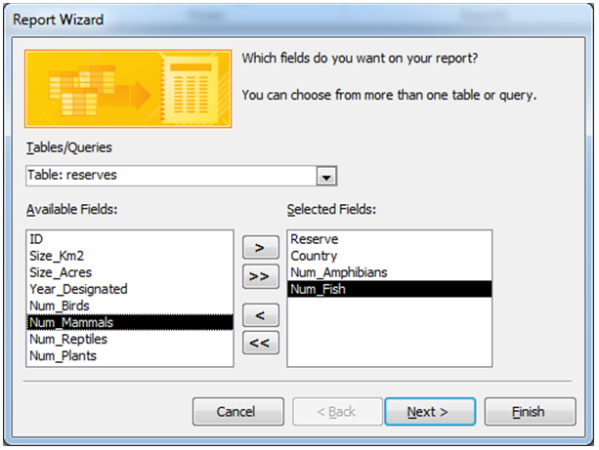
The Report Wizard
Select the tables and fields you want to display in your report

Slide 30
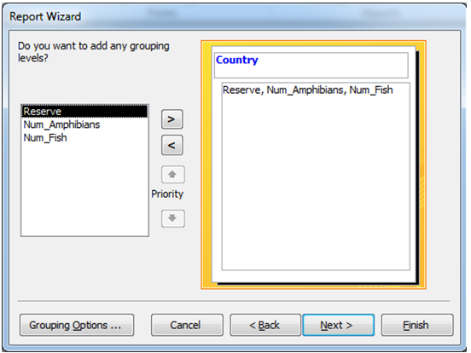
The Report Wizard
You can group records in the report using particular fields

Slide 31
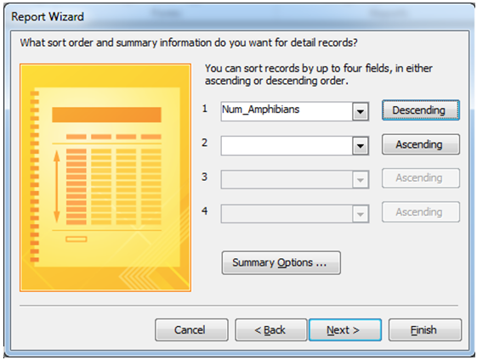
The Report Wizard
You can sort records in the report by one or more fields

Slide 32
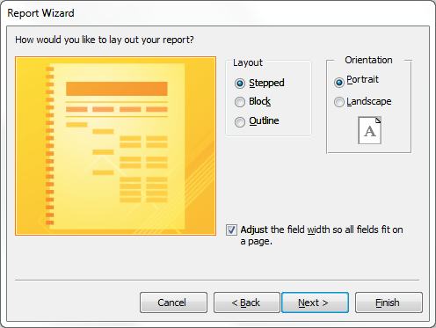
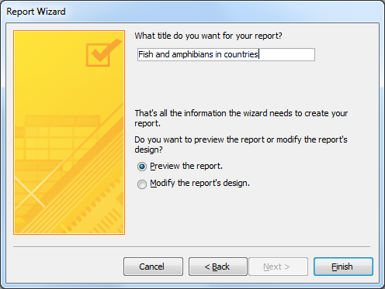
The Report Wizard
You can set certain aspects of your report’s formatting in the Wizard
The final step involves giving the report a name and clicking on ‘Finish’

Slide 33
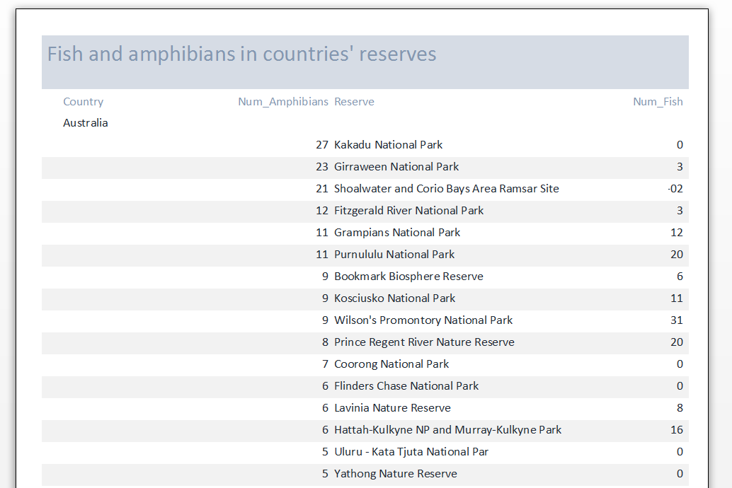
The Report Wizard
The finished report, ready for printing
You can continue to modify the report’s formatting at this point

Slide 34
Summary
Organize data in our database
Models, tables, relationships
Enter data in our database
Datasheet view
Retrieve data from our database
QBE and SQL queries
Present the retrieved data to the user
Report Wizard

