Slide 1
Databases 1 – Organisation and Creation
Lecture 18 – COMPSCI111/111G SS 2016

Slide 2
Today’s lecture
What is a database?
Understanding how data is organised in a database
Creating a database in Microsoft Access

Slide 3
What is a database?
A (typically large) collection of data about a particular topic, organized systematically
Examples:
Catalogue of library books
Patients’ files in a clinic
Entries in an address book
Students in a class
Computers allow us to store and manage databases that contain very large amounts of information

Slide 4
Aspects of a database
Before we can create our database, we need to decide how to:
Organize data in our database
Enter data in our database
Retrieve data from our database
Present the retrieved data to the user

Slide 5
1. Organising data - models
A model defines how data is organized and structured within the database
We’re going to look at the relational model in this course
When deciding what data to store in a database, we need to think about:
Entities: things about which we store information
Eg. students in uni, courses in uni
Relationships: specific connections among entities
Eg. students enrolled in CompSci111/111G

Slide 6
1. Organising data - tables
The relational model was developed by Edgar Codd in 1970
Data is stored and organized in tables
A table’s columns are called fields; an entity’s attributes
A table’s rows are called records; one instance of an entity
A collection of tables form a database
Field
Record

Slide 7
1. Organising data
Tables are connected together using relationships, thereby creating connections between different entities

Slide 8
1. Organising data
There are two parts to a relationship; primary key and foreign key
1. Primary key:
Generally, all tables must have a primary key field
All records must have a value in the primary key field
The primary key’s value must be unique
Primary key

Slide 9
1. Organising data
2. Foreign key
A field in one table that is related to a primary key field in another table
Creates a connection between the two fields
Can take blank values and/or repeated value depending on the relationship

Slide 10
Referential integrity
An important concept underlying relationships between tables
Referential integrity requires all values of a foreign key field to be:
Present in the related primary key field, OR
Null (ie. blank)

Slide 11
Referential integrity
Insert 9998881, COMPSCI111, 22/12/2015 into Enrolments
Insert 6697826, COMPSCI105, 16/12/2015 into Enrolments
Insert , COMPSCI101, 01/12/2015 into Enrolments




Slide 12
Types of relationships
There are three kinds of relationship that can exist between tables
One to one: one record in PK related to one record in FK
Eg. student can only have one transcript
One to many: one record in PK related to multiple records in FK
Eg. student can have multiple emergency contacts
Many to many: multiple records in PK related to multiple records in FK
Eg. many students can be enrolled in many papers

Slide 13
Aspects of a database
Before we can create our database, we need to decide how to:
Organize data in our database
Models, tables, relationships
Enter data in our database
Retrieve data from our database
Present the retrieved data to the user

Slide 14
Database Management System (DBMS)
Application software that is used to manage databases.
Four main functions:
Definition
Update
Querying
Administration
Examples:
Microsoft Access
Microsoft SQL Server

Slide 15
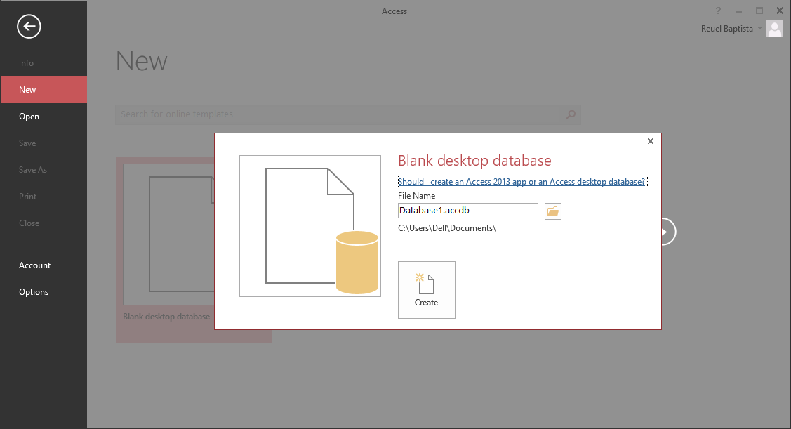
Creating a database
Templates
Creating a new database

Slide 16
Creating a table
New table button

Slide 17
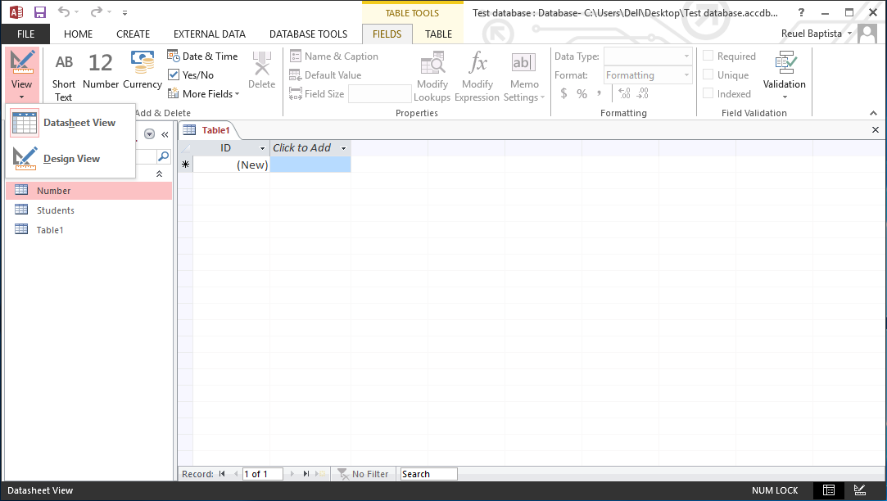
Creating a table
Design view: create/view the fields in the table
Datasheet view: create/view data in the table

Slide 18
Design view

Slide 19
Design view

Slide 20
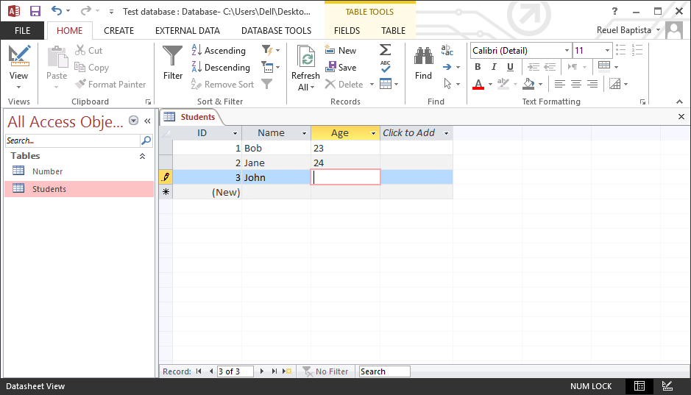
Datasheet view
Allows us to enter data into our table
Need to ensure that we enter the correct type of data in each field (eg. no text in a number field)

Slide 21
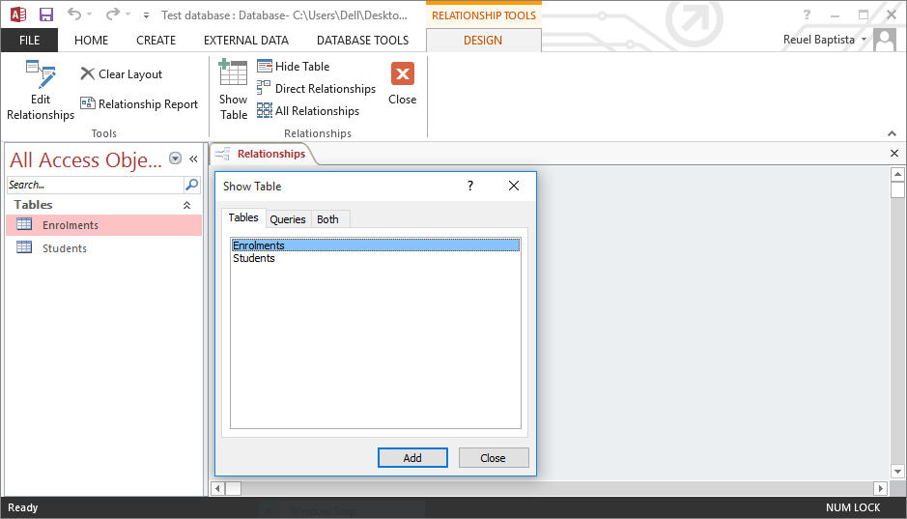
Creating relationships
Relationships view allows us to create relationships between fields in different tables
Database Tools tab → Relationships button

Slide 22
Creating relationships

Slide 23
Creating relationships

Slide 24
Creating relationships

Slide 25
Exercises
What is the primary key and the foreign key (if one exists) for the Label table?
What is the primary key and the foreign key (if one exists) for the Artist table?
What is the primary key and the foreign key (if one exists) of the Albums table?

Slide 26
Answers
Label
PK: ID
FK: none
Artist
PK: ID
FK: LabelID
Albums
PK: ID
FK ArtistID

Slide 27
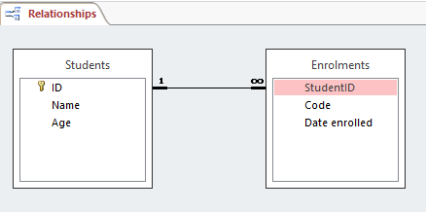
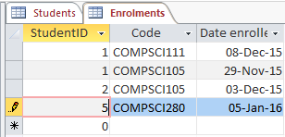
Inserting data
Can we insert this record in the Enrolments table?

Slide 28
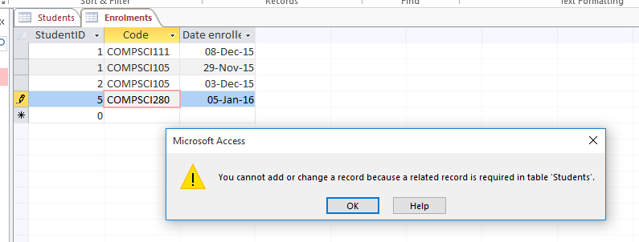
Inserting data
This won’t work; StudentID’s value (‘5’) doesn’t exist in the primary key ID

Slide 29
Summary
A database is used to store information in a systematic and orderly manner
The relational model uses tables to store information about entities and relationships to connect tables together
Relationships require tables, primary keys, foreign keys. Referential integrity is an important concept
Microsoft Access is a popular DBMS that we can use to insert and manage data in our database

