Slide 1
Welcome to COMPSCI111/111G
Summer School 2016

Slide 2
Today’s class
Introduction to COMPSCI111/111G
People
Assessment
Labs
Test and exam
Introduction to hardware
Bits, bytes and digital information

Slide 3
Lecturers
Damir Azhar
damir.azhar@auckland.ac.nz
303S, Level 3, room 390
Reuel Baptista
reuel.baptista@auckland.ac.nz
303S, Level 5, room 567
Paul Ralph
p.ralph@auckland.ac.nz
303S, Level 4, room 492
We all have an open door policy. Visit anytime or email for an appointment

Slide 4
Course coordinator and lab supervisor
Ann Cameron
303S, Level 4, room 479
a.cameron@auckland.ac.nz
Open door policy. Visit anytime or email for appointment
Contact Ann if you have questions about the course or labs

Slide 5
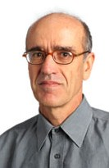
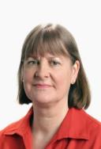
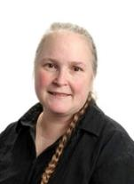
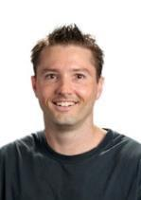
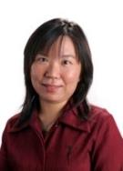
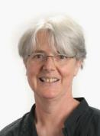
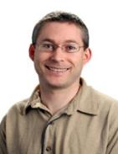
Computer Science Support Network
Radu Nicolescu
303-587 Ext: 86831
E-mail: r.nicolescu@auckland.ac.nz
Pat Riddle
Room: 303S.392
Ext: 87093
Email: pat@cs.auckland.ac.nz
Ann Cameron
Room: 303S.479
Ext: 84947
E-mail: ann@cs.auckland.ac.nz
Need to talk to someone?
We are here to
listen and help!
Come and talk to us!
Paul Denny
Room: 303S.465
Ext: 87087
Email: paul@cs.auckland.ac.nz
Angela Chang
Room 494
Ext: 86620
Email: angela@cs.auckland.ac.nz
Adriana Ferraro
Room: 303S.490
Ext: 87113
Email: adriana@cs.auckland.ac.nz
Andrew Luxton-Reilly.
Room: 303S.479
Ext: 85654
Email: andrew@cs.auckland.ac.nz

Slide 6
Marks for COMPSCI111/111G
Theory: exam and test
Practical: labs
Need to pass half of the theory and half of the practical in order to pass the course
Exam (60%)
Test (20%)
Labs (20%)

Slide 7
Test
Wednesday 27 January, 11.30am-12.30pm F&PA Auditorium
The test will cover lectures 1-14 and labs 1-5

Slide 8
Labs
An opportunity to practise what you learn in lectures
2 compulsory 3-hour labs each week
9 labs worth 20% of final mark
10% of each lab’s mark is given for arriving on time
Hand in lab assignment before start of next lab
Before labs start on Thursday please:
Buy a lab manual from UBS
Find the First Floor Teaching Lab (FTL - 303S-175)
Make sure you have a USB drive

Slide 9
Exam
Date and location will be announced by the Exams Office

Slide 10
Class representative

Slide 11
Places to find information
Canvas and email announcements
The course website: www.cs.auckland.ac.nz/courses/compsci111ssc
You need to purchase a 2016 Summer School lab manual from UBS
Coursebook; available on the home page of the course website
The Computer Science student forum: http://forums.cs.auckland.ac.nz
Any of the COMPSCI111/111G teaching staff ☺
Please use your University email account when emailing us

Slide 12
Computer Hardware
Lecture 1 – COMPSCI111/111G SS 2016

Slide 13
Today’s lecture
Identifying the key components in a computer
Understanding how these components work
Using this knowledge to understand computer specs

Slide 14
Overview of a computer
Communication
Input
Processing
Output
Storage

Slide 15
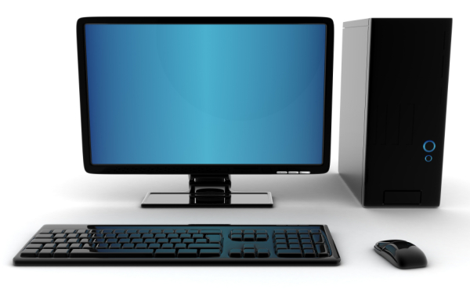
Computer hardware
“Those parts of the system that you can hit with a hammer (not advised) are called hardware”
Key design principle of modularity
System Unit
Monitor
Keyboard
Mouse

Slide 16
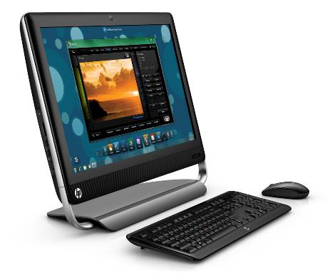
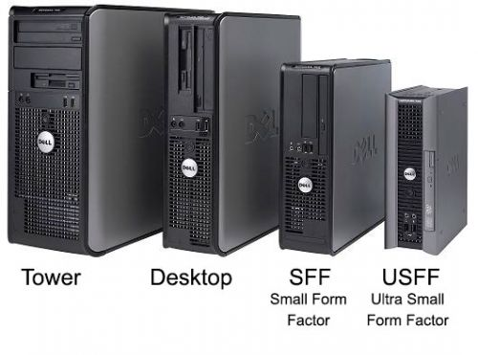
Form factors
System units come in lots of different form factors
All-in-one PC

Slide 17
Inside the system unit
RAM
Optical drive
Power supply
Fans
CPU
Hard disk drive
Expansion cards
Motherboard

Slide 18
Inside a laptop
CPU
RAM
Fans
Optical drive
Motherboard
Power supply (batteries)
Hard disk drive

Slide 19
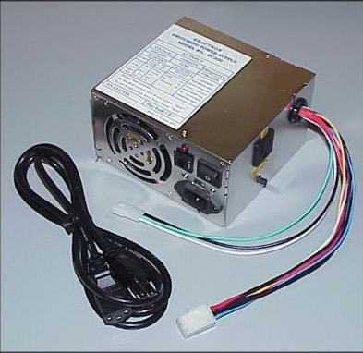
Power supply unit
Converts AC voltage to DC voltage for use within the computer

Slide 20
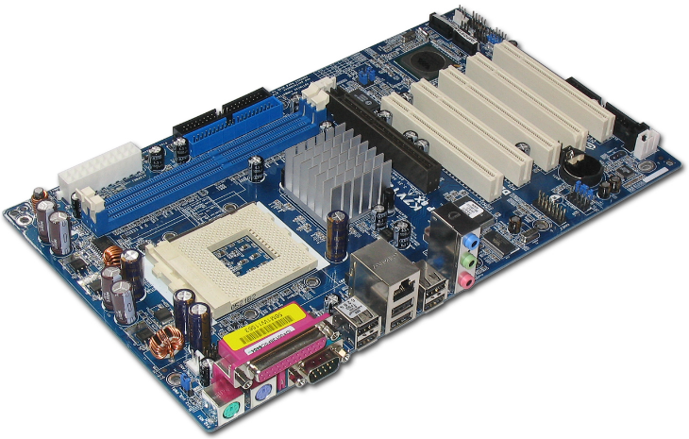
Motherboard
The main circuit board to which all components are connected, allowing them to communicate with each other

Slide 21
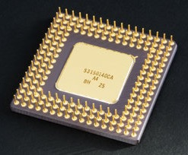
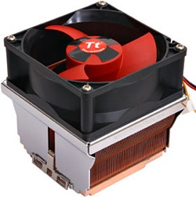
Central processing unit (CPU)
The ‘brain’ of a computer. Processes data in a computer using its instruction set
Performance measured in instructions per second
Clock speed (measured in Hertz [Hz]) measures the speed at which electrical signals pass through the processor
CPUs must be kept cool, generally using a heatsink and fan

Slide 22
CPUs - transistors

Slide 23
CPUs – Moore’s Law
Gordon Moore (Intel co-founder) stated in a 1965 paper: ‘The number of transistors on a single integrated circuit doubles approximately every 18 months, while the price remains the same.’
So…
In 3 years, CPUs will be 4 times faster
In 15 years, CPUs will be 1000 times faster

Slide 24
CPUs - Moore’s Law
Moore’s Law has been an important guide for many aspects of the tech industry, especially in CPU manufacture
We’re finding it more difficult to keep up with Moore’s Law as we reach the limits of our fabrication technology

Slide 25
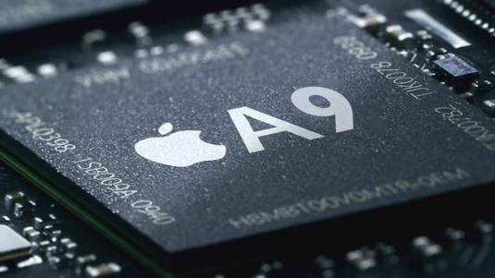
CPUs – other measures
Power efficiency and heat are just as important as clock speed
Modern CPUs have multiple cores, increasing their processing capacity
New kinds of processors, such as system on chip (SoC) are commonly used in mobile and embedded devices

Slide 26
Wirth’s Law
Niklaus Wirth stated in 1995 that ‘software gets slower more rapidly than hardware gets faster’

Slide 27
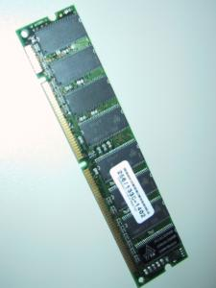
Primary memory
Used to store data for quick access by CPU
Main form of primary memory is Random Access Memory (RAM)
RAM is volatile memory
More RAM improves a computer’s speed by providing more quick access memory
Capacity is measured in bytes, clock speed measured in Hz
Many types of RAM; common type is DDR3 SDRAM

Slide 28
Secondary memory
Used to store files for repeated access over time
Also known as non-volatile storage; the storage medium retains its contents without electricity
Many forms of secondary storage:
Hard disk drive (HDD)
Solid state drive (SSD)
CDs, DVDs, Blu-ray
USB drives, external HDDs

Slide 29
Hard Disk Drive (HDD)
Stores data on spinning magnetic disks. Data is read and written by moving heads
Advantages:
Cheap storage medium
Widely used and supported
Can have very large capacity drives
Long operating life
Disadvantages:
Noisy operation
Can consume more power than SSDs
Fragile, needs to be handled carefully

Slide 30
Solid State Drive (SSD)
Stores data on flash memory, the same technology used by USB drives
Advantages:
Silent operation
Higher read/write rates when compared to HDDs
Low power usage
More durable
Use less space
Disadvantages:
Costlier than HDDs
Can wear out faster than HDDs

Slide 31
Memory capacity

Slide 32
Expansion cards
Additional circuit board that provides extra functionality
Examples: sound card, graphics card, network card
Plugged into motherboard using slots that follow certain standards:
ISA
PCI-E
AGP

Slide 33
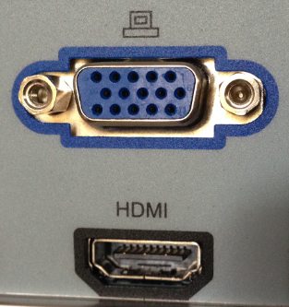
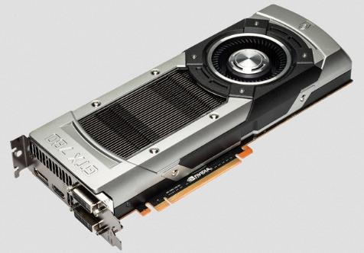
Graphics card
Used to perform graphics processing and run the computer’s monitors
Consists of:
GPU (built-in/discrete)
Video memory
Heatsink and fan
Ports

Slide 34
Redundant Array of Independent Disks (RAID)
RAID pools HDDs/SSDs together to form a larger, more reliable data storage mechanism
Each RAID configuration has its own strengths and drawbacks
RAID is commonly used in servers
Hard Disk 01
Data
RAID
Controller
Hard Disk 02
Hard Disk 03

Slide 35
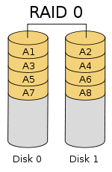
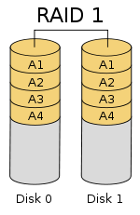
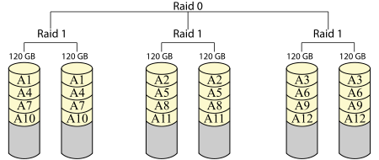
RAID configurations
Numerous configurations, we’re focusing on two:
RAID 0 – data stripes used to increase speed
RAID 1 – data redundancy used to increase reliability
RAID 10 combines RAID 0 and RAID 1 together
RAID 10

Slide 36
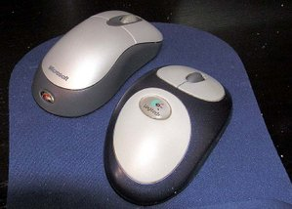
Input devices
Peripherals that enables the user to provide information to the computer
Common input devices:
Keyboard
Mouse
Webcam
Other input devices:
Voice recognition
Biometric scanners
RFID tags

Slide 37
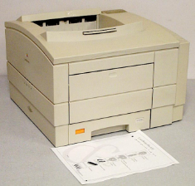
Output devices
Peripherals that present information processed by the computer to the user
Output devices include:
Computer monitor
Printer
Speakers
Touchscreens
New forms of output include:
Virtual reality

Slide 38
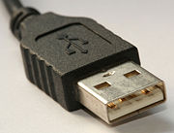
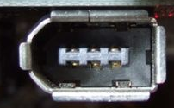
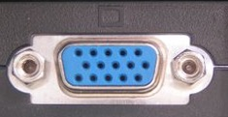
Connectors and buses
All peripherals are connected to the motherboard via ports
Ports form part of a bus
Wired connections:
USB (Universal Serial Bus)
Firewire and Thunderbolt high speed buses
Ethernet
VGA, DVI and HDMI for monitors
Wireless connections:
Wi-Fi
Bluetooth

Slide 39
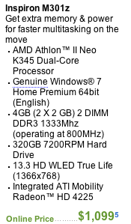
Computer specs
How much primary memory does this computer have?
How many cores does the processor have?
Does this computer have a motherboard?
Does this computer have a graphics card?

Slide 40
Summary
Computers process input from the user and other sources and provide output
Computer systems are designed using the principle of modularity
System units are made up of a number of components working together:
Power supply
Motherboard
CPU
Primary and secondary memory
Connectors and buses

