Slide 1
COMPSCI 111 / 111G Mastering Cyberspace: An introduction to practical computing
Programming with Python --
Conditions, loops and turtle graphics

Slide 2
Revision
Ask the user to enter a number of centimetres. The program should print out the number of metres and centimeters that are equal to the input.
#Author: Andrew Luxton-Reilly
#Date: 7/05/15
#Ask the user to enter the number of centimetres
cm = int(input("Please enter the number of centimetres: "))
#Calculate the number of metres and centimetres
m = cm // 100
cm = cm % 100
#Print the output to the user
print(m, "metres and", cm, "centimeters")

Slide 3
Exercise
Write a program that asks the user to enter a number of feet and a number of inches. The program should convert this to a length in meters (with decimal points)
Note: 1 inch = 2.54 centimetres
1 foot = 12 inches
Sample Output:
Please enter the number of feet: 6
Please enter the number of inches: 0
6 feet and 0 inches
is equivalent to 1.8288 meters

Slide 4
Conditionals in Stored Programs
Many of our everyday routine activities involve conditional behavior of this sort.
We can produce conditional activity in stored programs by stating that some steps should happen only if a test is met.
Such constructs ease construction of computer programs because it makes them more flexible and adaptive.
Nearly all nontrivial stored programs include some form of conditional behavior.
2/10/2015
COMPSCI 111/111G - Python 02
4

Slide 5
if statements
if <condition>:
statements to execute if condition is true
else:
statements to execute if condition is false
A colon appears in two places
after the <condition>
after the keyword else
The <condition> should be a boolean expression
Evaluates to either true or false
Statements to be executed are organised as blocks
Statements should be indented to the same amount
Any number of statements can be executed in a block

Slide 6
Comparison operators
Used to compare two things
Evaluates to a boolean value
Commonly used in a condition
Meaning | Operator | Example
Less than | < | a < b
Less than or equal to | <= | a <= b
Greater than | > | a > b
Greater than or equal to | >= | a >= b
Equal to | == | a == b
Not equal to | != | a != b

Slide 7
Example
Write a program that asks the user to enter a number. The program should determine if the number is odd or even, and print out an appropriate message.
#Author: Andrew Luxton-Reilly
#Date: 7/05/15
#Ask the user to enter a number
number = int(input("Please enter a number: "))
#Determine if the number is odd or even
if (number % 2 == 0):
print("You entered the number", number)
print("That number is even")
else:
print("You entered the number", number)
print("That number is odd")

Slide 8
Exercise
Write a program that asks the user to enter their age, and then prints out a ticket based on their age:
Child tickets (below the age of 12) cost $5.00
Adult tickets (age 12 or above) cost $9.99
The tickets should look like:
************
Child Ticket
Price: $5.00
************
************
Adult Ticket
Price: $9.99
************

Slide 9
Logical operators
Used to combine boolean expressions into more complex constructions
and
or
not
Meaning | Operator | Example
Logical AND | and | number >= 1 and number <= 2
Logical OR | or | number == 1 or number == 2
Logical NOT | not | not( number < 1 or number > 2)

Slide 10
Example
Write a program that asks the user to enter a number between 1 and 10 (inclusive). The program will print out "Correct" if the number is in the range and "Incorrect" if the number is outside the range.
#Author: Andrew Luxton-Reilly
#Date: 7/05/15
#Ask the user to enter a number
number = int(input("Please enter a number (1-10): "))
#Determine if the number is within the range
if (number >= 1 and number <= 10):
print("Correct")
else:
print("Incorrect")

Slide 11
Iteration in Programs
We can specify such repetitive activity with constructs for looping or iteration; in general, these involve:
Initializing the values of variables, including counters
Stating one or more steps that should occur on each loop
Including incrementing/decrementing any counters
Indicating the conditions for continuing or halting
Note that iteration relies centrally on both variables and conditional statements.
Nearly all nontrivial computer programs use iteration.
2/10/2015
COMPSCI 111/111G - Python 03
11

Slide 12
Iteration in Python
The most basic way to iterate in Python is with the while construction, which takes the form:
while <condition>:
statements to execute while <condition> is True
If the condition holds, then Python executes the statements in its scope (as denoted by indentation).
After this occurs, it returns to the top and checks the while condition again.
This process continues until the condition no longer holds.
When this occurs, Python skips the statements in the while block and executes any statements that follow it.
2/10/2015
COMPSCI 111/111G - Python 03
12

Slide 13
Flow Diagram
statements before the loop
Is condition
true?
Yes
Execute each statement in the block
No
statements after the loop

Slide 14
Example
Keep asking the user to enter a number bigger than 0 until they enter a number bigger than 0.
#Author: Andrew Luxton-Reilly
#Date: 7/05/15
#Set the number to be -1 to start
number = -1
while (number <= 0):
number = int(input("Please enter a positive number: "))
print("Well done")

Slide 15
Exercise
Write a program that repeatedly asks the user to enter a number between 1 and 10 until the number they enter falls inside that range
Sample output:
Please enter a number between 1 and 10: 0
Please enter a number between 1 and 10: 99
Please enter a number between 1 and 10: -1
Please enter a number between 1 and 10: 10
Well done

Slide 16
Using a loop to count
Extremely common in programming
Loop a specified number of times
Use the same pattern of code
#Loop from start to end
start = 10
end = 20
#Use a variable to keep track of the loop
count = start
while (count <= end):
#do something
print(count, "*", count, "=", count ** 2)
#increase value of count
count = count + 1

Slide 17
Example
Print out all the numbers between 1 and 1000
Use a variable to keep track of the numbers
Start the loop with number = 1
Stop the loop after the number reaches 1000
#Author: Andrew Luxton-Reilly
#Date: 7/05/15
#Use a variable to keep track of the loop
count = 1
#Keep doing the loop until we have reached 10
while (count <= 1000):
print(count)
count = count + 1

Slide 18
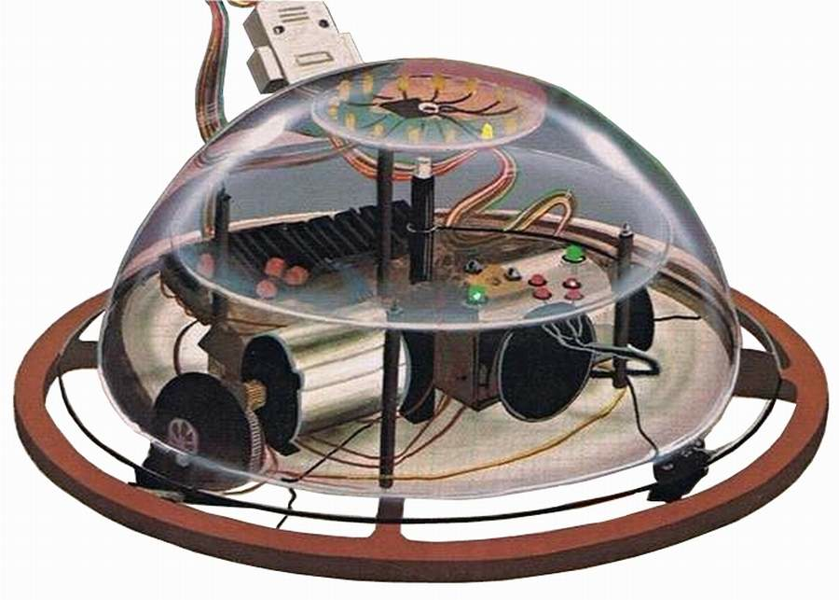
Logo and Turtle Graphics
In 1967, Seymour Papert and Wally Feurzeig created an interpretive programming language called Logo.
Had a simple syntax for children to be able to master rapidly
By 1969, Papert had added commands to control a robot turtle that drew lines on paper.
Extra commands could also
control a virtual turtle that drew
on a computer screen.
2/10/2015
COMPSCI 111/111G - Python 04
18

Slide 19
Importing Python Modules
Like many languages, Python distinguishes between two forms of commands:
Ones built into the core language and always available
Ones defined in modules (libraries) you load before use
A programmer can define his/her own modules or use ones available to all Python users.
The turtle module is an example of the second type, which you must load to use turtle graphics.
You can load any module into the IDLE environment with the import command.
2/10/2015
COMPSCI 111/111G - Python 04
19
Notes:
19

Slide 20
Basic Turtle Commands
The most basic commands cause the turtle to move or turn by specified amounts:
turtle.forward(50)
Moves turtle forward in direction it is facing by 50 steps
turtle.backward(30)
Moves turtle backward from its facing direction by 30 steps
turtle.left(60)
Turns the turtle 60 degrees counterclockwise
turtle.right(90)
Turns the turtle 90 degrees clockwise
These map directly onto commands commonly used to control mobile robots.
2/10/2015
COMPSCI 111/111G - Python 04
20
Notes:
20

Slide 21
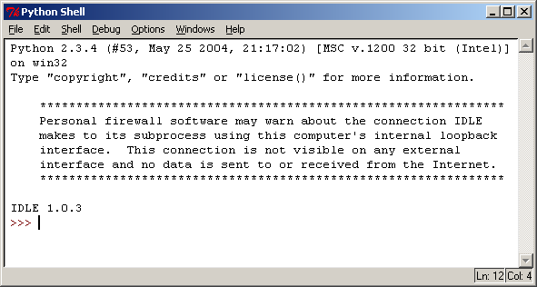
Manual Turtle Control
Python is an interpretive language, so we can control the turtle manually in IDLE. First we import the turtle module, which opens a new display.
>>> import turtle
>>>
2/10/2015
COMPSCI 111/111G - Python 04
21
Notes:
21

Slide 22
Advancing the Turtle
Here we instruct the turtle to move forward 200 steps and the turtle moves accordingly.
>>> import turtle
>>>
>>> turtle.forward(200)
>>>
2/10/2015
COMPSCI 111/111G - Python 04
22
Notes:
22

Slide 23
Turning the Turtle
Here we tell the turtle to turn left 90 degrees and the turtle alters its orientation.
>>> import turtle
>>>
>>> turtle.forward(200)
>>> turtle.left(90)
>>>
2/10/2015
COMPSCI 111/111G - Python 04
23
Notes:
23

Slide 24
Advancing in a New Direction
Next, we tell the turtle to move forward 200 steps again, but this time it goes north due to its new orientation.
>>> import turtle
>>>
>>> turtle.forward(200)
>>> turtle.left(90)
>>> turtle.forward(200)
>>>
2/10/2015
COMPSCI 111/111G - Python 04
24
Notes:
24

Slide 25
Turning the Turtle Again
Now we instruct the turtle to turn left 135 degrees, causing it to face its original position.
>>> import turtle
>>>
>>> turtle.forward(200)
>>> turtle.left(90)
>>> turtle.forward(200)
>>> turtle.left(135)
>>>
2/10/2015
COMPSCI 111/111G - Python 04
25
Notes:
25

Slide 26
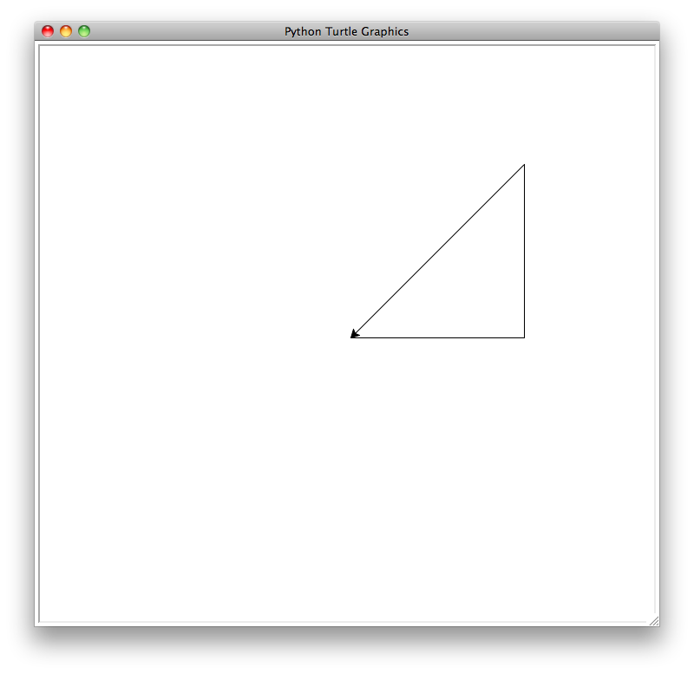
Closing the Triangle
Finally, we tell the turtle to move forward an amount based on Pythagoras’ theorem, producing a right triangle.
>>> import turtle
>>>
>>> turtle.forward(200)
>>> turtle.left(90)
>>> turtle.forward(200)
>>> turtle.left(135)
>>> turtle.forward(((200**2)+(200**2))**0.5)
>>>
2/10/2015
COMPSCI 111/111G - Python 04
26
Notes:
26

Slide 27
Storing/Loading Turtle Programs
We can also store a turtle program in a file and load it as a Python script or module to produce similar results.
Here is a program that moves the turtle forward and turns it left four times to produce a square.
import turtle
turtle.forward(200)
turtle.left(90)
turtle.forward(200)
turtle.left(90)
turtle.forward(200)
turtle.left(90)
turtle.forward(200)
2/10/2015
COMPSCI 111/111G - Python 04
27
Notes:
27

Slide 28
Example: Iterative Turtle
Write a Python program that draws a square with sides of length 200 units, this time by embedding turtle commands in the while construct.
import turtle
count = 0
while count < 4:
turtle.forward(200)
turtle.left(90)
count = count + 1
2/10/2015
COMPSCI 111/111G - Python 04
28
Notes:
28

Slide 29
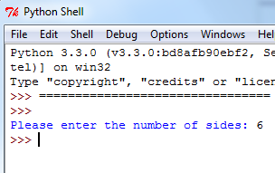
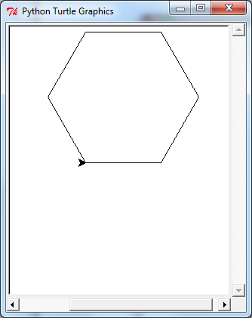
Exercise: Polygon
Write a Python program that draws a polygon. The program should prompt the user to enter the number of sides they want the polygon to have. Each side of the polygon should have a length of 100 units.
2/10/2015
COMPSCI 111/111G - Python 04
29
Notes:
29

