Slide 1
COMPSCI 111 / 111G Mastering Cyberspace: An introduction to practical computing
Programming with Python

Slide 2
Programming Languages
A programming language is a formal language that specifies how to perform a computational task
Many programming languages exist
Fortran
Visual Basic
C, C++, C#
Java
Python

Slide 3
Translating Code
High-level languages
Easy for humans to understand
Too complex for a CPU
Need to translate to a lower level language
Compiler
Translates entire file at once
Translated file can be understood by the CPU
Interpreter
Runs the code while it is being translated
Translates a line, runs the code, translates a line, etc.
Python is an interpretive programming language.

Slide 4
Statements
A program consists of a series of instructions
Instructions in a program are called statements
Computer executes them in the order they appear
Must be precise
Computer does what you say, not what you mean

Slide 5
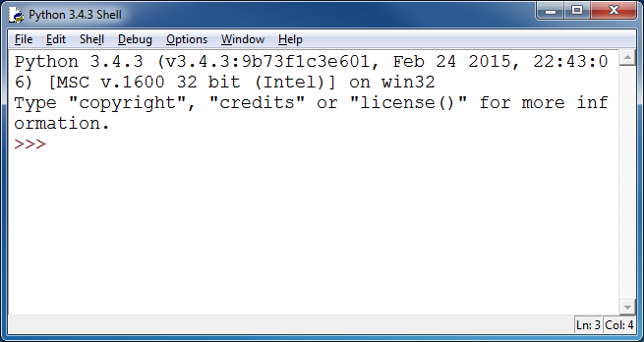
Using IDLE
Integrated Development Environment
Text Editor
Interpreter to run the code
May include other tools to help a programmer
IDLE is an IDE for Python

Slide 6
Running Python instructions
Interactive Interpreter
Allows you to type statements directly at the prompt
Statement is executed when you hit <Enter>
Very useful for experimentation
Good for learning
Running a Script
Type a sequence of statements into a file
Save the file with the file extension .py
Running the program executes each statement in turn

Slide 7
Example: Hello World
The first program you normally write
Traditional
Prints out the message "Hello World"
Python
Java
print("Hello World“)
public class MyProgram{
public static void main(String[] args){
System.out.println("Hello World");
}
}

Slide 8
Comments
Comments
Used to make comments to human readers
Ignored by the computer
Start with hash sign (#), ignores everything until end of line
Always start a program with comments describing the Author and Date.
#Author: Andrew Luxton-Reilly
#Date: 02/10/15
#Purpose: Show the use of comments
print("Hello") #Hello, Hello
print("Is there anybody in there")
print("Just nod if you can hear me")
print("Is there anyone at home")

Slide 9
Types of information
Strings
Sequence of characters
Plain text (ASCII or Unicode)
Enclosed in quote marks
E.g. "Hello", "Goodbye"
Integers
Numbers without a decimal point
E.g. -100, 0, 45
Floating-point numbers
Numbers with a decimal point
E.g. -1.00002, 0.0, 4.5, 45.0,

Slide 10
Printing output
Use the print statement
Printing more than one thing on a single line
Separate each thing with a comma
Single space used between different things in the output
print("Hello")
print(34.9)
print(2)
print("Hello", "World")
print("The year is 2006")
print("The year is", 2006)

Slide 11
Exercises
What is the output produced by the following program:
print("This", "is")
print("a program that has")
print(3, "lines")
print(1,2,3,4)
print("1,2,3,4")
print("1234", 1,2)
print("1",2,3,"4")

Slide 12
Arithmetic operators
Used to perform calculations between numeric values
Operation | Symbol
Exponent | **
Multiply | *
Divide | /
Divide (integer) | //
Remainder | %
Add | +
Subtract | -

Slide 13
Exercises
print(2 + 3)
print(3 – 4)
print(4 * 3)
print(3 / 2)
print(3 // 2)
print(2 ** 5)
print(7 % 3)
print(4 % 7)

Slide 14
String operations
Concatenation
Join two strings together
+
"Hello" + " " + "World"
Repetition
Repeat a string multiple times
*
"Hello World" * 3

Slide 15
Exercises
What is the output produced the following program?
print(1 + 2 + 3)
print("1" + "2" + "3")
print(1 * 2)
print("1" * 2)

Slide 16
Using Variables in Programs
A stored program can keep track of things that change during operation using variables, which:
Serve as place holders to store some form of information;
Take some initial value at the program’s outset;
Can change repeatedly during the program’s execution;
May be returned by the program when it halts.
The use of variables adds substantially to the flexibility and power of stored programs.
Program variables are similar to those in mathematics, but they are assigned values that can change in a run.
x = 9
x = 5
The value of variable x is initially 9
The variable x is then assigned a value of 5
28/09/2015
COMPSCI 111/111G - Python 02
16
Notes:
16

Slide 17
Assignment statement
Storing a value in a variable
Assigning a value to the variable
Equals sign
Valid name of a variable
Start with a lower case letter
Each subsequent word starts with upper case
May contain numbers (or the underscore)
May not be a keyword that means something special in Python
age = 23
sizeOfFruitbat = 56
numberOfWeasels = 17

Slide 18
Exercises
height = 10
width = 20
area = height * width
print("Area =", area)
age = 21
print("Age =", age)
age = age + 1
print("I am",age,"next year")

Slide 19
Exercises
What is the output produced by the following program?
a = 17
b = 5
print("a =" , a)
print("b =" , b)
temp = a
a = b
b = temp
print("a =" , a)
print("b =" , b)

Slide 20
Input for Programs
In many settings, we want our programs to interact with users; for this they need some means for:
Requesting and accepting external input
Generating and displaying external output
Variables are used to store results of input.
We will now examine how Python requests and accepts input.
28/09/2015
COMPSCI 111/111G - Python 02
20
Notes:
20

Slide 21
Reading Input in Python
The Python function input accepts information typed by the user and returns a string with its contents.
The operator’s one argument is printed as a prompt e.g.
would print "Enter your name: ", wait for a user to type something and hit enter, then store the result in the variable name.
The input function returns a string, so if you want to obtain a number, you must alter the data type, as in
name = input("Enter your name: ")
children = int(input("How many children: "))
weight = float(input("Enter your weight: "))
28/09/2015
COMPSCI 111/111G - Python 02
21
Notes:
21

Slide 22
Examples
Write a program that converts NZD to USD
Currently 1 NZD = 0.6409 USD
#Author: Andrew Luxton-Reilly
#Date: 02/10/15
#Ratio of NZD to USD
currencyRatio = 0.6409 # 1 NZD = 0.6409 USD
#Ask the user to enter the NZD value
nzd = float(input("Please enter the dollar value (NZD): "))
#Calculate the amount of USD
usd = nzd * currencyRatio
#Print the output to the user
print(nzd, "NZ dollars is worth", usd, "US dollars")

Slide 23
Exercise
Write a program that converts a temperature from Fahrenheit to Celsius.
The formula to convert from Fahrenheit to Celsius is:
Celsius = 5 / 9 * (Fahrenheit - 32)
Sample output:
Please enter a temperature in Fahrenheit: 72
72 degrees Fahrenheit is equivalent to
22.22222222222222 degrees Celsius

