Slide 1

COMPSCI 111 / 111G
An introduction to practical computing
CSS

Slide 2
Font
font-family
serif, sans-serif, cursive, fantasy,
monospace
font-size
xx-small, x-small,
length (e.g. 24pt)
small,
medium,
large,
x-large,
xx-large,
font-style
normal, italic
font-variant
normal, small-caps
font-weight
normal, bold
http://www.w3.org/Style/Examples/007/fonts.en.html
Notes:
Presenter
2014-04-24 01:33:45
--------------------------------------------
this will be examined
monospace all charaters take same space not all fonts do small-caps
can do font-size 24pt (use different metrics)
font-family
Preset font sizes
12pt (72 pts in an inch)
Specific font arial, times
Or generic
Font-variant – uppercase larger

Slide 3
Lengths
Use a variety of units
cm
mm
pt
px
Notes:
Presenter
2014-04-24 01:33:45
--------------------------------------------
px – pixels

Slide 4
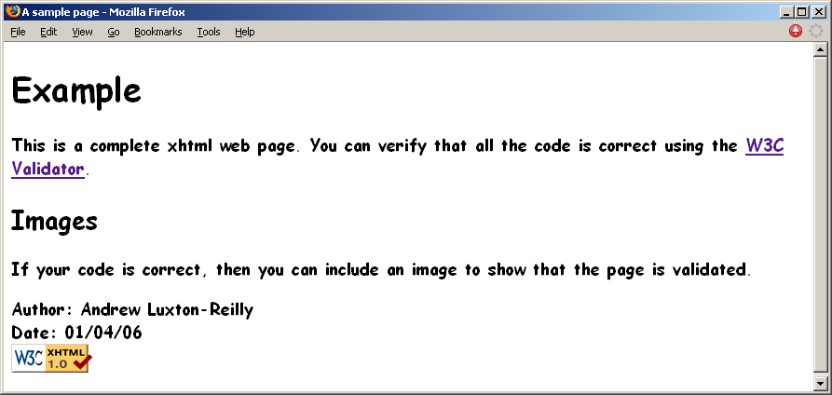
Font example
body
{
font-family: "Comic Sans MS", font-size: large;
font-style: normal; font-variant: normal; font-weight: bold;
cursive;
}
Notes:
Presenter
2014-04-24 01:33:45
--------------------------------------------
ex. of rule with selector “body”
font-family can specify what font to use if on system and what font to use if that one is not present, can actually use a list of fonts and browser will try to find the earliest one that is on the system, end the list with one of the default fonts
Generic has no “ “

Slide 5
Font Exercises
Exercise 1: Define a style that is applied to all paragraphs and changes the font so that it is 16pt and bold.
p { font-size : 16pt; font-weight : bold; }
Exercise 2: Define a style that is applied to all h2 headings and changes the font to small caps.
h2 { font-variant : small-caps; }
Exercise 3: Define the styles required to make all the text in the body of a document use italicised sans-serif font, preferably Verdana or Helvetica.
body { font-family: “Verdana”, “Helvetica”, sans-serif; font-style: italic; }

Slide 6
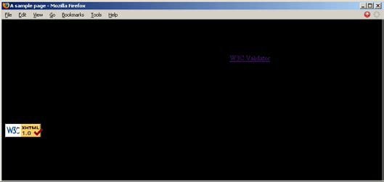
Background
background-color
body
{
background-color: black;
}
Notes:
Presenter
2014-04-24 01:33:45
--------------------------------------------
all spelling is american
remember default is foreground color is black so won’t see the writing

Slide 7
Text
color
black (default), red, green, blue, white, yellow, etc.
text-align
left (default), right, center, justify
text-indent
length
text-transform
none (default), capitalize, uppercase, lowercase
Notes:
Presenter
2014-04-24 01:33:45
--------------------------------------------
color is the color of the foreground color (i.e., the writing text) text-align center, right, left, justified
text-indent is indent first sentence of paragraph
text-transform can change the case of the text to uppercase or to all lowercase
Capitalize = first letter of every word

Slide 8
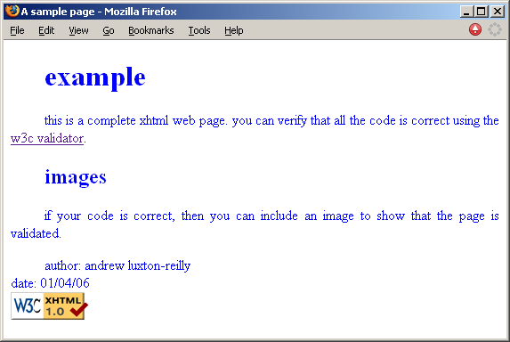
Text example
body
{
color: blue;
text-align: justify; text-indent: 1cm;
text-transform: lowercase;
}
Notes:
Presenter
2014-04-24 01:33:45
--------------------------------------------
text-align – justify means try to align the text with both margins

Slide 9
Colours
Sixteen colour names
black, red, green, blue, white, yellow, aqua, fuchsia, gray, lime, maroon, navy, olive, purple, silver, teal
RGB values
rgb(xxx, xxx, xxx)
xxx = 0 – 255
Hex values
#rrggbb
rr, gg, and bb = 0 – 255
values represented in hexadecimal (base 16): 0 - ff
Notes:
Presenter
2014-04-24 01:33:45
--------------------------------------------
No need to memorise
RGB values 0 - 255 hex value e.g., #a0ffab
#ffffff = white #000000 = black #ff0000 = bright red etc hex 0 - f

Slide 10
Color Exercises
Exercise 4: Define the styles required to make the background of the entire page silver, and the text coloured black. The main heading should have a black background and white font.
body { background-color: silver; }
h1 { background-color: black; color: white; }
Exercise 5: Define a style for an id selector called “greenText” so that any element that uses it has green font. You must use hex values for the color. Write a fragment of HTML5 code that applies the style you have defined to the word “grass” in the paragraph “The grass is green”.
#greenText { color: #00ff00; }
<p>The <span id=“greenText”>grass</span> is green</p>
Notes:
Presenter
2014-04-24 01:33:45
--------------------------------------------
give 6 minutes for exercises

Slide 11
Borders
border-color
color
border-style
none (default), dotted, dashed, solid, double, etc.
border-width
thin, medium, thick, length
Notes:
Presenter
2014-04-24 01:33:45
--------------------------------------------
border is put around entire block that info is contained
Can also use length

Slide 12
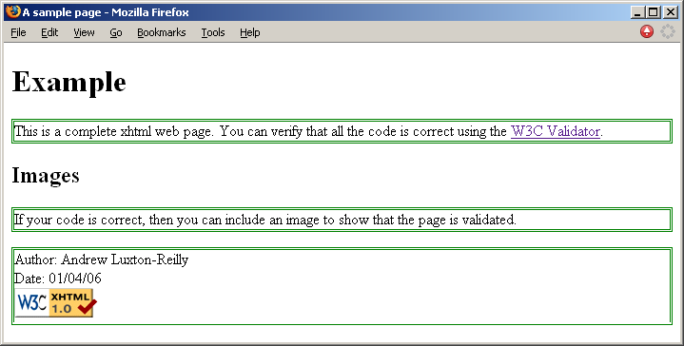
Borders
p
{
border-color: border-style: border-width:
green; double; medium;
}
Notes:
Presenter
2014-04-24 01:33:45
--------------------------------------------
can also just use the property “border” and put in all three values this is lab manual and coursebook border-width can be specified in pixels
paragraphs extend from one edge to the other

Slide 13
Borders
Can set borders individually for each side of the element:
  xxx = left, right, top, bottom
border-xxx-color
As for border-color
border-xxx-style
As for border-style
border-xxx-width
As for border-width

Slide 14
Table Borders
Property:
  Border
Value:
  width style colour
  E.g. 1px solid black
Should be specified for all table elements:
            table, tr, td {
            border: 1px solid black;
            }

