Slide 1
COMPSCI 111 / 111G Mastering Cyberspace: An introduction to practical computing
HTML5

Slide 2
Markup Languages
Heading
Paragraph
Formatting. Plain text contains all the content which will appear on the page. Using a variety of formatting styles makes the text much easier to read and can be used to emphasise points.
Paragraph
Emphasise
Markup Tags
(HTML)
<h1>Formatting.</h1> <p>Plain text contains all the content which will appear on the page.</p>
<p> Using a variety of formatting styles makes the text much <em>easier to read</em> and can be used to <em>emphasise points.</em></p>
Formatting
Plain text contains all the content which will appear on the page.
Using a variety of formatting styles makes the text much easier to read
and can be used to emphasise points.
Final
Appearance

Slide 3
Markup Languages
Markup
Indicates the formatting that should be used to display the page
Markup Language
A markup language consists of special tags which are placed in the text
Specifies how to format the text
Hypertext Markup Language (HTML)
Used to format web pages
Contains hypertext information (links)
Written in ASCII / Unicode
Embedded format codes (tags)
Notes:
Plan text
Ascii - Unicode

Slide 4
Browser Wars
HTML 1.0
Tim Berners Lee (1993)
Browsers added extra features
Internet Explorer had unique tags
Netscape Navigator had unique tags
Major problem
What tags should a publisher use?
How can this problem be resolved?
http://en.wikipedia.org/wiki/Browser_wars
Notes:
<blink> in netscape navigator but not in IE
this was the state in mid/late 90’s
each browser wanted to have an edge over the others by having their special unique tags

Slide 5
Development of HTML
HTML 2.0
Internet Engineering Task Force standard (1995)
HTML 3.2 / HTML 4.0
W3 Consortium recommendation (1997)
HTML 4.01
W3C recommendation (1999)
XHTML 1.0
W3C recommendation (2000)
HTML5
Fifth revision of HTML standard. Standardized October 2014.
http://en.wikipedia.org/wiki/Html
Notes:
companies deliberately introduced tags that weren’t used by other companies
the goal is to make it easy for tools to parse web pages
many browser including IE are not standard compliant -> makes web development difficult
X extensible – extra set of rules

Slide 6
Document Type Definition
Defines which standard is being used for the page
We use HTML5
Should appear at the top of the file
<!DOCTYPE html>
Notes:
All files need this
DTD at top

Slide 7
Encoding methods
Different character sets used to encode the page
ASCII
UTF-8
Unicode
Need to tell the browser which encoding is used
Located in the head of the document.
<meta charset=“UTF-8”>
Notes:
utf-8 and unicode 16 bit code
Plain text
Unicode extension of ascii
Utf-8 most common

Slide 8
Use at the start of every file
Copy and paste the code exactly as it appears
Will be provided in tests and exams
<!DOCTYPE html>
<html>
<head>
<meta charset=“UTF-8”>
</head>

Slide 9
HTML Source Code
Code used by the browser to display the page
White space is ignored
Comments
Ignored by the browser
Allow you to document your code
<!-- Put your comment here -->
Layout
Use tidy layout where possible
Make code easy to understand
Make code easy to maintain/ modify
Use whitespace and comments to help

Slide 10
Overview of tags
Markup achieved with “tags”
Enclosed with angle brackets < … >
Use lower case
Most come in pairs <tag> … </tag>
Tag usually applies to text between start and end tag
This word is in <span>italics</span>
Notes:
Tags always lowercase
DO not overlap container tags
<EM><B>text </EM></B> is not acceptable

Slide 11
Attributes
Some tags require additional information
Properties or attributes of the tag
<tag property=“value”> </tag>
Notes:
Attributes always/only in opening tag
Can have more than one

Slide 12
Nested Tags
Tags must be correctly nested
Cannot close an open tag until all the open tags that it affects are also closed
<tag>
Text only affected by “tag”
<tag2>
Text affected by both “tag” and “tag2”
</tag2>
Text only affected by “tag”
</tag>

Slide 13
Essential tags
<html>
Encloses the entire document
Specifies that the document uses html
<html>
.
.
.
.
.
.
.
.
</html>

Slide 14
Essential tags
<head>
Contains information for the browser
E.g. character encoding used
Does not contain any content to be displayed on the page
<html>
<head>
<meta charset=“UTF-8”>
</head>
.
.
.
.
.
</html>
Notes:
meta info in heading, style stuff in heading, heading is info for browser
Browser specific information – no content

Slide 15
Essential tags
<body>
Contains all the content that will appear on the page
<html>
<head>
<meta charset=“UTF-8”>
</head>
<body>
.
.
.
</body>
</html>
Notes:
contents

Slide 16
Essential tags
<title>
Part of the head
Specifies the title to be used by the browser
Name of the window
Used in navigation (bookmarks, history, etc.)
<html>
<head>
<meta charset=“UTF-8”>
<title>Introduction to tags</title>
</head>
<body>
.
.
.
</body>
</html>
Notes:
Used in bookmarks and history

Slide 17
HTML5 Exercise
Exercise 1: What does HTML stand for?
Hypertext Markup Language
Exercise 2: What is a document type definition used for?
Defines which standard is being used for the webpage
Exercise 3: What is “white space”?
Characters or series of white space characters that define horizontal or vertical spaces

Slide 18
Block-level tags
Define the structure of a “block”
Headings
Paragraphs
Lists
Tables
Preformatted text
Notes:
block level tag or in-line tag
block level goes from one side to other, if don’t cover the entire width, then centered
Preformatted like verbatim in latex

Slide 19
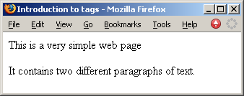
Paragraphs
<p>
Defines a paragraph of text
<html>
<head>
<meta charset=“UTF-8”>
<title>Introduction to tags</title>
</head>
<body>
<p>This is a very simple web page</p>
<p>
It contains two different paragraphs
of text.
</p>
</body>
</html>

Slide 20
HTML5 Exercise
Exercise 4: Create a complete HTML5 document with the title “Simple page”. The only text that should appear on the page is “Hello World”.
<!DOCTYPE html>
<html>
<head>
<meta charset=“UTF-8”>
<title>Simple Page</title>
</head>
<body>
<p>Hello World</p>
</body>
</html>

Slide 21
Headings
Six levels of headings
<h1> First level heading
<h2> Second level heading
<h3> Third level heading
<h4> Fourth level heading
<h5> Fifth level heading
<h6> Sixth level heading
Notes:
All headings are bold!!

Slide 22
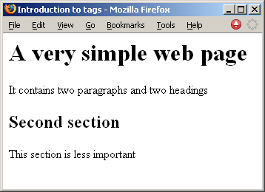
Headings
<html>
<head>
<meta charset=“UTF-8”>
<title>Introduction to tags</title>
</head>
<body>
<h1>A very simple web page</h1>
<p>It contains two paragraphs and two headings</p>
<h2>Second section</h2>
<p>This section is less important</p>
</body>
</html>
Notes:
Spaces between each block

Slide 23
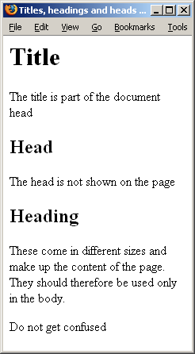
Example of Head, Heading and Title
<html>
<head>
<meta charset=“UTF-8”>
<title> Titles, headings and heads</title>
</head>
<body>
<h1>Title</h1>
<p>The title is part of the document head</p>
<h2>Head</h2>
<p>The head is not shown on the page</p>
<h2>Heading</h2>
<p>These come in different sizes
and make up the content of the page.
They should therefore be used only
in the body.</p>
<p>Do not get confused</p>
</body>
</html>
Notes:
Title appears in title bar
Head contains browser specific information
Heading is part of the content it is in the body
on a test, could be given this html and asked to draw what it looks like and vice versa, given
a picture be asked to write the html code that generates it

Slide 24
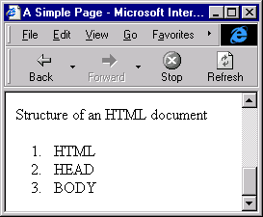
Ordered Lists
Ordered Lists
Automatically numbered
<ol> … </ol> Contains the entire list
<li> … </li> Used for each list item
<p>Structure of an HTML document</p>
<ol>
<li>HTML</li>
<li>HEAD</li>
<li>BODY</li>
</ol>
Notes:
3 types of lists
like enumerate and item
Space between different blocks

Slide 25
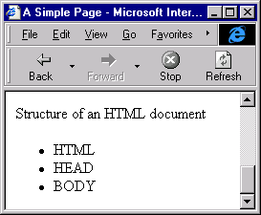
Unordered Lists
Unordered Lists
Bullet Points
<ul> … </ul> Contains the entire list
<li> … </li> Used for each list item
<p>Structure of an HTML document</p>
<ul>
<li>HTML</li>
<li>HEAD</li>
<li>BODY</li>
</ul>

Slide 26
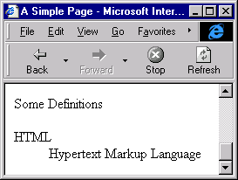
Description Lists
Terms and explanations
<dl> … </dl> Contains the entire list
<dt> … </dt> Defines a term in a description list
<dd> … </dd> Is used to describe a term in a description list
<p>Some definitions</p>
<dl>
<dt>HTML</dt>
<dd>Hypertext Markup Language</dd>
</dl>
Notes:
3 tags
Definition term
Definition description
different browsers show the definitions differently, some ident, some make bold

Slide 27
Tables
<table>
Used to format tables of information
By default, there are no borders shown
Notes:
Borders not created by default

Slide 28
Tags required to format Tables
Tags
– | <table> … </table> | Surrounds the entire table
– | <tr> … </tr> | Identifies a row in the table
– | <td> … </td> | Each element/cell of data in the row
Row
<tr>
<td> … </td>
<td> … </td>
</tr>
Data
Notes:
Like description list
Table row
Table data

Slide 29
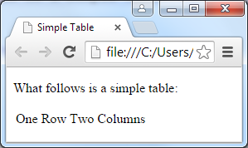
A simple table example
<html>
<head>
<meta charset=“UTF-8”>
<title>Simple Table</title>
</head>
<body>
<p>What follows is a simple
table:</p>
<table>
<tr>
<td>One
</tr>
</table>
</body>
</html>
Row</td><td>Two
Columns</td>
Notes:
No borders

Slide 30
Table Exercise
Exercise 1: Write a fragment of HTML5 code that will generate a table with 2 rows and 1 column. The text in the first row should be “first row” and the text in the second row should be “second row”.
<html>
<head>
<meta charset=“UTF-8”>
<title>Simple Table</title>
</head>
<body>
<p>What follows is a simple table:</p>
<table>
<tr><td>first row</td></tr>
<tr><td>second row</td></tr>
</table>
</body>
</html>

