Slide 1
COMPSCI 111 / 111G Mastering Cyberspace: An introduction to practical computing
L
T
X
A
E

Slide 2
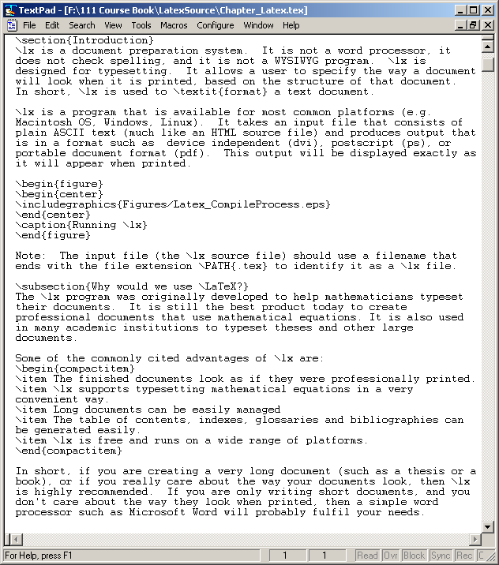
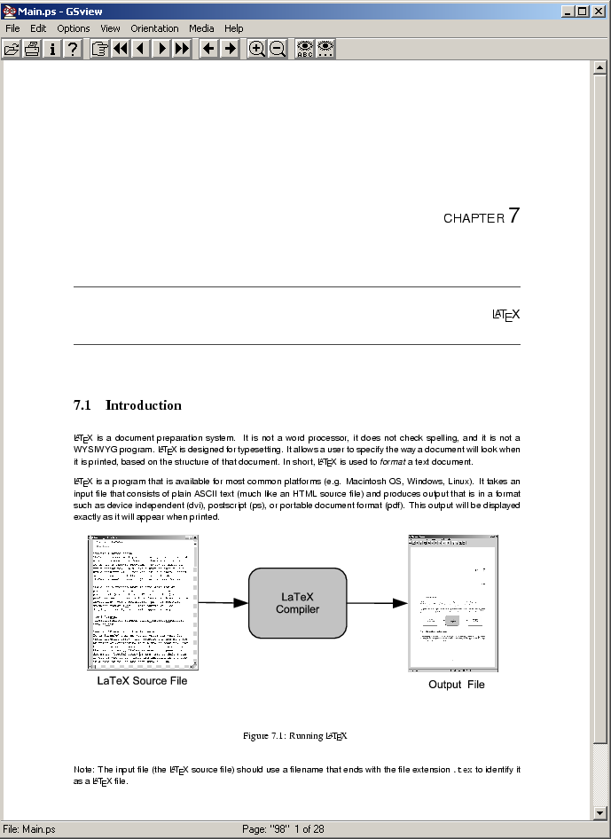
LaTeX
A document preparation system
Used to typeset a document
LaTeX
Compiler
http://en.wikipedia.org/wiki/LaTeX

Slide 3
Why?
Why use LaTeX when we have word processors?
Results look better
Focus on structure helps document development
Best tool available for mathematical layout
Works well for large documents
Automatically generates:
Table of contents
Lists of figures
Lists of tables
Index
Glossaries
Bibliography
Free and runs on many platforms

Slide 4
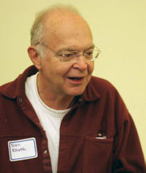
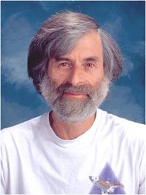
Development
Donald Knuth
Stanford University
The Art of Computer Programming
Created TeX and METAFONT
1978 - 1989 Development of TeX
Leslie Lamport
LaTeX 1984
Extensions to TeX
Easier than TeX
Focus on the structure of the document
Standard way to use TeX

Slide 5
Commands
Used to tell LaTeX how to typeset something
Commands are case sensitive
Optional parts are in square brackets
Compulsory parts are in curly braces
\commandname[options]{argument}

Slide 6
Environments
Apply a change to the content within the environment
New environments start new paragraphs
\begin{environmentname}
...
\end{environmentname}

Slide 7
Comments
Used to annotate the document
Ignored by the compiler
Aimed at other humans
% Comments starts with a percentage sign
% All text is ignored until the end of the
% line is reached.

Slide 8
Whitespace
Whitespace characters
Space
Tab
Line break
White space is largely ignored apart from:
Space between words.
Blank lines between blocks of text that are used to make paragraphs.
Two or more consecutive whitespace characters
Reduced to a single space
A B C
D E F
A B C D E F

Slide 9
Special characters
Characters that are used in the syntax of the language
Can't type these characters directly
Need a special way to print them
10 characters
\ $ % ^ & _ ~ # { }

Slide 10
Creating a LaTeX document
\documentclass
Defines the type of document
Book
Report
Article
Letter
The document environment encloses the contents of the document
The space between the document class command and the start of the document environment is called the preamble.
Contains commands that affect the entire document.

Slide 11
Creating a LaTeX document
\documentclass[a4paper]{article}
\begin{document}
...
\end{document}
Preamble
Document environment
Document contents

Slide 12
Adding a title
Require four commands to create a title
\title{ put the title here }
\author{ author goes here }
\date{ date goes here }
Once the information has been defined, insert the title
\maketitle
...
\begin{document}
\title{A very short document}
\author{Andrew Luxton-Reilly}
\date{2006}
\maketitle
This is the document.
\end{document}

Slide 13
Structuring a document
\part{ part name goes here }
\chapter{ chapter name goes here }
\section{ section name goes here }
\subsection{ subsection name goes here }
\subsubsection{ subsubsection name goes here }
\paragraph{ paragraph name goes here }

Slide 14
Table of contents
Table of contents is automatically generated using the \tableofcontents command.
Parts
Chapters
Sections
Subsections
Each command has an table of contents option
Displays a different name in the table of contents
\section[Introduction]{An introduction
to typesetting using the LaTeX language}

Slide 15
Footnotes
Footnotes are created in the text as you type them
\footnote{ footnote text goes here }
\documentclass[a4paper]{report}
\begin{document}
\title{A very short report}
\author{Andrew Luxton-Reilly}
\date{2006}
\maketitle
This is the document\footnote{Note that the document is a report} that I am using as an example.
\end{document}

Slide 16
Paragraphs and line breaks
LaTeX will remove excess whitespace
Need to explicitly include paragraphs and line breaks
Paragraph
Leave a blank line in the input
Line break
Use the command \\
A short paragraph.
Another short paragraph.
And\\
some lines\\
that appear sequentially.

Slide 17
Quote marks
Unidirectional quotes (") are inadequate
Use the symbols ` and ' for single quotes
Use the symbols `` and ' ' for double quotes
He said, ``As they say, `you win some, you lose some' ''.
He said, “As they say, ‘you win some, you lose some’ ”.

Slide 18
Dashes
Hyphen (-)
Short dash to join different words together
merry-go-round
En dash (--)
Longer dash used to indicate a range of values
pages 45–50
Em dash (---)
Very long dash between words or phrases
There are many commands—some more complex than others—that are used in LaTeX.

Slide 19
Ellipsis
Three dots in a sequence
Used to indicate text that ... has been removed
Or an unfinished ...
Can't just use three full stops in a row
LaTeX will use incorrect spacing
Use the \ldots command
\ldots or so he said.
… or so he said

Slide 20
Spaces
Lines have to be broken to wrap text
Try to break at a space
Try to break at a syllable
Some spaces we don't want to be broken
E.g. between initials and surnames
Use a tilde ~ to signify a space that we can't break
The lecturer for this course is A. J. Luxton-Reilly
Bad layout
The lecturer for this course is A.~J.~Luxton-Reilly

Slide 21
Emphasis
Emphasis
\emph{ text to be emphasized here }
It is \emph{very} important to practice the typesetting commands
so that you don't \emph{forget} them.

Slide 22
References
There are many LaTeX tutorials on the Internet
http://www.tug.org/interest.html
http://www.latex-project.org/
http://www.ctan.org
Web site that allows you to try it out
http://sciencesoft.at/index.jsp?link=latex&size=1280&js=1&lang=en
Tutorial documents
The (not so) short guide to LaTeX
Online course reference manual

