Slide 1
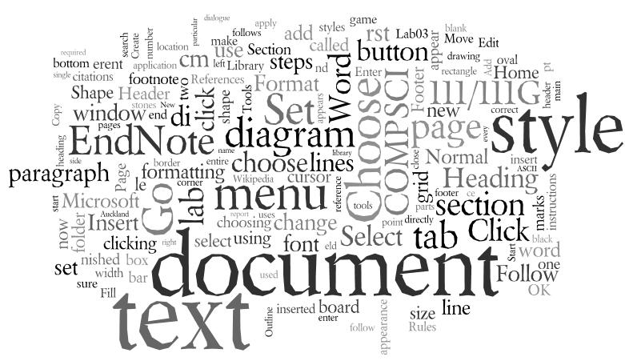
COMPSCI 111 / 111G Mastering Cyberspace: An introduction to practical computing
Word Processing

Slide 2
ASCII
American Standard Code for Information Interchange
Code used to represent English characters as numbers
There are 128 characters
ASCII codes for A - Z
A | 65 |  | I | 73 |  | Q | 81
B | 66 |  | J | 74 |  | R | 82
C | 67 |  | K | 75 |  | S | 83
D | 68 |  | L | 76 |  | T | 84
E | 69 |  | M | 77 |  | U | 85
F | 70 |  | N | 78 |  | V | 86
G | 71 |  | O | 79 |  | W | 87
H Y | 72 89 |  | P Z | 80 90 |  | X | 88
http://en.wikipedia.org/wiki/ASCII

Slide 3
Exercise
If “A” has the ASCII code 65 and “a” has the ASCII code 97:
What is the ASCII code for the word “Easy”?
What is the ASCII code for the word “Summer”?
69
97
115
121
83
117
109
109
101
114

Slide 4
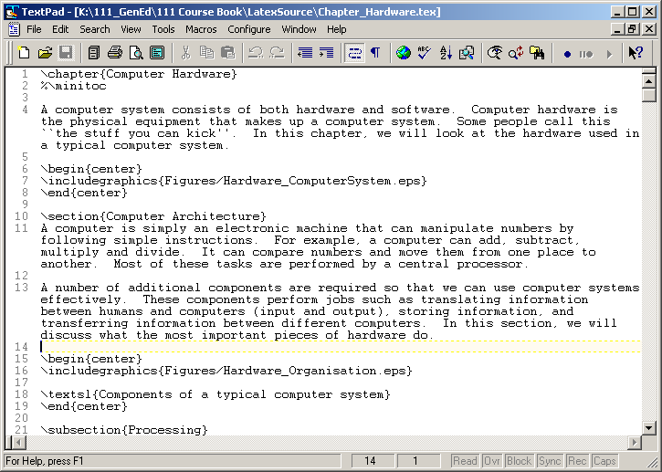
Text Editor
Text Editor
Allows user to edit the characters on the page
Plain text (ASCII)
Commonly used for editing:
configuration files
programming language source code.
Examples
Notepad
Notepad++
TextPad
http://en.wikipedia.org/wiki/Text_editor

Slide 5
Word Processors
Word Processor
Extension of a text editor
Allow user to format the document (change the appearance of text)
Fonts
Style, size, typeface
Paragraph
Alignment, spacing
Document
Margins, Headers, Footers
http://en.wikipedia.org/wiki/Word_processor

Slide 6
Standards
Each word processor decides how to store information
Uses special codes to identify the format of the text
Bold, italic
Font size
Alignment
File is saved with these codes
Standards
Proprietary (MS-Word)
Open standard (Open Office)

Slide 7
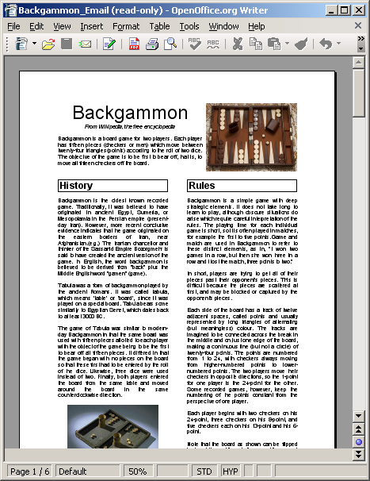
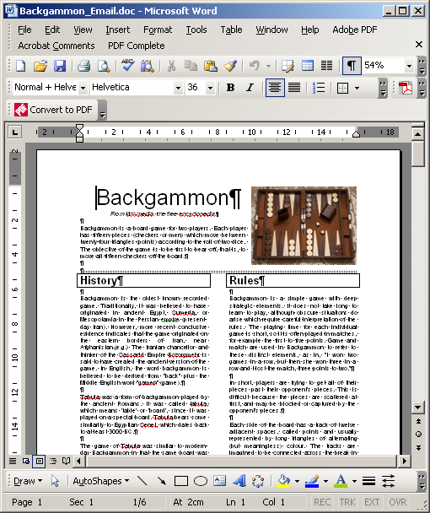
What you see is what you get
WYSIWYG (Whizzy-wig)
Graphical User Interface
What the user sees is the same as the output printed
Most modern word processors work this way
Microsoft Word
Open Office
http://en.wikipedia.org/wiki/WYSIWYG

Slide 8
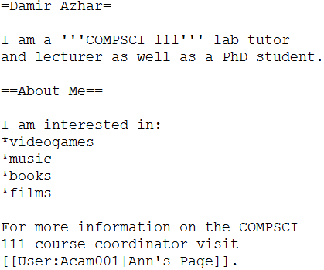
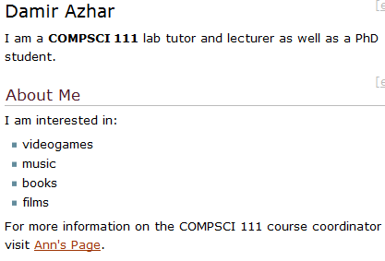
What you see is what you get
Programming is generally not WYSIWYG:
Examples covered in COMPSCI111:
Wiki markup (see example below)
Latex
HTML5
Python
What you see
What you get

Slide 9
Basic Features of a Word Processor
Editing Text
Word Wrap
Insert/ Delete
Select Text for action
Clipboard
Keeps multiple clippings
Cut, Copy, Paste
Formatting
Character
Paragraph
Document
Insert Point/ Cursor
yyyy
yyyy
Clipboard
xxxxxxx
yyyy
yyyy
xxxxxxx
Cut
Paste
xxxxxxx
xxxxxxx
yyyy
yyyy

Slide 10
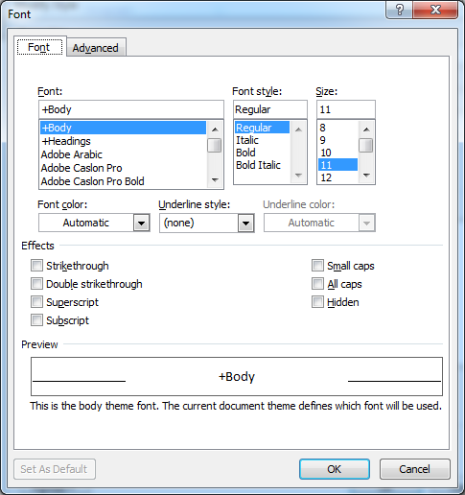
Font
Appearance of Text
Typeface
Style (Bold, Italic)
Size (in points)
Colour
Effects

Slide 11
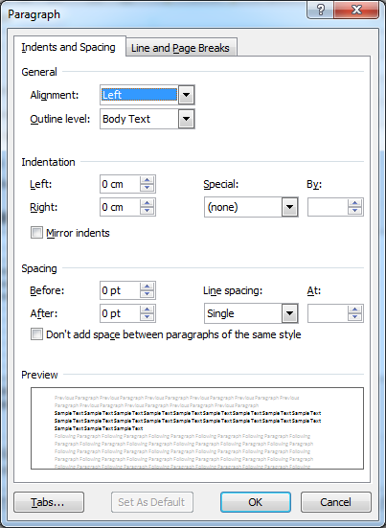
Paragraph
Appearance of Paragraph
Alignment
Spacing
Indent

Slide 12
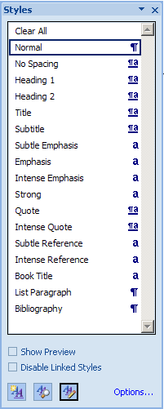
Styles
A named set of formatting changes
Why use styles?
Appearance is consistent
Can apply many changes at once
Modifying a style affects all text that uses that style
Manage existing styles
Create a new style

Slide 13
Headers, Footers and Footnotes
Header
Content found in the top margin of each page in a document
Footers
Content found in the bottom margin of each page in a document

Slide 14
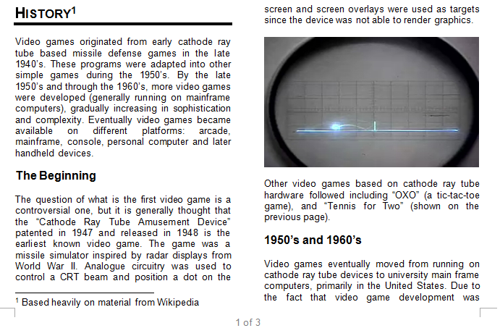
Headers, Footers and Footnotes
Footnote
Small note located at the bottom of a page.
Provides more information about something in the main text.

Slide 15
Plagiarism
Plagiarism involves taking another person's ideas, words or inventions and presenting them as your own.
Includes paraphrasing or rewording another person's work, without acknowledging its source.
All material, whether directly quoted, summarised or paraphrased, must be acknowledged properly.
http://www.cite.auckland.ac.nz/index.php?p=plagiarism

Slide 16
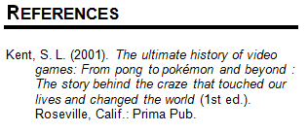
References and Citation
Citation
Tells readers where the information came from.
Within the text.
Reference
Provides details about the source.
Should enable reader retrieval of source.
Found at the end of a document.

Slide 17
RefWorks
Web-based bibliographic database
Maintain personal database of references.
Copy references from the UOA library catalogue (as well as other library databases) into reference database.
Insert references into documents in a variety of citation styles.
Advantages
Platform independent. RefWorks account accessible from any platform with compatible web browser and Internet access.
UOA students can create a RefWorks account for free.
Guides and tutorials available http://www.library.auckland.ac.nz/refworks/guides-tutorials.htm
http://www.library.auckland.ac.nz/endnote/endnote.htm

Slide 18
Write-N-Cite
Utility program that lets users interface between their RefWorks reference database and their MS Word documents.
Available for free for MS Word on Windows and Mac operating systems from RefWorks website.

