Slide 1
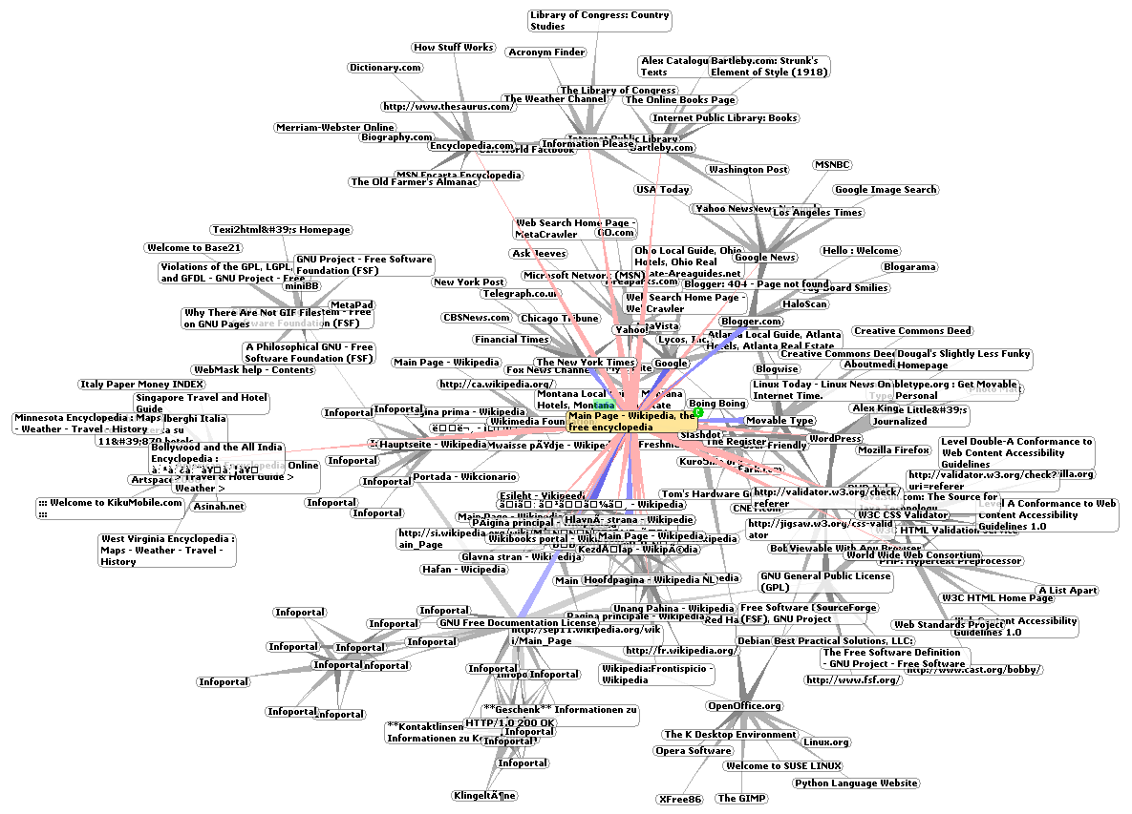
COMPSCI 111 / 111G An introduction to practical computing
World Wide Web
Notes:
Visualization of the web (wikipedia)
Confuse web and internet
Clear idea by the end of lecture
This Wikipedia and Wikimedia Commons image is from the user Chris 73 and is freely available at http://commons.wikimedia.org/wiki/File:WorldWideWebAroundWikipedia.png
under the creative commons cc-by-sa 2.5 license.

Slide 2
Hypertext
Hypertext
Text with hyperlinks to other text.
Typically displayed on a computer screen or other electronic device.
Hyperlink
Reference to data that the reader can follow via interaction.
Interaction is typically done using a mouse click, touching the screen or a keypress sequence.
hyperlink

Slide 3
Multimedia and Hypermedia
Multimedia
The integration of many forms of media
Text
Images
Sound
Animation
Hypermedia
The combination of Hypertext and Multimedia
Hyperlinks are made between any media
Hypermedia and hypertext terms were coined by Ted Nelson
cow
Hypermedia

Slide 4
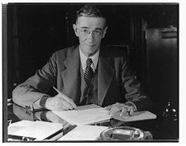
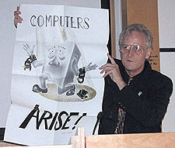
History
Vannevar Bush
MEMEX system described in 1945 essay
“As We May Think”.
Electromechanical device using microfilm
for storage.
To be used to develop and read a large
self-contained research library.
Ted Nelson
Project Xanadu.
Envisioned as a “digital repository scheme
for world-wide electronic publishing”.
First computer hypertext system.
First attempt at implementation began in 1960.
Incomplete implementation released in 1998
Tim Berners-Lee
1989 starts the WWW project at CERN
http://en.wikipedia.org/wiki/Www
Notes:
Text with links, Connects to related pieces of information
Normal now, But new before internet
Psychology: This is how brains work farm…Cow…fonterra…grocery prices…
Follow that line of thought
Vannevar Bush
1945 MEMEX – electro mechanical – microphese – photograph negative – reader magnifying glass also predicts personal computers, the Internet, the World Wide Web, speech recognition, and online encyclopedias
Press button start of link move arm press another button end of link
Reader press button bring up other microphese
Ted Nelson
Xanadu – coined name “hyper text”
Put all human knowledge in database
Never made it….still under development, first (incomplete) working version released 1998, open source one released last year – claim (by developers) that Xanadu is proper hypertext model vs WWWs is trivial
Tim Berners Lee - 1989
www at CERN
http://en.wikipedia.org/wiki/File:Vannevar_Bush_portrait.jpg
http://en.wikipedia.org/wiki/File:Ted_Nelson_at_Hypertext-03.jpg

Slide 5
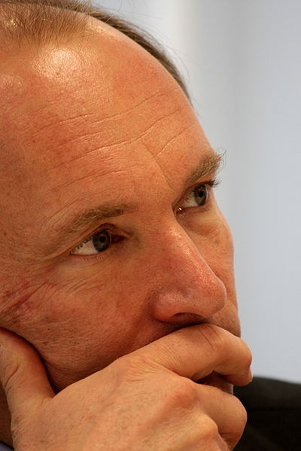
The WWW project
Background: CERN
Many networks existed
Each network had many documents
Aims
Access documents from any network in seamless manner
World-Wide (distributed)
Easy to add documents (dynamic)
Proposal
Use Hypertext
No intention to support hypermedia
Research only
This image by Paul Clarke, http://www.flickr.com/people/34916866@N02, licensed under Creative Commons Attribution 2.0 Generic
http://en.wikipedia.org/wiki/WorldWideWeb
Notes:
Late 80s conferences on hypertext(Active area of research)
CERN - European Organization for Nuclear Research Conseil Européen pour la Recherche Nucléaire
Large hadron collider
Drive from one part to another
Different groups
Different nationalities
Different networks
All connected to internet
Not easy to see each others research
Other collaborates elsewhere
We had the road but not the cars…
World wide
New information rapidly – dynamic
Access easily
Hyper text (not hyper-media)
Research documents and data

Slide 6
Evolution of the web (1)
1989 Tim Berners-Lee begins work on the WWW project
1991 WWW operational at CERN
1992 WWW goes public
1993 Mosaic created by Marc Andreessen (First GUI browser)
1994 US Senate allow commerce on Internet
1994 Netscape Communications formed, Yahoo! formed
http://en.wikipedia.org/wiki/Web_browser
Notes:
1991 prototype
1992 public domain
1993 University of Illinois (first graphical browser – icons – mouse)
1994 Commerce on internet – took off
1994 Netscape – using mosaic as basis. Netscape Navigator went on to reach up to 80% market share (1996) – distributed for free for non profits/educational providers, pay otherwise
1995 Internet Explorer (very similar) – worse at first but caught up in terms of features/performance by version 3/4 (96/97) given away for free

Slide 7
Evolution of the web (2)
1995 Microsoft Internet Explorer
1998 Netscape became open-source, developed into Mozilla Google founded
1997-2001 “Dot-com” bubble
2002-on The web becomes ubiquitous
http://en.wikipedia.org/wiki/Web_browser
Notes:
1995-1998 browser wars
dirty tricks: MS convinced ISPs&PC vendors to hand out IE instead of Netscape Navigator by using Windows licenses as leverage and making IE brandable (add your own logo/custimzation). IE 4(1997) integrated in Windows
1998 Microsoft has won
Netscape became open source
Mozilla founded – Firefox
Google started
Search engine companies
1994 yahoo – manually maintained – library cards
1998 google
2003 mozilla foundation – open source, free thunderbird, firefox
Dotcom bubble (1997-2002) – simply add e- or .com to company name and see rapid rise in stock prices: "prefix investing.“ "get big fast"

Slide 8
Technical Details
HTML
Hypertext Markup Language
Language used to create Hypertext documents
Covered later on in course
HTTP
Hypertext Transfer Protocol
Protocol used to transfer Hypertext documents
Client-Server Model
Notes:
Internet tcp/ip road
www http
Web server
Wait for request
Look for document
Send document
http hyper text transfer protocol
Protocol to Send and receive webpages
Web fraction of internet
Glocal body of information avaliable using http

Slide 9
Technical Details
TCP/IP
Ensures data is routed reliably (see lecture 4)
WWW
Global body of information available using HTTP
TCP/IP
HTTP
Notes:
Internet tcp/ip road
www http
Web server
Wait for request
Look for document
Send document
http hyper text transfer protocol
Protocol to Send and receive webpages
Web fraction of internet
Glocal body of information avaliable using http

Slide 10
Cyberspace Addresses
Uniform Resource Locators (URL)
Address used for any web resource
Protocol
Name of the protocol used
ftp:// http:// https://
Domain
Name of a host computer (IP address or domain name)
www.cs.auckland.ac.nz
File/ Resource
Path of the file
/Damir/LectureSlides.pdf
By default, web browsers will use http as the protocol.
If no file given, they will often default to index.html
ihug.co.nz should be
http://ihug.co.nz/index.html
Notes:
Web address
Protocol domain file
http
https
ftp
www.cs.auckland.ac.nz DNS
/pat/index.html
Can leave off parts

Slide 11
Terms
Web Site
A collection of Web pages related to a single topic or theme. Normally designed and maintained by a single individual or organisation
Web Page
A hypermedia document designed for the WWW
Web Browser
Software used to access information on the World Wide Web
Sends requests to a web server
Client
Web Server
Software that makes local files available through the web
Fulfils requests from a web browser
Server
Notes:
Web server
hosting webpages
Web browser
client part
Web page
document (hypermedia)
Web site
Collection of web pages (computer science department)\common look and feel

Slide 12
Accessing a web page (1)
Client (Web Browser) runs on the local machine
User requests a web page
Client contacts the DNS to find the IP address
Web page Requested
Browser
Computer
DNS
DNS resolves the domain name
Notes:
User Sends a request through browser on computer
Computer asks Dns for address of webserver for said request

Slide 13
Accessing a web page (2)
Web server runs on the destination machine
Request sent to destination domain
Web server accepts the request and finds the web page
Web Page
Browser
Web Server
Computer
Computer
Web page requested from destination domain using HTTP
Notes:
Through DNS contact computer behind address,
ask web server there for the web page in request

Slide 14
Accessing a web page (3)
Web page is sent from the server to the client
Client (web browser) displays the page
Web page displayed
Web Page
Browser
Web Server
Computer
Computer
Web page sent from server to client using HTTP
Notes:
Sends page back to client, display in browser

Slide 15
More Terms
Proxy
A computer which sits between the client and server, intercepts and processes requests
Cache
Store of information for quick access
(e.g. caching may be used by proxy servers to speed web use)
Firewall
Prevents unauthorised access to or from a private network
Server
Client
Proxy
Proxy used
by ISP
Cache
Notes:
Client does the display part
Proxy
between the client and server
high school – filter out pages, enhance performance (using cache) “xtra”
“has your page changed” request
for country-coded things (iTunes only certain things in US, Netflix until this year etc.)
Firewall – prevents unauthorized access – stops hacking

Slide 16
Logging web page access
Client keeps log
History in web browser
Operating System keeps log
Requests are logged by Windows on local machine
ISP keeps log
Requests from "IP address" to "IP address" for "Page Name"
Some ISPs may have the logs available for users to check
Web server keeps log
Gets requests from "IP address" for "Page Name”
Your viewing habits are being tracked!
http://en.wikipedia.org/wiki/Google_and_privacy_issues
Notes:
Using internet leaves traces
Archived – never goes away
Everything tracked - archived
Information is there forever
Stored in client program – history
OS – keeps a log
ISP – keep a log – extra, slingshot
Webserver – keep a log – IP address

Slide 17
Navigating
Finding information
Lots of users have problem finding new information
Lots of users have problems finding known information
Web is very large, rapidly changing
Search Engines
Automated
Essential
Our gateway to information
Notes:
Trouble finding stuff again….Really hard….
Not really good navigation tools
Now no one indexes manually
Depend on search engines
--------------------------
Worse than Library example
Imagine all pages torn out of all the books, then placed back in different shelves. At the bottom of each page, put a sticky label saying where the next page is, or where other relevant material is. Imagine the author of the book adding sticky notes whenever they find relevant material.
That is the web!!
Dangling links - where some of the pages have been moved.
Alta Vista 250 Million pages
50 Million images and sounds
Over 1 billion pages as of January 2000
Searching using URL’s works really well

Slide 18
Problems
Broken Links
Pages which have been moved or deleted, but links are not updated.
No inherent security/ tracking/ accounting system
Difficult to have layers of security
Forces publishers to rely on advertising revenue
No inherent information indexing
Much of the information is not accessed by search engines (e.g. encrypted, protected)
Information created on-the-fly from databases
Information in other formats (postscript, pdf, archived) may be missed
Notes:
Structure of webpages
If you have big web, how to make money: lock certain parts? (difficult w structure, how does google index etc)

Slide 19
Search Engines
Companies (Worldwide Market Share 2014)
Google (66.44%)
Baidu (China) (11.15%)
Microsoft Bing (10.29%)
Yahoo (uses Bing since 2009) (9.31%)
Specialised Alternatives
DuckDuckGo
Wolfram Alpha
Automatically search every web page
Archive the contents
Index all the words
Try to determine the relevance of the page
http://en.wikipedia.org/wiki/Search_engines
http://www.netmarketshare.com/search-engine-market-share.aspx?qprid=4&qpcustomd=0
Notes:
http://en.wikipedia.org/wiki/File:Cern_datacenter.jpg
Search engines – companies
Google – don’t be evil – motto
DuckDuckGo (DDG) is an Internet search engine that emphasizes protecting searchers' privacy and avoiding filter bubble of personalized search results
Wolfram Alpha (also styled WolframAlpha and Wolfram|Alpha) is a computational knowledge engine
Programs – go out and look at websites (crawler)
Put into big database
Weight terms as more important than others
Search on term, find pages that are most relevent
Algorithms are trade secrets
Getting a high rank on google search – worth a lot of money: SEO
http://www.netmarketshare.com/search-engine-market-share.aspx?qprid=4&qpcustomd=0

Slide 20
Can we trust the search engines?
Search Engines
gateway to information
pages are rated (how?)
Since Ranking Algorithms are secret, we have to trust – but can we?
Publishers/ Advertisers
Trick the search engines (repetition of words, )
Search engines tailor advertisements to searches
Pay for higher rating?
Who owns the search engines? How do they make their money?
Censorship
‘Right to Forget’ in the EU since June 2014
But even before that many requests for deletion (DMCA, local laws etc.)
http://en.wikipedia.org/wiki/Google_censorship
Notes:
(early 90s)
Gopher
Veronica
Searched plain text
Google
(Advertisers – can pay money to get higher rank)
Censorship:
China version of google is different – so google is filtering…as of 2010 they use google.hk as main (unfiltered), however great firewall of china does filtering now
France – nazi propoganda is illegal, Germany has strong anti-nazi laws
so must be filtered out or google is sued

Slide 21
Crawling the Web: Where do search engines get their information?
A ‘Web crawler’ is an internet bot that systematically browses the WWW and indexes encountered websites.
Might store encountered websites for later processing.
Start off with list of URLs and add any links encountered on these pages to their ‘To-Visit’ list.
Follows a number of policies
Selection: Only ‘important’ pages are indexed (2009: Large search engines index 40%-70% of indexable web, up from 16% in 1999)
Re-visit: When should the index for what page be updated, cost vs benefit.
Politeness: Crawlers are really good at getting lots of data quickly – they have to be careful not overload a website.
Parallelization: How do several crawlers split the task/web and recombine their results.
Notes:
Also Web spider or ant
Potential aim is to only encounter as many web pages as possible
Policies
Re-visit: algorithm behind deciding which page to revisit: uniform (all same frequency), according to ither metrics (some pages are updated more frequently, some pages are visited more often than others, i.e. more popular etc.)
Politenes: Robots.txt file on a website indicates which parts of a website should not be crawled/indexed, written by
http://en.wikipedia.org/wiki/Web_crawler

Slide 22
Searching
Searching Tips
Learn how to use the advanced features of your search engine
If the first page is not promising, choose different key words
Some tips on searching with Google:
http://www.otago.ac.nz/library/pdf/Google_searching.pdf
http://www.google.co.nz/insidesearch/tipstricks/all.html
Finding useful sites
Use specialist sites for specific searches
Build a list of useful resources:
Rotten Tomatoes
IMDB
IRD
Amazon
Notes:
Advanced features allow to exclude terms, limit search to certain pages/times etc.
Browsers allow to define keywords that directly used page’s search engines (Imdb, bbc etc.)
Go to about pgaes
To figure out how they work
Use advance features

Slide 23
Google Top Trending 2014
NZ
FIFA World Cup
Robin Williams
Commonwealth Games
Malaysia Airlines
iPhone 6
Jennifer Lawrence
Charlotte Dawson
Flappy Bird
Spark
Ebola
Google trends: topcharts NZ
Google Trends: topcharts Global
Global
Robin Williams
World Cup
Ebola
Malaysia Airlines
ALS Ice Bucket Challenge
Flappy Bird
Conchita Wurst
ISIS
Frozen
Sochi Olympics

Slide 24
Google Top Trending 2015
NZ
Agario
Cricket World Cup
Cyclone Pam
Natalia Kills
Jonah Lomu
Google Classroom
Lamar Odom
Rugby World Cup
Jerry Collins
Caitlyn Jenner
Google trends: topcharts NZ
Google Trends: topcharts Global
Global
Lamar Odom
Charlie Hebdo
Agar.io
Jurassic World
Paris
Furious 7
Fallout 4
Ronda Rousey
Caitlyn Jenner
American SNiper

Slide 25
Google News
News aggregator, variation of the search engine
Automatically searches thousands of publications and displays summaries, relevant parts. Examples:
Many Publishers/News Agencies unhappy
Google reuses (snippets of) their content
Shut down in Spain in December 2014, where new law requires payment for reuse
Where in Ukraine is Viktor Yanukovych?
Yanukovych's exact whereabouts remained unknown
Yanukovych surfaced Saturday in the city of Kharkiv
Robots will be smarter than us all by 2029, warns Google futurologists
computers will be able to understand our language, learn from experience
By 2029 they will outsmart even the most intelligent humans, according to Google's director of engineering Ray Kurzweil.
Notes:
Index everything
Search imagesCopyright…….fragments of text….might produce whole thing….
Photos…..small thumbnails
company selling small thumbnails for phones
can get it from google for free
they won….

Slide 26
(Online) innovations
Voice over IP
Google Hangouts, Skype, ISPs
Cheap/free voice communication
Peer to Peer networks
BitTorrent
Swarming downloads
Wolfram
WolframAlpha: searching = computing
Wolfram language: knowledge-based programming
Free Books
http://digital.library.upenn.edu/books/
http://books.google.com
Internet for everybody anywhere
Google Project Loon (http://www.google.com/loon/): using high-altitude balloons to create a wireless network that provides internet in rural and remote areas.
Outernet (https://www.outernet.is/en/): free internet anywhere in the world through satellites
Notes:
Google books: scan and make online available all books in several large research libraries (out of copyrights) –
controversial (pending court case, started 2005) since they also scan copyrighted books but only publish snippets/block out certain pages.
Just some of the many many things
Project loon: test phase launched in NZ in 2013 (Tekapo) – plan is to cover entire 40th parallel south latitude with 300 balloons – aimed mostly at developing countries so they don’t have to use expensive fibre

Slide 27
Web-agents and other future directions
Computer programs that operate on your behalf
Tracks all your browsing habits
Makes suggestions based on what you have read
Recommender Systems: Big, active research area, permeates many areas (shopping, video streaming, search)
TiVo Suggestions, Netflix recommendations
Similar principle with television viewing
Netflix Prize (2006-2009), $1 Million: Improve Netflix’ own algorithm for predicting user ratings for movies based on previous ratings by 10%.
The Internet is changing extremely rapidly
Too fast for legislation to keep up
Too fast to predict the future
Some things coming soon
Wearable PC’s
Integrated Media (Interactive T.V.)
Household Appliance connections
And of course: new approaches to internet-related crime.
Notes:
Recommender systems are a big deal in general (lots of money for businesses with happy customers).
More on future directions in the future of computing lecture

