Slide 1
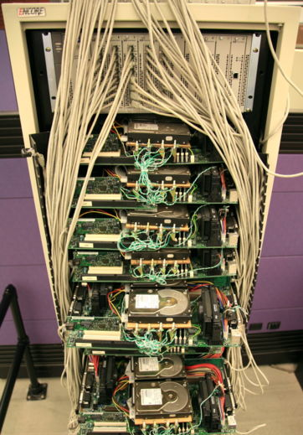
COMPSCI 111 / 111G An introduction to practical computing
Publishing online
Blogs, Wikis
Notes:
Pictures: Printing press, Google early servers
Technologies we use to Publish things online:Wikis and blogs . Traditionally only business and corporations publish
To reach a large number of people: Newspaper television
Now individuals can reach that number
Making connection to the audience
If it becomes popular you can reach millions
Extremely difficult 20 years ago
Some of the ways to publish information, available to everyone. Ways information is distributed has changed rapidly: very little of how your parents used to get their information is still the same, internet and related technology such as tablets, mobile phones, on-demand TV have changed how we consume information. Newspapers struggling, so is TV and traditional book publishers – everybody trying to come to terms with this brave new online world where everybody can reach everybody else.
http://en.wikipedia.org/wiki/Printing_press
http://en.wikipedia.org/wiki/File:Google’s_First_Production_Server.jpg

Slide 2
Publishing online
Information is made available to the public
target audience?
Technology
Yields new channels for dissemination
Different possibilities of presentation
Social and legal issues
Copyright
Privacy
Cultural issues (can be read anywhere world)
Concern with your own safety
durability/archiving
Notes:
Easy to use for non-technical person
What is your target audience
blogs for children, teenagers, ploitical
formal or informal
Text pictures videos
Copyright just as true on internet
Copy just as illegal on the internet
Easy to publish – people do it a lot
People in the industry know the privacy laws
Individuals don’t
Other people may not want their details published – friends names
Internet is archived indefinately
Internet history site (what did this website look like January 23 1998)
Facebook – timeline
Cultural differences – operating in international medium
People publish stuff they won’t normally tell complete strangers
Strangers could be gang members – sell drugs – serial rapists – EVERYBODY: “gee I am not looking forward to walking home tonight because I have to walk down this scary street….
I am enjoying my soceer game, I play it every Wednesday….(now know where you are every Wednesday)

Slide 3
Da Vinci’s “Blog”
Notes:
Excerpt from his journal Photographic reproduction of expired copyright material Leonardo da vinci’s journal

Slide 4
Blog
Web log
Website
Posts are made in chronological order, displayed in reverse chronological order (newest first).
Very easy to use
Estimated blogs worldwide: more than 100 million
Example: Computer Science Department/Ian Watson’s Blog
Uses
Online Diary (now supplanted by facebook, twitter etc)
Commentary: Political, cultural, economical, personal, technical, …
Different Types
Photoblog, videoblog, audioblogs (podcasts)
Terminology
Blogger - person that posts entries to a blog
Blogging - writing posts to a blog
http://en.wikipedia.org/wiki/Blog
Notes:
In 1997, John Bargerm, editor of Robot Wisdom, coined the term “web-log” while attempting to describe the daily list of sites that he “logged” onto during his web travels.
Blogging took off in ’99 and shortly thereafter.
Stewart Brand whole earth catalogue
The well
Biking SF, vegan food, arthouse movies
Info wants to be free
Top of Blog = last entry
Scripts make it very very easy to add new content
Text area hit submit and gets added
Posts maintained in reverse chronological order
Current month displayed – other months archived
So very popular
online diary
research journals
companies can keep clients informed – IT support
political groups
Blog – normally means txt based
Podcosts – audio blog

Slide 5
Successful blogs and bloggers
Some of the most popular blogs:
Mashable - News (24 million visitors/month)
Gizmodo- Design/Technology (15 million visitors/month)
TMZ - Entertainment (30 million visitors/month)
Business Insider – Business/Technology (25.5 million visitors/month)
Only start a blog if you have something to say.
Notes:
http://www.therichest.com/rich-list/world/worlds-10-top-earning-bloggers/
Mashable: news/social media, with local outlets
Gizmodo: Technology
TMZ: Entertainment, Celebrities, Gossip
Business Insider: Business Technology – made up in entertaining ways (have to, to make it appeal to masses
Biggest (according to online lsits): Huffington Post (110 million monthly visitors) , however more of a classical news site that uses blog-tech

Slide 6
Social Issues
Political movements
E.g. during Arab spring
Many personal viewpoints
difficult for repressive governments to clamp down on free media
political censorship is also done online
Advantages
Gives people a voice
Enabling technology for grassroots movements
Dangers
Providing too much information
Children inviting wrong kind of attention (e.g. MySpace)
Notes:
Arab spring: Transformative. Use satellite phones
Letters to editors declined. Replaced by online comments
Guardian
War in IRAQ – blogs used by western media
people posting what actually happening
could be a different perspective
political organizations can affect what is in these blogs
http://www.welovetheiraqiinformationminister.com/
Just now: Raif Badawi, Saudi Arabian blogger, convicted to 1000 lashes for ‘propagating liberal thought+violating Islamic values’ through his blog
CAMPAIGN FOR FREE SPEECH ONLINE
people can be put underpressure or
organizations can be shut down
Internet is freeest but not completely free
Small groups can build community
Pamphlets, street corners, meetings
Now easier
Blog webpage consists series posted messages
Easy to add new content
Series posts time stamped , chronological order
Easy sharing information –
can be very rapid
individuals can get info to many people
Shouldn’t trust more than a random stranger
back up viewfor test
Depends on the source……

Slide 7
Microblogging
Microblogging is a broadcast medium that exists in the form of blogging.
A microblog differs from a traditional blog in that posts are smaller:
Twitter posts, called tweets, are limited to 140 characters.
Microblogs "allow users to exchange small elements of content such as short sentences, individual images, or video links", which may be the major reason for their popularity.
Among the most notable services are
Twitter,
Tumblr,
FriendFeed,
Cif2.net,
Plurk, Jaiku and identi.ca.

Slide 8
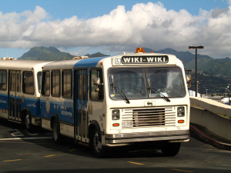
Wiki
Created by Ward Cunningham in 1995.
Introduced to discuss programming tricks
Simplest online database that could possibly work
Anyone with appropriate access can edit any page
Notes:
Fast airport bus service into Honolulu: Wiki(Hawaiian) = fast
Wikipedia
how many have used
Wiki – 1995 – Ward cunningham
programing patterns – architecture
templatre for how to solve problem
Trying to write a book on this with a bunch of people around the world
Make a webpage that anyone could edit by clicking the edit button
rapid to develop content
http://en.wikipedia.org/wiki/File:HNL_Wiki_Wiki_Bus.jpg

Slide 9
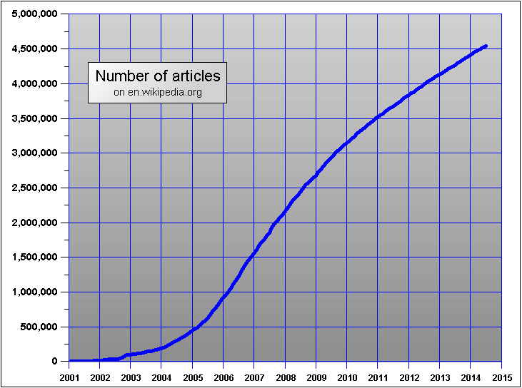
Wikipedia
Launched 2001, worlds biggest wiki. Runs on MediaWiki.
July 2014: 32.4 million articles in 287 languages; 4.5 million in English, 800 new articles per day
10,000 - 30,000 requests per sec; about 400 web servers
Notes:
http://en.wikipedia.org/wiki/History_of_Wikipedia
Most famous wiki is wikipedia
crowd-sourced encyclopedia
Largest wiki
2001 not much content
Statistics:
125K have taken action (login, edit) in last 30 days
21m users in last 30 days
http://stats.grok.se/en/latest90/K-trivial_set
http://stats.grok.se/en/latest90/Vladimir_Putin
wikileaks

Slide 10
Advantages and Disadvantages of Wikipedia
Advantages
Everyone can contribute
Easy to use
Quick to develop material
Enormous amount of available topics and information
Disadvantages
No direct quality control
Management bias
Information changes rapidly
Vandalism a possibility practically guaranteed
Notes:
Anybody can edit it: criminals, people with opinions but don’t really know
If you are an expert you can put info in
Very rapid for new content
If you don’t find something “your high school”
you can add it
But since anyone can write – no quality control
anyone can vandalise
delete or write something else.
Controversial topics
George Bush, Abortion
flip back and forth a lot
Lock down in that case, moderated by some one impartial
Information changes rapidly….so in a weak might be gone….difficult to reference accurately
People on the internet anonymous and with strong opinions: if you talk to sb at a party you might be careful how strongly you voice your opinion – not so much on the internet.
4) Should you trust the information on a wiki and why??
http://en.wikipedia.org/wiki/File:Kilroy_Was_Here_-_Washington_DC_WWII_Memorial.jpg

Slide 11
Dealing with Vandalism
Bots: In most cases, the vandalism is automatically detected and reverted by a bot, called ClueBot NG. The vandal is always warned with no human intervention.
Recent change patrol: Wikipedia has a special page that lists all the most recent changes. Some editors will monitor these changes for possible vandalism.
Watchlists: Any registered user can watch a page that they have created or edited or that they otherwise have an interest in. This functionality also enables users to monitor a page for vandalism.
Incidental discovery: A reader who comes across the vandalism by chance can revert it.
Notes:
Bots: In most cases, the vandalism is automatically detected and reverted by a bot, called ClueBot NG. The vandal is always warned with no human intervention.
This is currently unlikely to be the case, considering the reliability and speed of ClueBot NG and recent changes patrollers.

Slide 12
Exercises
Exercise 1: What is a blog ?
A web log. An online diary or journal.
Exercise 2: What are some of the possible benefits of blogs?
Gives people a voice; you can reach a wide audience with a blog
Easy to do; little technical expertise required and low costs.
Can bypass state controls (to a certain extent)
Exercise 3: Should you trust the information on a blog? Why?
Depends.
Exercise 4: Should you trust the information on a wiki? Why?
Depends.

Slide 13
Reliability of Wikipedia
IBM research (2003) showed vandalism repaired rapidly
Early study reported in Nature (2005)
Wikipedia scientific articles were generally accurate
Rate of serious errors similar to Encyclopedia Britannica
More accurate for academic topics than for pop culture
E.g. “Dark energy” article 95% correct, but
Article on Indie pop band "Passion Pit” has 10 serious errors, according to its former drummer, Nate Donmoyer.
Making it work
Everyone who adds content also takes responsibility
Self-moderating: develop consensus policy, cooperate to ensure high quality
Use change management tools
http://en.wikipedia.org/wiki/Reliability_of_Wikipedia
Notes:
Even though: Wiki quite reliable - mostly
Studies done
E.B challenged it, Nature rebutted point by point
When content destoryed – repaired extremly rapidly
most users don’t know anything is wrong
When modified produces a list of all modifications – easy to go back to an earlier version
click on histoy, go back to previous version, click restore
Academic articles beginning to cite Wikipedia
Over 600 citations in ScienceDirect database (2009)
Nature – wikipedia general accurate
Academics say don’t cite wikipedia….not suitable source
but academics are citing it
600 sites in science direct database in 2009
and is growing
Critical of wikipedia (make sure it is right)
Better for opinion then for evidence
Citations in these notes from wikipedia – good way to get an introduction
academic references at bottom of articles
Annual conference/ hiearchy down to subject managers, people for partiuclary

Slide 14
Encyclopedia Britannica
Has stopped to publish paper edition.
Readers can now contribute to articles.
Fewer articles than in Wikipedia.
A sample of an article in Encyclopedia Britannica:
http://www.britannica.com/EBchecked/topic/1055698/dark-energy

Slide 15
Other Popular Wikis
WikiVoyage
Travel guide with entries for countries, cities, areas, sights
Formerly WikiTravel
Wikia
Collection of Wikis, anybody can create wiki on any topic
Focus on gaming and entertainment topics
~10 million entries altogether
WikiMapia
Combination of Google Maps and an extra layer of polygons that mark interesting areas, buildings etc.
~13 million entries
WikiHow
Extensive collection of how-to guides
Articles often include media such as photos and videos
Notes:
Not just wikis that look exactly like wikipedia, (i.e. also use the same software) but general websites that use the wiki model (user contribution etc.)
Roughly ordered by size (most of these have more than 10 million entries)
AboutUs (website wiki, automatically populated)

Slide 16
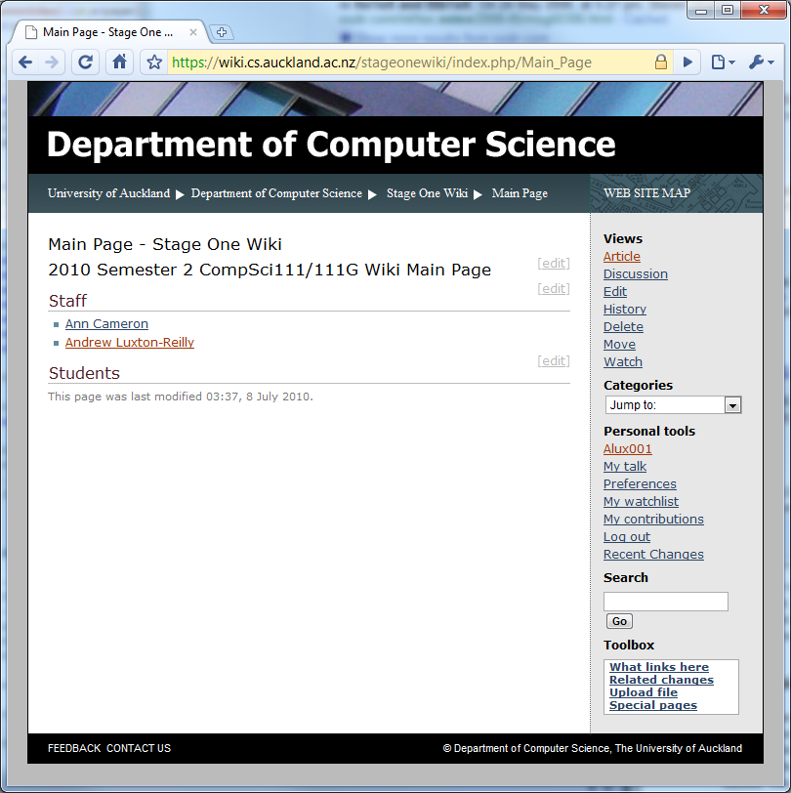
Computer Science Stage One Wiki
Free Wiki software
Simple security model, used for Wikipedia, CS Dept, …
Page content
Navigation bar
Toolbox
Notes:
Reminder of slides not going to go through
For labs

Slide 17
Stage one wiki
Set up for COMPSCI 111 / 111G
Anyone can read the wiki
Must log in before editing
Main pages are protected
Purpose
Students can collaborate
Create / compile resources for the COMPSCI 111 course
Tool for the COMPSCI 111 community
Use
Encouraged to contribute

Slide 18
User page
A page is set aside for each user
Click on user name to access the user page
Same as any other page in the wiki
Link to user page

Slide 19
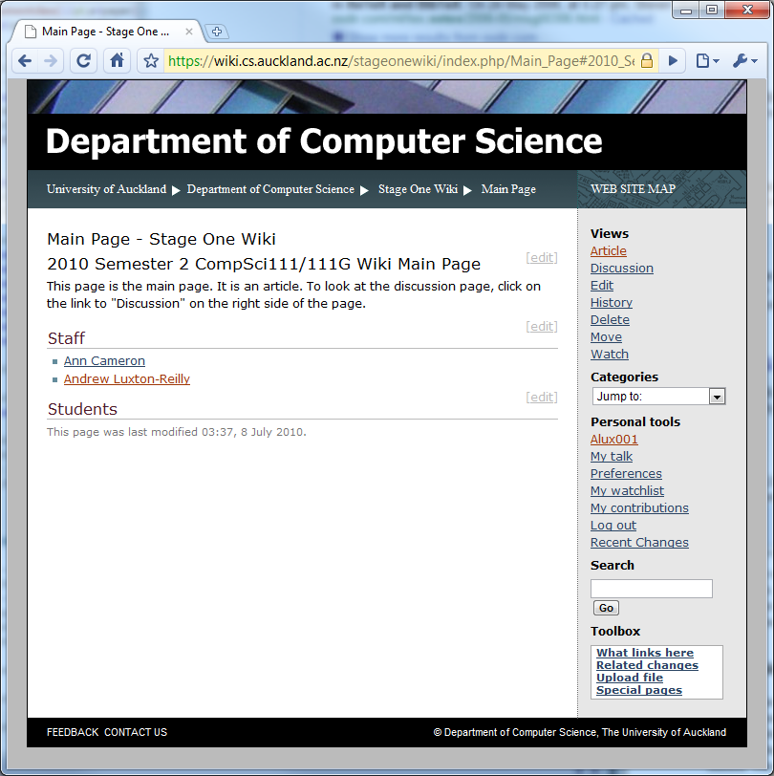
Articles
Main content of the wiki
A single page is an article about a topic

Slide 20
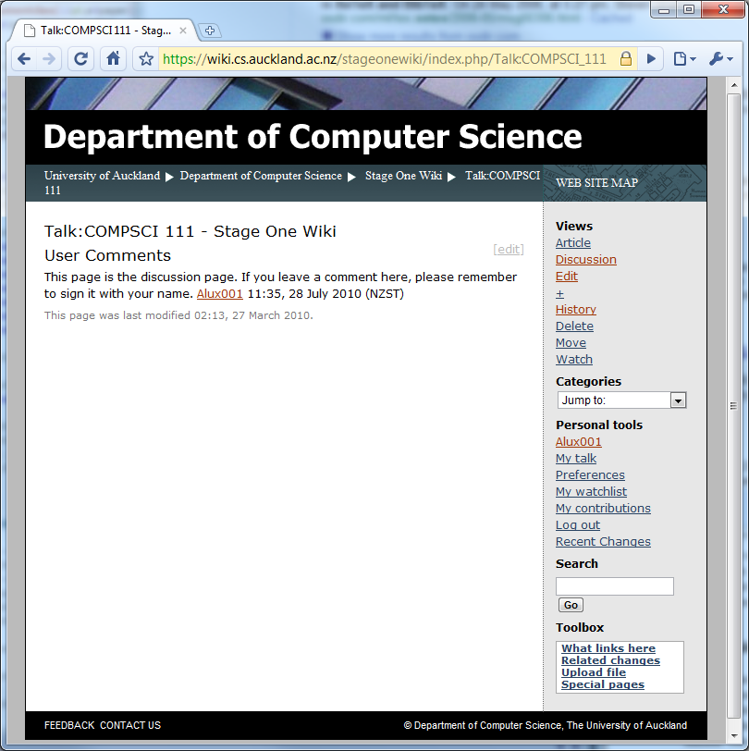
Discussion page
Each page in the wiki has an associated “talk” page
Allows users to discuss content of a page
Can write comments, ask questions etc. without disrupting article
Notes:
Discussion pages can be very entertaining on Wikipedia: some people (lots) have very strong opinions on certain topics -> edit wars.

Slide 21
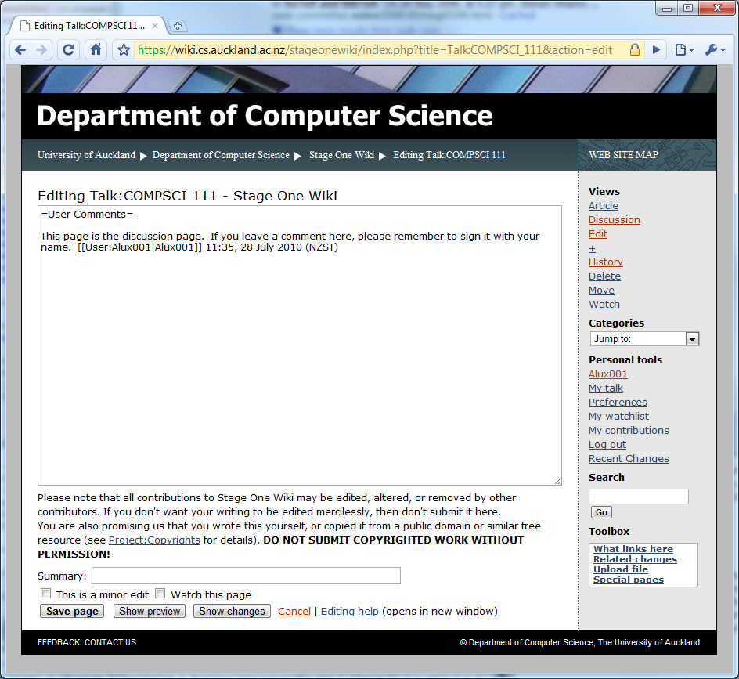
Editing a page
Simply click the edit button and start making changes.
Always preview and read the page before you save changes
Changes are tracked (as normal for wikis)

Slide 22
Markup
Wikis use their own markup language, sometimes called wikimark
Also accept some HTML markup
Different wiki systems use different markup

Slide 23
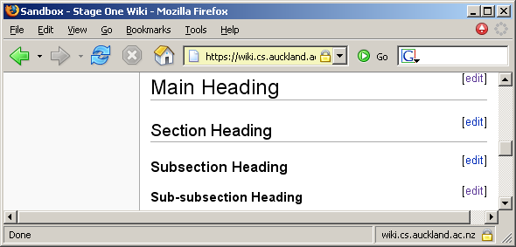
Headings
Four different levels of heading
= Main heading=
== Section Heading ==
=== Subsection heading ===
==== Sub-subsection heading ====

Slide 24
Paragraphs
A single line break is ignored
A blank line starts a new paragraph
This is the sandbox.
Please feel free to play in it :)
You should use this page
to experiment with the wiki
markup language and try out

Slide 25
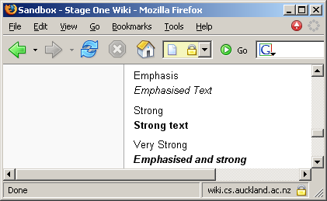
Character Styles
Emphasis
''Emphasised Text''
Strong
'''Strong text'''
Very Strong
'''''Emphasised and strong'''''

Slide 26
Links
Adding an internal link (to another wiki page)
[[Name of Page]]
Adding an external link (to a page outside the wiki)
http://www.cs.auckland.ac.nz
Adding an external link (to a page outside the wiki), but displaying text for the link
[http://www.cs.auckland.ac.nz CS Dept]

Slide 27
Lists
Ordered List
# my item 1
## my item 1.1
# my item2
Unordered List
* my item 1
** my item 1.1
* my item 2

Slide 28
Other Ways to Publish Online
Online direct publishing
Through Online Store (Amazon, Nook, Kobo)
Or simply as your own e-book
Whole books or just short stories or articles
The Martian was initially self published.
Andy Weir, the author put the book online on his website in serial format, a chapter at a time for free.
Eventually at the request of fans he released an Amazon Kindle version for 99 cents.
The book was picked up by publishers in 2013 and has since become a best seller and a popular film.
Notes:
Web=constantly evolving landscape: none of the things we talked about existed 20 years ago, few 15 -> no idea whats going to happen within the next decade.
Tumblr also big in terms of microblogging
Amazon offers biggest market access (over 100 countries for kindle store) but .mobi is proprietary format vs the more common epub format
Creating an Ebook easy with freely available tools. Manuals online.

Slide 29
Summary
Blog = Web log
Electronic journal with posts that are displayed in reverse chronological order
Usually from a single author, editorial style
Political, cultural, economical, personal, technical, …
Photoblogs, videoblogs, audioblogs (podcasts)
Wiki = web pages that anyone (of a certain group) can edit
Everyone can contribute to a central pool of content
Prime example: Wikipedia
Not always accurate, but nevertheless very useful
Wiki systems have their own languages for writing pages
Language overview for the MediaWiki system: http://en.wikipedia.org/wiki/Wikipedia:Cheatsheet
And many other, constantly evolving ways to publish content on the web.

