Slide 1
COMPSCI 111 / 111G An introduction to practical computing
Electronic Communication
Email, instant messaging, forums
Notes:
This entire week focusing on internet
Email
Chat
Discussion forums

Slide 2
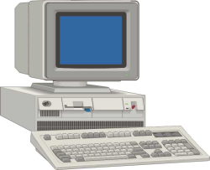
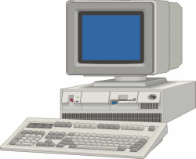
What is e-mail?
Electronic mail
System for sending and receiving message over the Internet
Asynchronous system
Messages are sent and received some time later
Just like physical letters, but faster
Normally takes seconds
Must know the address of the recipient
Notes:
E-mail = electronic mail
Traditionally plain text
Just like snail mail
Asynchronous = time delay
Synchronous = telephone
Have to know address (EXACTLY)
10 Snake Road (instead of 8) – person would fix….
Computer not that smart

Slide 3
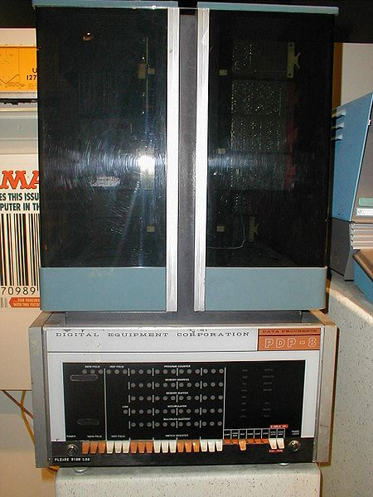
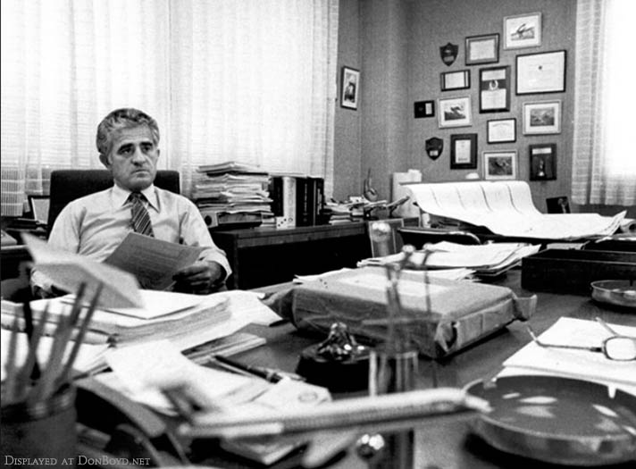
Electronic mail (e-mail)
Started very early (late 1960's)
Before the Internet
Multiple people shared the same
machine, no computers in office
People left messages for other
users
Typical
1960s
office
http://en.wikipedia.org/wiki/Email
Notes:
http://en.wikipedia.org/wiki/File:PDP-8.jpg
Large mainframes This one is a PHP 8
Expensive – not very many = time shared
Go to computer – book time – use for an hour
Didn’t have one in your office
Need to compunicate messages to other users “part of the network is very slow don’t use that”
“printer driver out of date – printer won’t work” “don’t try and print it will lock the machine up”
“I left seven processes running don’t close these processes down – I need the results tomorrow”
Could leave a note and cello tape it
But offten accessed by more than one terminal
Leave a electronic message when logged on
Hard-drive and processors were shared
“please delete some files – I need the space”
Early messages – leaving simple short messages to other users on the computer
Need to know their user name
Prid013
Put a message into a place and next time I logged in I would receive that message

Slide 4
First network email
Ray Tomlinson
Send first email message from one computer to another over network (1971)
Used the @ sign for email addresses
http://openmap.bbn.com/~tomlinso/ray/firstemailframe.html
Notes:
Was at BBN (built ARPANET)
Send message to a person on a different machine…. Early days of internet, they had some computers connected
Must use username and “machine name”
@
Can’t remember the text of the first email something like”qwertyuiop”
Didn’t think this was a big deal….
Told collegue what was working on….he said “don’t tell anyone else” Because you shouldn’t be working on that….its a waste of time”
Email is still one of the most widespread uses of internet

Slide 5
Email Address
Understanding the address
localpart@domainname
The local part of the address
Often a username
The domain name where the mail
server is located
e.g. stefan.wender@auckland.ac.nz
Notes:
Localpart = username
Systemstaff
Domainname = DNS

Slide 6
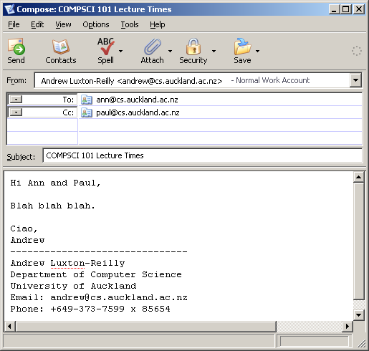
Composing an email message
Compose the message
Use an application or webmail
‘From’ sender is easily faked.
Mail goes to all recipients (To,Cc, Bcc) but other recipients don’t see Bcc address.
Spam filter might catch mail with blank subject.
Signature is not legally binding.
source address
destination address
Bcc:
stefan@cs.auckland.ac.nz
carbon copy
blind carbon copy
subject
message body
signature
Notes:
Webmail - Gmail,hotmail,yahoo
Stand alone application Outlook, thunderbird – webmail most common these days
Bcc
Subject is blank can be removed by SPAM filter
Less likely to be read for people that get lots of messages
Used for filters

Slide 7
Sending an email message (1)
Program sends the email message to mail server
Uses Simple Mail Transfer Protocol (SMTP)
Usually located at your Internet service provider (ISP)
Email message
Message stored on SMTP server
Email message
Email Client
SMTP Mail server (program)
Computer
Computer
Message sent using SMTP over the Internet
Notes:
Program needs to figure out where to send it too
Send message to mail server (like extra or University mail server)
Protocols – like yesterday
SMTP = simple mail transfer protocol
Sends it to the mail server
When computer is set up it is given the address of the mail server
smtp.cs.auckland.ac.nz

Slide 8
Sending an email message (2)
SMTP server contacts the Domain Name System Server to find address of mail server
Name IP address
... ...
mailhost-vip.auckland.ac.nz 130.216.159.124 ...
SMTP Mail server program
DNS Server
Computer
Notes:
Where is the destination computer????
Call the DNS to find IP address

Slide 9
Sending an email message (3)
SMTP server sends the email message to destination mail server
SMTP Mail server
Email message
Destination
Mail Server
Computer
mail.cs.auckland.ac.nz
Notes:
Sits on mail server until user logs on
This is way delay can be days or weeks

Slide 10
Sending an email message (4)
User collects mail from mail server
Different protocols for collecting mail
POP3 (Post Office Protocol 3)
IMAP (Internet Message Access Protocol)
Email message
Message stored on mail server
Email message
Email Client
Mail Server
Computer
Computer
Message received using POP3 or IMAP protocol
Notes:
When user logs in
“I’m here I want to “get mail””
Smtp – sending mail
pop3,imap – getting mail
(pop3 old fashioned)

Slide 11
POP3 versus IMAP
POP3 (derived from Post Office Protocol 3)
Email is downloaded from server to local computer and deleted from the server after download
No Internet connection necessary to read the downloaded messages
If local computer is erased, the messages are lost
IMAP (Internet Mail Access Protocol)
Email is kept on server
Email client just shows what messages are on the server and downloads them on demand (not deleting them). Possible to download only partially, e.g. only the subject line.
Email can usually only be read when connected to the Internet
email clients can be set to maintain a local copy for offline
Good to access email messages from different machines
Notes:
POP3 protocol
Mail server moves all mail onto your local machine then mail is deleted
Pain if you used more than 1 computer (home machine, office machine)
If laptop is stolen – there is no other copy – gone
IMAP
Mail on server
Client sends messages back and forth to server
If delete mssg, delete on server as weel
If you move messg to another folder…..
Can set to only download headers (better for bandwidth)
Sychronises all computers
Cost of infrastructure is larger (more hard disk space)

Slide 12
Gmail
Web interface for email (similar to Hotmail, Yahoo!)
Started early 2000s
900 million users as of May, 2015.
Sophisticated search facilities, both for content and contacts.
Different views available (e.g. conversation views)
Chat, hangout added later
Problems for user: phishing, targeted ads, tries to get you do other things (e.g. use google+)
Notes:
Last numbers probably closer to 550Million
Branch out into companies (60% of mid-sized US companies use gmail) education providers (UoA), governments.

Slide 13
Privacy and email
Messages pass through many machines
Can be read by others while in transit
Messages are stored on the destination mail server
Can be accessed by the administrator of the system
Misdirected email might be automatically send to administrator
Backup copies might be made automatically be the mail server
Legality
Illegal to read physically posted mail (Federal crime in the USA)
Perfectly legal to read email messages
Many major companies in USA check employees email (25% - 75% depending on the survey)
Notes:
Privacy and email - not clear cut
In US federal crime to tamper with mail
But can read email…..
Might get someone elses email accidentaly
(this has happened to me…)
Mistake in address (postmaster will look at email and try and deliver)
andrew-l (so a lot of people would send to andrew-1)
Administering this systems means
…..Other people might sometimes get a copy….
Legal requirment email kept for 7 years “staff”
A lot of compaines backup by default
US some compaines read employees email (25%-75%)
Data stored on their machines
They pay for bandwidth
You should only do business email on their machines
Most employess use business email for personal purposes sometimes
Might be read and
Certainly is archived

Slide 14
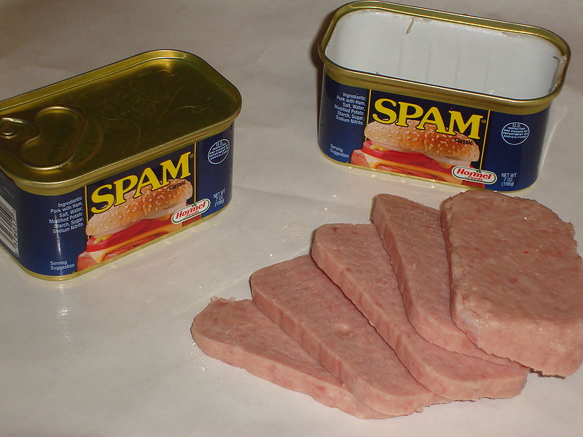
Spam and Scam
What is spam?
Advertising emails, named after canned meat
via an old Monty Python Sketch
Unsolicited, bulk email (message send to thousands of people)
Spamming is illegal, but enforcement is difficult
About 100 billion spam email messages per day (2013)
Many email clients provide spam filters
Scam via email?
Emails promising money, free gadgets, prizes
Hoaxes: made-up stories, asking you to forward mails, pay money.
Phishing: acquire sensitive information by masquerading as a trustworthy entity (e.g. as your bank, or your mail provider)
Notes:
http://en.wikipedia.org/wiki/File:Spam_with_cans.jpeg
Usually advertises a commercial product, a website,
Can be verified by searching the internet (e.g. hoaxbusters.ciac.org)
(e.g. online banking password, password of your email account),
2007 90 billion spam email a day
30% of internet bandwidth
2010 200 billion
75% of email traffic worldwide
So internet speed 1/3 lower because of spam
Mail storage – backups of mail
(Spam costs enoumous amount of money)
Information represted over and over again
Bulk email
Advertising
Vaiagra etc
Illegal in US and NZ
Enforcing quite difficult
Launch from cites where it is not illegal
Or hack into someone elses site and send from there
Can’t be traced to them
Some spammers make millions – so they see as worthwhile
Spam filters pretty good
UofA catch 10 for every 1 they let through
You only see a fraction
Try to collect up email addresses
Spammers – paid by address
Programs that search through webpages
Scams
Promise something for free
Click on link or reply
“valid email address”
Gulible enough to reply
Goto the SPAM top of the list
hoaxs
Someone thought was fun
New virius…please pass on to all your friends
ALWAYS A BAD IDEA
Hoaxbusters – urban legend
Phising
Kiwibank
Click here to log in
Reenable you account
Will look exactly the same……..BUT……(different domain name)
Will steal all your money
Send to a million and 10 will do it……

Slide 15
New Zealand Spam Law
Unsolicited Electronic Messages Act 2007
Prohibits unsolicited commercial electronic messages with a New Zealand link.
Requires commercial electronic messages to include accurate information about the person who authorised the sending of the message, as well as a working unsubscribe facility to enable the recipient to instruct the sender that no further messages are to be sent.
Prohibits address-harvesting software used to create address lists for sending unsolicited commercial electronic message.
Deters people from using information and communication technologies inappropriately.
Electronic message covered by the Act:
Email
Fax
Instant messaging
Text and image based messages of a commercial nature sent to mobile phones

Slide 16
Exercises
What does asynchronous communication mean?
Participants do not communicate with each other concurrently.
Give an example of an asynchronous system of communication, other than email.
Text messages
Forum posts
Explain, as simply as possible, what SMTP is used for.
Delivers email to the destination mail server.
Which protocol can be used to download your messages to your local machine so you can read your email when you are not connected to the Internet?
IMAP or POP.
What is spam?
Unsolicited, bulk email, usually of a commercial nature.

Slide 17
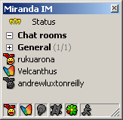
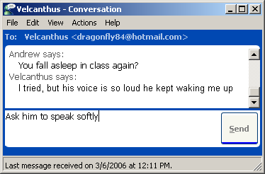
Instant messaging (IM)
Synchronous system of communication
List of contacts
Displays contacts that are currently online
Messages are sent immediately in real time
Notes:
Use to be Stand alone applications
Now build into other devices (facebook) and people use it less because of text messaging
Synchronous communication system

Slide 18
Chat system (1)
Start up the chat client: Set the status to "online"
Client tells the server
that you are online, gives
server list of contacts
Server
Server stores:
your IP address, list of your contacts
Client
(me)
Client
Notes:
No longer standard
Sends ip address
List contacts
Name
Match up with database

Slide 19
Chat system (2)
Server responds
Server sends IP addresses
of all your contacts that are
currently online
Server sends your IP address
to anyone that lists you as
a contact
Server
Client
(me)
Client
Notes:
Database has List of friends and there ip address
Now sends ip address to friends

Slide 20
Chat system (3)
Clients can chat to each other without the server
Server
Client
Client
Notes:
Can now connect directly
Ping server every so often to see if new friends on line

Slide 21
Common chat systems
Chat Systems
ICQ (from 1996)
MSN
Yahoo
Google Chat and Hangout
Skype messages
Facebook Chat/Messenger
WhatsApp, WeChat, Viber, etc.
Applications used as clients
Many
Some clients allow user to connect to multiple chat systems (e.g. Miranda IM)
WhatsApp (contortion of ``What’s up?”) allows for cross-platform instant messaging
Chat rooms
Anyone in the same “room” can see the same chat
Notes:
100 different systems

Slide 22
Instant Messengers
Users Transitioning from Email and SMS
WhatsApp
600 million active users (August 2014)
20 billion sent messages/day (April 2014)
Acquired by Facebook in February 2014 for $19 billion
WeChat
438 million active users (August 2014), 70 million outside China
Viber
Instant messaging and VoIP calls, also to landline
280 million registered users
Google Hangouts
Integrated into Gmail
Allows chat, voice calls and video calls
Facebook Messenger
500 million users (November 2014)
Text and voice
Notes:
WhatsApp biggest instant messenger, WeChat in China, viber third, Facebook had 1.3 billion active users (June 2014)

Slide 23
Dangers
Any electronic communication
You cannot easily know who a person is
People misrepresent themselves
Who they say they are
Who they really are
Notes:
http://www.publicdomainpictures.net/view-image.php?image=6007&picture=curious-student
Problems with email and chat
Can say anything on text
“12 yr old girl”
Scary
Anonymity
Good and bad

Slide 24
Attachments
File that is attached to a message
Usually sent via email
Not secure
better send a link to the file than the file itself (much smaller, more likely to arrive) E.g. use dropbox, google drive
Attachments may contain dangerous files
Malware: Spyware, viruses etc.
Particularly dangerous: executable attachments (.exe, .com)
Other seemingly harmless file types may also contain executable code
Never open an attachment you cannot trust
Notes:
Can send attachments
Any kind of file (as long as not to big)
Can be used to keep backups of important files on email system?
Reencodes it as plain text (everything is just numbers)
Email set up to only mail plain text (ASCII)
At the other end reconvert back
Attachments can be programs
Can do nasty things if you run them
VIRUSES
If you are sent a program
.exe or .com
Never ever run it
Even if it comes from a friend (address can be stolen)
Key loggers
Delete info on your hard drive

Slide 25
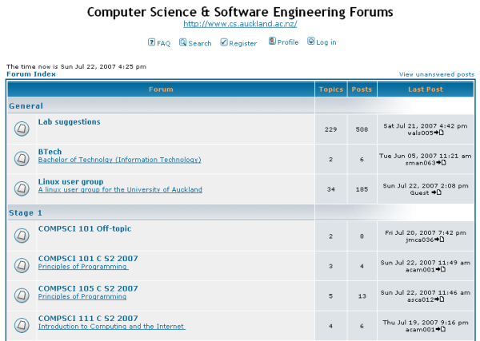
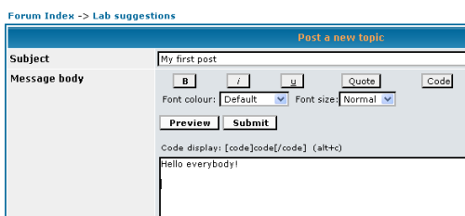
Forums
Message board
Asynchronous communication
Discussion group
Online communities
COMPSCI 111 SS C 2016
Moderator
Administrator with ability to edit,
delete, move messages
Thread
An online conversation
Message with replies
USENET (started 1980)
Huge system of public forums
Over 50,000 newsgroups
Notes:
Message are public
Anyone can look at them
Online communities
Moderator – can lock threads
USENET – before the web
More modern variations: Reddit, Digg etc. Merges forum with social networks etc.

Slide 26
“Good manners” on the Internet
Netiquette (Etiquette on the Net)
How to behave politely
How to avoid pitfalls
Understanding cultural norms, understanding online communities
Some Reading
http://www.101emailetiquettetips.com/
http://www.faqs.org/rfcs/rfc1855.html
http://www.albion.com/netiquette/
http://en.wikipedia.org/wiki/Netiquette
Notes:
Don’t write in caps

Slide 27
Summary
Email can be used to send messages to email addresses
Asynchronous communication
Usually not secure, i.e. can be read by other people
Can be misused for spam and scam
Used to send files as attachments
Can be misused to distribute malware: spyware , viruses etc.
Instant messaging
Synchronous communication
Usually also not very secure
Used to see if friends are online
Good to chat with other people
Chat rooms allow to chat with many people at the same time
Forums
“Electronic discussion group”, usually moderated,
larger and more stable than chat rooms

Slide 28
More Exercises
Under what conditions can you open an email attachment safely?
Never. Always ask friend if they really sent it.
What does CC stand for and what does it do?
Carbon copy – sent to those emails addresses as well
What does BCC stand for and what does it do?
Blind carbon copy – sent to those emails as well – but no one else knows this
What is a thread?
Online conversation – message with replies
What is a forum?
Electronic message board - asynchronous

