Slide 1


COMPSCI 111 / 111G
Mastering Cyberspace:
An introduction to practical computing
Spreadsheets

Slide 2
IF functions
Makes a decision
– Different values used in the cell depending on the logical test
IF( logical_test , value_if_true, value_if_false )
Must be either true or false
value
condition (test)
boolean function
This value appears in the cell if the boolean is true
This value appears in the cell if the boolean is false

Slide 3
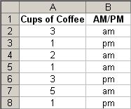
Example - coffee data
Imagine an experiment where we record the number of cups of coffee that we drink, and whether it was morning or afternoon. The table of data might appear as shown below:
How can we calculate the average number of coffees that we drink in the morning?

Slide 4
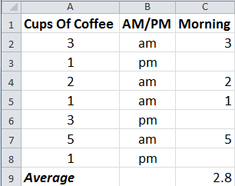
Example - coffee data
Add a new column to store the morning coffee data.
– If the contents of column B is the text "am" then use the value stored in column A. Otherwise, leave it blank.
=IF(B2="am",
A2, "")

Slide 5
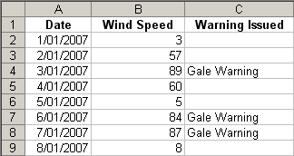
Exercise - Simple IF
Given the wind speed as shown in the table below, write the formula that would appear in cell C2. Note that a Gale Warning is issued when the wind speed exceeds 63 km/hr.
=IF(B2 > 63, “Gale Warning”, “”)

Slide 6
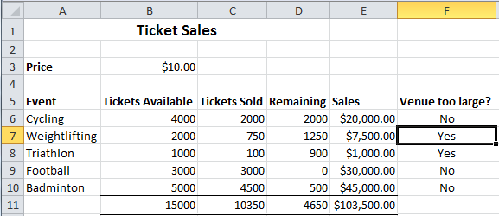
Exercise - IF
IF less than 50 percent of tickets available at a venue were sold, then the venue is too large. To produce the result in cell F7, what formula should you use in this cell?
=IF(C7/B7 < 0.5, “Yes”, “No”)

Slide 7
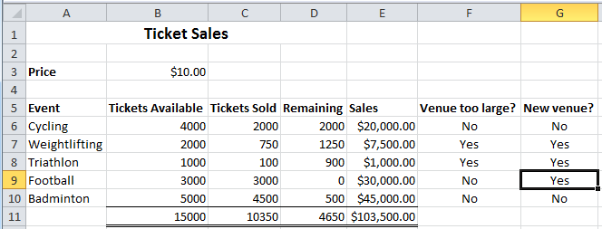
Example – IF with a Boolean Function
Ticket Sales
– Check if more than 90% of the tickets were sold, or if less than 50% of the tickets were sold. In either case, a new venue is required next time.
=IF(OR(C9/B9>0.9,C9/B9<0.5), “Yes”, “No”)

Slide 8
Looking up values in a table
Often have tables of data
  We want to look up a value
  e.g. given ID number, what is the name?
Student ID | Name | Phone
9100983 | Andrew | 123-4567
2098382 | Albert | 234-7654
2289483 | Adrienne | 321-7839
2109374 | Ann | 567-8932
Use a lookup formula
  VLOOKUP - looking up values in a vertical table
  HLOOKUP - looking up values in a horizontal table

Slide 9
VLOOKUP
VLOOKUP( value, table, column, [range] )
Value.
This is the value we already have written down. We want to use this value to look up a corresponding value in a table.
Boolean value.
Range of cells.
True if we want to match a range of values
This is the table we are using to look up the value in.
Number.
This specifies which column in the table contains the data we want.
False if we want an exact match.
Usually we want to use absolute references for the table.

Slide 10
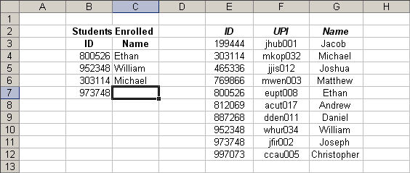
Example
=VLOOKUP( value, table, column, range )
False
1
2
3

Slide 11
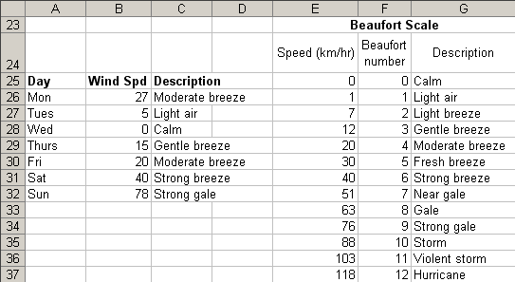
Example
Use a VLOOKUP to find the description for a recorded wind speed
=VLOOKUP( value, table, column, range )
=VLOOKUP(B26, $E$25:$G$37, 3, TRUE)

Slide 12

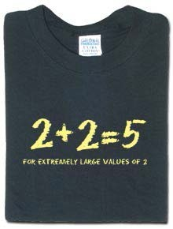



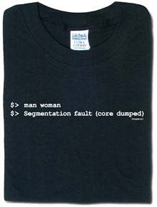
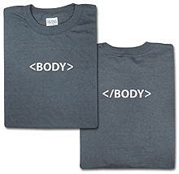
Exercise: ThinkGeek T-Shirts
http://www.thinkgeek.com/

Slide 13
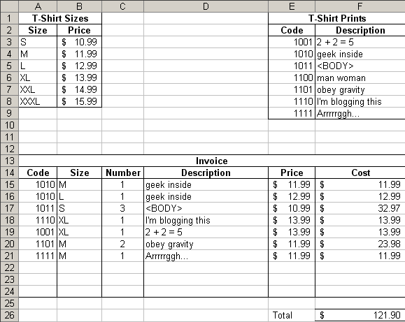
Exercise
What formulae should be used in cells D15, E15, F15 and F26?
D15:
=VLOOKUP(A15,$E$3:$F$9,2,FALSE)
E15:
=VLOOKUP(B15,$A$3:$B$8,2,FALSE)
F15:
=C15 * E15
F26:
=SUM(F15:F21)

Slide 14
HLOOKUP
Same as VLOOKUP, but for horizontal tables
HLOOKUP( value, table, row, [range] )
Value.
This is the value we already have written down. We want to use this value to look up a corresponding value in a table.
Boolean value.
Range of cells.
True if we want to match a range of values
This is the table we are using to look up the value in.
Number.
This specifies which row in the table contains the data we want.
False if we want an exact match.
Usually we want to use absolute references for the table.

Slide 15
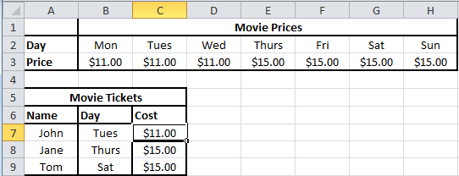
Exercise
What formula would be used in cell C7?
– Use a HLOOKUP
=HLOOKUP(B7,$B$2:$H$3,2,FALSE)

Slide 16
Graphing data
Start by sorting the data into dependent and independent variables
Independent | Dependant
1 | 1.5
2 | 4.9
3 | 2.4
4 | 2.6
5 | 3.3

Slide 17
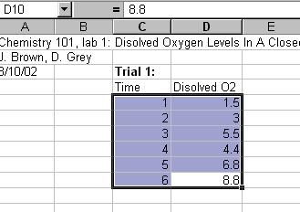
Enter the data
Highlight the data that you wish to graph by holding down the left mouse button & drag over your numbers, then release.
The area highlighted will be graphed. So make sure that you have selected all the data that you want to appear on your graph.

Slide 18
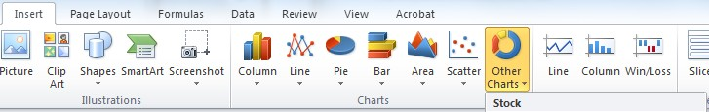
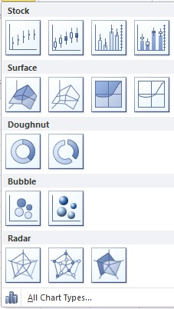
Create a chart
With your data highlighted,
left click on the chart type which you want to use
Click on other charts to see what other types are available

Slide 19
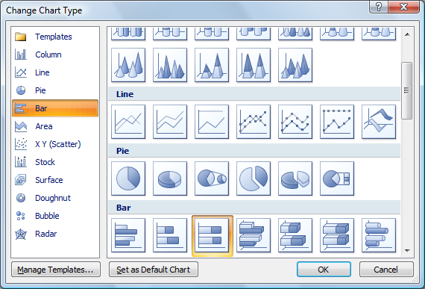
Change Chart
Click right on your chart an select “Change chart type”

Slide 20
Change layout/style
Select your chart and select the “Design” ribbon
Styles
Layouts

Slide 21
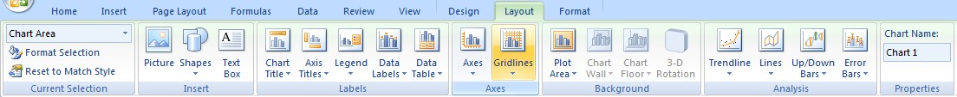
Enter labels
Enter a title
Label the X and Y axes.
Enter title
Label axis
Format legend

Slide 22
A completed graph
Tickets sales
10000
9000
8000
7000
6000
Tickets
5000
Tickets sold Tickets available
4000
3000
2000
1000
0
Cycling
Weightlifting
Triathon
Event
Soccer
Badminton

Slide 23
Simple data analysis
Congratulations you have made a graph, but you still have to draw a line or curve to relate the data.
Rarely in science do we “connect the dots” in a graph. Rather, we would like to show the trend of our data in the form of a best fit line.
How do we do this in Excel?

Slide 24
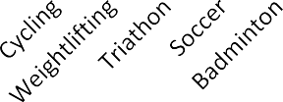
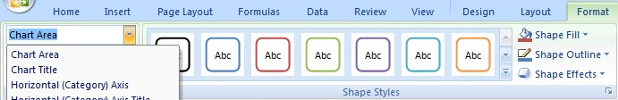
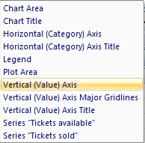
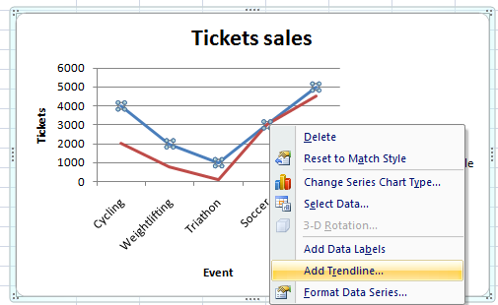
Adding a Trendline
Make sure the chart is selected
Select “Chart”
Select “Select Area”
Right click on chart and select
“Add Trendline”
Tickets sales
6000
5000
4000
3000
2000
1000
0
Tickets
Tickets available Tickets sold
Event

Slide 25
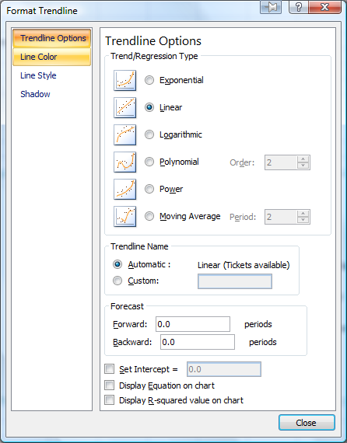
Graphing – Adding a Trendline
Choose the trend that you wish to show with your data.

Slide 26
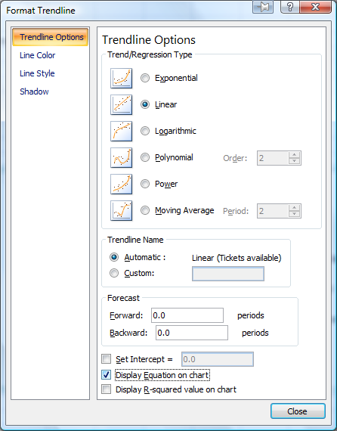
Adding equation
To add the equation of the line, choose the tab entitled “Trendline Options”
Select “Display
equation on chart”.

Slide 27
The completed graph
Tickets sales
6000
5000
4000
Tickets
y = 300x + 2100
3000
Tickets available Tickets sold
Linear (Tickets available)
2000
1000
0
Cycling
Weightlifting
Triathon
Event
Soccer
Badminton

