Slide 1
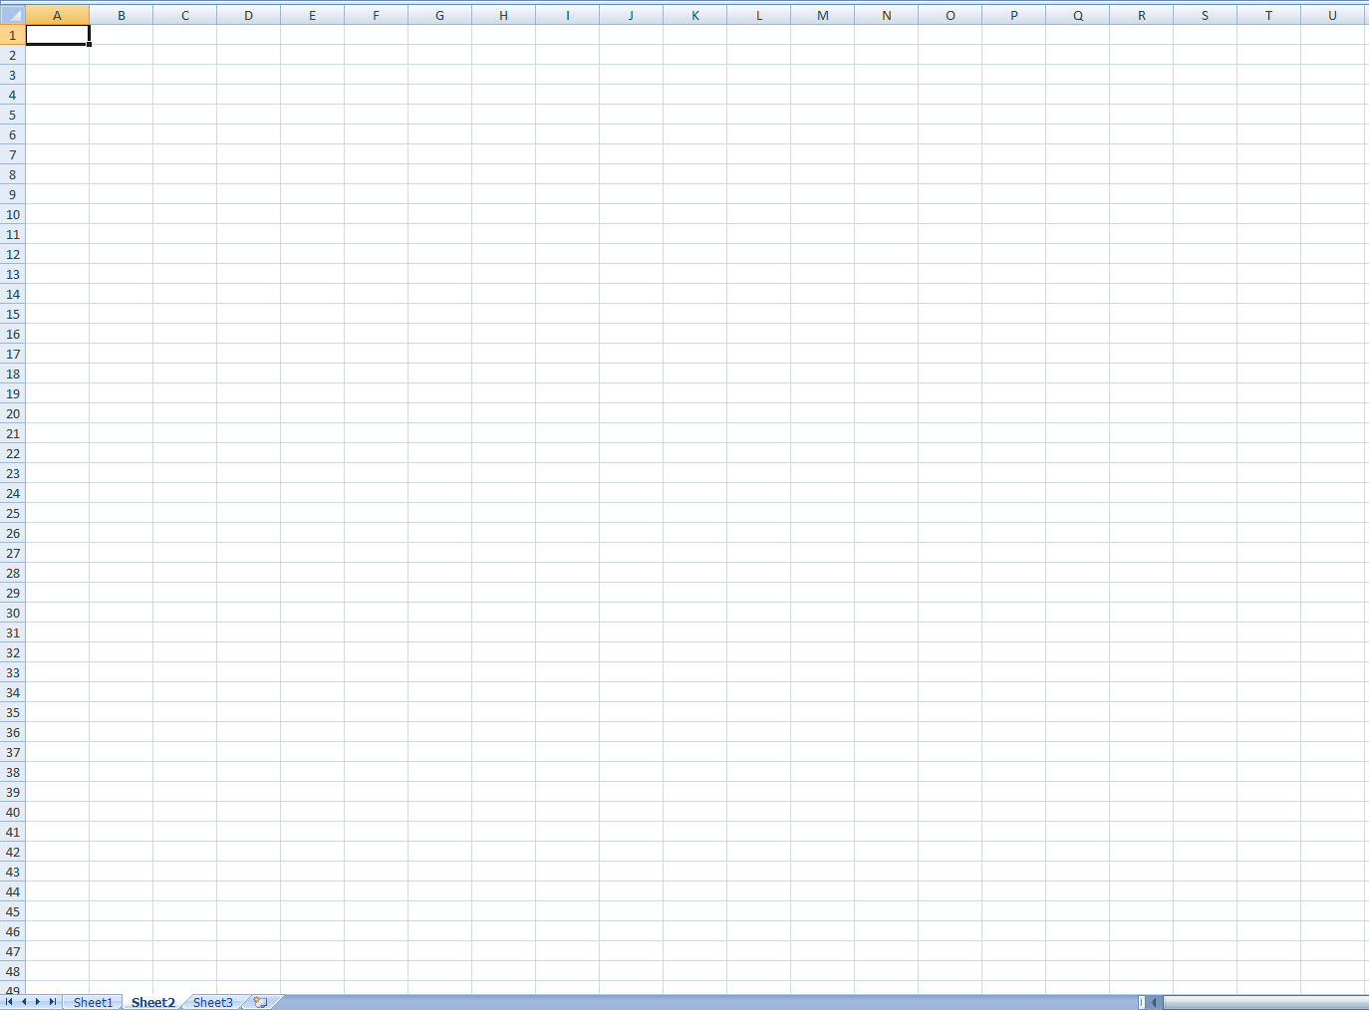
COMPSCI 111 / 111G Mastering Cyberspace: An introduction to practical computing
Spreadsheets

Slide 2
The 1st Killer App. VisiCalc
The idea for the electronic spreadsheet came to me while I was a student at the Harvard Business School, working on my MBA degree, in the spring of 1978. Sitting in Aldrich Hall, room 108, I would daydream. "Imagine if my calculator had a ball in its back, like a mouse..." (I had seen a mouse previously, I think in a demonstration at a conference by Doug Engelbart, and maybe the Alto).
And "..imagine if I had a heads-up display, like in a fighter plane, where I could see the virtual image hanging in the air in front of me. I could just move my mouse/keyboard calculator around, punch in a few numbers, circle them to get a sum, do some calculations, and answer '10% will be fine!'" (10% was always the answer in those days when we couldn't do very complicated calculations...)
Source: www.bricklin.com/history/intro.htm

Slide 3
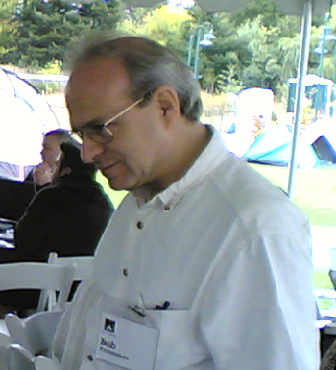
Development
Background
Dan Bricklin and Bob Frankston
VisiCalc released in 1979.
Notes:
http://en.wikipedia.org/wiki/File:Dan_Bricklin.jpg
http://en.wikipedia.org/wiki/File:Bob_Frankston,_crop.jpg

Slide 4
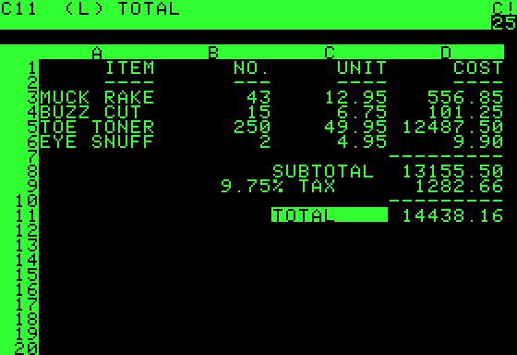
Design
Visible Calculator
Organize calculations as we would on paper - in columns and rows.
Supports automatic updating of calculations.
Copy formulas so we may apply these to large amounts of data.

Slide 5
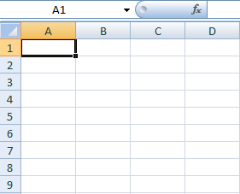
Microsoft Excel - Overview
Used to represent a table of data
Rows (labelled with numbers)
Columns (labelled with letters)
Cells
Columns
Current cell
Entry box
Rows
http://en.wikipedia.org/wiki/Microsoft_Excel

Slide 6
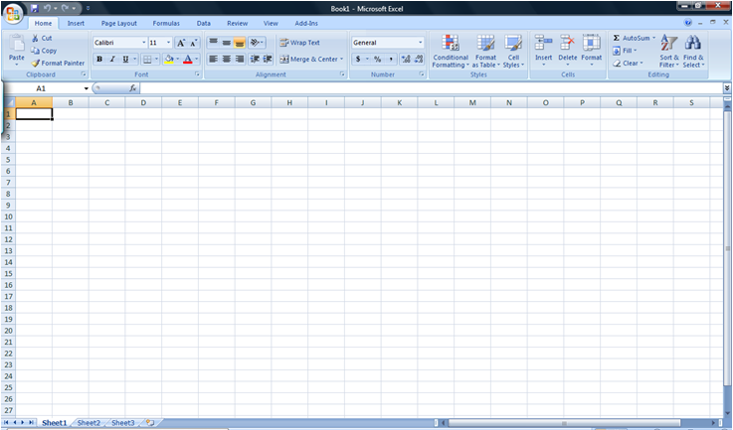
Changing appearance of cells
Alter Size
Click on cell separator and drag
Add Borders
Format Cell
Add Shading
Format Cell
Font
Style
Size
Alignment
Numbers
Decimal points

Slide 7
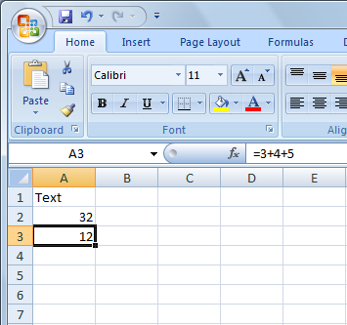
Entering Data
Cells contain
Text
Numbers
Formulae (start with “=“)
Entry box
Type data in entry box
Hit Enter key to accept value
All formulae are recalculated
Results shown in each cell

Slide 8
Formulae
Entering formulae
Always begin with an equals sign
Calculation typed into entry box
Result displayed in the cell
Formula
Result

Slide 9
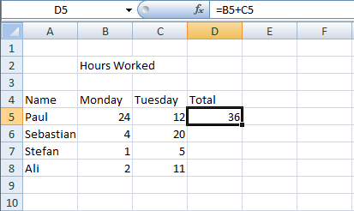
Using Cell References
Cell Reference
Formulae refer to other cells
Specify cell location using Row and Column IDs

Slide 10
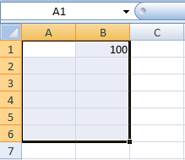
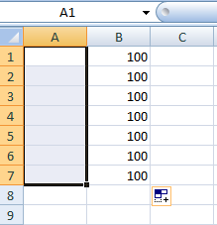
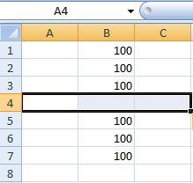
Filling Down and Filling Right
Save time
Fill many cells with same contents
Select a group of cells
Fill Right
Fill Down
Select cells
Fill Down
Selected and Fill Right

Slide 11
Filling Cells with Formulae
Use Fill Down/ Fill Right on formulae
Saves us entering new formula for each row
D5 should contain =B5 + C5
D6 should contain =B6 + C6
D7 should contain =B7 + C7
D8 should contain =B8 + C8

Slide 12
Relative References
Cell reference in formula
Use same formula, different cell references
Cell reference is relative to position of formula
Spreadsheets adjust formula automatically during fill operation
=B5 + C5
=B8 + C8

Slide 13
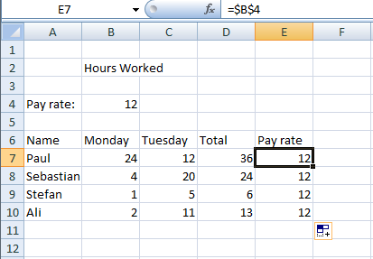
Cell references that don’t change
Absolute references
Sometimes the cell reference should not change
Eg. for constants
Use a dollar sign $ before the row or column
formula stays the same

Slide 14
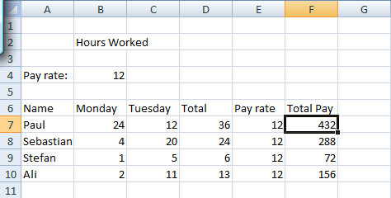
Relative and Absolute references
Sometimes formulae require a mixture of references that change and references which are fixed
= D7 * $B$4

Slide 15
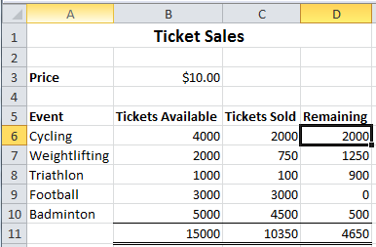
Exercises
Exercise 1: Is the reference to cell D6 in the formula =$D$6*2 a relative or an absolute reference?
An absolute reference
Imagine that you are keeping track of the sales for tickets at the Olympic games. A number of different sports are located in different venues. Each venue has a number of seats available. Your spreadsheet will keep track of the number of tickets available and the number actually sold.
Exercise 2: Given the following spreadsheet, what formula would you use in cell D6 to calculate the number of tickets remaining?
=B6 – C6

Slide 16
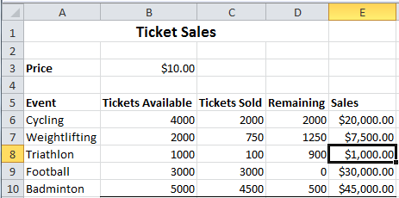
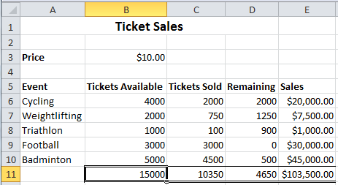
Exercises
Exercise 3: What formula would you use in cell E8 to calculate the money made from ticket sales?
Exercise 4: What formula would you use in cell B11 to calculate the total number of tickets available?
=C8 * $B$3
=B6 + B7 + B8 + B9 + B10

Slide 17
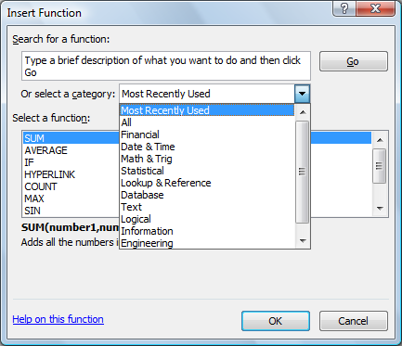
Using built-in functions
Insert a Function
Many categories
Help is useful

Slide 18
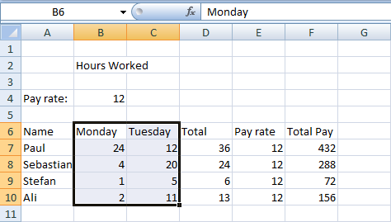
Functions
Many functions exist
Allow us to make more complicated formulae
Examples
SUM
MAX
MIN
AVERAGE
Specifying a range of cells
Top Left cell
Bottom Right cell
B6:C10
Functions may apply to a cell or a range of cells

Slide 19
Functions
Format of Excel functions:
=nameOfFunction(comma separated list of parameters)
Examples:
=SUM(5,6,7)
=AVERAGE(A2:D2)

Slide 20
Boolean Logic
Boolean value
True or False
2-valued logic
Compare two different values
=
>
<
>=
<=
Example. Are the following true or false?
=(3 = 4)
=(4 < 6)
=(MAX(5, 6) = 5)
=(SUM(1,2,3) = 6)

Slide 21
IF functions
Makes a decision
Different values used in the cell depending on the logical test
IF( logical_test , value_if_true, value_if_false )
Must be either true or false
value
condition (test)
boolean function
This value appears in the cell if the boolean is true
This value appears in the cell if the boolean is false

Slide 22
Boolean Functions
AND( a, b )
True only when a and b are both true
OR( a, b )
True if either a is true or b is true
NOT( a )
True only when a is false
Are the following formulae TRUE or FALSE?
=AND( 3 = 4, 2 = 2 )
=OR( 7 < 5, 3 > 3 )
=NOT( 3 = 2 )
=OR( AND( 2 = 3, 4 > 3 ), NOT( 2 = 3 ) )

