Slide 1
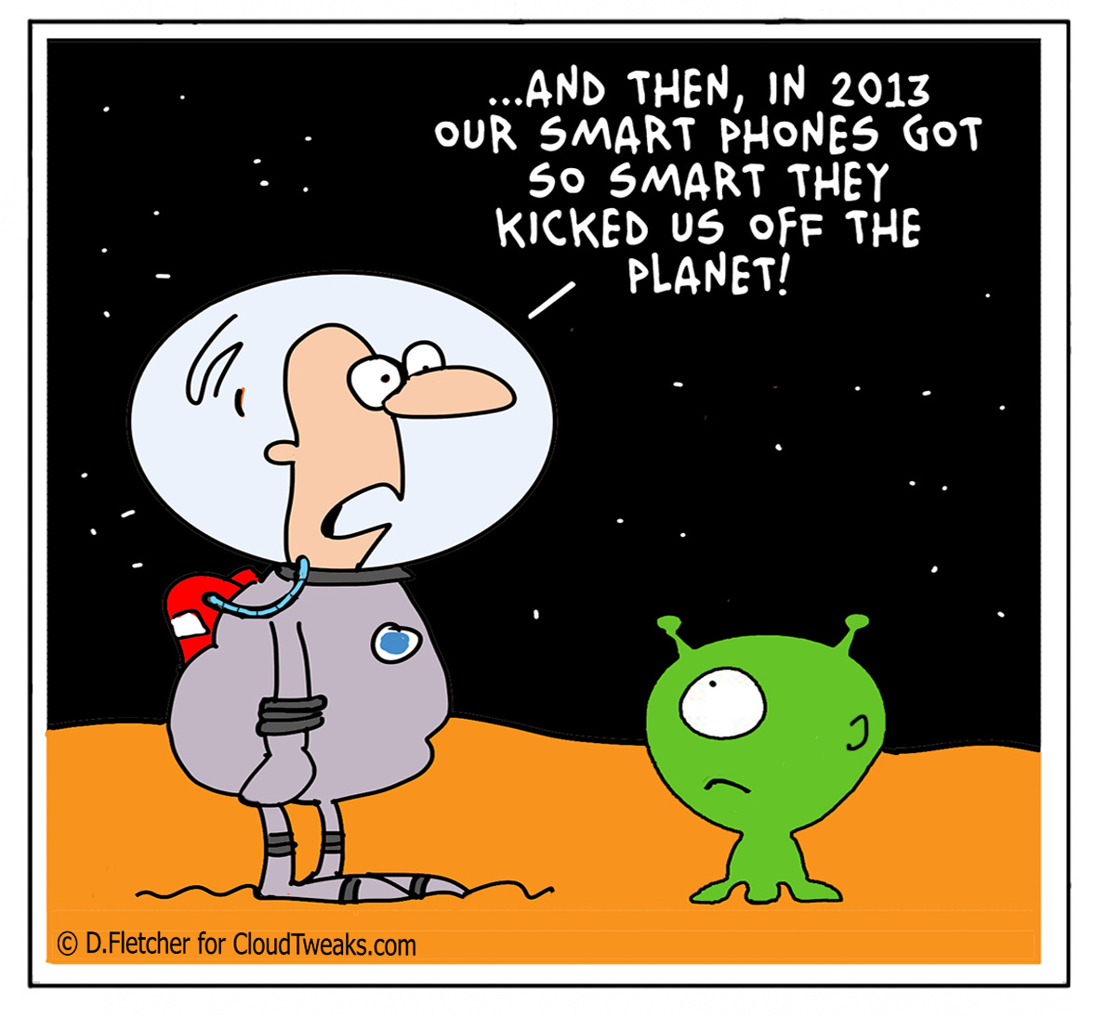
History of Computing
Lecture 9 – COMPSCI111/111G SS 2017

Slide 2
Today’s lecture
The history of computing, focusing on the personal computer (PC)
The first computers
Computers in WWII
1950s - 1980s: from the room to the desk
1980s – 2000s: the computer becomes personal
Future of the PC

Slide 3
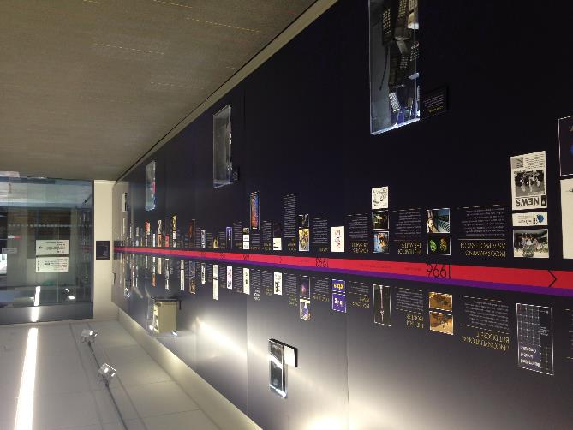
Why bother?!
Knowing the history of computing gives us:
A better understanding of how computers work
An appreciation how quickly computing technology has developed
Insights into the future of computing
Computer Science timeline

Slide 4
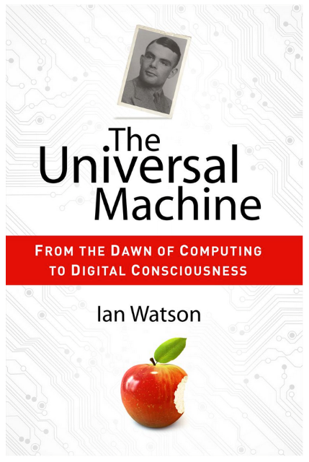
Helpful resources
“The Universal Machine” by Assoc Prof Ian Watson

Slide 5
Helpful resources
Computer Science Department’s Computing History displays
Website explaining the displays: https://www.cs.auckland.ac.nz/historydisplays/

Slide 6
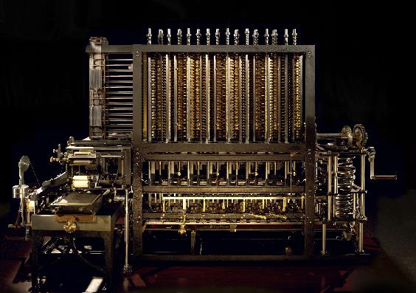
The first computers
People were the first computers, performing calculations by hand to produce tables of mathematical results (eg. ordinance tables)
In 1832, Charles Babbage designed the Analytical Engine; a mechanical device that performed basic arithmetic
Basic operations could be combined to perform complex calculations
Key advantages: speed and accuracy
Cost, construction challenges and the Engine’s size meant it was never built

Slide 7
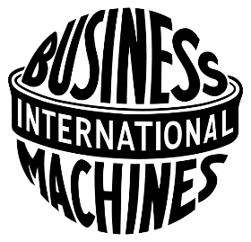
The first computers
It took clerks 7 years to manually compile the results of the 1880 US census
The Electric Tabulating System designed by Herman Hollerith compiled the 1890 Census results in 2½ years rather than a decade!
Over the 1800’s and early 1900’s, computing machines were designed and refined
In 1914, Computing-Tabulating-Recording Company (CTR) was renamed International Business Machines Corporation (IBM)

Slide 8
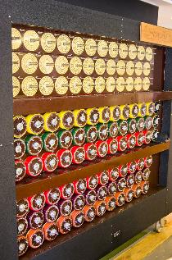
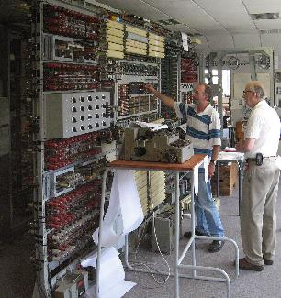
Computers in WWII
IBM and Harvard built the Harvard Mark 1 to calculate artillery tables for the US military
In Bletchley Park, computers were used to break encrypted German radio messages
Alan Turing developed the Bombe in 1939 to decode Engima messages
Tommy Flowers developed Colossus to decode Lorenz messages
Rotating drums on the Bombe
Using a reconstruction of Colossus

Slide 9
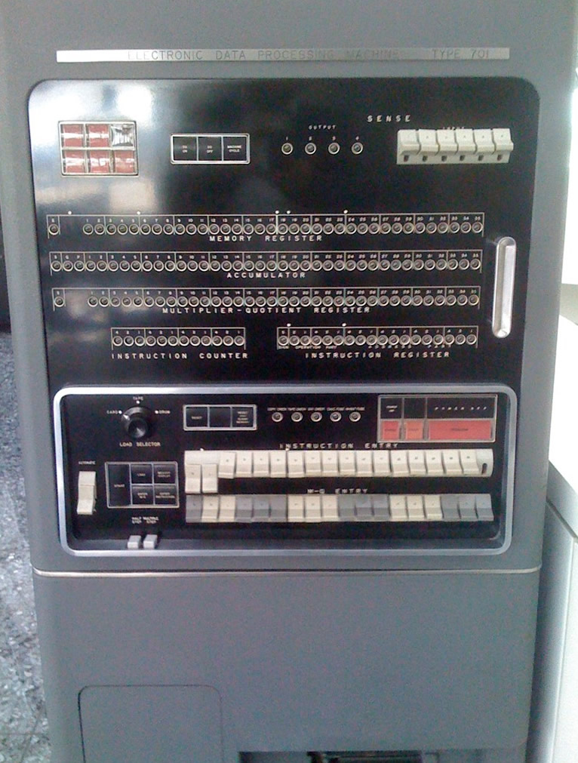
The 1950’s
Mainframes such as the UNIVAC and the IBM 701 were the only computers available
Mainframes were very expensive, took up a lot of room and were difficult to operate
IBM 701 operator’s console

Slide 10
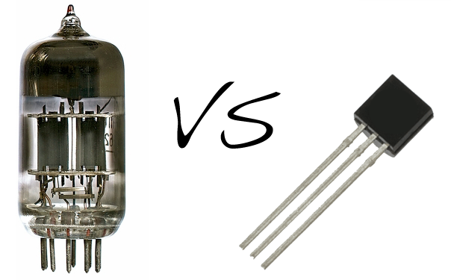
The 1960’s
Invention of the transistor, which replaced vacuum tubes, made computers smaller, faster and more reliable
IBM became the dominant computer manufacturer, producing successful computers like the IBM 7090

Slide 11
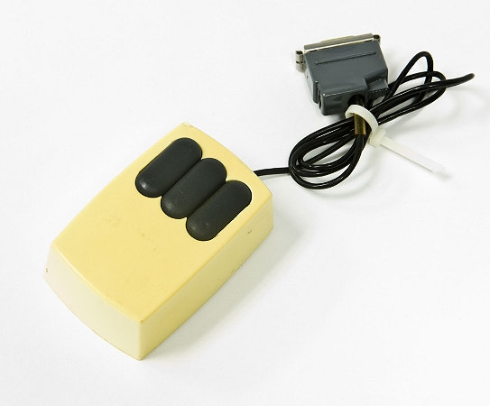
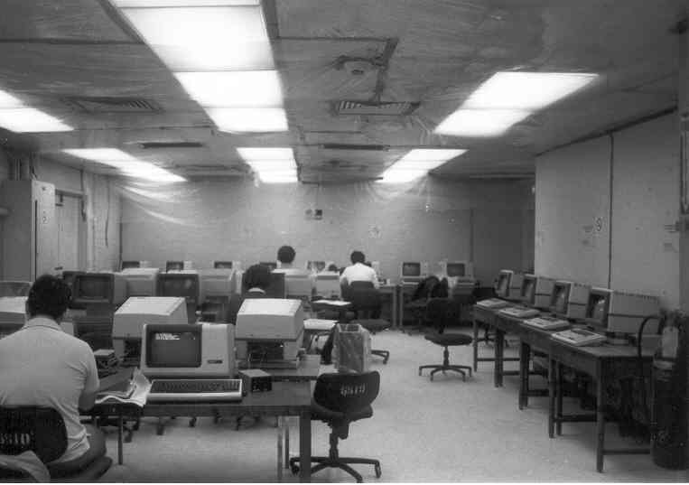
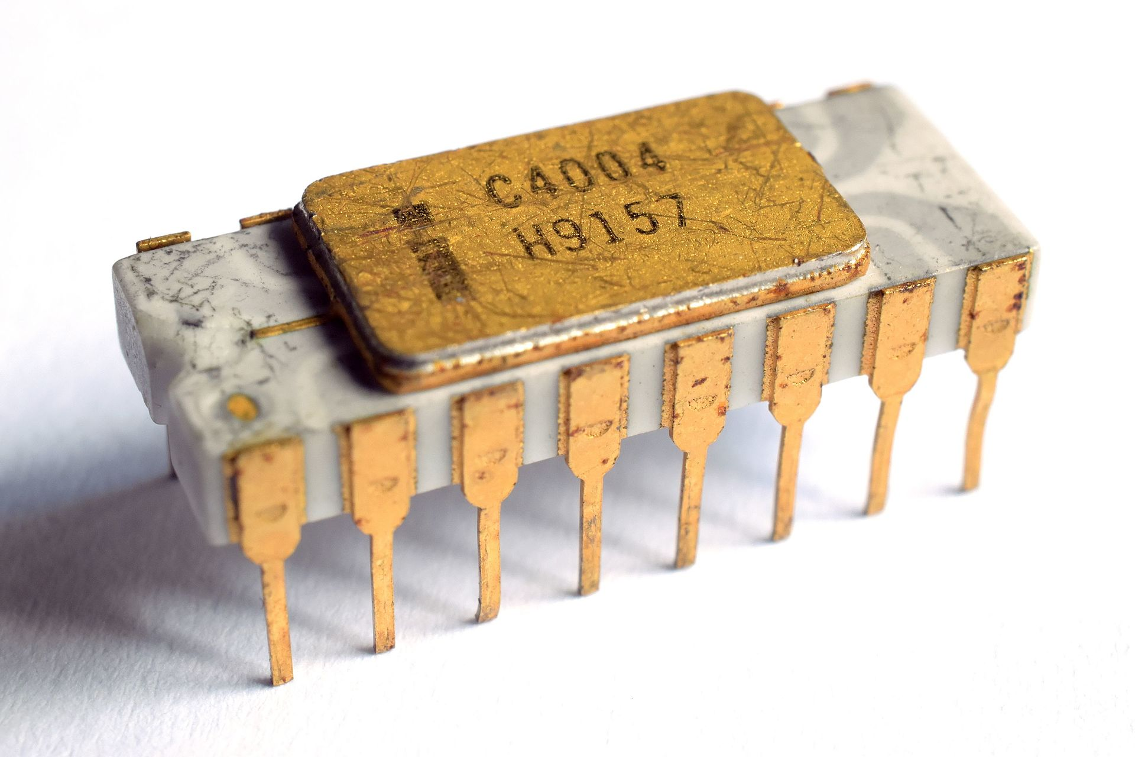
The 1970’s
Palo-Alto Research Centre (PARC)
Opened by Xerox in 1969
Created things used by modern computers; eg. mouse, GUI, laser printer
Terminals and time-sharing systems
Users worked on a terminal connected to a main computer
Each user’s processing was completed in a short slice of time on the main computer. To the user, it seemed like they had full use of the main computer
First microprocessor – the Intel 4004
Intel founded in 1968 by Gordon Moore and Robert Noyce
Intel 4004 released in 1971, followed by the Intel 8080 in 1974

Slide 12
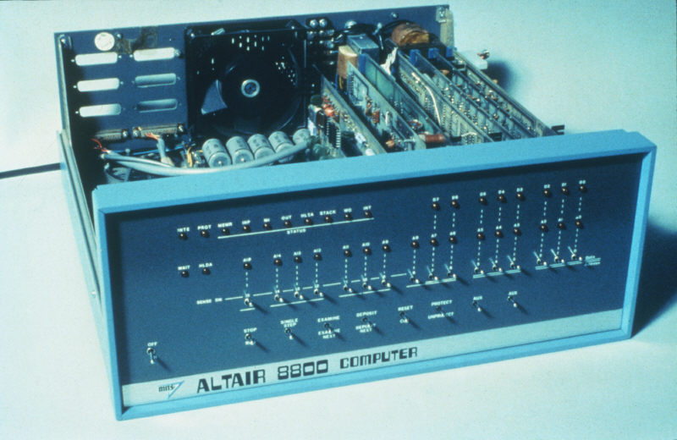
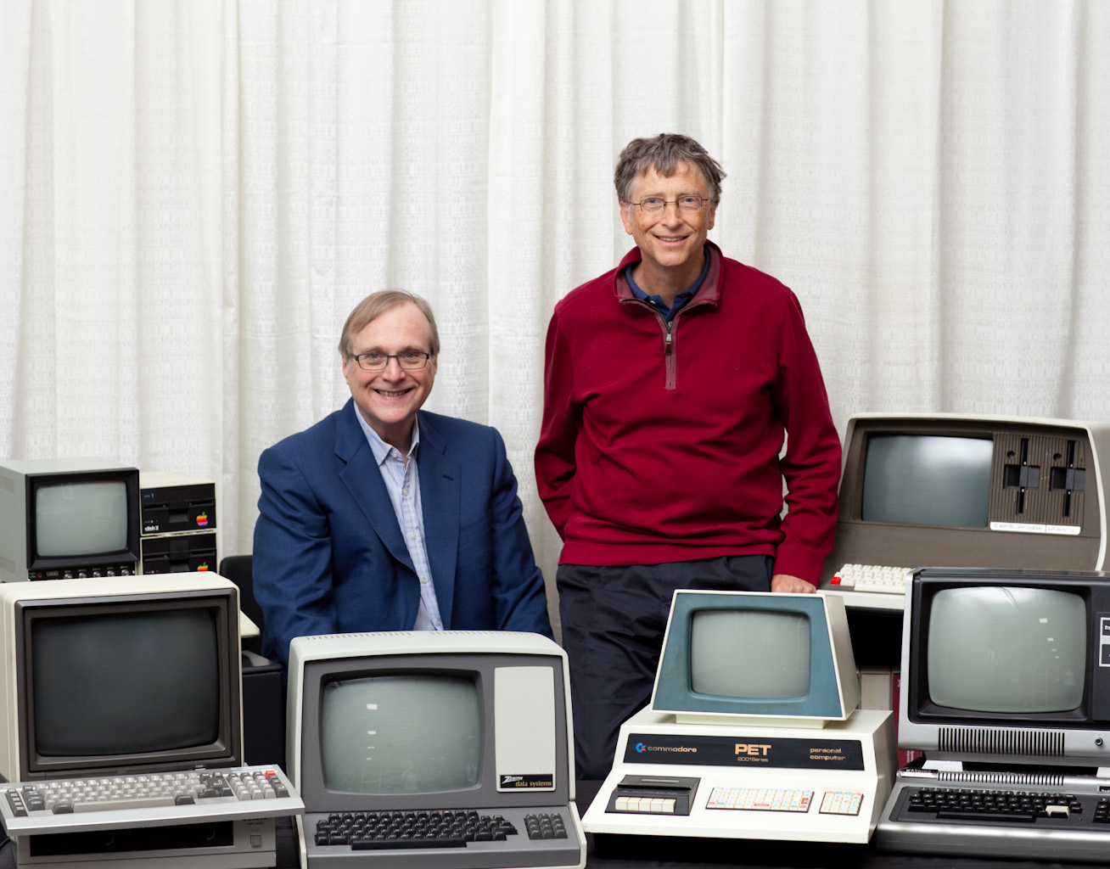
The 1970’s
MITS releases the Altair in 1975
Founded by Ed Roberts, MITS originally produced calculators
The Altair was a kitset computer that buyers had to assemble
Initially, users had to toggle the front switches to load programs into the Altair’s memory
Microsoft founded in 1975
Bill Gates and Paul Allen developed a BASIC interpreter for the Altair

Slide 13
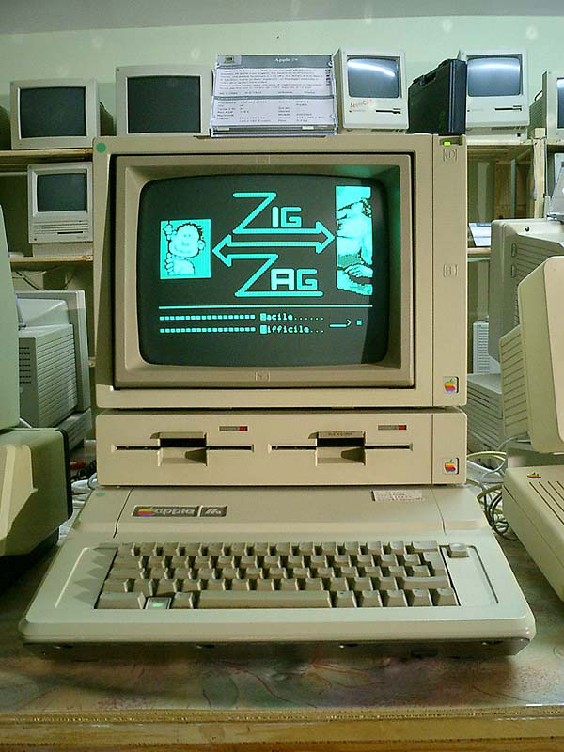
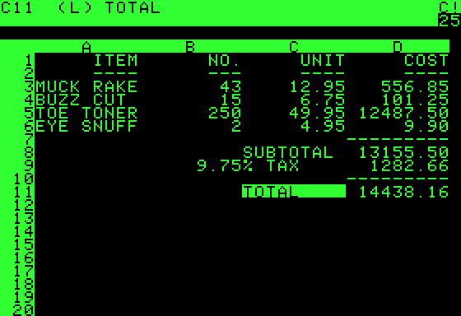
The 1970’s
Apple founded in 1976
Steve Jobs and Steve Wozniak initially sold the Apple I kitset
Apple II was the first successful personal computer
First sold in 1977
Features: colour graphics, slots for third-party cards
VisiCalc released in 1979
Developed by Dan Bricklin and Bob Frankston of VisiCorp
First spreadsheet program
VisiCalc was initially released on the Apple II. It became the computer’s killer app, making the Apple II very popular
VisiCalc was killed by Lotus 1-2-3

Slide 14
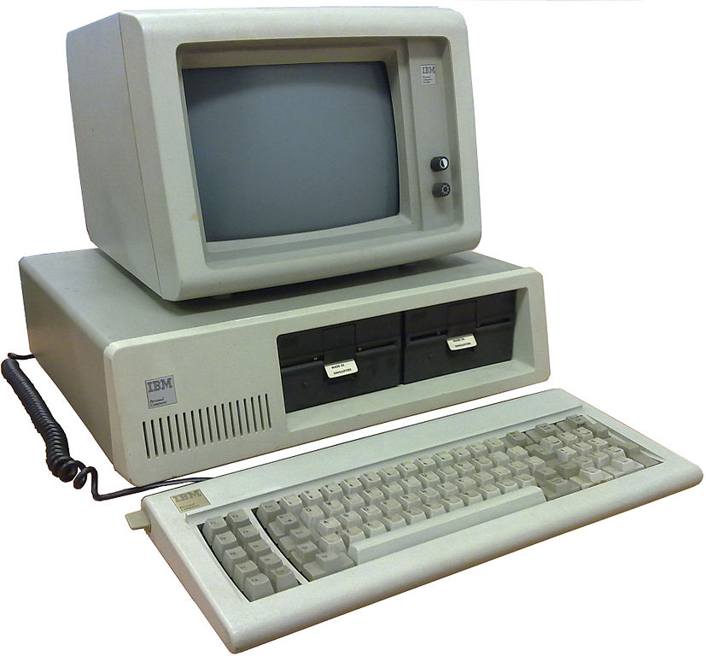
The 1980’s
Microsoft purchased QDOS in 1981 from Seattle Computer Products
“one of the shrewdest business deals of the century…” – The Universal Machine
QDOS was renamed MS-DOS and licensed to IBM
PC-DOS was the operating system for the IBM PC, released in 1981
Other manufacturers reverse-engineered the IBM PC’s proprietary BIOS and produced ‘IBM clones’
Crucially, Microsoft was able to license MS-DOS to other manufacturers, meaning they could compete with IBM
This eroded IBM’s market dominance and made Microsoft very profitable

Slide 15
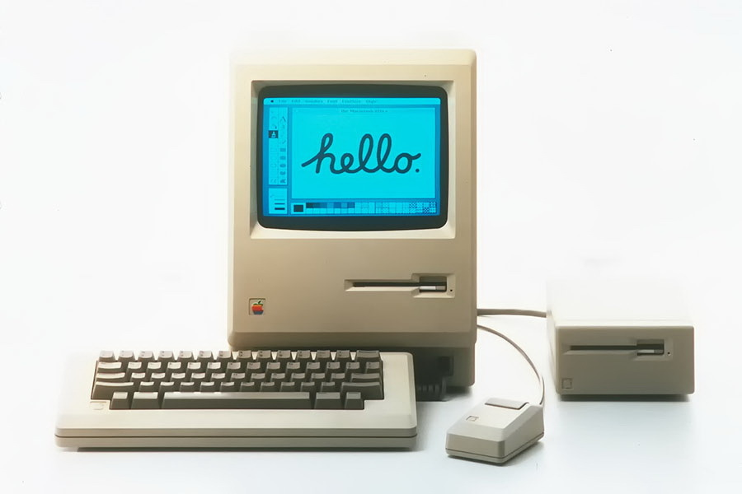
The 1980’s
In 1984, Apple released the Macintosh; the PC with a GUI (based on the Alto)
“For the first time a person could buy a computer, take it home, take it out of the box, turn it on and use it without having to learn and type complex and arcane commands.” -The Universal Machine

Slide 16
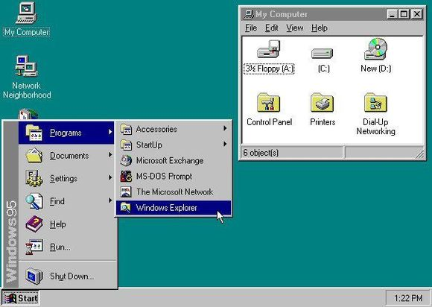
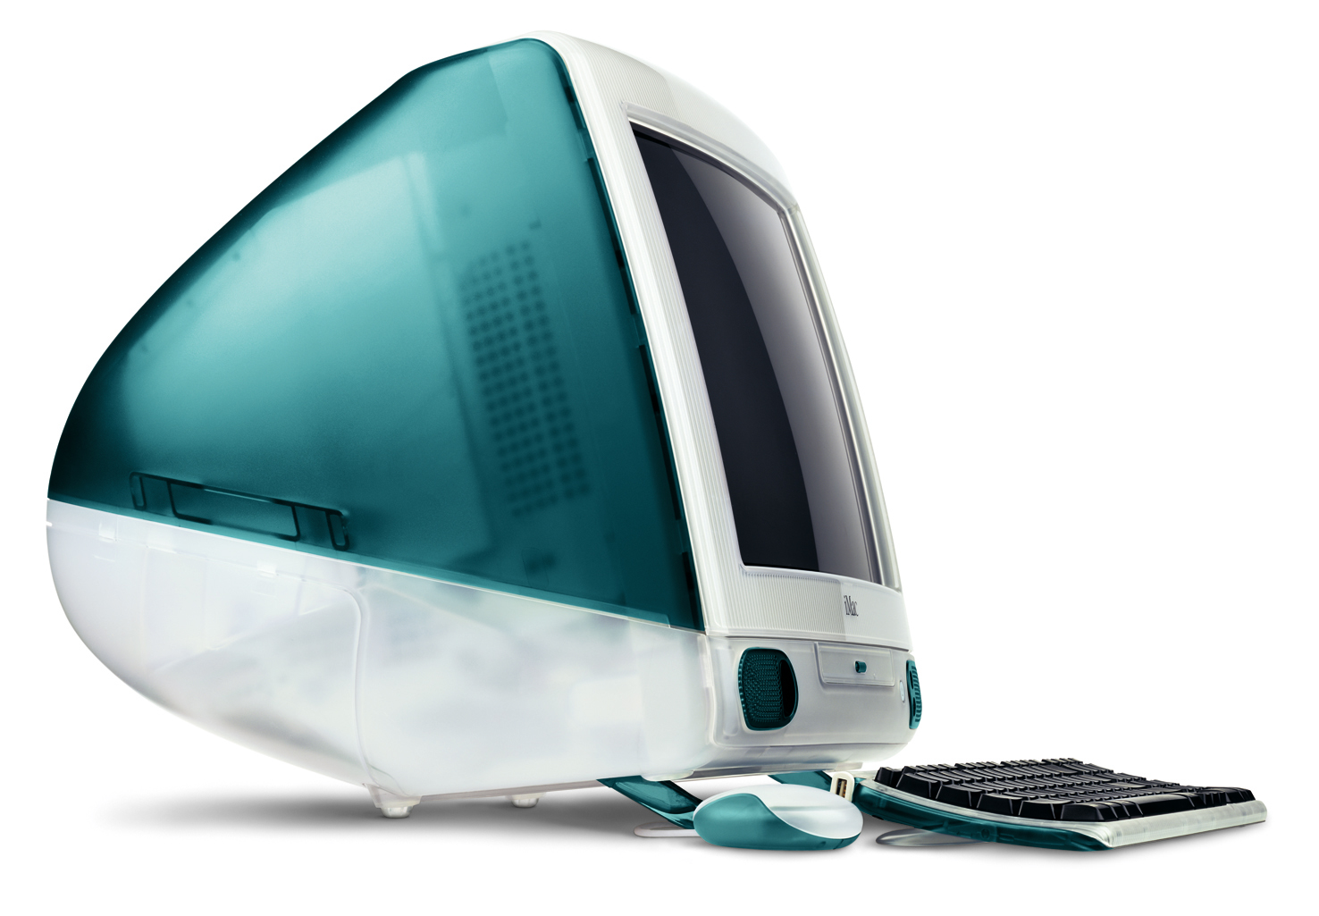
The 1990’s
Microsoft releases Microsoft Office (1990) and Windows 95, followed by Windows 98
Apple releases the iMac in 1998

Slide 17
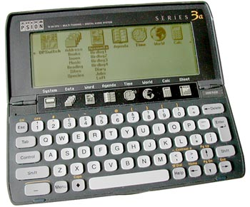
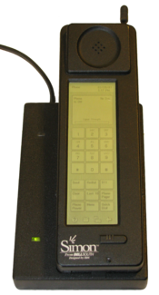
The 1990’s
Personal Digital Assistants (PDAs) were popular in the 1990s because they were portable
Common features included a touchscreen display, web browser, music player and apps
Psion’s Series 3, released in 1991, was the first ‘real’ PDA
The IBM Simon, released in 1994, was the first device with PDA and cellphone functionality

Slide 18
The 1990’s
Other popular PDA brands included:
Palm
Blackberry
Nokia
Apple

Slide 19
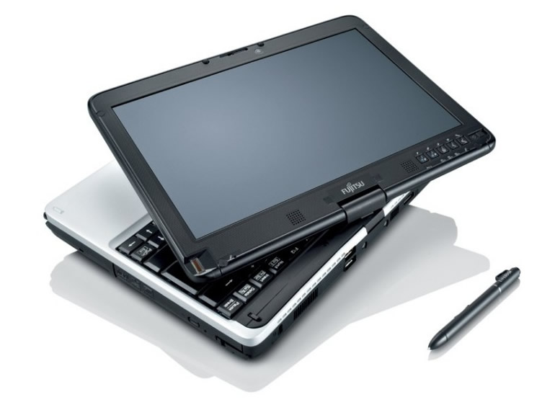
The 2000’s
Laptops become more powerful and portable (lighter and better battery life)
Growing popularity of different ways of interacting with computers; gestures, voice commands, touchscreens
Greater availability of fast Internet connections opens new uses for our PCs

Slide 20
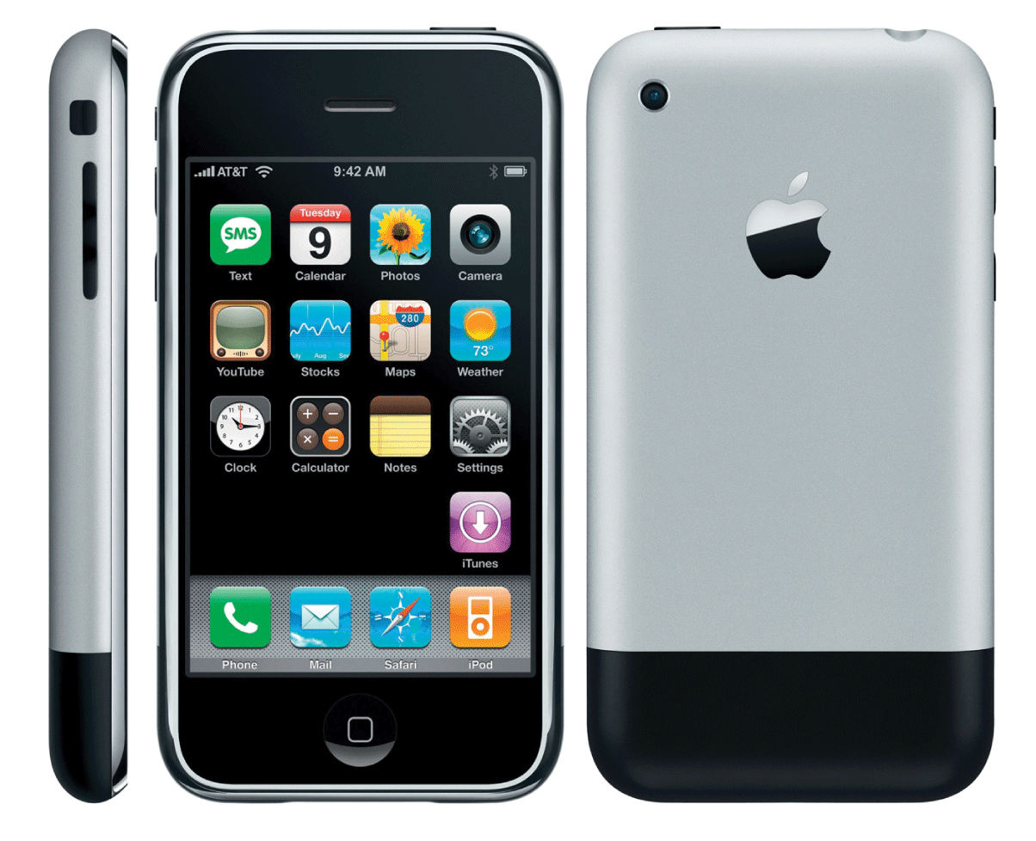
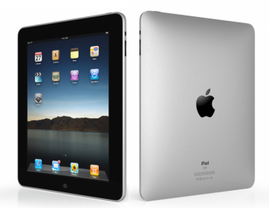
The 2000’s
Apple releases the iPhone in 2007 and the iPad in 2010, creating new categories of personal computing devices
The variety of fixed (eg. desktops) and mobile (eg. tablets) computing devices we have today brings us closer to an era of “ubiquitous computing”

Slide 21
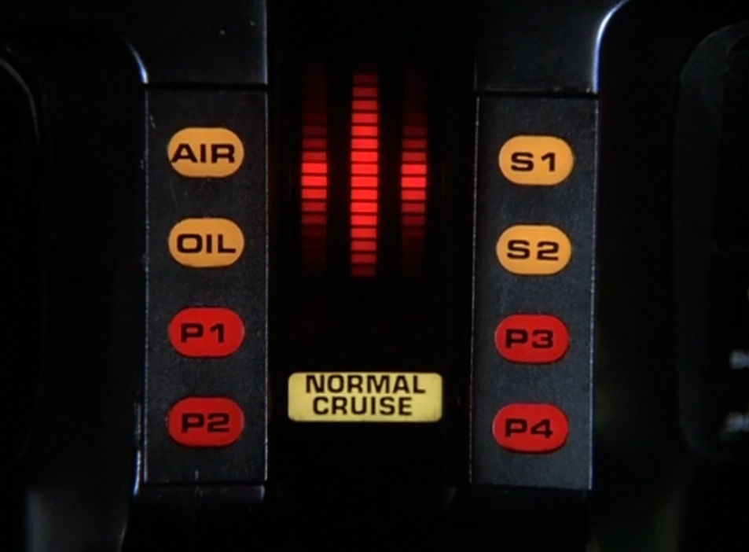
The future of the PC
The end of the desktop PC with the rise of:
Mobile computing
Cloud computing
Computers get even more personal – wearable tech, embedded tech
Computers that are artificially intelligent?

Slide 22
Questions
Give two advantages of transistors over vacuum tubes
What did other PC manufacturers have to reverse-engineer in order to create ‘IBM clones’?
Name two new ways (apart from the mouse and keyboard) to interact with computers

Slide 23
Answers
Give two advantages of transistors over vacuum tubes
Any of: smaller, lighter, longer life, more energy efficient
What did other PC manufacturers have to reverse-engineer in order to create ‘IBM clones’?
The IBM PC’s BIOS (Binary Input-Output System)
Name two new ways (apart from the mouse and keyboard) to interact with computers
Any of: touchscreens, voice, gestures

Slide 24
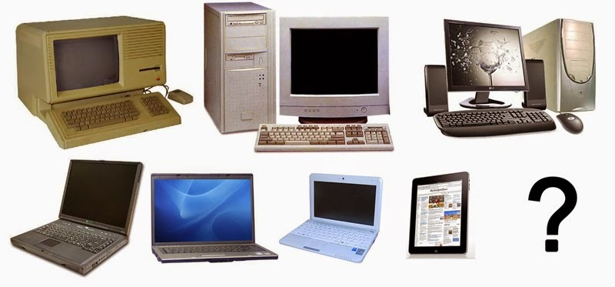
Summary
The first computers were people, followed by very large electromechanical devices
Key technologies such as transistors and microprocessors helped to reduce size and cost
Software, such as MS-DOS and VisiCalc, were important to the success of early personal computers
Over time, computing technology has become smaller, cheaper, more user-friendly, more powerful

