Slide 1
Word processing
Lecture 8 – COMPSCI111/111G SS 2017

Slide 2
Today’s lecture
Storing information using ASCII
Word processor basics:
File formats
WYSIWYG
Basic features of a word processor:
Font and paragraphs
Styles
Headers, footers, footnotes, endnotes
Referencing

Slide 3
ASCII
ASCII = American Standard Code for Information Interchange
Associates English characters with numbers meaning text in documents can be stored as strings of binary
Each ASCII code is 7 bits long, meaning ASCII can represent 128 characters
There are other encoding schemes such as UTF-8 and ANSI

Slide 4
ASCII
Excerpt of an ASCII table
A | 65 |  | L | 76 |  | W | 87 |  | g | 103 |  | r | 114
B | 66 |  | M | 77 |  | X | 88 |  | h | 104 |  | s | 115
C | 67 |  | N | 78 |  | Y | 89 |  | i | 105 |  | t | 116
D | 68 |  | O | 79 |  | Z | 90 |  | j | 106 |  | u | 117
E | 69 |  | P | 80 |  | … |  |  | k | 107 |  | v | 118
F | 70 |  | Q | 81 |  | a | 97 |  | l | 108 |  | w | 119
G | 71 |  | R | 82 |  | b | 98 |  | m | 109 |  | x | 120
H | 72 |  | S | 83 |  | c | 99 |  | n | 110 |  | y | 121
I | 73 |  | T | 84 |  | d | 100 |  | o | 111 |  | z | 122
J | 74 |  | U | 85 |  | e | 101 |  | p | 112
K | 75 |  | V | 86 |  | f | 102 |  | q | 113

Slide 5
ASCII
What is the ASCII code for ‘EASY’?
What is the ASCII code for ‘CompSci’?
E | A | S | Y
69 | 65 | 83 | 89
C | o | m | p | S | c | i
67 | 111 | 109 | 112 | 83 | 99 | 105

Slide 6
ASCII
Text you type: YES
The text in ASCII: 89 69 83
Binary stored by the computer: 1011001 1000101 1010011

Slide 7
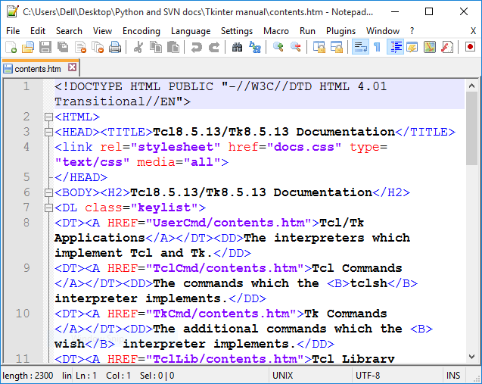
Text editors
Application software that enables the user to edit text
Text is stored using ASCII or another encoding scheme
Used to edit:
Text files (.txt)
Configuration files
Source code
Examples:
Notepad
Notepad++
TextPad

Slide 8
Word processors
Application software that enables the user to edit text and add formatting to the text
Files created by word processors store text and formatting information according to a format
Proprietary standards, eg. Word file format (.doc)
Open standards, eg. OpenDocument format (.odt)
Microsoft products now use the Office Open XML format, arguably an open standard
Examples:
Microsoft Word
Apple Pages
OpenOffice Writer

Slide 9
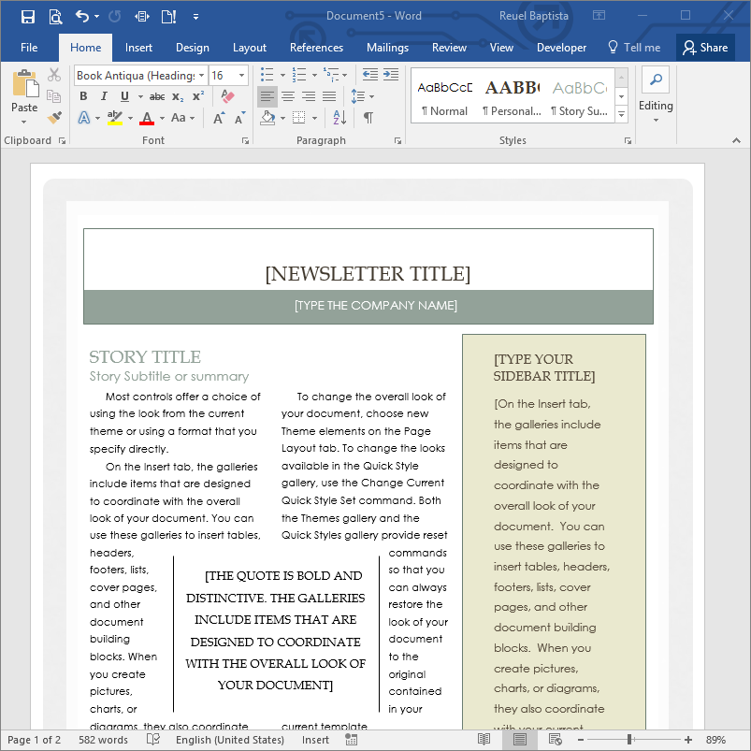
WYSIWYG
What You See Is What You Get – WYSIWYG
The document created using the word processor’s GUI is the same as the document that comes from the printer

Slide 10
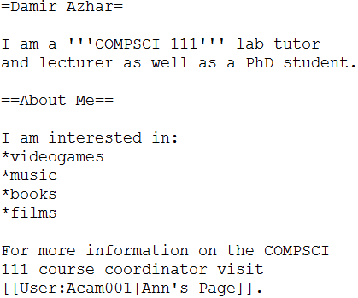
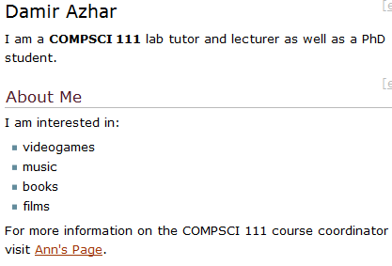
WYSIWYG
Computer code is usually not WYSIWYG (eg. wiki markup, LaTeX code, HTML)
What you see
What you get

Slide 11
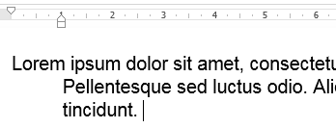
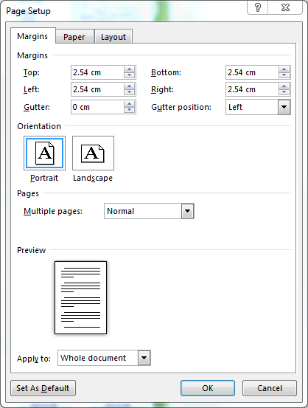
Basic features
Editing text:
Spelling and grammar checker
Aligning text using the margins and ruler
Clipboard:
Cut, copy, paste
Formatting:
Changing font
Change document settings
Format paragraphs

Slide 12
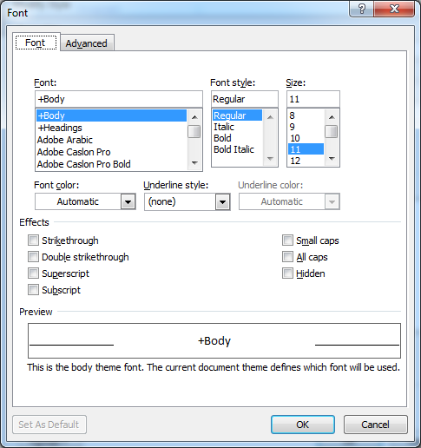
Font
Font window lets you change:
Font
Style (bold, italic)
Size (in points)
Colour
Effects (strikethrough, subscript superscript)

Slide 13
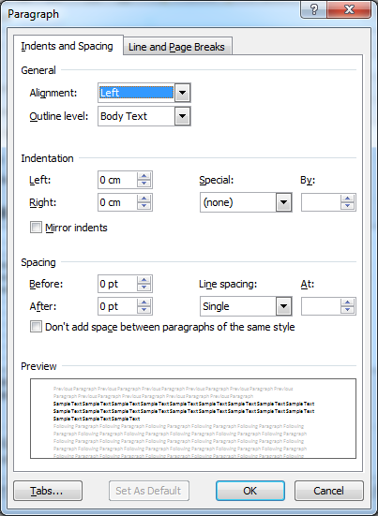
Paragraphs
Paragraph window lets you change:
Position
Indentation
Spacing
The ‘Line and Page Breaks’ tab let you adjust how the paragraph behaves between pages

Slide 14
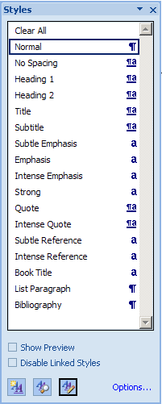
Styles
A group of formatting changes that can be applied to text in the document
Advantages:
Gives the document a consistent appearance
Makes applying formatting faster
Quicker to change how text is formatted, just change the change the style
Manage existing styles
Create a new style

Slide 15
Styles

Slide 16
Headers and footers
Header: text that is repeated at the top of every page
Footer: text that is repeated at the bottom of every page

Slide 17
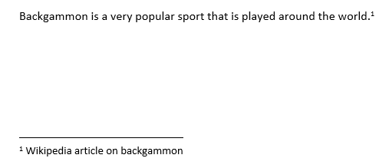
Footnotes and endnotes
Footnote: text that appears at the bottom of a page

Slide 18
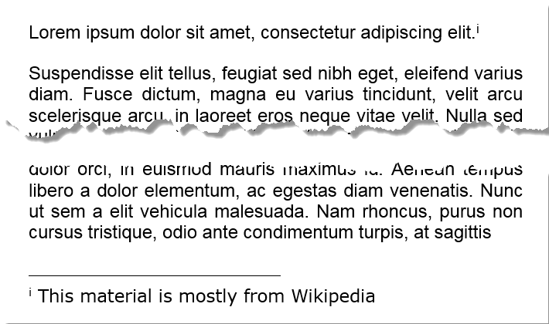
Footnotes and endnotes
Endnote: text that appears at the end of the document

Slide 19
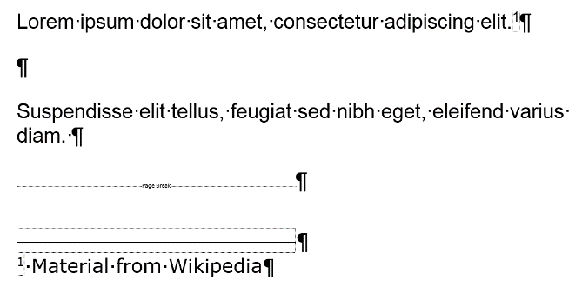
Formatting symbols
Formatting symbols are non-printing characters that are used to mark spaces, paragraphs and page breaks etc. in a document
Examples of formatting symbols:

Slide 20
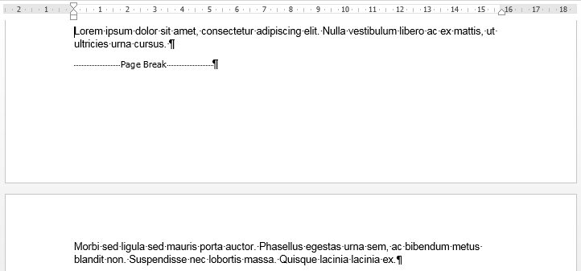
Page breaks
Page breaks mark where the current page ends. Anything below the page break is moved to the next page of the document

Slide 21
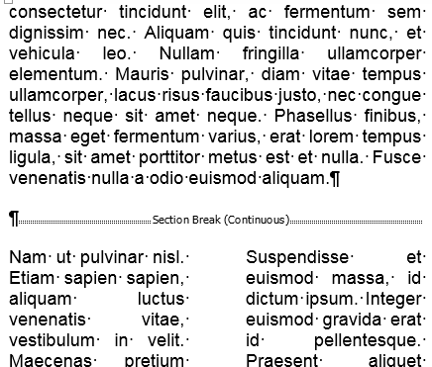
Section break
Section breaks mark the point where one section ends and a new section begins
Individual sections can have their own formatting, headers/footers, page orientation, columns etc.

Slide 22
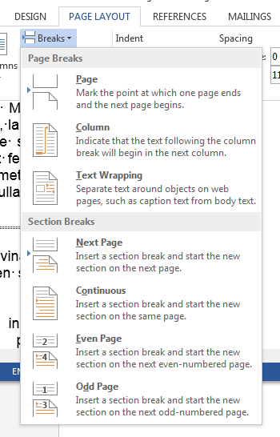
Section break
Two kinds of section break:
Continuous: the new section begins on the same page as the original section
Next page: the new section begins on a new page after the original section

Slide 23
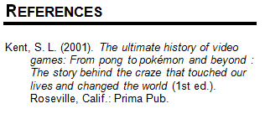
References and citations
Citation: inserted within the text to tell readers where the source of the information
Reference: inserted at the end of the document, provides details about the source so the user can retrieve it

Slide 24
Plagiarism
Taking someone else’s work and presenting it as your own work
This is a serious breach of academic integrity
See the University’s academic integrity policy
To avoid plagiarism, you should always acknowledge any use of someone else’s work in your own work. Includes:
summarising or paraphrasing someone else’s work
using graphs, images or other media from someone else’s work
Referencite has a good guide on when and how to reference

Slide 25
Refworks
Online reference manager; used to manage references and insert them into your documents
Bibliographic information can be entered manually, loaded from the UoA library catalogue or loaded from a database
References are generated in accordance with a wide variety of referencing styles

Slide 26
Refworks
Advantages:
Web-based, so you can access it from any computer, regardless of operating system
Supports a range of databases and referencing styles
The Write-n-Cite plugin for Word allows you to insert references directly from Refworks
UoA students get a free Refworks account: https://www.library.auckland.ac.nz/refworks/

Slide 27
Refworks

Slide 28
Write-N-Cite
A plugin for Microsoft Word that enables the user to insert references when working in their document
Refworks can be accessed by clicking on the ‘ProQuest’ or ‘Refworks’ tab
Refworks downloads the references you have stored online onto your computer
Using Refworks, you can insert citations and bibliographies

Slide 29
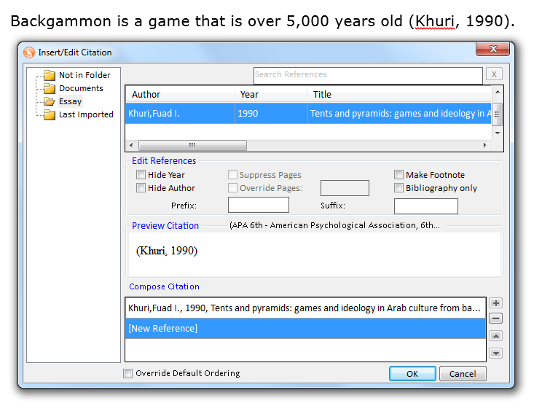
Write-N-Cite
Inserting a reference using Refworks

Slide 30
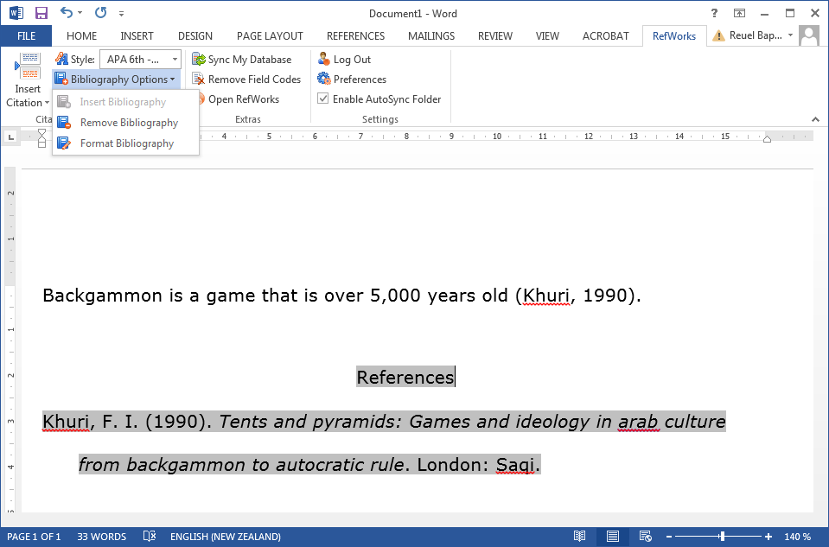
Write-N-Cite
Inserting a bibliography using Refworks

Slide 31
Questions
What word has been represented using ASCII?
What are formatting symbols and what are they used to mark?
Name one advantage of using styles in a document
67 | 108 | 97 | 115 | 115

Slide 32
Answers
What word has been represented using ASCII?
What are formatting symbols and what are they used to mark?
Invisible characters used to mark spaces, paragraphs and page breaks
Name one advantage of using styles
Any of: consistency, easy to apply, quick to change
C | l | a | s | s
67 | 108 | 97 | 115 | 115

Slide 33
Summary
Overview of the ASCII code
Distinction between text editors and word processors
Basic features of a word processor
Referencing using Refworks

