Slide 1
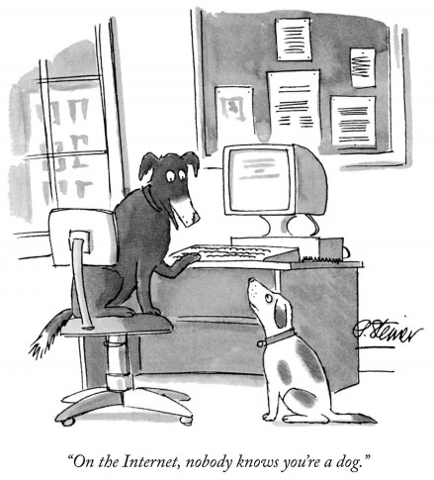
The World Wide Web
Lecture 7 – COMPSCI111/111G SS 2017

Slide 2
Today’s lecture
Recap material on the Internet and World Wide Web (WWW)
Understand how the WWW works
Understand how search engines work
The implications of search engines

Slide 3
Recap
In Lecture 4, we saw:
WWW refers to the applications (eg. web pages, email, Skype, Youtube etc) that run on the Internet, which refers to the underlying hardware
The Internet includes the hardware and protocols that transport data from sender to receiver
We’ve already looked at a few WWW applications (eg. email, blogs, instant messaging)

Slide 4
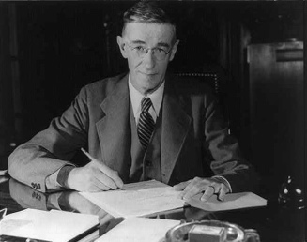
Hypertext
Hypertext is basically text with links
Allows associations to be made between pieces of text
Vannevar Bush – “As We May Think” (1945)
Bush described a device called a memex, which could store text and links within the text
Ted Nelson – the Xanadu Project (1960s)
First computer-based hypertext implementation
Although developed in the 1960s, the first public release was in 1998

Slide 5
Multimedia and hypermedia
Multimedia: the integration of many forms of media (text, video, sound, images etc)
Hypermedia: the creation of links between multimedia content

Slide 6
The WWW project
Tim Berners-Lee worked at CERN in the 1980s
Physicists performing research at CERN found it difficult to share their research with each other
Berners-Lee thought he could solve this problem using hypertext and wrote “Information Management: A Proposal” outlining his idea in 1989
He envisioned a linked information system where pages could be added and accessed by CERN employees
Pages would be stored on a server

Slide 7
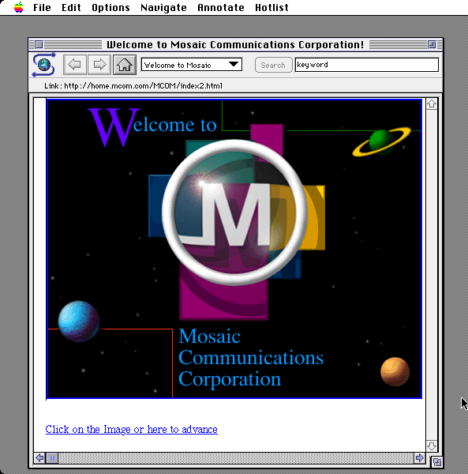
The WWW project
After development in CERN, the first public web server was set up in 1991
In June 1993, Mosaic was released; the first widely used web browser
By Oct 1993, there were 500 web servers around the world
By this point, Berners-Lee realised the WWW had to be freely available so he convinced CERN to make the source code public

Slide 8
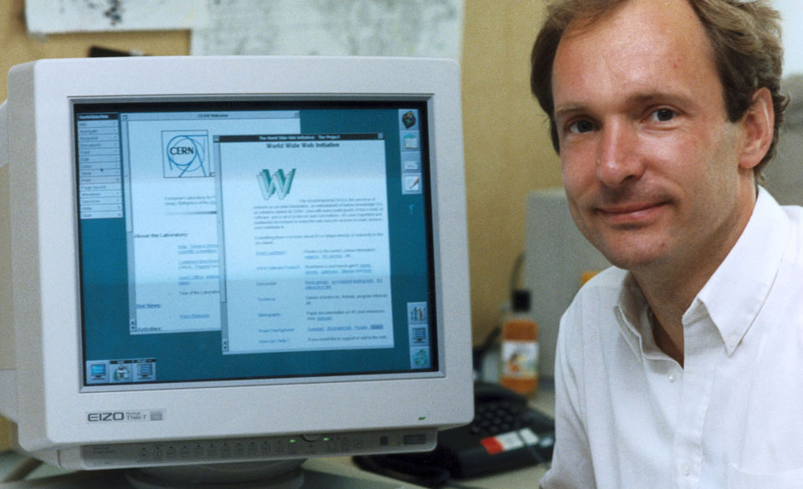
The WWW project
In 1994, Berners-Lee established the World Wide Web Consortium (W3C), which creates standards for the WWW

Slide 9
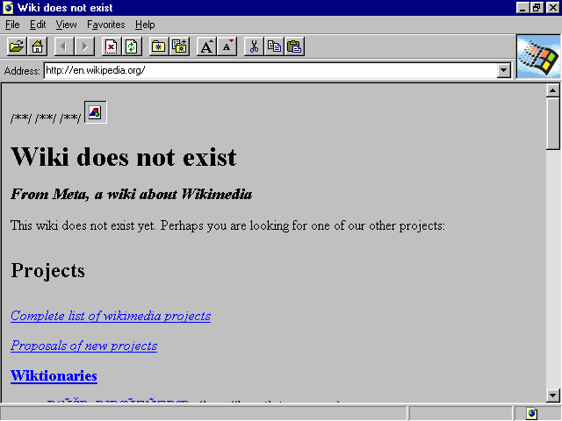
Evolution of the Web
1994: Netscape Communications and Yahoo! founded
1995: first version of Microsoft Internet Explorer released
1998: Google founded
1997‐2001: “Dot‐com” boom and bust
2004: shift to ‘Web 2.0’ (eg. wikis)

Slide 10
Some terms
Webpage: a hypermedia document on the WWW that is usually accessed through a web browser
Website: a collection of webpages usually on the same topic or theme
Web browser: application software used to access content on the WWW
Web server: a computer with software that makes files available on the WWW

Slide 11
Uniform Resource Locator (URL)
https://www.cs.auckland.ac.nz/~andrew/teaching.html
Protocol: https
Other common protocols: ftp, http
Domain: www.cs.auckland.ac.nz
Can be a domain name or an IP address
Path on server: /~andrew/
Resource: teaching.html

Slide 12
HTTP
HyperText Transfer Protocol; used by web browsers to request resources (eg. webpages, images, sounds) from a web server
There’s also HTTPS = HyperText Transfer Protocol Secure
Encrypts the HTTP connection using TLS (Transport Layer Security)
Becoming essential for websites to use HTTPS to keep user information secure

Slide 13
DNS SERVER
Find IP address of www.google.com
GET /index.html HTTP/1.1
HTTP/1.1 200 OK
CLIENT
GET /img/logo.jpg HTTP/1.1
SERVER
HTTP/1.1 404 NOT FOUND

Slide 14
Logging browsing history
A number of computers keep a record of the webpages accessed by a client:
Web browser
Computer’s operating system
ISPs
They hold varying amounts of information
In Australia, ISPs must retain information about their customers’ web usage for at least 2 years
The web server

Slide 15
Other parts of the WWW
Proxy: sits between client and server so it can intercept and process requests
Cache: stores recently requested resources so they can be accessed quickly
A proxy can use a cache to store recent requests, enabling it to process requests faster
Firewall: prevents unauthorised access to a private network
Firewall
Proxy
Client
Server
Cache

Slide 16
Problems with webpages
Broken links
Usually the result of a webpage being moved or deleted
No inherent security/tracking/accounting system
Difficult to have layers of security and a consistent level of security
Websites rely heavily on ad revenues
No inherent way of indexing information
Difficult to find information on the web, although search engines help
Dynamically generated webpages and different file formats (eg. PDF, archives) also make indexing difficult

Slide 17
Search engines
A website that helps a user to search for information on the WWW
Software indexes content on the web. This index is used to build a list of results based on the search terms entered by the users
Indexing: organising data so that it is easier to search
Popular search engines include:
Google
Bing
Yahoo search
DuckDuckGo

Slide 18
Search engines

Slide 19
How do search engines work?
Spiders crawl across the WWW to scan webpages
Spiders are programs that follow links and gather information from webpages
The search engine’s index is updated with information gathered by the spiders

Slide 20
How do search engines work?
User enters a search term
The search engine uses algorithms to find the most relevant results in its index
These algorithms are secret and highly complex
They use a number of criteria, such as keywords and popularity, to determine a page’s relevance to the user
Search engine gives the user a list of results
This list is complied from billions of webpages in a couple of seconds!

Slide 21
Can we trust search engines?
Bias in the results?
Since search algorithms are secret, we have to trust that they operating fairly
Effect of filtering on search results (eg. DMCA, images of child abuse)
Advertising plays a big role in how search engines operate
Search engines make money from advertising
Companies misuse search engines to get a competitive edge: NakedBus using ‘inter city’ on Google Adwords (a good summary can be found here)

Slide 22
Can we trust search engines?
The right to be forgotten (R2BF)
In 2014, European Court of Justice decided R2BF meant Google has to remove out-of-date search results when requested by individuals
A good summary can be found here
In Europe, the General Data Protection Regulation 2016 contains a more limited ‘right to erasure’
R2BF helps an individual to preserve their privacy
However, the R2BF distorts search results and could be abused (eg. a businessman wanting news articles removed from search results)

Slide 23
Filter bubble
Occurs when a search algorithm offers personalised results, which limits the diversity of information presented to the user
Examples include Facebook’s News Feed and Google’s personalised search results
Personalised search results can help people to find relevant information
However, it also risks isolating people within their own bubble of information

Slide 24
Privacy
Search engines are gathering vast amounts of information about our searches and ourselves
This information is generally used for advertising purposes
Can we trust private companies to treat our information with care? To keep it secure? To not sell it to others without consent?
While you can search anonymously, search history can be used to identify individuals
A reporter used a person’s anonymised search history to track them down – article here

Slide 25
Questions
What problem did Tim Berners-Lee want to solve using the Web?
What is the difference between a firewall and proxy?
Name two ways that bias could be introduced into search results

Slide 26
Answers
What problem did Tim Berners-Lee think he could solve using the Web?
Sharing information between researchers at CERN
What is the difference between a firewall and proxy?
Firewall: prevents unauthorised access to a network
Proxy: intercepts and processes requests from clients and servers
Name two ways that bias could be introduced into search results
Any of: DMCA requests, filtering illegal content, filter bubbles, right to be forgotten

Slide 27
Summary
The WWW was designed to be a system to share information
It has become a system for creating and sharing a variety of content
Key protocol on the WWW is HTTP
Search engines use an index of the WWW to provide results based on search terms
Issues around search engines
Bias
Protecting privacy (eg. R2BF)
Use of personal information for advertising
Filter bubbles

