Slide 1
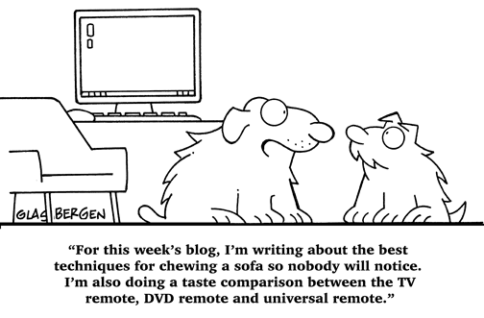
Publishing Online
Lecture 6 – COMPSCI111/111G SS 2017

Slide 2
Today’s lecture
Blogs
Wikis
Social issues around online publishing

Slide 3
Blogs
Short for web log, a website where posts are displayed in reverse chronological order (ie. newest posts first)
Around 150 million blogs worldwide on a range of topics from personal to political
Range of uses for a blog:
Personal, eg. Ian Watson’s blog
Provide commentary on an issue; eg. Kiwiblog
Keep followers up to date, eg. Office blog

Slide 4
Blogs
Different kinds of blogs: photo blog, video blog (vlog), audio blogs (podcasts)
Online blogging platforms include Blogger, Wordpress, Silvrback
You can even host your own blog using Ghost, Wordpress, Joomla

Slide 5
Blogs - advantages
Blogs can also be sources of news (eg. TMZ, Gizmodo)
Blogs gave people a voice during political unrest
Eg. blogs were an important means of communication during the Arab Spring
Can be difficult for governments to censor bloggers. Some governments have even gone as far as shutting down their country’s Internet access

Slide 6
Blogs - disadvantages
Can provide too much information about yourself
Extremely difficult to erase any information that has been placed on the Internet because information is easily duplicated
Blogs can contain incorrect information or personal opinion, so can be unreliable sources of information
Some people use blogs or the comments section on blog posts to harass or insult other people

Slide 7
Microblogging
A form of broadcast communication that is similar to blogging
The key difference is that smaller portions of content are shared on microblogs
Well-known microblogging platforms include:
Twitter
Tumblr
Pinterest
Instagram

Slide 8
Wikis
A set of public webpages that can be edited by anyone, which encourages collaboration
Can also have private wikis that can only be edited by authorised people
Created by Ward Cunningham in 1995. Named after the ‘wiki-wiki’ shuttle buses in Hawaii (‘wiki’ means ‘quick’ in Hawaiian)
Wiki pages are written in plain text, with wiki markup used to add formatting (italicise text, add links etc.)

Slide 9
Wikipedia
Wikipedia is the best known wiki. Launched in 2001 by Jimmy Wales and Larry Sanger
Today, it has over 5.3 million English articles with around 20,000 articles added each month
Funded by grants and public donations
Wikipedia runs on the MediaWiki software platform and is hosted on around 400 servers

Slide 10
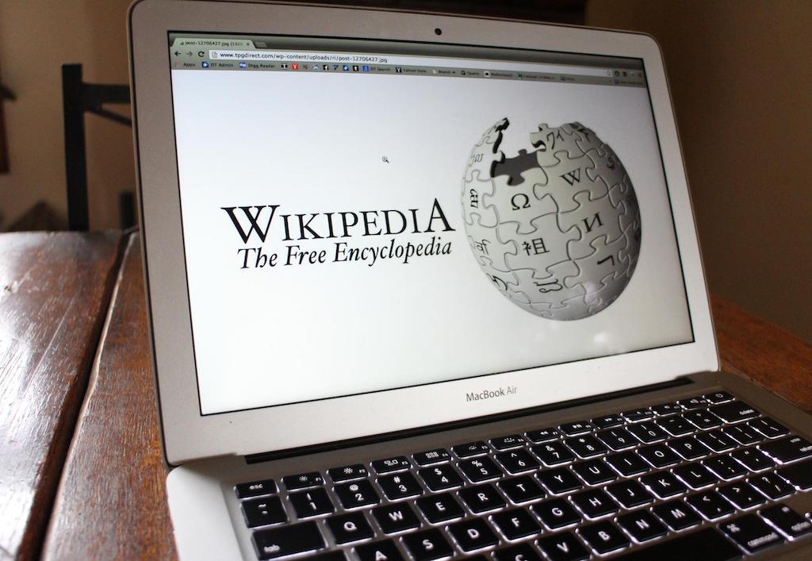
Wikipedia
Advantages:
Everyone can access and contribute to Wikipedia
Easy to use
Quick to develop material
Enormous amount of topics and information available
Disadvantages:
No direct quality control
Bias in some articles
Information changes rapidly
Vandalism is a real problem

Slide 11
Wikipedia - vandalism
Wikipedia has a number of automated and manual systems for addressing vandalism
Bots: vandalism is automatically detected and reverted by a bot called ClueBot NG
Recent change patrol: a group of people monitor the Recent Changes page to modify or remove vandalism
Can also modify or remove edits that don’t meet Wikipedia’s standards

Slide 12
Wikipedia - vandalism
Watchlists: registered users can watch a page that they have created/edited or are interested in, allowing them to watch for vandalism
Reader-reported vandalism: readers can address vandalism by:
Reverting to an older version of the page
Warning the vandal that their actions have been noted
Report the vandal to Wikipedia administration

Slide 13
Wikipedia’s reliability
2005 study in Nature: experts analysed 42 articles, found the articles had the same error rate as Encyclopedia Britannica
A summary of other studies can be found on Wikipedia
Generally, Wikipedia articles on academic topics are more accurate than articles on pop culture and politics
Maybe because these articles are more subjective or opinion-based?
Wikipedia should be a starting point for research rather than a definitive source of information

Slide 14
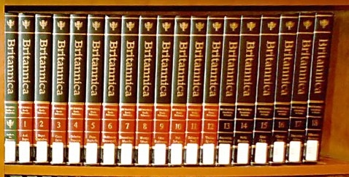
Encyclopedia Britannica
This popular printed encyclopedia now only exists online
Articles have generally been checked for accuracy and correctness
Users can’t directly edit the articles but can suggest changes
Britannica runs a Publishing Program, which allows people with expertise in their field to publish articles on Britannica

Slide 15
Other wikis
WikiVoyage
Travel guide with entries for countries, cities, areas, sights
Wikia
Collection of Wikis, anybody can create wiki on any topic
Focus on gaming and entertainment topics
~10 million entries altogether
WikiMapia
Combination of Google Maps and an extra layer of polygons that mark interesting areas, buildings etc.
~13 million entries
WikiHow
Extensive collection of how‐to guides
Articles often include media such as photos and videos

Slide 16
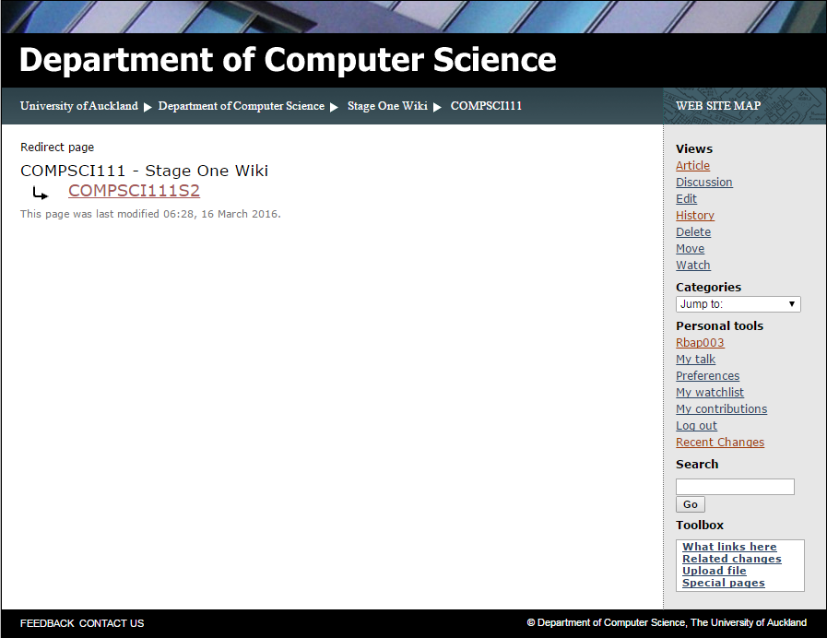
Computer Science wiki
The CS Department hosts a number of Wikis, which use the MediaWiki software
Anyone can read the wiki but only CS students can edit the wiki when the log in
You’ll get to contribute to the Stage One Wiki in the labs

Slide 17
Computer Science wiki
Content
Navigation bar
Link to my user page

Slide 18
Navigation bar
Edit the current page
Add page to your watchlist
View the page’s edit history
View recent changes in the wiki

Slide 19
Wiki markup
A special language used to format wiki pages
Some wikis accept wiki markup and HTML tags (which we’ll see later in the course)
Chapter 4 of the online reference manual contains a helpful guide to wiki markup

Slide 20
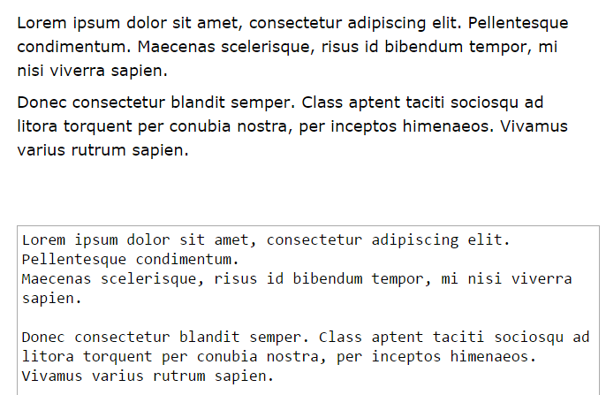
Wiki markup - paragraphs
A new line is ignored while a blank line creates a new paragraph

Slide 21
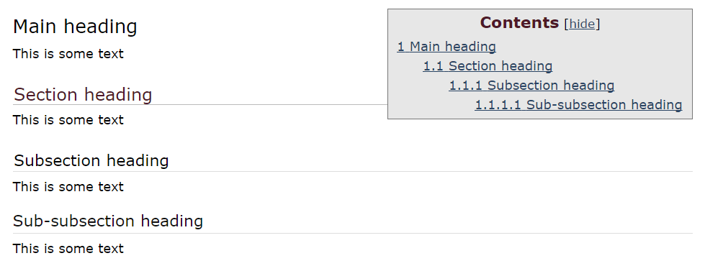
Wiki markup - headings
Four levels of headings: =Main heading= ==Section heading== ===Subsection heading=== ====Sub-subsection heading====

Slide 22
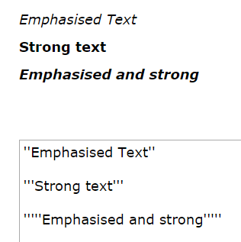
Wiki markup - formatting
Emphasis ''Emphasised Text''
Strong '''Strong text'''
Very Strong '''''Emphasised and strong'''''

Slide 23
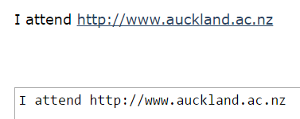
Wiki markup - links
Two kinds of links:
Internal links: used to link to other pages in the wiki
External links: used to link to other webpages
Internal link:
[[name of page]] [[User:Dazh001]]
External link:
URL http://www.auckland.ac.nz

Slide 24
Wiki markup - links
You can add labels to links so they they’re easier for readers to understand
Internal links:
[[name of page | label]] [[User:Dazh001 | Damir]]

Slide 25
Wiki markup - links
External links
[URL label] [http://www.auckland.ac.nz UoA]
Note only one pair of square brackets and a space instead of a bar character

Slide 26
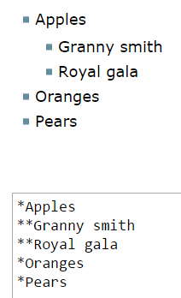
Wiki markup - lists
Two kinds of lists
Unordered lists:
Uses the * character in front of each list item
Use multiple * to create sub-lists

Slide 27
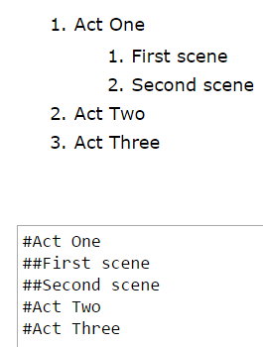
Wiki markup - lists
Ordered lists:
Uses the # character in front of each list item
Use multiple # to create sub-lists

Slide 28
Questions
What kinds of Wikipedia articles are more likely to be accurate?
What is the key difference between blogs and micro-blogs?
What would the following wiki markup look like when viewed in a web browser?

Slide 29
Answers
What kinds of Wikipedia articles are more likely to be accurate?
Academic topics
What is the key difference between blogs and micro-blogs?
Micro-blogs are designed for sharing smaller pieces of content

Slide 30
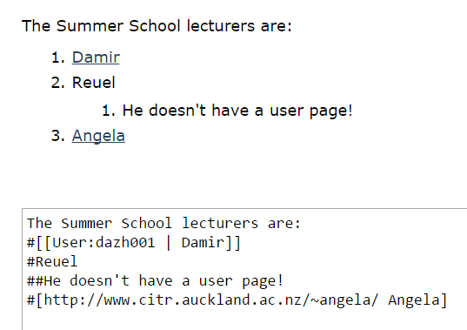
Answers
What would the following wiki markup look like when viewed in a web browser?

Slide 31
Summary
Blogs
Overview, uses
Advantages and disadvantages
Wikis
An overview of Wikipedia
Wiki markup: paragraphs, headings, formatting, links, lists

