Slide 1
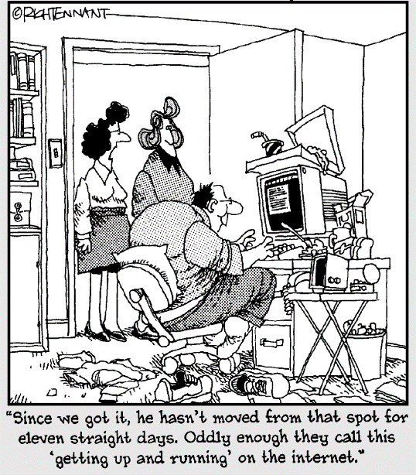
Networking and the Internet
Lecture 4 – COMPSCI111/111G SS 2017

Slide 2
Today’s lecture
History of the Internet
How the Internet works
Network protocols

Slide 3
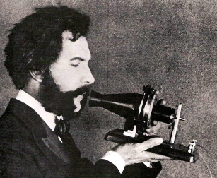
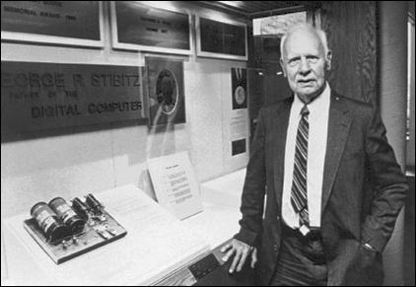
The telephone
1876: first successful bi-directional
transmission of clear speech
by Alexander Bell and Thomas Watson
1940: first successful transmission
of digital data through over
telegraph wires by George Stibitz

Slide 4
WWII and the Cold War
Computer technology played an important role in code-breaking during WW2
Cold War between US and USSR led to a technology and arms race
  Peaked with the launch of Sputnik in 1957
1958: Advanced Research Projects Agency (ARPA) established
April 1969: construction of ARPANET begins, a packet-switching network

Slide 5
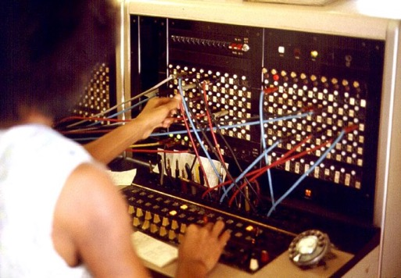
Circuit-switching network
Nodes are connected physically via a central node
Used by the telephone network
Originally, switchboard operators had to manually connect phone calls, today this is done electronically
B
A

Slide 6
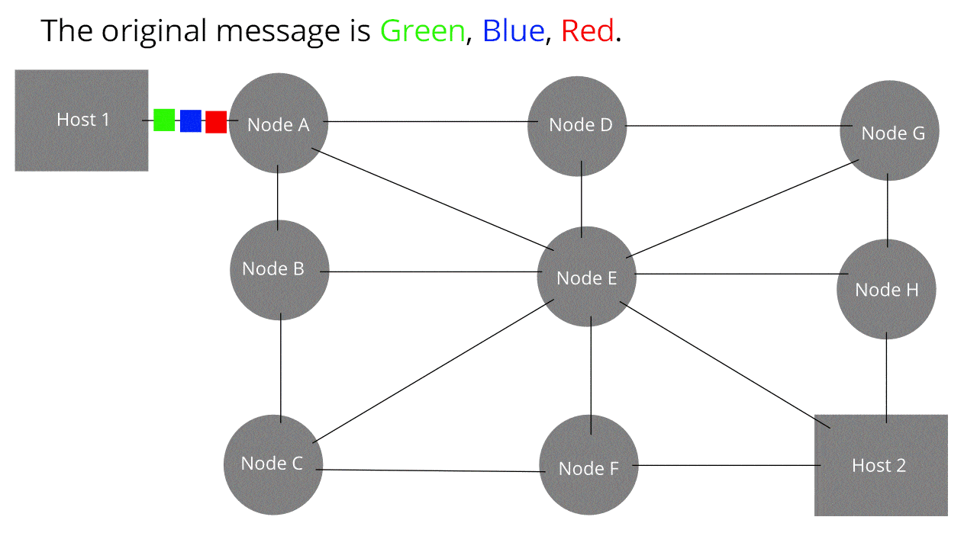
Packet-switching network
Data is broken into packets, which are then sent on the best route in the network
Each node on the route sends the packet onto its next destination, avoiding congested or broken nodes

Slide 7
ARPANET
October 1969: ARPANET is completed with four nodes
1973: Norway connects to ARPANET via satellite, followed by London via a terrestrial link

Slide 8
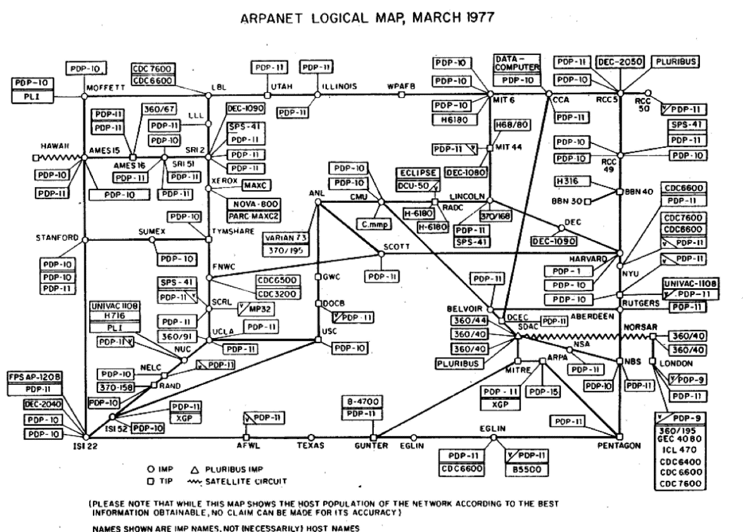
ARPANET in 1977

Slide 9
ARPANET
1983: TCP/IP implemented in ARPANET
1990: ARPANET is formally decommissioned

Slide 10
ARPANET to the Internet
Networks similar to ARPANET sprang up around the USA and in other countries
1984: domain name system (DNS) implemented
1985: NSFNET was established
1989: Waikato University connects to NSFNET
1991: World Wide Web (WWW) created at CERN (European Organization for Nuclear Research) by Tim Berners-Lee
1995: NSFNET is retired

Slide 11
WWW vs Internet
World Wide Web (WWW) refers to the applications (eg. web pages, email, Skype, Youtube etc) that run on hardware
The Internet refers to the hardware on which the WWW runs

Slide 12
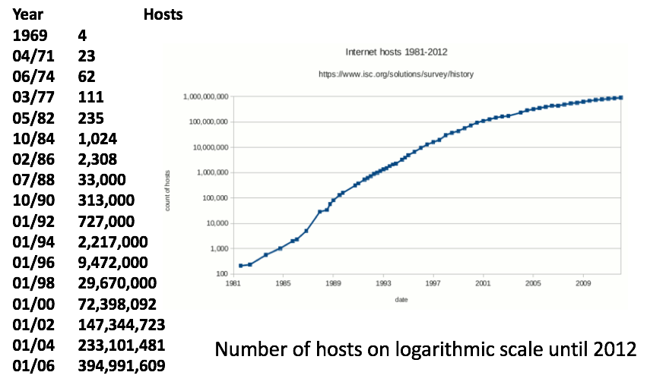
Internet growth

Slide 13
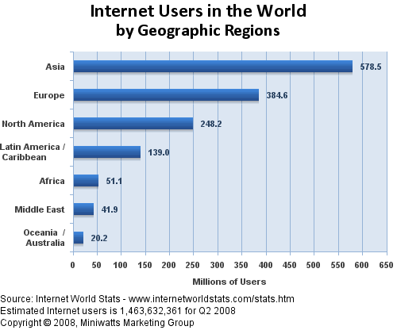
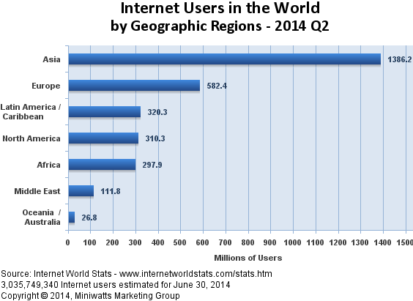
Internet usage

Slide 14
Types of networks
Local Area Network (LAN)
  Operates within 1 km radius
  Client-server or peer-to-peer configuration
  Can connect multiple LANs to form an intranet
Wide Area Network (WAN)
  Distances over 1km
The Internet
  Network of networks that use the TCP/IP protocol

Slide 15
How the Internet works
The Internet
Networking hardware
Protocols
IP addresses and Domain names
Client and server software

Slide 16
Networking hardware
Connection
  Wired, eg. Ethernet
  Wireless, eg. Wi-Fi, cellular
Network card
  Can be built into the motherboard or an expansion card
  Some network cards support wired and wireless connections
Switch
  Used to connect multiple devices
  to the same network
Router
  Directs traffic around the network
  and connects networks together

Slide 17
Networking hardware
Modem (modulator/demodulator)
  Responsible for transmitting and receiving data on the physical medium
  For example, a modem:
    Modulates data from computer/router onto a phone line
    Demodulates signals from a phone line and sends to the computer/router
There are different kinds of modems
  Dial-up modems up to 56Kbs
  Broadband (DSL - digital subscriber line) modems between 256Kbs to 20Mbs

Slide 18
Protocol
Protocol: a standardised method of communication
Ensures that the sender and receiver can communicate properly
Protocols include rules for:
  Opening and maintaining a connection
  Sending and receiving data
  Ending the connection

Slide 19
Protocols
Common Internet protocols:
  TCP/IP: transports data reliably
  UDP: transports data faster but less reliably
  FTP: used for transferring files over a network
  HTTP: used for client/server communication such as transferring web pages
  POP3, IMAP, SMTP: used for email
Many protocols used in networking are defined in a RFC (Request for Comments) document
  RFC 791: IP
  RFC 2616: HTTP

Slide 20
Protocols – TCP/IP, UDP
IP - Internet Protocol:
  A unique identifier for computers on the Internet
  Defines routing information
  v4: 32-bit addresses (eg. 192.168.1.1), ran out of addresses
  v6: 128-bit addresses (eg. 2001:0db8:0a0b:12f0:0000:0000:0000:0001)
TCP - Transmission Control Protocol:
  Divides the message into packets (typically about 1 KB)
  Checks that all packets arrive (error detection)
  Ensures packets are not sent faster than they can be received (flow control)
  Combines packets to recreate the data
UDP – User Datagram Protocol:
  Lacks error detection and flow control, better suited to real-time data such as video streaming, Skype calls etc.

Slide 21
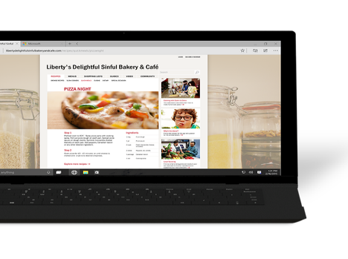
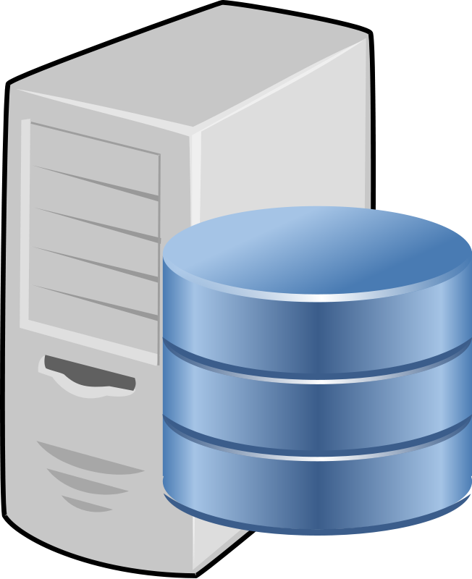
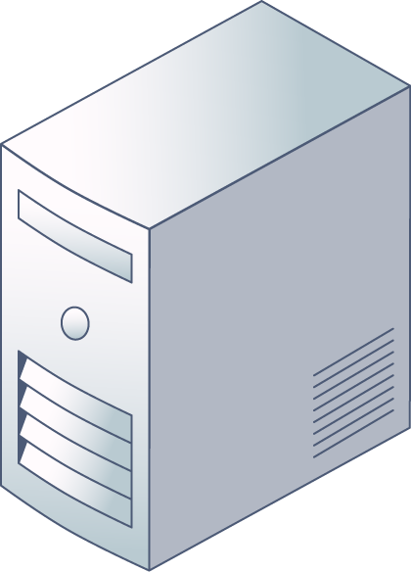
IP addresses and domain names
Domain name system (DNS) is used to convert between IP addresses and human-readable text (domain name)
DNS servers perform the translation between IP address and URL
cs.auckland.ac.nz
130.216.158.22
DNS server
CS server

Slide 22
Client and server software
Client software:
  Web browsers
  Email clients:
Server software:

Slide 23
Connecting to the Internet
At home, you plug your modem into your phone jack
Your modem sends and receives information from the Internet over your phone line
Computer
Router
Modem
Phone Jack

Slide 24
Connecting to the Internet
An Internet Service Provider (ISP) provides you with an IP address and a connection to the Internet
Modem
ISP
Server
Modem
Internet
Modem

Slide 25
The Internet’s backbone
High-capacity fibre optic cables laid on land and under the sea
Owned by companies who rent out capacity on the cables
They connect countries together to form the global Internet so are extremely important
  Having multiple backbone cable connections provides extra capacity and redundancy

Slide 26
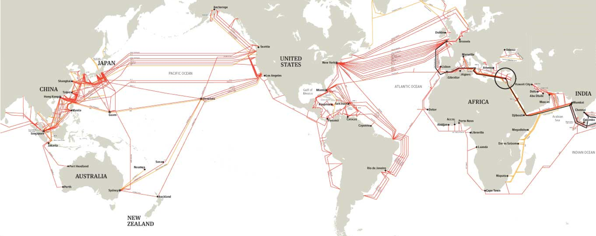
The Internet’s backbone
Go to www.submarinecablemap.com to see the undersea backbone cables

Slide 27
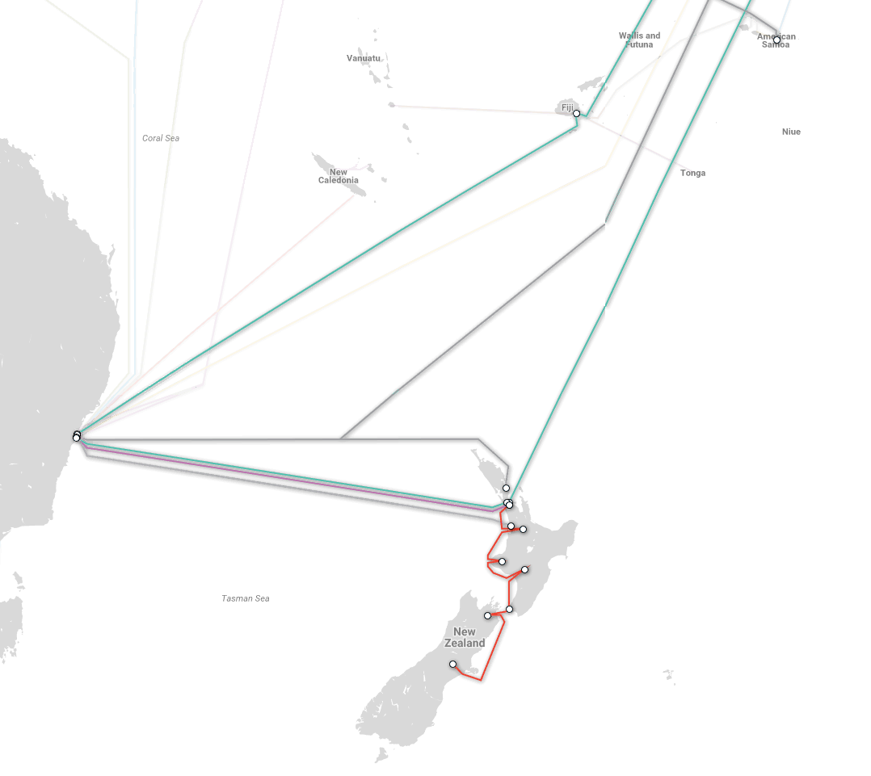
NZ’s backbone cables

Slide 28
Questions
What network model does the Internet use?
What protocol should your program use if it is time-sensitive?
What is the name of the documents that describe the technical details of protocols?

Slide 29
Answers
What network model does the Internet use?
  Packet-switched network
What Internet protocol should your program use if it is time-sensitive?
  UDP – user datagram protocol
What is the name of the documents that describe the technical details of protocols?
  RFCs – request for comments

Slide 30
Summary
The Internet is packet-switching network consisting of multiple networks joined together
A number of protocols and technologies underpin the Internet
As more people use the Internet, organisations tasked with maintaining it need to ensure the Internet can handle the increased demand (eg. moving from IPv4 to IPv6)

