Slide 1
Bits, bytes and digital information
Lecture 2 – COMPSCI111/111G SS 2017

Slide 2
Today’s lecture
Understand the difference between analogue and digital information
Convert between decimal numbers and binary numbers
Notes:
Plan for this lecture is to understand the difference between analogue and digital information, and what this means when we store information on a computer
Learn how to convert between decimal numbers and binary numbers

Slide 3
Analogue vs digital information
Information in the real world is continuous
Continuous signal
Information stored by a computer is digital
Represented by discrete numbers
Weight shown
Real Weight
Weight shown
Real Weight
Notes:
Information in the real world is made up of continuous values.
For example, when measuring your weight, you could weigh 70kg, or 70.12kg, or 70.125kg. You can measure your weight very accurately in the real world because data is continuous, it doesn’t increase in fixed increments
However, in the digital world, data increases in fixed increments because of the way computers handle information
So if a computer could only take whole measurements of weight, and you weighed 70.14kg, then the computer would report that you weigh 70kg
Important to note that you loose some of the real world data when you represent it digitally

Slide 4
Encoding information
Real world information is stored by a computer using numbers
Visual information
11111111111111111111111
01111111111111111111111
00001111111111111111111
00000011111111111111111
00000000011111111111111
44444000001111111111111
75444000000011111111111
55554401000000111111111
33367544000000011111111
22283554444000000111111
99928357544000000011111
99999233657504000001111
99999983666554400000011
99999928338674400000001
Image
Pixels
Give each pixel colour a number.
Let the computer draw the numbers as coloured pixels (eg. black = 0).
Notes:
Computers represent real world information using numbers
Let’s look at a couple of examples:
Each colour is assigned a unique number
Each pixel in the image has a colour
The computer stores a series of numbers, representing the colour in each pixel
This process is not perfect and sometimes this information is lost. A lot of lost information creates a pixelated image

Slide 5
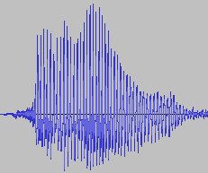
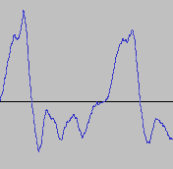
Encoding information
Sound information
Sound
Waveform
Samples
Give each sample a number (height of green box).
Let the computer move the loudspeaker membrane according to the samples.
Notes:
With sound information, the incoming sound from the real world is sampled at a given frequency
These samples allow the computer to assign a number to the sound
The computer stores these numbers in order to record the sound
Note that the computer is not able to perfectly capture the sound when sampling. We can hear this loss of information when listening to a poor recording of a song

Slide 6
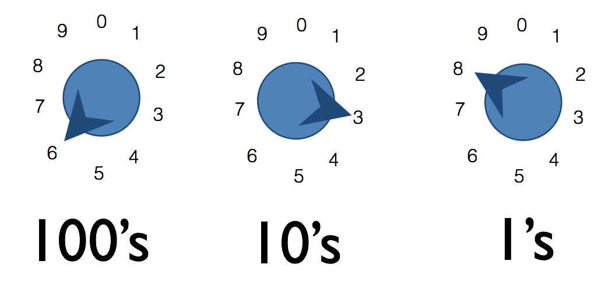
Decimal numbers
The decimal number system is a base 10 system
You can think about it as a dial with 10 positions:
600 + 30 + 8 = 638
Notes:
We’re familiar with the decimal number system, which uses the number 10 as the base
We can visualise the decimal number system as a set of dials with 10 positions each
[Explain diagram]

Slide 7
Decimal numbers
The number of dials corresponds to the numbers that can be generated
So:
Possible numbers = 10^{n}
Range = 0 to 10^{n}-1
For example, if we have four dials…
Therefore:
10⁴ = 10,000 possible numbers
Note 10 = base 10 and 4 = number of dials
Range = 0 to 9999 (ie. 0 to 10⁴-1)
Notes:
The number of dials corresponds to the range of numbers that can be generated
So:
10^n gives us the amount of possible numbers that we generate with a n digit number
The range of numbers we can generate goes from 0 to 10^n-1
If we have four dials:
10,000 numbers are 10^4
We can generate numbers from 0 to 9999

Slide 8
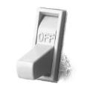
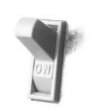
Binary numbers
A number whose value is either 0 or 1
It’s too complex to create 10 states in electronic circuitry. Much easier if we have two states like a switch, ON and OFF
This is how binary numbers work; 0 usually means OFF and 1 usually means ON
0
1
Notes:
With that background, we can now look at binary numbers
A binary number is a number with two possible values, 0 or 1
We need binary numbers because it would be too complex to create the circuitry and logic necessary to use the decimal number system in computers
However, it’s much easier if we have two numbers or two states; off or on
This is how binary numbers work; 0 = off, 1 = on

Slide 9
Binary numbers
Each binary number is called a bit (binary digit)
Using strings of bits, we can represent any whole number
Using one switch (ie. one bit) we can represent up to two numbers (ie. 0 and 1)
Notes:
A binary number is also known as a bit (binary digit)
Using strings of binary numbers, we can represent any whole number
If we have two switches, we can generate up to two numbers (ie. 0 or 1)

Slide 10
Binary numbers
Using two switches (ie. two bits) we can generate up to four numbers
Binary
Decimal
00
0
01
1
10
2
11
3
Notes:
If we had two switches, or in other words two bits, we could generate up to four numbers

Slide 11
Binary numbers
So:
Possible numbers = 2^{n}
Range = 0 to 2^{n}-1
For example, if we have four switches…
Therefore:
2⁴ = 16 possible numbers
Note 2 = base 2 and 4 = number of switches
Range = 0 to 2⁴-1:
0000₂ to 1111₂
0₁₀ to 15₁₀
Notes:
Using underscore 2 and underscore 10 to distinguish between binary and decimal numbers
So:
The amount of possible numbers that you can generate with an n-bit number is 2 ^ n
The range is 0 to 2 ^n -1
If we have four switches:
We can have 16 possible numbers
Numbers will go from 0000 (ie. 0) to 1111 (ie. 16)

Slide 12
Converting binary to decimal
With decimal numbers, each dial’s position has a value:
1 * 10³ + 5 * 10² + 2 * 10¹ + 1 * 10⁰
1000 + 500 + 20 + 1
= 1521₁₀
Similarly with binary numbers, each switch’s position has a value. Convert 1101₂ to decimal:
1 * 2³ + 1 * 2² + 0 * 2¹ + 1 * 2⁰
1 * 8 + 1 * 4 + 0 * 2 + 1 * 1
= 13₁₀
Notes:
Now that we know how the binary and decimal number systems work, we can learn how to convert numbers between the two systems
Let’s recap the decimal number system first
You can see each 10 has an exponent that corresponds to its value
Now lets look at an example in binary
You can see each 2 has an exponent that corresponds to its value, except that we start at 0

Slide 13
Converting binary to decimal
Convert 10011₂ to decimal
Convert 35₁₀ to binary
Notes:
Show the repeated ‘DIVIDE BY TWO’ method AND the number minus binary method (88-64 etc)
Answers:
19
100011

Slide 14
Prefixes
A group of 8 bits is a byte
A group of 4 bits is a nibble
Bytes are the common unit of measurement for memory capacity
There are two sets of prefixes:
Decimal
Binary
Notes:
Byte the a common unit of measurement used in computing
Made up of 8 bits
Nibble is 4 bits
Byte forms the basis the two kinds of prefixes that are used:
Decimal
Binary
Going to look at each in turn

Slide 15
Decimal prefixes
10^{n} | Prefix | Symbol | Decimal
1 | none |  | 1
10³ | kilo | K | 1000
10⁶ | mega | M | 1,000,000
10⁹ | giga | G | 1,000,000,000
10¹² | tera | T | 1,000,000,000,000
10¹⁵ | peta | P | 1,000,000,000,000,000
10¹⁸ | exa | E | 1,000,000,000,000,000,000
10²¹ | zetta | Z | 1,000,000,000,000,000,000,000
Notes:
Decimal prefixes are based on the decimal number system
Each increase in the decimal number system has its own prefix
Therefore
10^3 = 1000 = kilo
10^6 = 1,000,000 - mega

Slide 16
Binary prefixes
2^{n} | Prefix | Symbol | Decimal
2⁰ | none |  | 1
2¹⁰ | kibi | Ki | 1024
2²⁰ | mebi | Mi | 1,048,576
2³⁰ | gibi | Gi | 1,073,741,824
2⁴⁰ | tebi | Ti | 1,099,511,627,776
2⁵⁰ | pebi | Pi | 1,125,899,906,842,624
2⁶⁰ | exbi | Ei | 1,152,921,504,606,846,976
2⁷⁰ | zebi | Zi | 1,180,591,620,717,411,303,424
Notes:
Binary prefixes, on the other hand, are based on the binary number system
Each increase has its own prefix that are similar to the decimal prefixes (eg. Kilo vs kibi)
Therefore:
2^10 = 1024 = kibi
2^20 = 1,048,576 = mebi

Slide 17
Prefixes in Computer Science
Both decimal and binary prefixes are used in Computer Science
Decimal prefixes are preferred because they are easier to calculate, however binary prefixes are more accurate
Binary prefix | Decimal prefix | Value (bytes)
8 bits | 1 byte | same
1 KiB (1 x 2¹⁰ bytes) | 1 KB (1 x 10³ bytes) | 1024 ≠ 1000
1 MiB (1 x 2²⁰ bytes) | 1 MB (1 x 10⁶ bytes) | 1,048,576 ≠ 1,000,000
Notes:
Both the binary and decimal prefixes are used
Usually hard drive capacities are measured using decimal prefixes and RAM capacities are measured using binary prefixes
Generally, decimal prefixes are usually preferred because they are easier to calculate than binary prefixes
However a measurement using decimal prefixes isn’t exactly equivalent to the binary prefix
For example, 1MiB is not exactly equal to 1MB

Slide 18
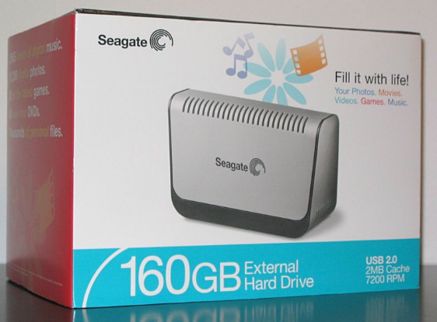
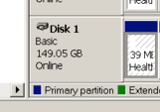
Example – hard disk sizes
A 160GB hard disk is equivalent to 149.01GiB
160GB = 160 x 10⁹
149.01GiB = (160 x 10⁹) ÷ 2³⁰
Notes:
Looking at this HDD, we can see that its capacity is advertised as 160GB
However, Windows uses gibibytes, meaning it reports the HDD’s capacity as 149.05GiB

Slide 19
Questions
Which has more bytes, 1KB or 1KiB?
How many bytes are in 128MB?
Convert 88₁₀ to binary
Convert 111001₂ to decimal

Slide 20
Answers
Which has more bytes, 1KB or 1KiB?
1KB = 1000 bytes while 1KiB = 1024 bytes
How many bytes are in 128MB?
128 x 10⁶ = 128,000,000 bytes
Convert 88₁₀ to binary
1011000₂
Convert 111001₂ to decimal
57₁₀

Slide 21
Summary
Computers use the binary number system
We can convert numbers between decimal and binary
Decimal prefixes and binary prefixes are used for counting large numbers of bytes

