Slide 1
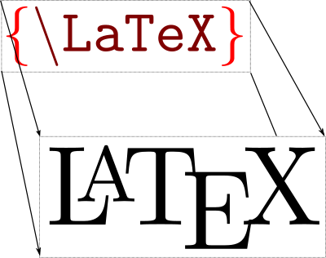
Lecture 11 – COMPSCI111/111G SS 2017

Slide 2
Today’s lecture
What is LaTeX?
A brief history of LaTeX
Basic LaTeX commands:
Document structure
Environments
Special characters; quotes, ellipsis, dashes

Slide 3
What is LaTeX?
LaTeX is a document preparation system for typesetting
LaTeX encourages authors to focus on their document’s content and leave the formatting for later
LaTeX can be used for a range of documents:
Essays and theses
Journal articles
Technical documents
Presentations

Slide 4
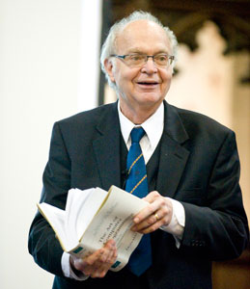
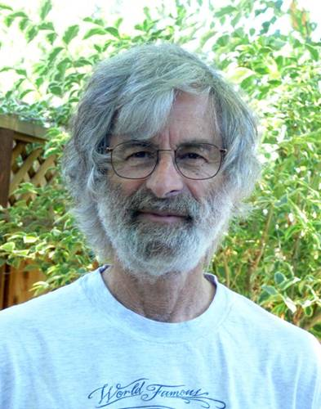
History of LaTeX
Donald Knuth created TeX in 1978
Aim was to make it easy to create books and to ensure that documents looked the same on any computer
TeX files can be typeset into PDF files
Leslie Lamport created LaTeX in 1985
LaTeX = Lamport TeX
Introduced a number of extensions to TeX which made it faster and easier to use
Soon, LaTeX became the standard way to use TeX

Slide 5
Why use LaTeX?
Very efficient when working with large documents
Versatile mathematical tools
LaTeX can automatically generates:
Table of contents
List of figures
Index
Bibliographies
LaTeX distributions are open source

Slide 6
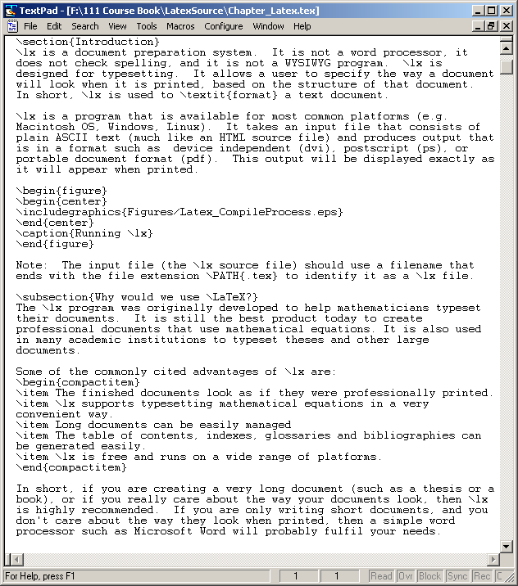
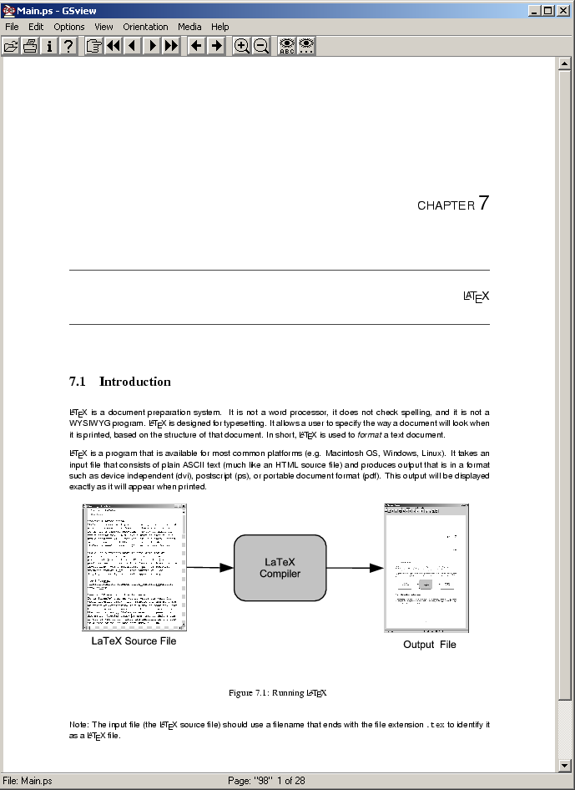
Using LaTeX
LaTeX
compiler

Slide 7
LaTeX commands
Use to provide the LaTeX compiler with instructions
General structure of LaTeX commands:
Example of a LaTeX command:
Command name: documentclass
Options: a4paper
Argument: article
Not all commands have options and/or arguments
\commandname[options]{argument}
\documentclass[a4paper]{article}

Slide 8
Comments
Used to annotate the document
They are ignored by the LaTeX compiler
% Comments start with a percentage sign
% All text is ignored until the end of the
% line is reached

Slide 9
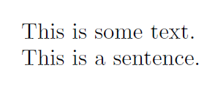
Whitespace characters
Includes spaces, tabs and line breaks
Two or more consecutive whitespace characters are reduced down to a single space character
One line break is treated as a space. However, two line breaks creates a new paragraph
A sentence
This is
some text.
This is a sentence.

Slide 10
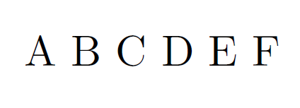
Whitespace
A B C
D E F

Slide 11
Special characters
These characters have a special meaning in LaTeX
Need to type an escape character (‘\’) before you can type a special character
There are 10 special characters in LaTeX
Example:
\ $ % ^ & _ ~ # { }
A pie costs \$4.00.
A URL contains a $\backslash$ character.

Slide 12
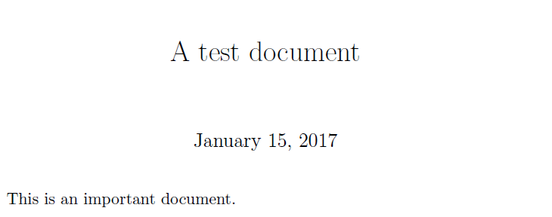
Creating a LaTeX document
\documentclass[a4paper]{article}
\begin{document}
\title{A test document}
\maketitle
This is an important document.
\end{document}
documentclass
Preamble
Document body

Slide 13
Documentclass command
This command defines the type of document that is being typeset
[option] used to define paper size
a4paper
a5paper
letterpaper
{argument} used to define the type of document
Book
Report
Article
Letter

Slide 14
Adding a title
There are four commands that can be used to create the document’s title
\title{document title}
\author{author’s name}
\date{date here}
By default, LaTeX will insert today’s date
\maketitle
This command inserts the title in the document and comes after the commands above

Slide 15
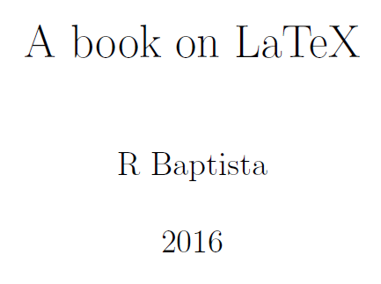
Adding a title
\documentclass[a4paper]{book}
\begin{document}
\title{A book on LaTeX}
\author{R Baptista}
\date{2016}
\maketitle
LaTeX typesets documents.
\end{document}

Slide 16
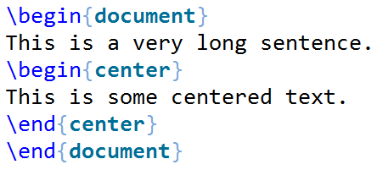
Environments
Environments apply a specified change to the text within the environment
An environment will also start a new paragraph
\begin{environment name}
…
\end{environment name}

Slide 17
Environments
document
Used to define the body of the document
center
Aligns the content within the environment on the centre of the page
displaymath, equation
Environments for displaying math equations
itemize, enumerate, description
Three kinds of lists

Slide 18
Structuring a document
\part{ part name goes here }
\chapter{ chapter name goes here }
\section{ section name goes here }
\subsection{ subsection name goes here }
\subsubsection{ subsubsection name goes here }

Slide 19
Table of contents
\tableofcontents uses the location of the structuring commands (eg. \page, \chapter, \section etc) to build a table of contents
Insert the \tableofcontents command after the \maketitle command
May need to compile your document twice in order to see the complete table of contents

Slide 20
Paragraphs and line breaks
Earlier, we saw leaving a blank line between two pieces of text creates a new paragraph
You can create a new line by using \\

Slide 21
Footnotes
Use \footnote{} within the text to insert a footnote
\begin{document}
Pythagoras was born in Greece\footnote{Wikipedia} around 2,500 years ago.
\end{document}

Slide 22
Quote marks
LaTeX uses directional quotes (eg. “ ”) rather than unidirectional quotes (eg. " ")
Single quotes
Open using ` character and close using ' character
Double quotes
Open using `` characters and close using '' character
`Hello'
``Hello''

Slide 23
Dashes
Hyphen (‐)
Short dash to join different words together
En dash (‐‐)
Longer dash used to indicate a range of values
Em dash (‐‐‐)
Very long dash between words or phrases
merry-go-round
pages 45--50
the start --- the finish

Slide 24
Ellipsis
A character made of up three dots used to indicate missing text
Must insert an ellipsis using the \ldots command, not three full stops, so that you get the correct spacing between the dots
There is \ldots missing

Slide 25
Avoiding line breaks
There can be times when we don’t want LaTeX to automatically insert a new line break
The Lord of the Rings is an epic high-fantasy novel series written by J. R. R. Tolkien, who was an English author.

Slide 26
Avoiding line breaks
To avoid this, we use the tilde character (~) in place of the spaces
The Lord of the Rings is an epic high-fantasy novel series written by J.~R.~R.~Tolkien, who was an English author.

Slide 27
Basic formatting
\emph command emphasises the enclosed text
\textbf command makes the enclosed text bold
This was a \emph{long} lecture
This was a \textbf{cool} lecture

Slide 28
Question

Slide 29
Answer

Slide 30
Summary
History of LaTeX
Basics of LaTeX: comments, special characters, whitespace
Creating a LaTeX document
\documentclass
Environments
Structuring documents
Quotes, dashes, basic formatting

